Slide 1
WinDbg
Not for the faint-hearted
Notes:
It’s good you’re here. It’s still time to leave!

Slide 2
Audience | API developers, operation
Goal | Given a memory dump Then I want to know what happened
Questions? | Keep them to yourself
Notes:
Jk, feel free to interrupt me anytime if there is something you don’t understand

Slide 3
How to write a memory dump
ProcDump from Sysinternals (Present in App Service)
procdump64.exe -r -a -ma <process-id>
-R -A use a clone, avoid outage (not possible on App Service)
-MA 'Full' dump
-accepteula
Handles automatically x86 vs x64
You need available memory
Notes:
App Services have debugging tools: D:\devtools\
You can’t avoid an outage when writing a dump in an App Service because user does not have the permission to call PssCaptureSnapshot
Available memory especially when cloning process.
Treat memory dump as PII (session, HTTP Request – headers, cookies…)

Slide 4
Collect the evidence
Most likely you will analyse the dump on a different machine
This is where most people get stuck
Notes:
Having a memory dump is not enough.
Pay attention to the next three slides, I’ll let you know when you can play Candy Crush again

Slide 5

Runtime
C# is managed
Data Access Component (currently named mscordacwks.dll)
Debugging extension: SOS.dll
You need to get both DLLs
Bitness (x86 vs x64)
.NET Framework version (or rather CLR version)
Notes:
See the star in the top-left corner, as long as it’s there you have to listen to me.
WinDbg only deals with native memory
Debugging managed code requires special knowledge of managed objects […]:
Objects have various kinds of header information in addition to the data itself.
Objects may move in memory as the garbage collector does its work. […]
The debugger must be able to distinguish AppDomains and assemblies.
DAC run some of the same algorithms that the execution engine itself runs.
Allows you to analyse a dump without having the matching .NET Framework installed.
--
Multi-language Standard Common Object Runtime Library
https://github.com/Microsoft/dotnet-samples/blob/master/Microsoft.Diagnostics.Runtime/CLRMD/docs/GettingStarted.md
https://github.com/dotnet/coreclr/blob/master/Documentation/botr/dac-notes.md

Slide 6
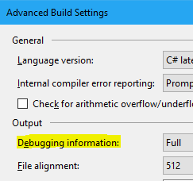
Symbols (PDBs)
Version your DLLs
Debugging information: Full* or Pdb-only*
Publish the symbols to a symbol server
or store them as artefacts (Keep builds around)
Know which build is running in prod
Debugging without symbols is not fun
Notes:
Leverage AssemblyInformationalVersionAttribute, you need to identify a build / commit
* Except if .NET Core that you’re deploying to a non Windows env. Then Portable
https://stackoverflow.com/a/28980070/57369
https://github.com/dotnet/core/blob/master/Documentation/diagnostics/portable_pdb.md
Different build retention on different branches.
You can extract the DLLs from the dump (SaveModule) but it’s not ideal

Slide 7
Configure WinDbg
One-time configuration:
Symbols C:\symbols\local;srv*C:\symbols\microsoft*https://msdl.microsoft.com/download/symbols
Source C:\symbols\source
When analysing a dump:
Copy PDBs into C:\symbols\local
If you have the DLLs, copy them into C:\symbols\source
Notes:
If using non-store version, save the workspace.
Preview vs WDK

Slide 8
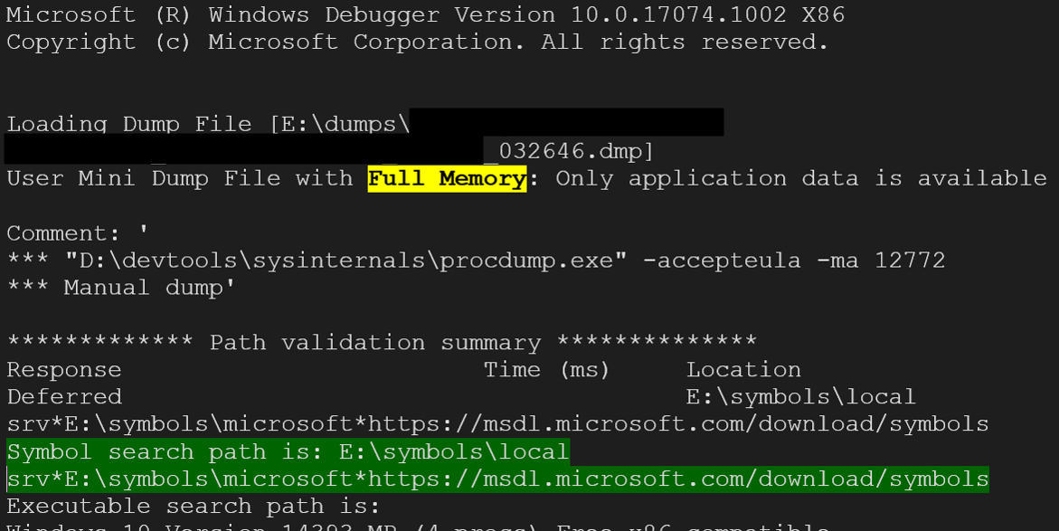
Load the Memory Dump
Notes:
(Open Crash Dump…) Ctrl+D in non-store version

Slide 9
Load SOS.DLL and mscordacwks.dll
SOS .load C:\path-to-dll\SOS.dll
Mscordacwks .cordll -lp C:\directory-in-which-mscordacwks-is-located
Do not include mscordacwks.dll in the path

Slide 10
Extensions
SOSEX
.load SOSEX
MEX
.load MEX
In WinDbg Preview .load E:\path-to-your-extensions\x86\extension-name.dll
List extension commands !<extension-name>.help

Slide 11
Diagnose with WinDbg?
Crashes
Hangs
Memory leaks
Notes:
I’ve renamed procdump64.exe to procdump.exe and added it to my PATH Samples are available on GitHub

Slide 12
Crashes - console app, Worker...
Symptoms an app / worker dies on you, quite often on startup
Capture the crash:
procdump.exe -e -ma -x C:\dumps .\CrashConsole.exe
-e Write a dump when the process encounters an unhandled exception
-x Launch the specified image with optional arguments
Single command in WinDbg: !analyze -v
Notes:
Launch the Console manually and look at meaningless exception
1st chance vs 2nd chance exception
Load dump: point to Exception of interest
Same command can be used for BSOD, high chance you’ll get a driver name
--
Sample app: https://github.com/gabrielweyer/blog-samples/tree/master/windbg-brownbag

Slide 13
Hang - ASP.NET 1/3
Symptoms very slow requests, increasing threads count. Problem fixes itself.
Perf counters (not easy in SaaS)
Might be missed by instrumentation
!mex.runaway2
!mex.mthreads
!sos.SyncBlk
Notes:
New Relic did not track failing requests, Apdex went UP during the outage
runaway2 => see if one thread very busy, heavy computation. Slow response times can be due to the worker doing lots of things.
--
Sample app: https://github.com/gabrielweyer/blog-samples/tree/master/windbg-brownbag

Slide 14
Hang - ASP.NET 2/3
!mex.aspxpagesext
!mex.us
~<thread-id>e !sos.CLRStack
no deadlock in ASP.NET Core
because there is
no
SynchronizationContext

Slide 15
Hang - ASP.NET 3/3
Don’t block on async code

Slide 16
Memory leak 1/2
Symptoms Slowness, growing private bytes
Perf counters (not easy in SaaS)
You can leak
managed memory
Notes:
--
Sample app: https://github.com/gabrielweyer/blog-samples/tree/master/windbg-static
Blog: https://gabrielweyer.github.io/2018/03/09/windbg-1-static-root/

Slide 17
Memory leak 2/2
!sos.DumpHeap –stat
!gcroot <address>
There is always an OutOfMemoryException on the heap!
!dae
Notes:
Big memory footprint is not always a problem. Pooling, upfront allocation
Always OOM on the heap
Any idea why?
--
https://blogs.msdn.microsoft.com/tess/2009/08/10/why-do-i-see-executionengineexception-stackoverflowexception-and-outofmemoryexception-on-the-heap-when-debugging-net-applications/

Slide 18
Tools (free)
WinDbg: store (Win 10 Anniversary and above) / Windows Development Kit
SOSEX
MEX
DebugDiag
PerfView
ProcDump

Slide 19
Tools (PAID)
dotMemory, dotTrace (part of R# Ultimate)
ANTS Performance Profiler

Slide 20
Resources
My guide
Actually links to other resources

Slide 21
Thank you
WinDbg is HARD
Notes:
WinDbg is hard, it’s a big topic
Don’t feel afraid

