Slide 1
Treat yo’self
So how you are eating?
James Craig
Thomas Harman
Rohit Nahar
Gabriel Yeung

Slide 2
Fitness apps
100K+ app
4 Million downloads of free apps
300K downloads of paid apps
DAILY! -Business Insider

Slide 3
Diet apps
Missing for the big picture!
Why ? Well, user retention.
-Too tedious. -Needs too much interaction. -Not easy to make habit.

Slide 4
Solution
Make it seamless!

Slide 5
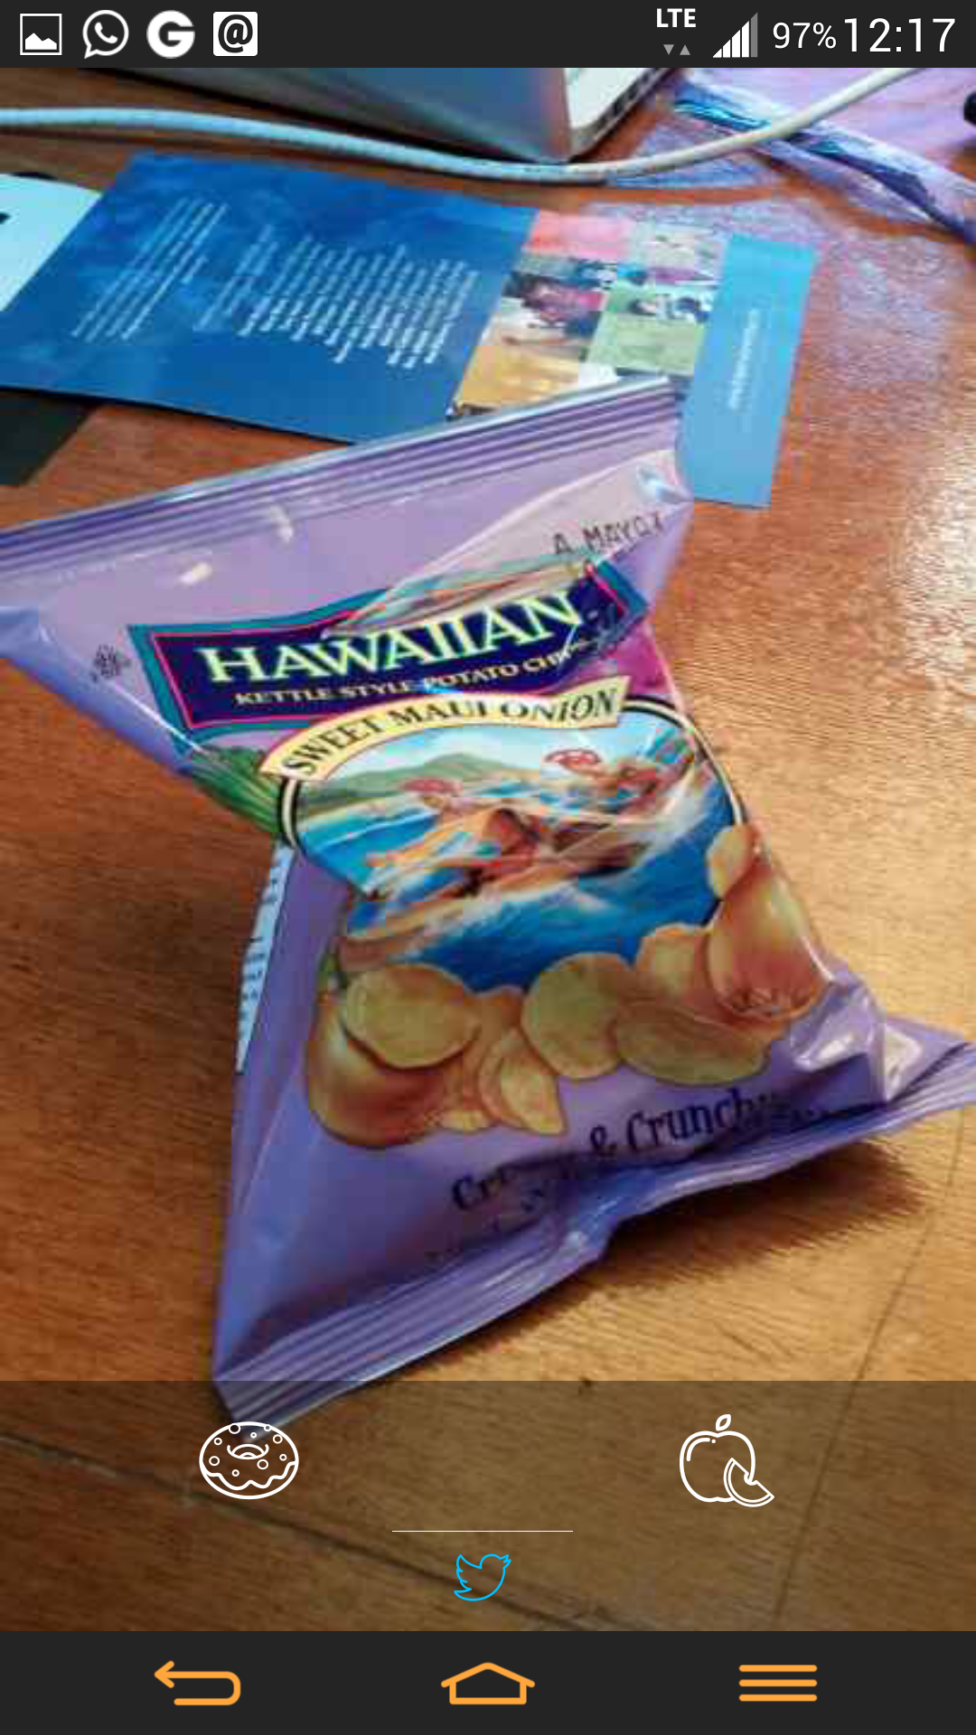
CLICK, RATE
&
DONE!

Slide 6
Does that really work?
Simple food journal > No food journal
Food journals = 50% more chance of weight loss 200% more effective amongst females.

Slide 7
How does it work?
Accountability
Motivation
Rewards
Social - share and care

Slide 8
Does social work?
It does!
Nike+ Running : 77% increase in traffic.
Endomondo : Logs 90K worksouts on FB alone
RunKeeper : 11Million users share runs on FB.

Slide 9
Q & A

