Slide 1
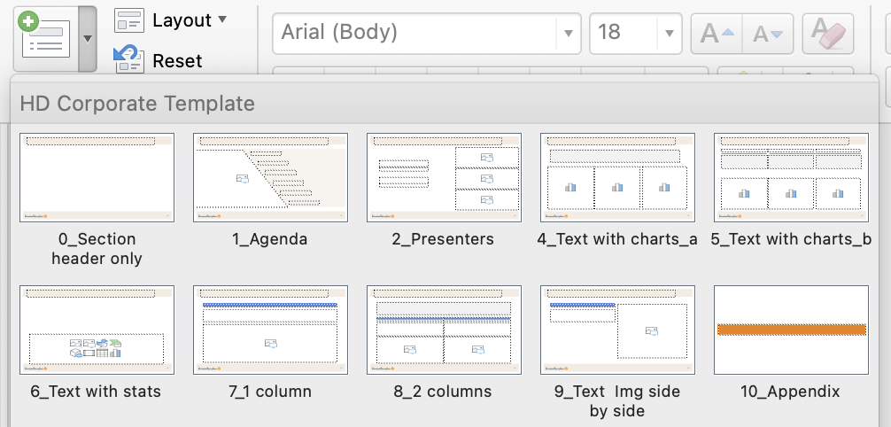
How to Add Luxaflex and WCC Images to Your Presentation
_________________________________________________________
Follow these steps to easily insert Luxaflex or WCC product images into your presentation:
To Access the Image Folder
Hold Control and click on Image Library
Then, navigate to the folder that contains either WCC or Luxaflex images.
Find and Download Your Image
Scroll through the folder to locate your desired image.
Download the image and save it to your desktop.
Insert the Image into Your Presentation
Open your presentation template.
Navigate to the slide where you want to place the new image.
Delete the existing image (if applicable).
Insert the new image from your desktop.
Now, your presentation is updated with the latest Luxaflex or WCC product image!
General Guideline
To create a new slide, click the arrow to see the template options.
Reference pages 16-20 for color options, text boxes, charts and graphs. When creating a new graph, please use the colors in the example graphs for consistency.

Slide 2

Here is the Title Here is the Subtitle
December 9, 2024

Slide 3

Agenda
1
Section
2
Section
3
Section
4
Highlighted Section
5
Section
6
Section

Slide 4
Today’s Presenter
First Name Last Name
Title
First Name Last Name
Title

Slide 5
Headline Subheadline

Slide 6
Headline Subheadline

Slide 7
Headline Subheadline

Slide 8
Headline Subheadline

Slide 9
Headline Subheadline
This is a body paragraph.
This is a body paragraph.

Slide 10
Headline Subheadline
North America
Europe
International
This is a body paragraph.
This is a body paragraph.
This is a body paragraph.
This is a body paragraph.
This is a body paragraph.
This is a body paragraph.

Slide 11
Headline Subheadline
$9,999M
Description
$9,999M
Description
99%
Description
$999M
Description
9.0x
Description
$9,999M
Description
$9,999M
Description
99%
Description

Slide 12
Headline Subheadline
First Level
Second Level

Slide 13
Headline Subheadline
First Level
Second Level
First Level
Second Level
First Level
Second Level

Slide 14
Appendix

Slide 15
Q&A

Slide 16
Colors & Typeface
PRIMARY
Gray
91 103 112
TYPEFACE
Headline: Arial Regular
Body Copy: Arial Regular
Highlight Copy: Arial
The primary colors could be used for text.
The accent colors could be used in graphs, color boxes and bars.
Please only use Arial in the presentation.
Orange
240 130 0
ACCENTS
1
240
130
0
255
206
147
2
92
136
218
190
207
240
3
234
170
0
255
225
145
LINE
4
46
117
182
165
200
232
5
0
51
102
92
173
255
6
140
177
208
209
224
236
7
91
103
110
187
195
199
8
0
0
0
91
103
112

Slide 17
Text Boxes
$9,999M
Description
Blue Bar
Orange Bar
Grey Bar
Arrow
1
2
3
Headline
Body Copy
Headline
Body Copy
Headline
Body Copy

Slide 18
Chart Style 1
Graph Title
Graph Title
Graph Title
Source: Name
Source: Name
Source: Name

Slide 19

Chart Style 2
Graph Title
Nominal (26)%
Graph Title
Chart Title (constant currency)
Revenue | $9,9M – 9,9M
Adj. EBITDA | $990M – $990M
+42bps
15.8%
margin
16.3%
margin

Slide 20
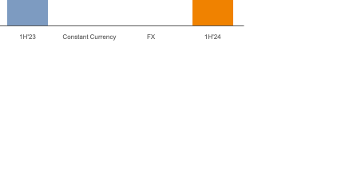

Chart Style 3
Title
First Lien Net Leverage Ratio
Net Sales
(US GAAP)
Adj. EBITDA & Adj. EBITDA Margin
(US GAAP)
Nominal +0.4%
Nominal (4%)
+2%
(1%)
(2%)
(2%)
17%
margin
(84)bps
17%
margin
post acquisition
incl. MTM gains

Slide 21
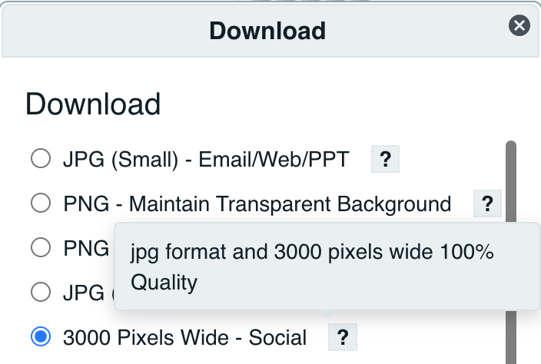
General Guideline
General Guideline:
When creating new slide, please click the arrow to see all designed templates. All templates are named with their purpose.
Please use colors from the color palette on the side to stay on brand.
P13-17 shows all the reusable components, such as text boxes, charts and graphs, for you to use in the presentation. When creating new graph, please use the example graph as references. The use of colors must follow the examples to stay consistent.
Download Images:
Please download images from [ ] Collection in Widen with specification “3000 Pixels Wide – Social”.
Link to collection: link

