Slide 1

Remote Sensing System
Performance Evaluation of Computer Systems and Networks
AA 2023 - 2024
Francesco Taverna
Gabriele Pianigiani
Saverio Mosti

Slide 2
Road Map
Introduction to the problem and objective
Model
Implementation
Verification
Simulation
Experiments
Conclusion

Slide 3
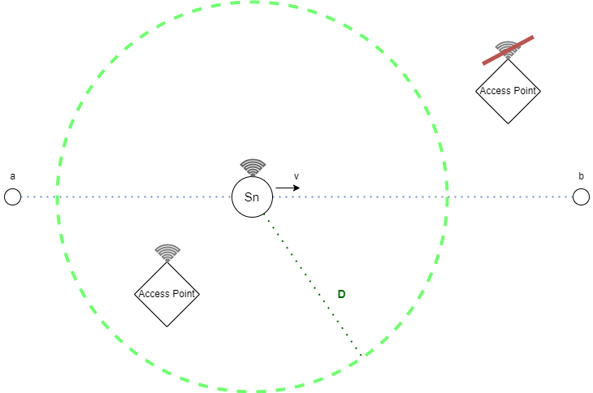
Introduction
N sensing nodes
M access points.
A working plane of H x L meters.
Sensing nodes periodically transmit a broadcast message every T second, with a transmission range of D meters.
Whenever an access point receive a message, it will be directly forwarded to a Sink Node.
Access point position is randomly generated inside the working plane.
Sensing nodes are moving with a constant speed between two waypoint.
When it reaches one, another waypoint will be generated.

Slide 4
Objective
The objective of the project is testing the effectiveness and efficiency of a series of different scenarios obtained by varying determined parameters such as:
Dimension of the working plan.
Quality of the receiver.
Transmission range of a sensing node.
Maximum speed of a sensing node.
Effectiveness: Maximization of the number of unique packets correctly sent to the sink node per unit of time.
Efficiency: Minimization of the number of duplicates per message.
We want to find out what are the parameters that changing have the most influence on the two above.
Moreover, will be analysed the best “trade-off” configuration of most important parameters.

Slide 5
Model
Assumptions
Transmission time is null.
Sink node has no queuing.
We only care about the number of messages that reach the sink node, not how many message it can elaborate per second.
All the distribution are uniform.
Factors
M: Number of AP.
D: Transmission range of a SN.
N: Number of SN.
H & L: Dimensions of the working plan.
T: Transmission period of a SN.
Vmax: Maximum speed of a SN.
Psucc: Probability of a correct reception by an AP.

Slide 6
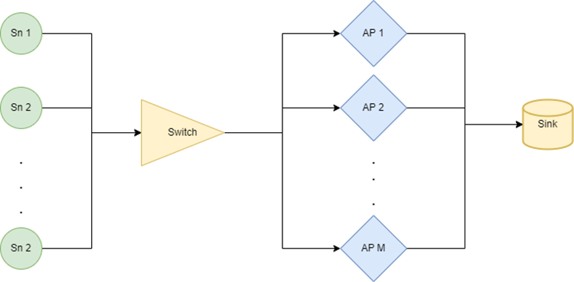
Implementation

Slide 7
Verification
Degeneracy Tests
No Sensing Nodes ( N = 0 )
No Access Points ( M = 0 )
D ∊ { 0 ; 2H }
Vmax = 0 (Theoretical Verification)
Psucc ∊ { 0 ; 1 }
Consistency Tests
T ∊ { 1 s ; 4 s }
Continuity Tests
Psucc ∊ { 0.65 ; 0.7 ; 0.75 }
D ∊ { 70 m ; 80 m ; 90 m }

Slide 8
Simulation - Calibration
Sensing nodes “follow” the standard 802.11 for a common wireless device:
D ~ 100m
T ~ 200ms (beacon periodically sent by an Access Point)
A sensing node moves like a Human: Speed ~ 3m/s
The working plan is a square dimensioned like 3 cities of various dimensions:
From (2500 x 2500) to (8000 x 8000)
Psucc ∊ [ 0.3 ; 0.8 ] Urban environment, so very noisy channel.

Slide 9
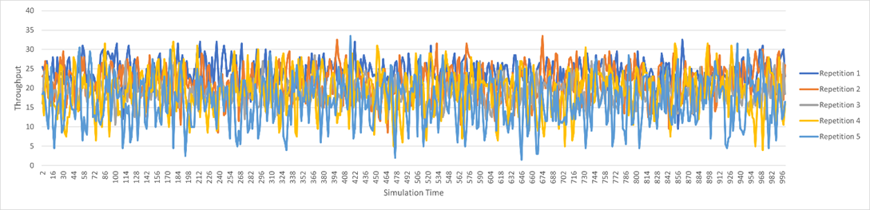
Simulation - Warm-up time and Simulation Time
Warm-up time: 2.5 s
Simulation time: 1800 s

Slide 10
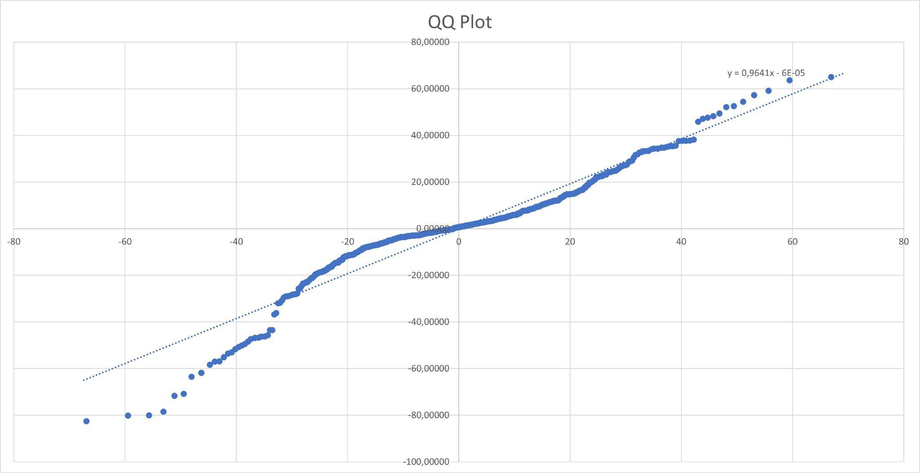
Experiments
2kr: Rate of successful unique messages
Factor | Variation
H | 32.55%
D | 35.16%
Psucc | 6.92%
H + D | 17.95%
H + Psucc | 2.93%
D + Psucc | 3.29%
H + D + Psucc | 1.11%
Others | < 1%

Slide 11
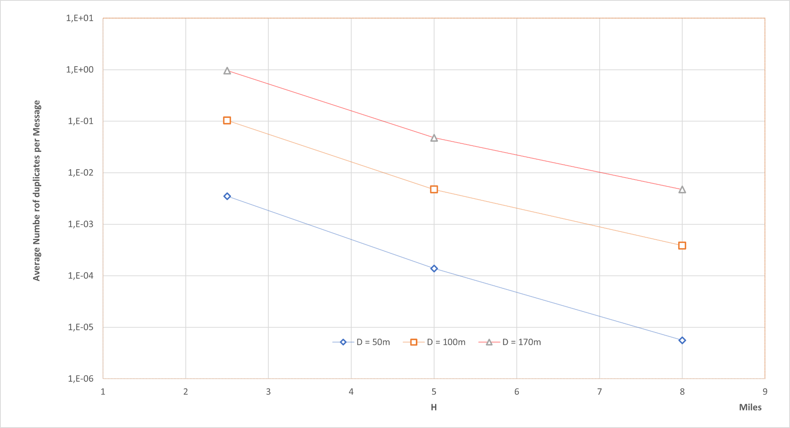
Experiments
Full Factorial Analysis - Average number of duplicates generated per message

Slide 12
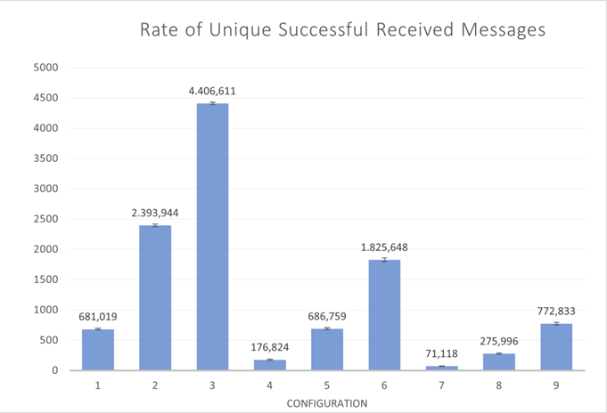
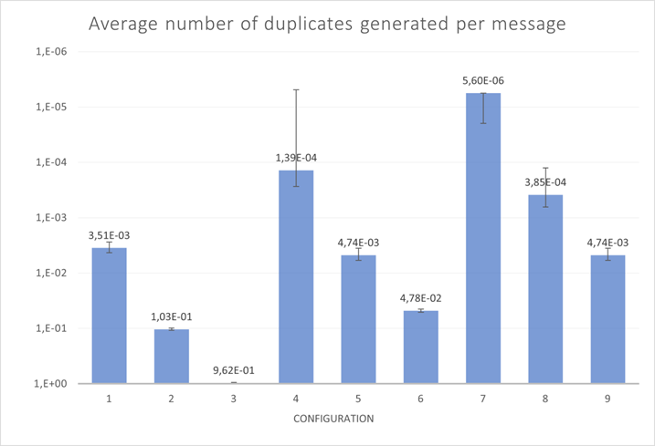
Conclusions
H =2500 m
H =5000 m
H =8000 m
H =2500 m
H =5000 m
H =8000 m
D = 50 m | 100 m | 170 m

