Slide 1
EASY FOOD
HMW1 di GABRIELE PUGLISI
Matricolo O46002038 – 27 MARZO 2021

Slide 2
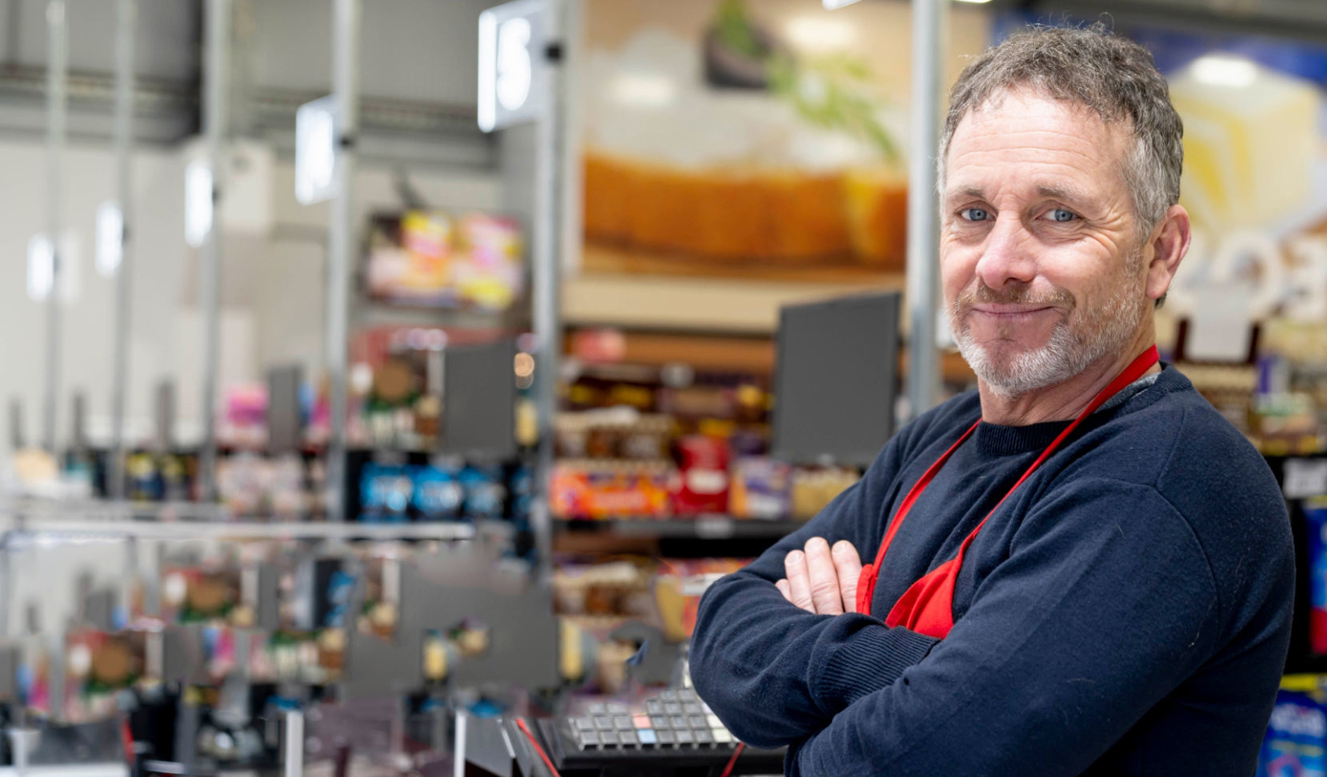
Descrizione del progetto
La web app Easy Food permette, lato frontend, ai visitatori di acquistare prodotti enogastronomici per la propria attività di ristorazione. Il target, fondamentalmente, sono imprese, ma la vendita è aperta anche ai privati.
Per acquistare uno o più prodotti presenti nel portale, il cliente deve effettuare una registrazione. La registrazione è diversa a secondo se il cliente è un'impresa o un privato.
Il backend di Easy Food permette la gestione agile dell'inventario, delle transazioni e delle fatture rilasciate alle imprese, inoltre un dipendente incaricato può creare e gestire gli ordini verso i produttori.

Slide 3
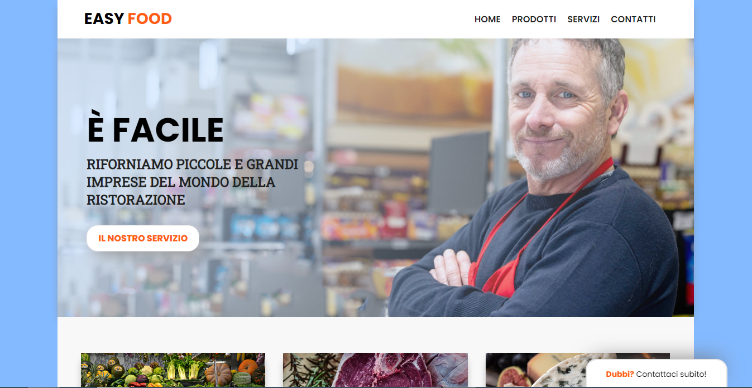

Slide 4
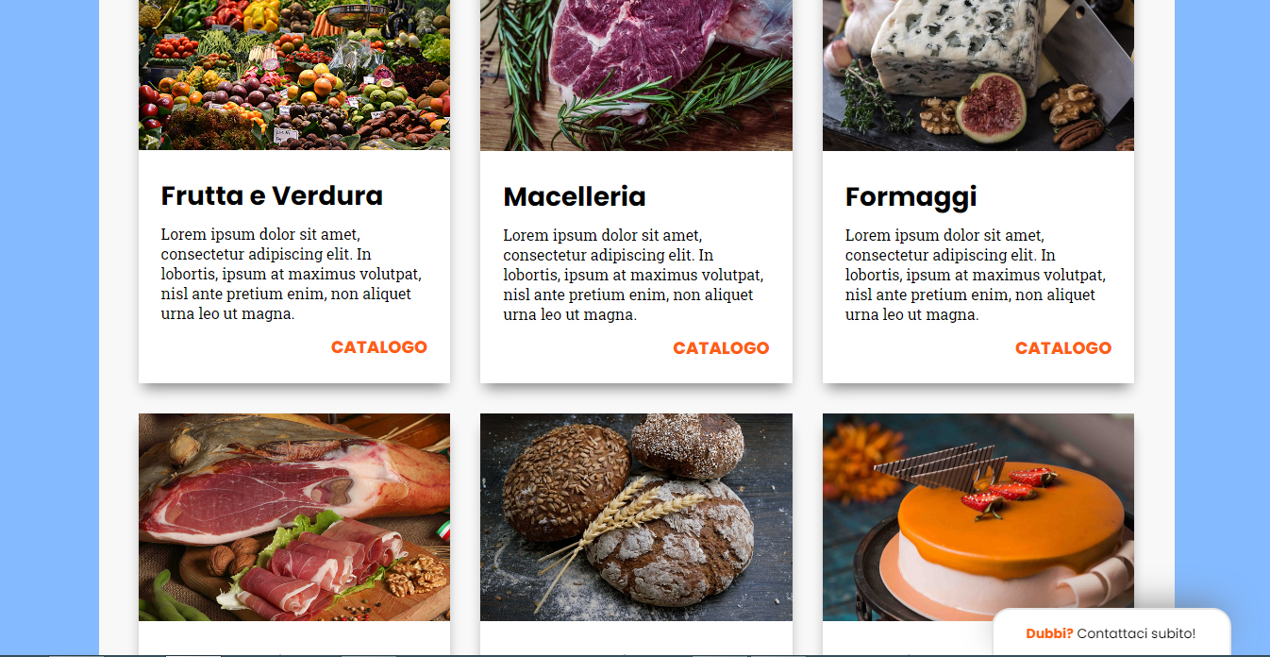

Slide 5
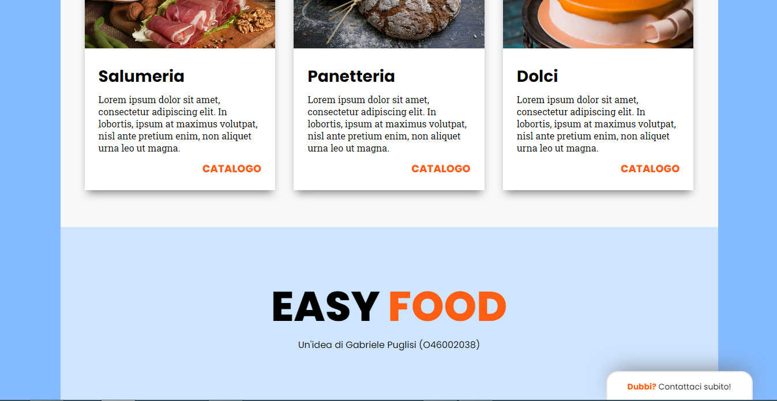

Slide 6
/*body*/ body { margin: 0px; background-color: #84baff; } .container { width: 100%; max-width: 1140px; margin: 0 auto; } /*Tipografia*/ .content-header h1 { font-size: 60px; font-family: 'Poppins', sans-serif; text-transform: uppercase; font-weight: 700; margin: 0; width: fit-content; } | tagline-header { font-size: 18px; max-width: 70%; font-family: 'Roboto Slab', serif; text-transform: uppercase; font-weight: 600; margin: 0px 0 15px 0; color: #212121; } @media only screen and (min-width: 600px) { .tagline-header { font-size: 24px } .content-header h1 { font-size: 60px } .tagline-header { max-width: 85%; } } | /*navigazione*/ .barra-navigazione { width:100%; height:70px; background: white; display: flex; align-items: center; -webkit-box-shadow: 0px 10px 14px -5px rgba(133,133,133,1); -moz-box-shadow: 0px 10px 14px -5px rgba(133,133,133,1); box-shadow: 0px 10px 14px -5px rgba(133,133,133,1); }

Slide 7
.logo-brand { margin-right: auto; padding-left: 3rem; font-family: 'Poppins', sans-serif; text-transform:uppercase; font-size: 24px; font-weight: 800; } .menu { margin-left: auto; padding-right: 3rem; display: none; } .menu ul { list-style: none; display: flex; flex-wrap: wrap; } | .menu ul li { padding: 0px 20px 0px 0px } .menu ul li a { font-family: 'Poppins', sans-serif; text-transform:uppercase; font-size: 16px; font-weight: 600; text-decoration: none; color: #212121; } @media only screen and (min-width: 768px) { .menu { display: flex; } .hamburger-menu { display: none; } } | .hamburger-menu { margin-right: 3rem; } .hamburger-menu-icon { font-size: 36px!important; color: #212121; } /*Header*/ .header { background-image: url('img/header-background.jpg'); background-size: cover; background-repeat: no-repeat; background-position: 100% 50%; -webkit-box-shadow: 0px 10px 14px -5px rgba(133,133,133,1);

Slide 8
-moz-box-shadow: 0px 10px 14px -5px rgba(133,133,133,1); box-shadow: 0px 10px 14px -5px rgba(133,133,133,1); } @media only screen and (min-width: 768px) { .header { background-position: center center; } } .background-veil { width: 100%; height: 100vh; min-height: 400px; max-height: 500px; background: rgba(207,229,255, 0.55); display: flex; align-items: center; | flex-wrap: wrap; } @media only screen and (min-width: 992px) { .background-veil { background: rgb(207,229,255, 0.6); background: linear-gradient(120deg, rgba(207,229,255, 0.75) 10%, rgba(207,229,255, 0) 100%); } } .content-header { text-align: center; max-width: 500px; display: flex; flex-wrap: wrap; justify-content: center; } | @media only screen and (min-width: 600px){ .content-header { justify-content: left; text-align: left; padding-left: 3.3rem; } } .call-to-action { padding: 10px 20px 10px 20px; background: white; border: 1px solid #eee; border-radius: 20px; margin-top: 15px; -webkit-box-shadow: 10px 10px 30px -2px rgba(153,153,153,1); -moz-box-shadow: 10px 10px 30px -2px rgba(153,153,153,1); box-shadow: 10px 10px 30px -2px rgba(153,153,153,1); }

Slide 9
.call-to-action a { font-family: 'Poppins', sans-serif; text-transform:uppercase; font-size: 16px; font-weight: 800; color: #ff5e13; text-decoration: none; display: block; width: 100%; } /*prodotti*/ .prodotti { background: #f8f8f8; display: flex; flex-wrap: wrap; justify-content: center; padding-top: 3rem; padding-bottom: 3rem; } | .card { display: flex; background: white; flex-wrap: wrap; flex: 100%; max-width: 100%; box-sizing: border-box; margin: 1rem; -webkit-box-shadow: 0px 10px 14px -5px rgba(133,133,133,1); -moz-box-shadow: 0px 10px 14px -5px rgba(133,133,133,1); box-shadow: 0px 10px 14px -5px rgba(133,133,133,1); } .card:hover { -webkit-box-shadow: 0px 10px 14px -5px rgba(31,31,31,1); | -moz-box-shadow: 0px 10px 14px -5px rgba(31,31,31,1); box-shadow: 0px 10px 14px -5px rgba(31,31,31,1); } .img-card { max-height: 250px } .img-card img{ width:100%; object-fit: cover; max-height: 250px } .info-card { padding: 1.5rem; } .title-card { padding-bottom: 0.5rem }

Slide 10
.footer-brand p { margin: 0; font-family: 'Poppins', sans-serif; } /*chat box*/ .chat-wrap { display: flex; position: fixed; top: calc(100% - 50px); z-index: 9999; width: 100%; height: 65px; pointer-events: none; } .chat-box { display: flex; margin-left: auto; width: 250px; height: 50px; border: 2px solid #e6e6e6; | border-radius: 20px 20px 0px 0px; background: white; align-items: center; justify-content: center; text-align: center; -webkit-box-shadow: 0px -10px 39px -12px rgba(112,112,112,1); -moz-box-shadow: 0px -10px 39px -12px rgba(112,112,112,1); box-shadow: 0px -10px 39px -12px rgba(112,112,112,1); } .details-chat-box { width: 80%; } .details-chat-box p{ font-family: 'Poppins', sans-serif; font-size: 14px; } | @media only screen and (min-width: 1200px) { .chat-wrap { max-width: 1200px; left: calc(50% - 570px); right: calc(50% - 570px); } }

Slide 11
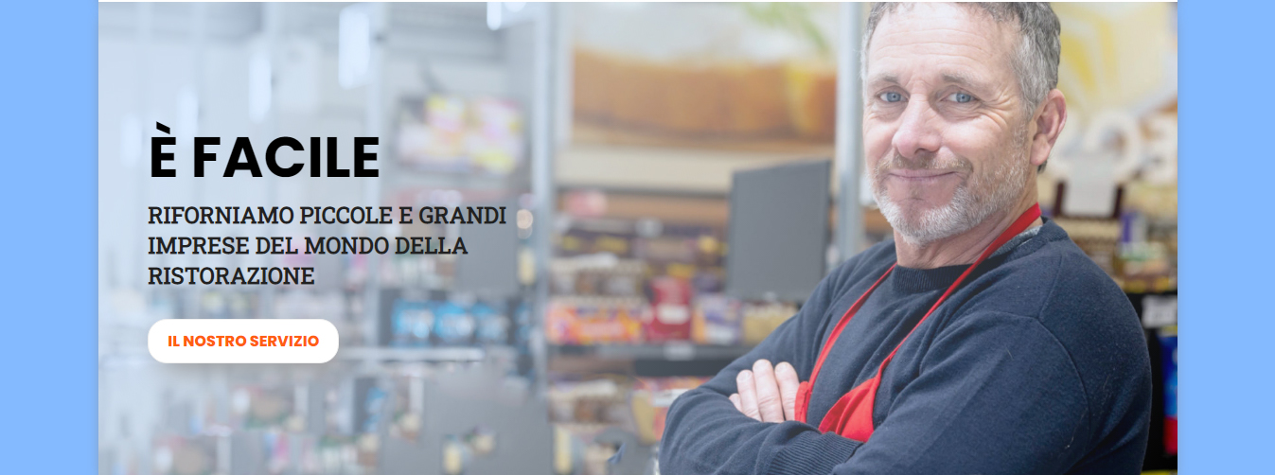

Slide 12
.content-header h1 { font-size: 60px; font-family: 'Poppins', sans-serif; text-transform: uppercase; font-weight: 700; margin: 0; width: fit-content; } .tagline-header { font-size: 18px; max-width: 70%; font-family: 'Roboto Slab', serif; text-transform: uppercase; font-weight: 600; margin: 0px 0 15px 0; color: #212121; } | @media only screen and (min-width: 600px) { .tagline-header { font-size: 24px } .content-header h1 { font-size: 60px } .tagline-header { max-width: 85%; } } .header { background-image: url('img/header-background.jpg'); background-size: cover; background-repeat: no-repeat; background-position: 100% 50%; -webkit-box-shadow: 0px 10px 14px -5px rgba(133,133,133,1); | -moz-box-shadow: 0px 10px 14px -5px rgba(133,133,133,1); box-shadow: 0px 10px 14px -5px rgba(133,133,133,1); } @media only screen and (min-width: 768px) { .header { background-position: center center; } } .background-veil { width: 100%; height: 100vh; min-height: 400px; max-height: 500px; background: rgba(207,229,255, 0.55); display: flex; align-items: center; flex-wrap: wrap; }

Slide 13
@media only screen and (min-width: 992px) { .background-veil { background: rgb(207,229,255, 0.6); background: linear-gradient(120deg, rgba(207,229,255, 0.75) 10%, rgba(207,229,255, 0) 100%); } } .content-header { text-align: center; max-width: 500px; display: flex; flex-wrap: wrap; justify-content: center; } | @media only screen and (min-width: 600px){ .content-header { justify-content: left; text-align: left; padding-left: 3.3rem; } } .call-to-action { padding: 10px 20px 10px 20px; background: white; border: 1px solid #eee; border-radius: 20px; margin-top: 15px; -webkit-box-shadow: 10px 10px 30px -2px rgba(153,153,153,1); -moz-box-shadow: 10px 10px 30px -2px rgba(153,153,153,1); box-shadow: 10px 10px 30px -2px rgba(153,153,153,1); } | .call-to-action a { font-family: 'Poppins', sans-serif; text-transform:uppercase; font-size: 16px; font-weight: 800; color: #ff5e13; text-decoration: none; display: block; width: 100%; }

Slide 14
@media only screen and (min-width: 992px) { .background-veil { background: rgb(207,229,255, 0.6); background: linear-gradient(120deg, rgba(207,229,255, 0.75) 10%, rgba(207,229,255, 0) 100%); } } .content-header { text-align: center; max-width: 500px; display: flex; flex-wrap: wrap; justify-content: center; } | @media only screen and (min-width: 600px){ .content-header { justify-content: left; text-align: left; padding-left: 3.3rem; } } .call-to-action { padding: 10px 20px 10px 20px; background: white; border: 1px solid #eee; border-radius: 20px; margin-top: 15px; -webkit-box-shadow: 10px 10px 30px -2px rgba(153,153,153,1); -moz-box-shadow: 10px 10px 30px -2px rgba(153,153,153,1); box-shadow: 10px 10px 30px -2px rgba(153,153,153,1); } | .call-to-action a { font-family: 'Poppins', sans-serif; text-transform:uppercase; font-size: 16px; font-weight: 800; color: #ff5e13; text-decoration: none; display: block; width: 100%; }

Slide 15

.barra-navigazione { width:100%; height:70px; background: white; display: flex; align-items: center; -webkit-box-shadow: 0px 10px 14px -5px rgba(133,133,133,1); -moz-box-shadow: 0px 10px 14px -5px rgba(133,133,133,1); box-shadow: 0px 10px 14px -5px rgba(133,133,133,1); } @media only screen and (min-width: 768px) { .menu { display: flex; } .hamburger-menu { display: none; } } | .hamburger-menu { margin-right: 3rem; } .hamburger-menu-icon { font-size: 36px!important; color: #212121; } .logo-brand { margin-right: auto; padding-left: 3rem; font-family: 'Poppins', sans-serif; text-transform:uppercase; font-size: 24px; font-weight: 800; } .menu { margin-left: auto; padding-right: 3rem; display: none; } | .menu ul { list-style: none; display: flex; flex-wrap: wrap; } .menu ul li { padding: 0px 20px 0px 0px } .menu ul li a { font-family: 'Poppins', sans-serif; text-transform:uppercase; font-size: 16px; font-weight: 600; text-decoration: none; color: #212121; }

Slide 16
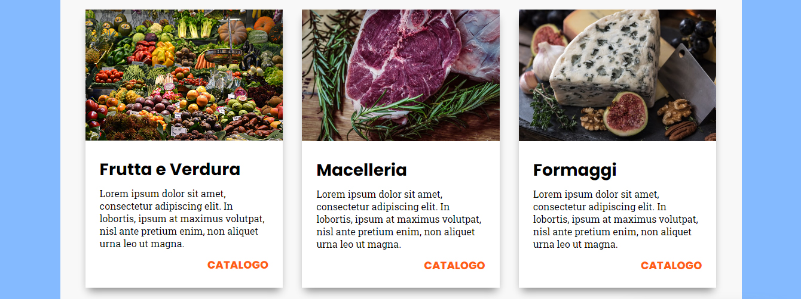

Slide 17
.prodotti { background: #f8f8f8; display: flex; flex-wrap: wrap; justify-content: center; padding-top: 3rem; padding-bottom: 3rem; } .card { display: flex; background: white; flex-wrap: wrap; flex: 100%; max-width: 100%; box-sizing: border-box; margin: 1rem; -webkit-box-shadow: 0px 10px 14px -5px rgba(133,133,133,1); -moz-box-shadow: 0px 10px 14px -5px rgba(133,133,133,1); box-shadow: 0px 10px 14px -5px rgba(133,133,133,1); } | .card:hover { -webkit-box-shadow: 0px 10px 14px -5px rgba(31,31,31,1); -moz-box-shadow: 0px 10px 14px -5px rgba(31,31,31,1); box-shadow: 0px 10px 14px -5px rgba(31,31,31,1); } .img-card { max-height: 250px } .img-card img{ width:100%; object-fit: cover; max-height: 250px } .info-card { padding: 1.5rem; } | .title-card { padding-bottom: 0.5rem } .title-card h2{ font-family: 'Poppins', sans-serif; font-size: 28px; margin: 0px; } .description-card p{ margin: 0px; font-family: 'Roboto Slab', serif; } .action-card { padding-top: 0.75rem; float: right }

Slide 18
.action-card a{ text-decoration: none; font-family: 'Poppins', sans-serif; font-size: 18px; text-transform: uppercase; font-weight: 800; color: #ff5e13; } @media only screen and (min-width: 600px) { .card { flex: 44%; max-width: 44%; } } @media only screen and (min-width: 992px) { .card { flex: 29%; max-width: 29%; } }

Slide 19
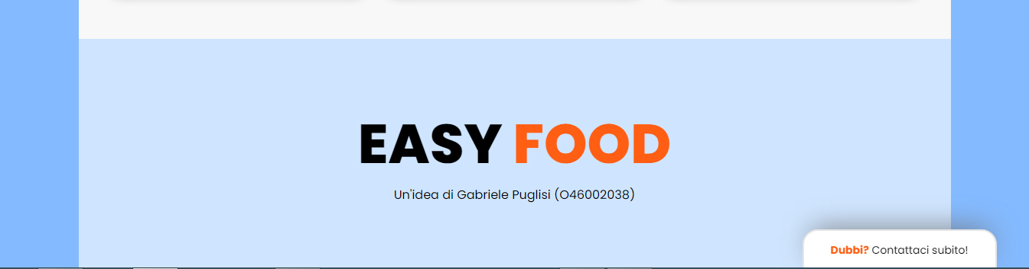
footer { background: #cfe5ff; height: 300px; display: flex; flex-wrap: wrap; align-items: center; justify-content: center; text-align: center; } | .footer-brand h1{ font-family: 'Poppins', sans-serif; text-transform:uppercase; font-size: 72px; font-weight: 800; margin: 0px; } | .footer-brand p { margin: 0; font-family: 'Poppins', sans-serif; }

