Slide 1
Deblur & Denoise on KaoKore
as an Inverse Problem
Computational Imaging 2025-26
Gabriele Centonze

Slide 2
Description of the project
• Task: deblur + denoise, formulated as an inverse problem y = Ax + n
- A: Gaussian blur (sigma=2, kernel 9x9); n: additive Gaussian noise, 4 levels (0.005, 0.01, 0.05, 0.1)
• Dataset: KaoKore v1.3, 256x256 RGB portraits (9257 images)
- Official train / dev / test split from the dataset's own labels.csv: 7405 / 926 / 926
• Goal: implement and critically compare methods from different methodological families
- under the same experimental conditions (same degraded inputs for every method)
• 3 of the 4 proposed methods (allowed for single-student projects):
- Variational (FISTA + Wavelet), Hybrid (PD-Net + TV), End-to-end (UNet)

Slide 3
Methodology — overview
• The inverse problem is ill-posed: A attenuates high spatial frequencies
- naive inversion amplifies noise uncontrollably -> regularization / a prior is required
• Three different ways of introducing that prior:
- Variational: an explicit hand-crafted prior (wavelet sparsity), no learning
- Hybrid: known physics (A, image gradient) + a few learned correction blocks
- End-to-end: the whole mapping y -> x is learned from data
• All three share the exact same forward operator and read the exact same
- pre-generated degraded PNG files for evaluation (fair comparison)

Slide 4
Methodology — Variational: FISTA + Wavelet
• min_x 1/2||Ax - y||^2 + lambda ||Wx||_1 (W: orthogonal wavelet transform)
• Non-smooth but convex -> proximal gradient method (Beck & Teboulle, 2009)
• For orthogonal W, prox of the L1 term = soft-thresholding of wavelet coefficients
• Nesterov-style extrapolation: convergence rate O(1/k^2) instead of O(1/k)
• Step size 1/L: L = ||A^T A|| = 1 exactly, thanks to circular boundary conditions
- (A becomes a symmetric circulant operator, diagonalized by the Fourier transform)

Slide 5
Methodology — Hybrid: PD-Net + TV
• min_x 1/2||Ax - y||^2 + lambda * TV(x)
• Unrolled Chambolle-Pock primal-dual algorithm
• Exact proximal / projection steps replaced by small learned CNN blocks
• Dual variable lives in gradient space (not data space): ties the network
- explicitly to the TV structure, unlike a generic learned primal-dual
• Data-fidelity gradient A^T(Ax-y) stays exact (not learned) at every iteration
- -> hybrid: known physics + learned correction, not a black box

Slide 6
Methodology — End-to-end: UNet
• Fully supervised: learns the direct mapping y -> x from training pairs
• Chosen over ViT / NAF-Net: the degradation is spatially local (small kernel,
- per-pixel noise) -> no need for long-range attention; simpler to implement well
- in the available time
• Encoder-decoder with skip connections: preserve fine spatial detail across
- the bottleneck, needed since input and output share almost all structure
• Residual learning: x_hat = y + UNet(y), the network only learns the correction

Slide 7
Implementation — FISTA + Wavelet
• Wavelet: Daubechies db4, 3 decomposition levels, mode='periodization'
- (periodization keeps the DWT exactly orthogonal, required for the prox to be exact)
• 100 iterations per image, no learned parameters
• lambda tuned by grid search on the dev set (20 images), separately per noise level
- (0.005 -> 0.0025, 0.01 -> 0.0035, 0.05 -> 0.0175, 0.1 -> 0.07: grows with noise, as
- expected from the discrepancy principle)

Slide 8
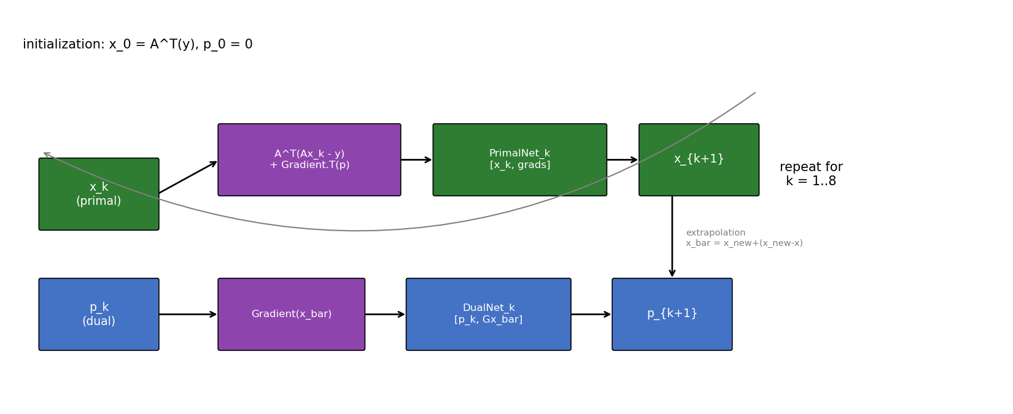
Implementation — PD-Net
• 8 unrolled iterations, independent weights per iteration; CNN blocks: Conv3x3-LeakyReLU-Conv3x3
• 4 specialized models (one per noise level), 700 training images, 12 epochs, Adam (lr=2e-4), L1 loss

Slide 9
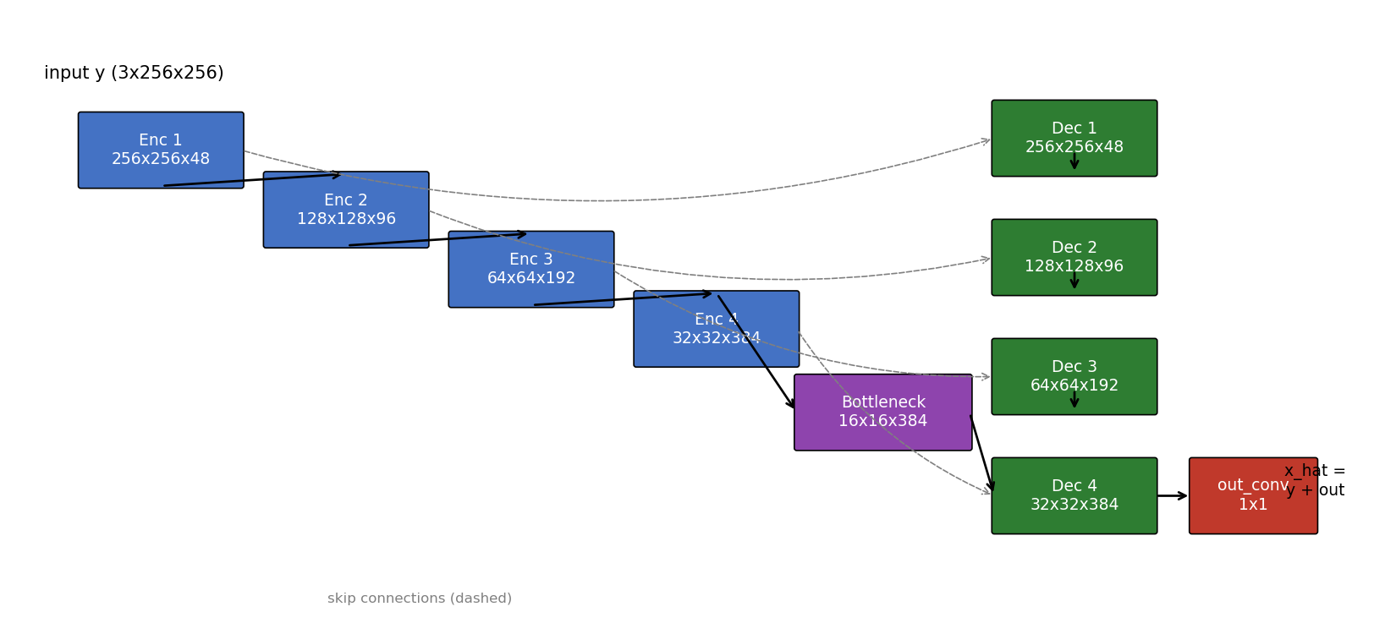
Implementation — UNet
• 4 downsampling levels, base channels 48, GroupNorm (stable with small batch size)
• 4 specialized models (one per noise level), 1000 training images, 20 epochs, Adam (lr=2e-4), L1 loss

Slide 10
Introduce the experiments
• Degradation: Gaussian blur sigma=2, kernel 9x9, circular boundary conditions
• Noise: additive Gaussian, std = noise level directly (0.005 / 0.01 / 0.05 / 0.1), on [0,1] images
• Degraded observations generated once, saved as 8-bit PNGs -> identical inputs for all methods
• Time-constrained scope decisions (declared explicitly, not hidden):
- evaluation on a fixed subset (80 test + 20 dev images) instead of the full 926/926
- 3 of 4 methods (allowed for single-student projects); generative method (Diffusion+DPS) dropped
- 4 specialized models per learned method, for a fair comparison against FISTA's per-level lambda

Slide 11
Numerical results — summary table
Method | Noise level | PSNR (dB) | SSIM | Time/image (s)
FISTA-Wavelet | 0.005 | 31.17 | 0.861 | 1.5724
FISTA-Wavelet | 0.01 | 31.00 | 0.855 | 1.5724
FISTA-Wavelet | 0.05 | 28.96 | 0.779 | 1.5724
FISTA-Wavelet | 0.1 | 27.09 | 0.699 | 1.5724
PD-Net | 0.005 | 33.43 | 0.904 | 0.0376
PD-Net | 0.01 | 33.84 | 0.910 | 0.0376
PD-Net | 0.05 | 31.77 | 0.862 | 0.0376
PD-Net | 0.1 | 30.14 | 0.822 | 0.0376
UNet | 0.005 | 33.39 | 0.903 | 0.0373
UNet | 0.01 | 34.03 | 0.913 | 0.0373
UNet | 0.05 | 32.08 | 0.872 | 0.0373
UNet | 0.1 | 30.49 | 0.835 | 0.0373

Slide 12
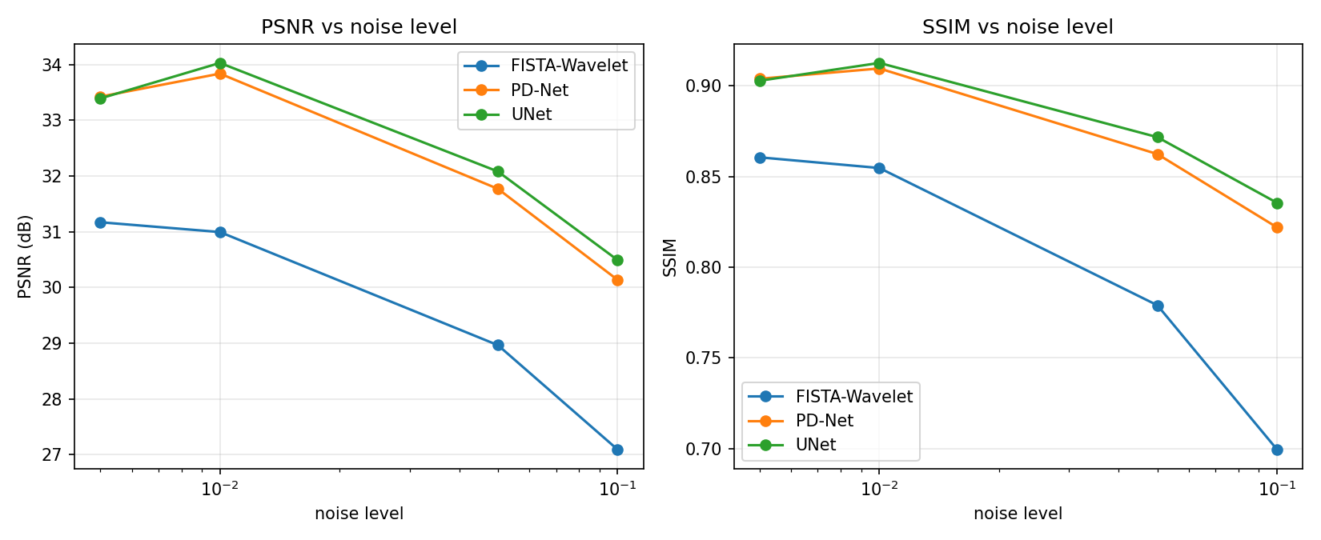
Numerical results — comparison plot

Slide 13
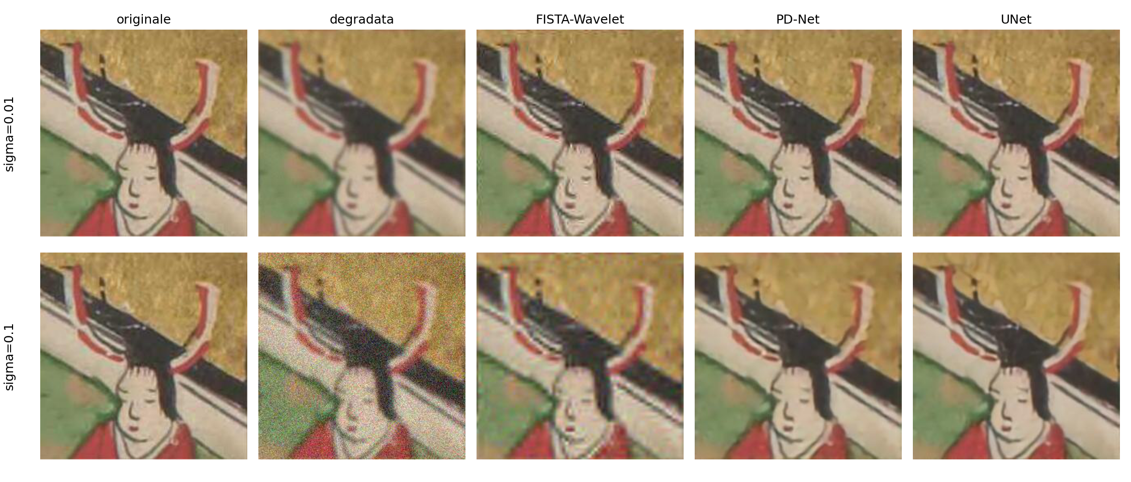
Numerical results — visual comparison

Slide 14
Conclusions
• UNet and PD-Net outperform FISTA by 2-3 dB PSNR at every noise level:
- a prior learned on KaoKore's own statistics beats a generic wavelet-sparsity prior
• UNet and PD-Net achieve near-identical accuracy, but PD-Net uses ~100x fewer parameters
- (302 KB vs 33 MB checkpoints): embedding known physics reduces what must be learned
• FISTA is ~40x slower per image (iterative optimization vs a single forward pass),
- but needs no training and is fully interpretable, unlike the two learned methods
• Limits: reduced evaluation subset and training set/epochs, due to time constraints
• Future work: full test set and training set, more epochs, add the 4th method
- (Diffusion + DPS), try NAF-Net as an alternative end-to-end architecture

Slide 15
Bibliography
• A. Beck, M. Teboulle. "A Fast Iterative Shrinkage-Thresholding Algorithm for Linear Inverse Problems." SIAM J. Imaging Sciences, 2009.
• A. Chambolle, T. Pock. "A First-Order Primal-Dual Algorithm for Convex Problems with Applications to Imaging." JMIV, 2011.
• J. Adler, O. Öktem. "Learned Primal-Dual Reconstruction." IEEE Trans. Medical Imaging, 2018.
• O. Ronneberger, P. Fischer, T. Brox. "U-Net: Convolutional Networks for Biomedical Image Segmentation." MICCAI, 2015.
• Y. Tian et al. "KaoKore: A Pre-modern Japanese Art Facial Expression Dataset." 2020 (dataset).
• D. Evangelista. IPPy library (course material), reused/adapted for the Blurring, Gradient operators and the Learned Primal-Dual design pattern.

