Slide 1
Structural Overview
Github Repository
Live Website
Razor Pages on .net 6
MongoDB database management
Automatic Deployment
Azure
MongoDB
Cross-Platform Webapp
Private/Secure User Account
Sharable Content Other Users
Azure automatically builds from the Github repository and deploys to the live website.
MongoDB manages the backend database.
Development Environment
User Experience

Slide 2
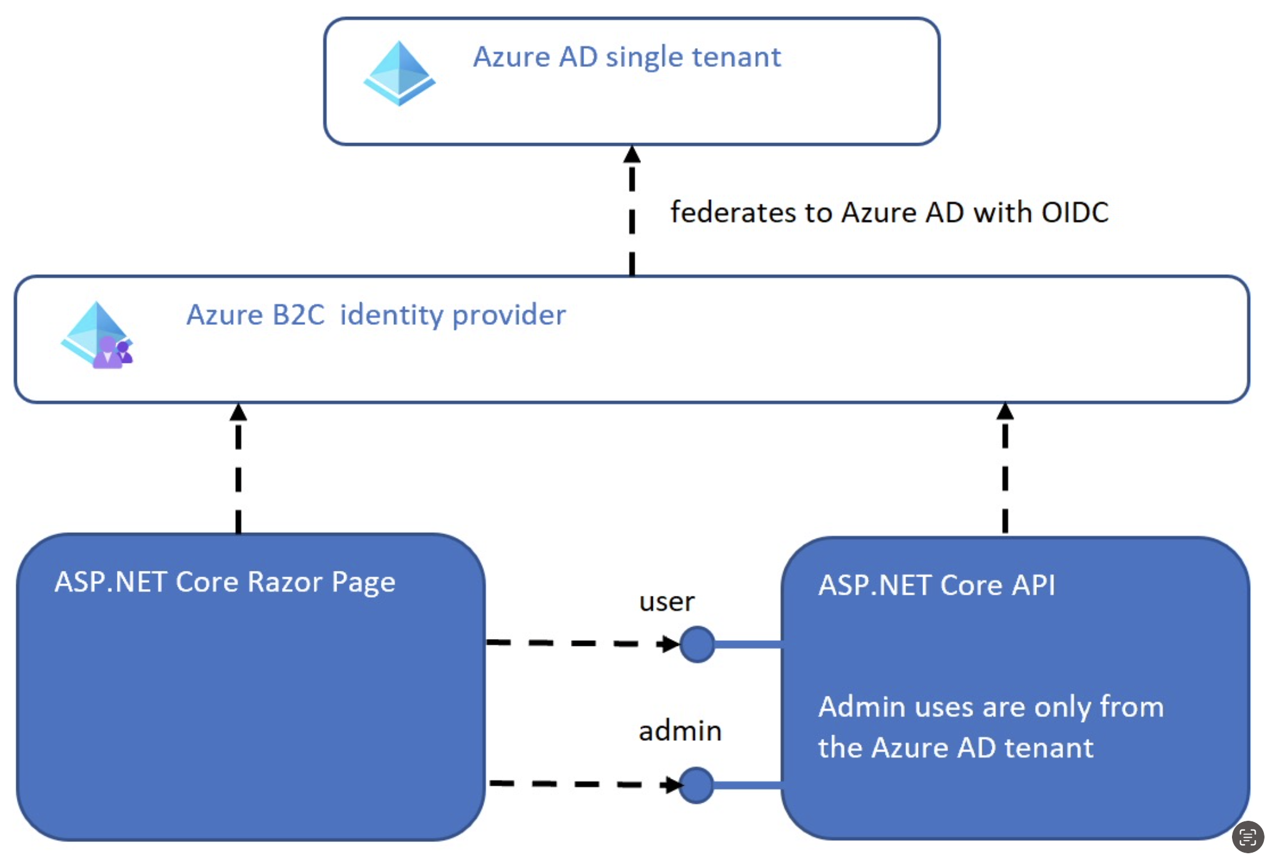
Relationship with Azure AD and .Net

Slide 3
Models
User
Day
Workout
string Id { get; set; }
string ObjectIdentifier { get; set;}
string FirstName { get; set; }
string LastName { get; set; }
string DisplayName { get; set;}
string EmailAddress { get; set; }
double Height { get; set; }
double Weight { get; set; }
List<string> Goals { get; set; }
int DaysToWorkOut { get; set; }
string Id { get; set; }
string days { get; set; }
string Id { get; set; }
string sets { get; set; }
string reps { get; set; }
string name { get; set; }
string type { get; set; }

Slide 4
Features
Displays user information with options to edit the information
This is where the user will log their workout progress they have done
Profile
This is where the user add custom workout goals
Goals
Logbook

Slide 5
Goal Features
This will be where they are able to share their content
This is where they are able to look at other users published material
Publish
Stream

