Slide 1
Web Data Extraction
Riccardo Dominici Cristian Traballoni Gabriele Rizzitiello

Slide 2
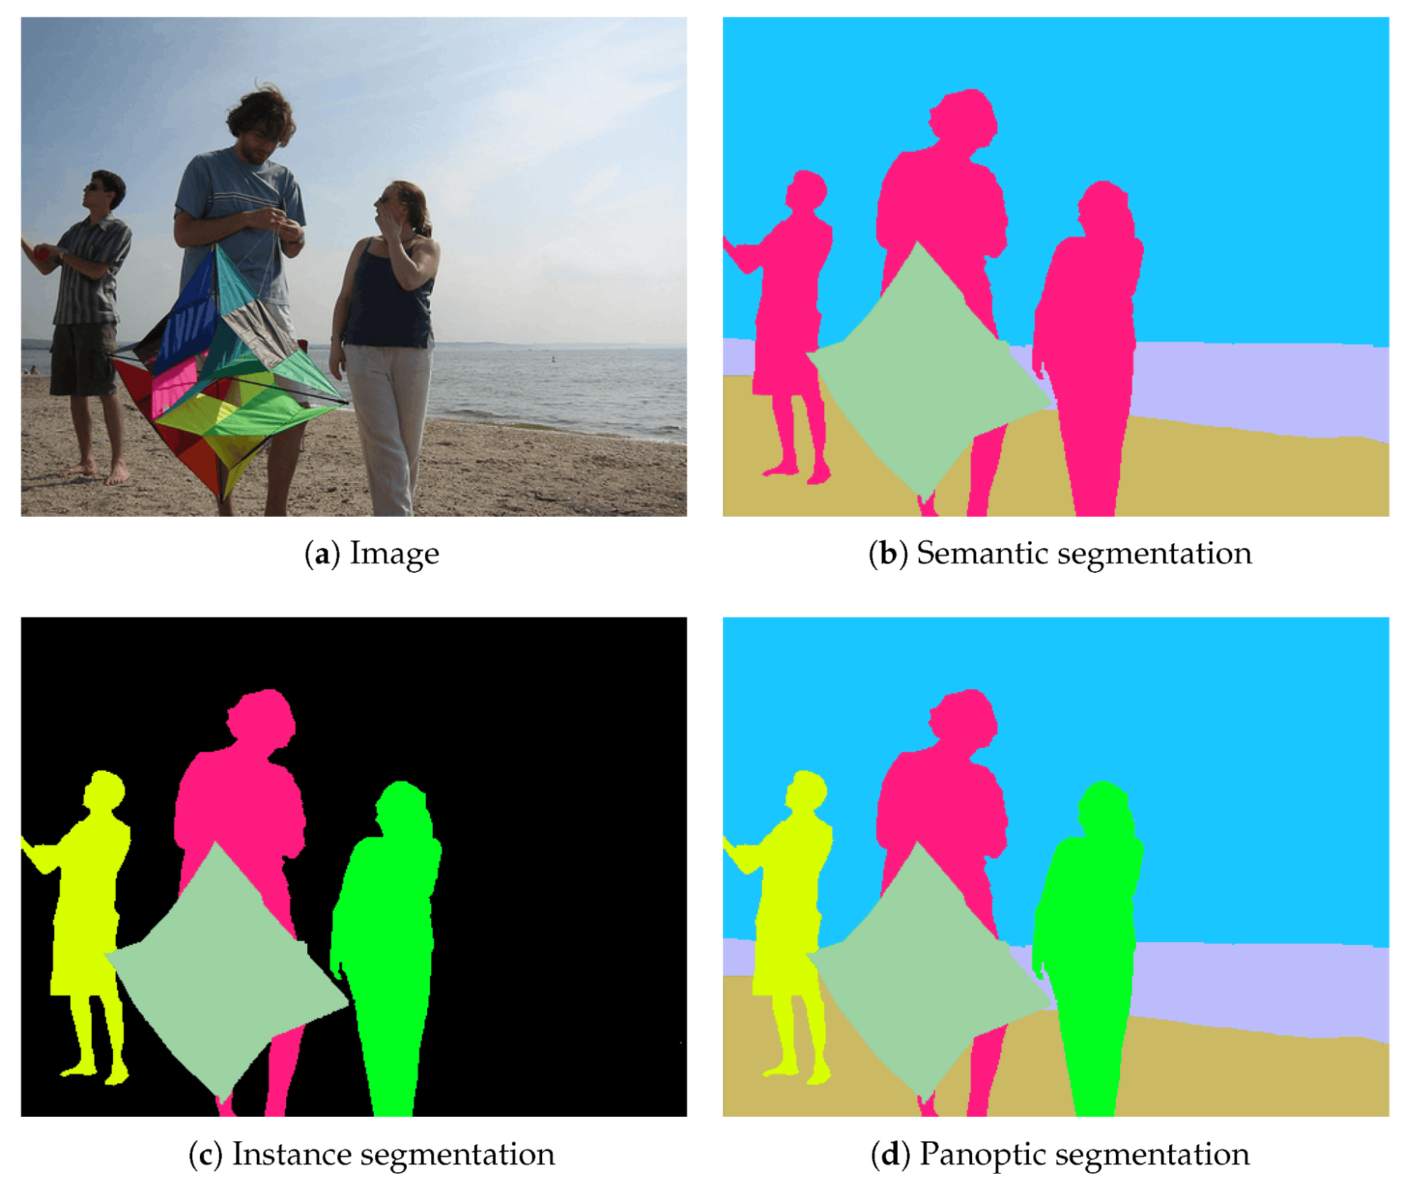
Research topic – Image Segmentation
Image segmentation is a computer vision technique that divides an image into meaningful regions or "segments", assigning tags to each pixel based on classes of interest
01
There are two approaches: semantic segmentation, which labels each pixel according to class, and instance segmentation, which also identifies individual instances of each object
02
03
Segmentation is critical for image analysis in areas such as autonomous driving, medicine, and object detection

Slide 3



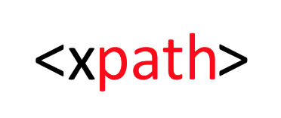
Data extraction
Download html files
Management of html files
ArXiv allows you to search and retrieve information on papers once you have chosen a search topic download the associated html files
The extracted html files were 323, organized in a specific folder named 'sources'
Extraction of tables, captions, footnotes and paragraphs
Management of json files
The extracted data were organized in a .json file, one for each paper, structured to maintain the extracted data
Using Xpath it was possible to extract the tables and the relevant information related to them

Slide 4
Xpath – table and caption
Through the following query, we retrieve all table IDs for a generic HTML file. These IDs can then be filtered, retaining only the actual tables (slightly reducing potential noise), by checking for the presence of the character 'T' in the ID
xpath_query_id_tables = "//table/@id"
For each table ID, we retrieve its corresponding HTML content using the following query. The method `estrai_con_xpath` executes the specific query
table = estrai_con_xpath(file_path,"//table[@id=‘" + id + “’]")
The caption of a table is extracted using the following query. Once the specific table is identified, we trace back to the ancestor figure from which the caption can be accessed. To handle problematic situations, such as nested spans containing relevant text, we used the OR operator in an additional query to broaden the range of cases to manage
xpath_query_caption = "//table[@id=‘"+ id + “’]/ancestor::figure/figcaption/text() |
//table[@id=‘"+ id + “’]/ancestor::figure/figcaption//*/text()”

Slide 5
Xpath – footnote and paragraph
Through the ID of the i-th table, we retrieve all the footnote references present, both in the table and in its caption. For each of these, we use the split method to save the corresponding number in num_footnote, in order to reconstruct the ID of the footnote located at the bottom of the page, and then retrieve it.
xpath_query_href_cite = "//table[@id='"+ id + "']/ancestor::figure//cite//@href”
xpath_query_footnote = "//li[@id='bib.bib"+ num_footnote + "']/*/text() | //li[@id='bib.bib"+ num_footnote + "']//*/text()"
Through the table's ID, we retrieve the ID of the ancestor figure to obtain the paragraphs. When a paragraph refers to a table, it recalls the figure's ID in the href, so we retrieve all the paragraphs that refer to the table in question by checking for the presence of the id_figure using the substring method.
xpath_query_id_figure = "//table[@id='"+ id + "']/ancestor::figure/@id“
xpath_query_paragraph = "//*[substring(@href, string-length(@href) - string-length(‘” + id_figure[0] +”’) + 1) =‘” + id_figure[0] +"']/ancestor::p“

Slide 6

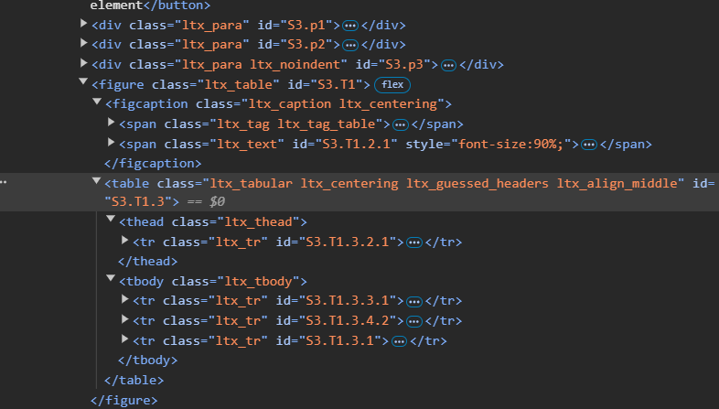
Challenges and difficulties
Caption and footnotes
The diversity of papers in HTML formatting has made it necessary to generalize some XPath instructions. Specifically:
Some captions are split among nested children of the figcaption class.
Sometimes, footnotes are contained within nested children of the tag referenced by the found ID.
Data formatting before JSON
Before creating a JSON file for each paper, it was necessary to clean the data and insert it into appropriate data structures. Specifically, it became essential to define a function to isolate paragraphs that referenced the same table, as they would otherwise be merged into one.

Slide 7





Quality of the extraction
Average and stats for tables
Average references per table
The average number of tables extracted per file estimated in verifying the quality of data extraction was equal to 4.98;
the total number of tables was 1607
The average number of references per table estimated in verifying the quality of data extraction was equal to 1.22, meanwhile the number of tables without references was 116
Tables without caption
Tables without footnotes
The number of tables extracted without caption estimated in verifying the quality of data extraction was equal to 9 (0.56%)
The number of tables extracted without footnotes estimated in verifying the quality of data extraction was equal to 944 (58.74%)

Slide 8
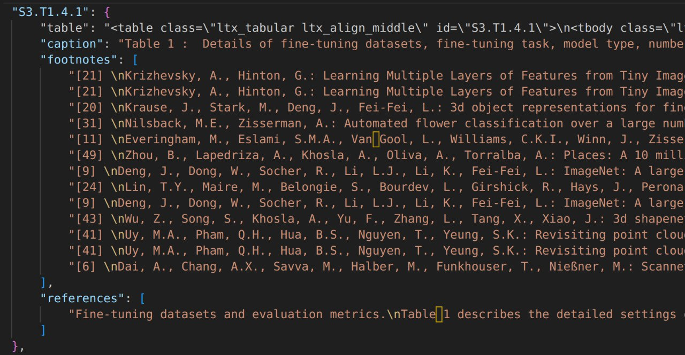
Conclusions
The general quality control of the extraction process was conducted continuously. During the project, 30 sample papers were reviewed out of a total of 323, with positive results.
The 9 caption-less tables were examined, revealing that they consist of 4 figures and 5 mathematical formulas that indeed lack captions
The web data extraction project has automated the extraction and transformation of structured information, from scientific papers on arXiv, analyzing the HTML files of the papers, each document was converted into JSON format, with the data clearly organized
Foto json

Slide 9
End of presentation
Thank you for your attention

