Slide 1
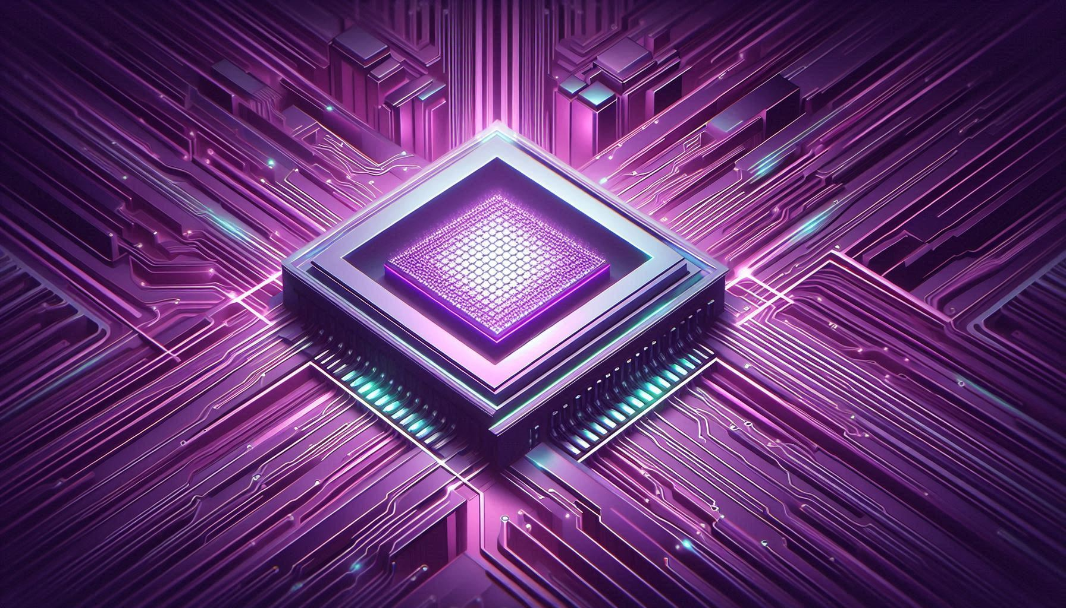
QUANTUM COMPUTING
Gabriele Gabrielli
28 February 2025

Slide 2
1980s:Theoretical foundations proposed by Richard Feynman
and David Deutsch
1998: First 2-qubit quantum computer
2016: IBM makes 5-qubit quantum computer accessible via cloud
2019: Google 53-qubit
2021: IBM 127-qubit
2022: IBM 433-qubit
2023: IBM 1,121-qubit
December 2024: Google’s Willow: 105-qubit with error correction
February 2025: Microsoft’s Majorana 1: first topological processor
2027: IBM 10.000-qubit

Slide 3
QUBIT
Oversimplified definition:
Bit
Qubit
1
1
0
0

Slide 4
QUBIT
Oversimplified definition:
State superposition:
|ψ⟩ = α |0⟩ + β |1⟩ where |α|² + |β|² = 1
Bit
Qubit
1
1
Entanglement:
0
0
|ψΦ⟩ = α|00⟩ + β|01⟩ + γ|10⟩ + δ|11⟩

Slide 5
COMPUTATION
Initialization of the qubits
Entanglement
Actual computation with Quantum Circuits - Unitary Operations
Measurement (superposition collapse)
Error correction

Slide 6
COMPUTATION
Initialization of the qubits
Entanglement
Actual computation with Quantum Circuits - Unitary Operations
Measurement (superposition collapse)
Error correction
Traditional Computer
circuit
solution
Quantum Processor

Slide 7
COMPUTATION
Goal of the quantum algorithm (implemented in the circuit): make the probability of the solution state as high as possible.
|ψ⟩ = p₁|00000000⟩ + p₂ |00000001⟩ + … + p_{solution} |00101110⟩ + … + p₂₅₆ |11111111⟩
When the measurament occurs, the qubits will likely assume the value of the solution.
This likely is mildly ‘enforced’ by error correction.

Slide 8
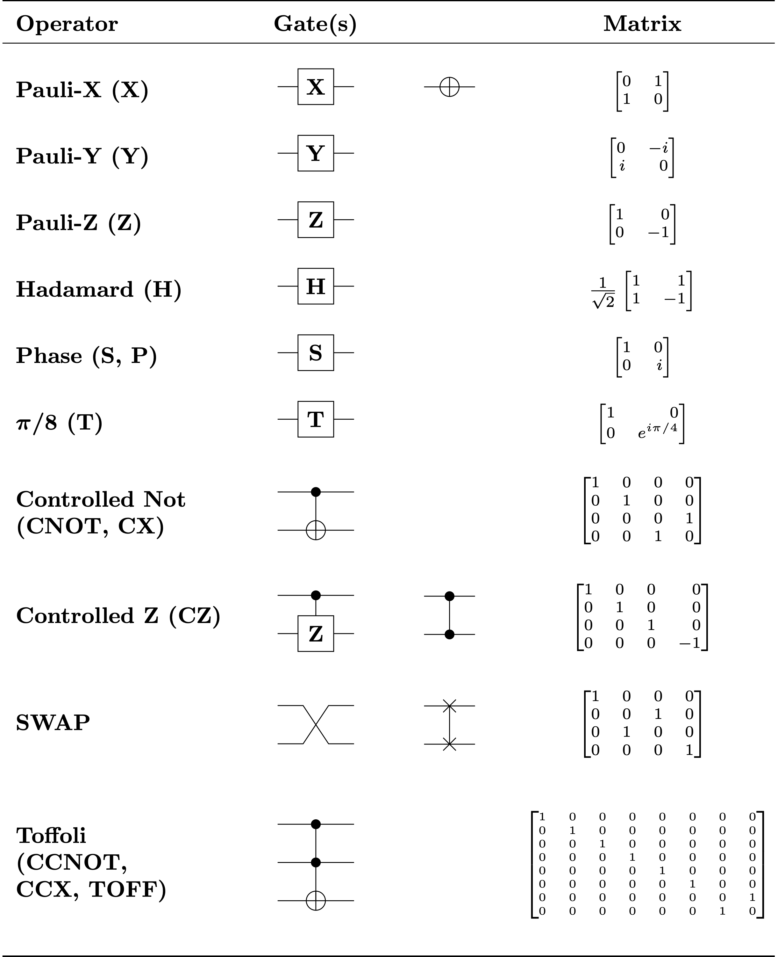
COMPUTATION
The only operations allowed in quantum circuits are the unitary operations.
Unitary operations are matrices applied to the vector of the probability amplitudes of one or more entangled qubits.
A matrix is unitary if its inverse is equal to its conjugate transposed.

Slide 9
DEMO
Logic AND gate
~
Quantum Toffoli gate

Slide 10
CLASSIC ALGORITHMS
Classic algorithms theory measure the efficiency by counting the number of operations to get a certificate verification for a certain problem.
Possible Solution
Algorithm
Certificate
Verification is usually easier (i.e. less computationally expensive) than the solving procedure.

Slide 11
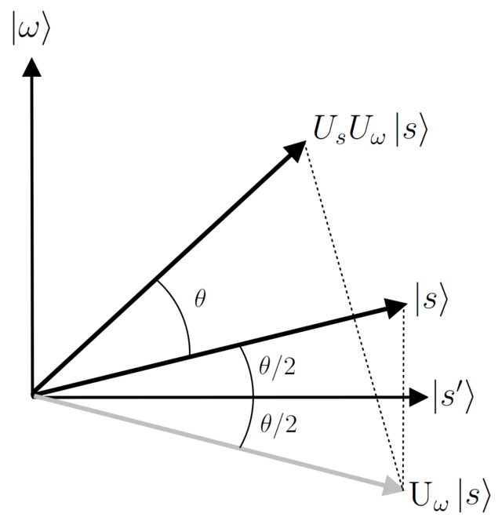
GROVER ALGORITHM
The classic algorithm (providing verification certificate) must be converted into a quantum circuit.
The qubits must be enaugh to represent the total space of solutions. That is, each state in the superposition is a different possible solution.
The grover algorithm circuit apply the verificaton circuit to the whole solution space, rising the probability for that state.

Slide 12
GROVER ALGORITHM
Grover Algorithm uses quantum parallelization to apply the validation certificate algorithm to all the possible solution.
|ψ⟩ = p₁|00000000⟩ + p₂ |00000001⟩ + … + p_{solution} |00101110⟩ + … + p₂₅₆ |11111111⟩
Using Grover Algorithm, the new complexity is the square root of the original complexity. One year of classic computation last than 2 minutes in quantum computation.

