Slide 1


DESIGN AND DEVELOPMENT OF AN E-PORTAL
3rd January 2013
Presented by Smartline Solutions Ltd

Slide 2
BACKGROUND
Online Database
Reference point for import/export traders
Information related to import/export business
Procedures
Legislation
Regulations
Workflow System
Application of import/export licenses and permits
Notes:
- Let us start by giving you a brief overview of what we set out to do. We are inevitably developing a web-based database that will assist TTFA in performance monitoring of the central corridor.
- How will we do this?
The foundation of this project lies in the data categorized as follows:
Computerized data – will mention the stakeholders

Slide 3
SCOPE & DELIVERABLES
Needs Analysis
User requirements, Software Requirements Specification
Business mapping report, Database design
System Development
Online Database
Workflow Management – License & Permits
Integration to key existing systems
Training
User & Administrator Manuals
Training of Trainers (ToTs)

Slide 4
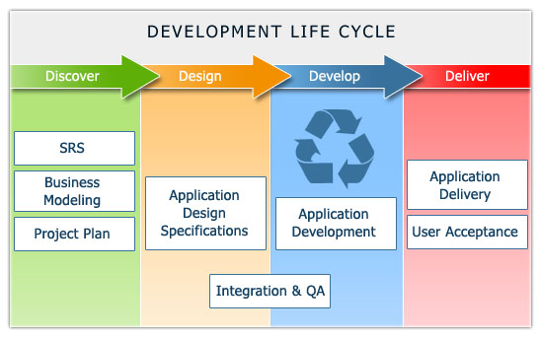
METHODOLOGY

Slide 5
PROJECT MILESTONES
Inception Report
First 15 days
Confirmation of user requirements and securing a common vision
Interim Report
1.5 months
System Development Progress
Major stakeholder review of progress
Final Report
3 months
Final review
Planning for deployment

Slide 6
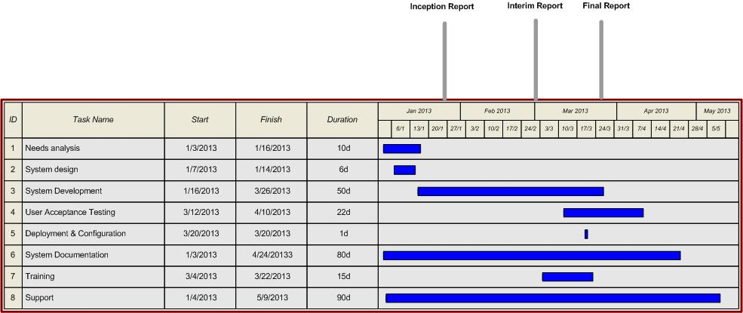
GANTT CHART

Slide 7
REQUIRED FACILITIES
Work stations for 5 team members, 2 permanent
Internet connectivity
Access to key stakeholders & information
Web Services for existing systems (Critical for seamless integration)

Slide 8
TOOLS
Tools are as follows:
mySQL Enterprise – Database
PHP – Source Code
Symfony – Modular Development/Secure Portal
SOAP Web Service Implementation
Twig User Interface Development
Adobe CS5 – Graphics
Microsoft Office & Visio – System Documentation
OpenERP – Project Management Module

