Slide 1
Tausi
Spatial Analysis – Removing ineligible areas from the area of interest
September 2025
Arjanne Immens / Karin Viergever
Geomatics NBS

Slide 2
Request: Spatial assessment on project areas
Review ineligible areas based on the following criteria:
Organic Soils & Water Bodies
Identify and exclude areas with organic soils, wetlands, and tidal wetlands.
Forest Cover History
Exclude areas with continuous non-forest cover over the past 10 years.
Deforestation
Remove areas that have experienced deforestation within the last 10 years.
Infrastructure
Exclude areas intersecting with buildings and roads.

Slide 3
Summary of Analysis
This assessment provides an overview of key spatial and environmental characteristics within the project area, based on available open-source datasets and visual validation. The following elements were reviewed:
Forest Cover & Change
Using Hansen Global Forest Change data (2015–2024), with notes on limitations in tropical dry forests.
Land Cover & Water Bodies
Reviewed datasets: Copernicus, Dynamic World, MODIS, Open Street Map and JRC Global Surface Water.
Protected Areas
Ramsar Wetlands dataset reviewed.
Built-up Areas
Dynamic World data, satellite imagery or OSM buildings.
Roads
Reviewed dataset: OSM roads.
Data Gaps
Organic soils and wetland eligibility not assessed due to lack of suitable data

Slide 4
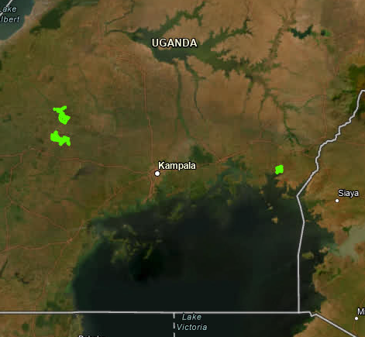
Summary in hectares
The total area includes:
3 project areas
848 small polygons
Total area: approximately ~8,925 ha (calculated using ArcGIS)
Excluded from the project area:
Intersections with OpenStreetMap (OSM) data
Intersections with Built in dynamic world
Potential exclusions from the project area:
Continuously non-forest areas(based on Hansen Forest Loss 2015–2024): ~126 ha
New project area:

Slide 5
Conclusion
This analysis is based on global open-source datasets with varying spatial resolutions and update frequencies. While these datasets are valuable for initial screening, a more detailed and accurate assessment would require higher-resolution imagery. The chloris data in house is just partly covering the area of interest and therefor not used.
Based on the analysis, the following observations and recommendations are made:
Organic soils and wetland eligibility have not been assessed due to the lack of suitable data for the region.
Intersections with roads, buildings, and waterways (based on OpenStreetMap) are minimal, collectively covering only a small fraction of the total area. These areas have been excluded from the project area.
Dynamic World identifies approximately ~100 ha as built-up. However, these classifications are not consistently confirmed by satellite imagery or OpenStreetMap data. These areas are currently extracted from the project area.
The use of Hansen Global Forest Change data in this context is uncertain, as the dataset has known limitations in detecting forest dynamics in dry tropical regions such as the area of interest. The interpretation should be used with caution. 126 ha is identified as continuously non-forest. After QC it is clear the data quality is not suitable for the analysis over this project area. These these continuous non forest pixels are not excluded from the project area.

Slide 6
Analysis per data type

Slide 7
Tidal wetland mapping (ineligibility criteria)
We found only overlap with 2 features in the OSM data related to water. No overlap between the areas of interest and any mapped water bodies or wetlands across the reviewed datasets with the landcover, protected areas and JNR data.
However, these datasets typically have a spatial resolution of 30 to 100 meters, which may miss smaller features such as narrow streams, seasonal wetlands, or locally significant water bodies.
Data used to review wetland mapping:
Landcover datasets:
Copernicus, Dynamic World, Modis: No water or flooded vegetation
Water
JRC Global Surface Water: No Water areas
Protected areas
Ramsar Wetlands: No Ramsar sites
Open Street map
Waterways

Slide 8
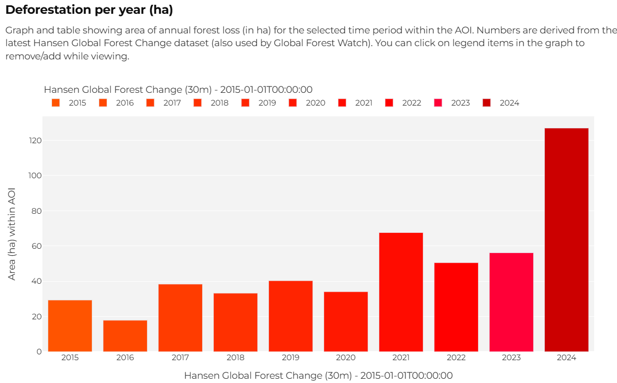
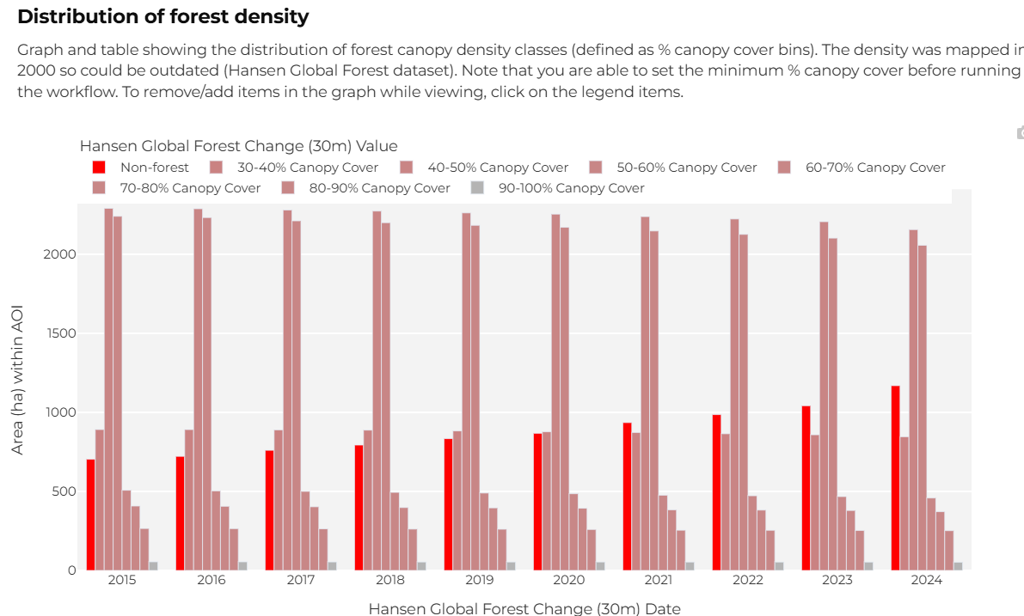
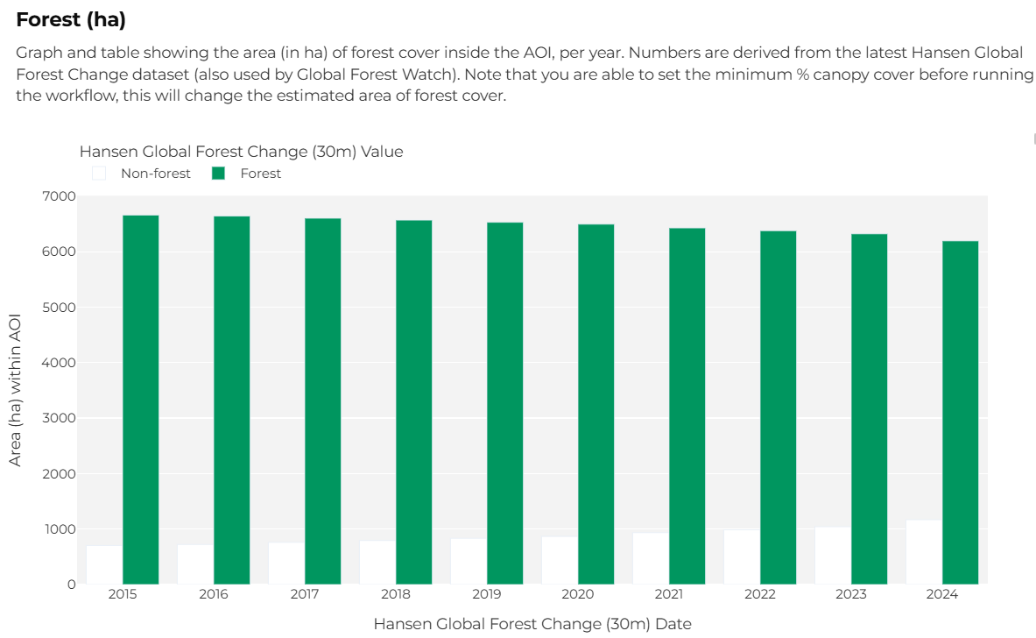
Forest over past 10 years (Hansen)
Based on Hansen Global Forest Change data:
Over the past 10 years, the forest cover in the area has declined from 90% to 84% in 2024.
Dataset limitations in Uganda:
Less accurate in dry forests and agroforestry landscapes
May underestimate forest cover in mosaic or community-managed areas
Use Hansen data with caution. Higher-resolution data from Chloris is available, but only partially covers the area and was therefore not used in this analysis.

Slide 9
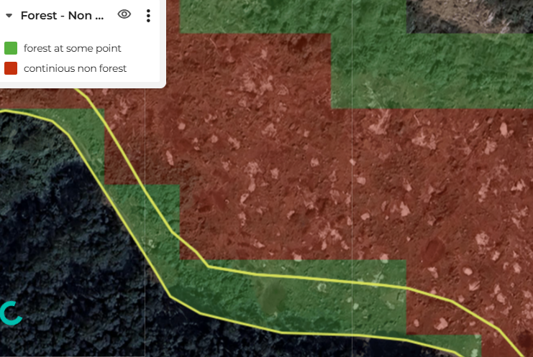
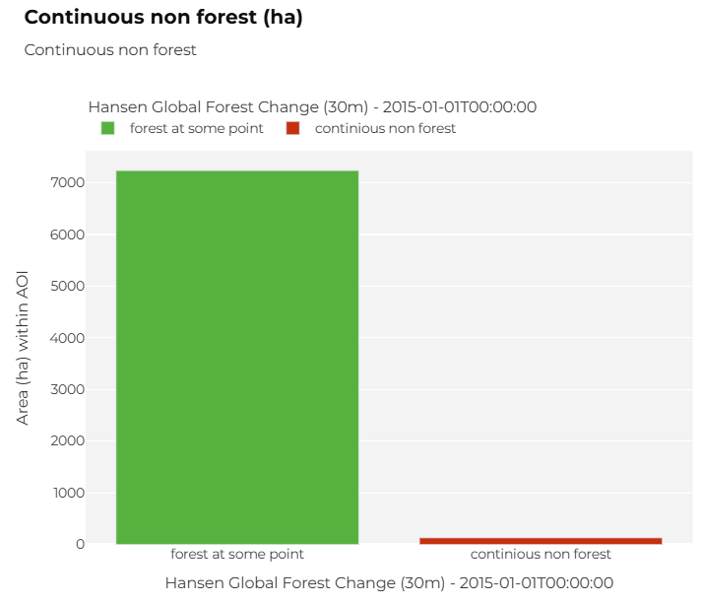
Continuous non-forest over past 10 years (Hansen)
By combining Hansen Global Forest Change data from 2015 to 2024 and applying a mask to retain only pixels classified as non-forest, a total of 126 ha were identified as continuously non-forest throughout the period. This is ~1,5% of the total area.
However, it’s important to note that the Hansen dataset has a 30-meter spatial resolution and known limitations in tropical dry forest regions, such as those found in Uganda. Therefore, results should be interpreted with caution.
The continuous non-forest areas can be excluded from the area of interest if needed.

Slide 10
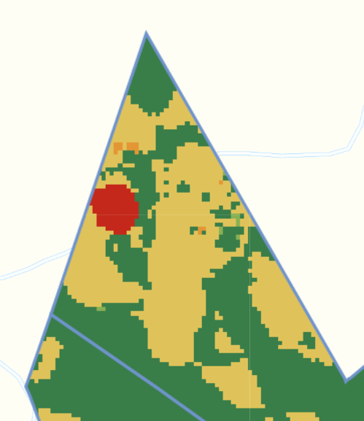
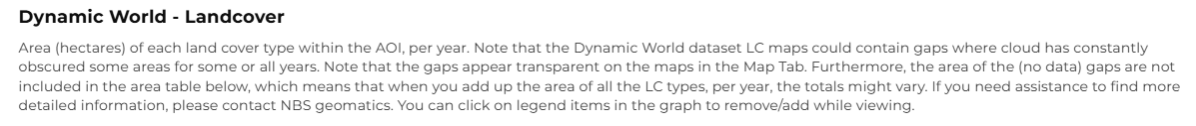
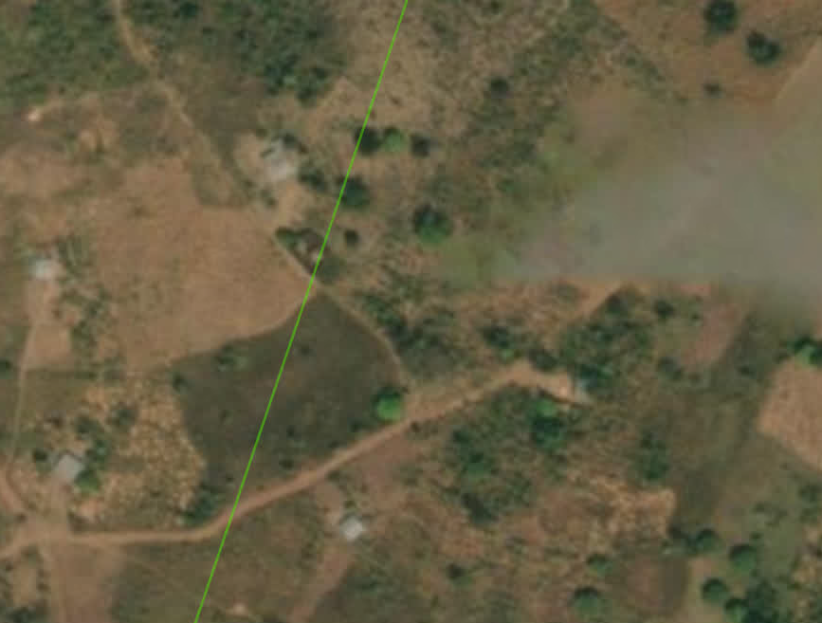
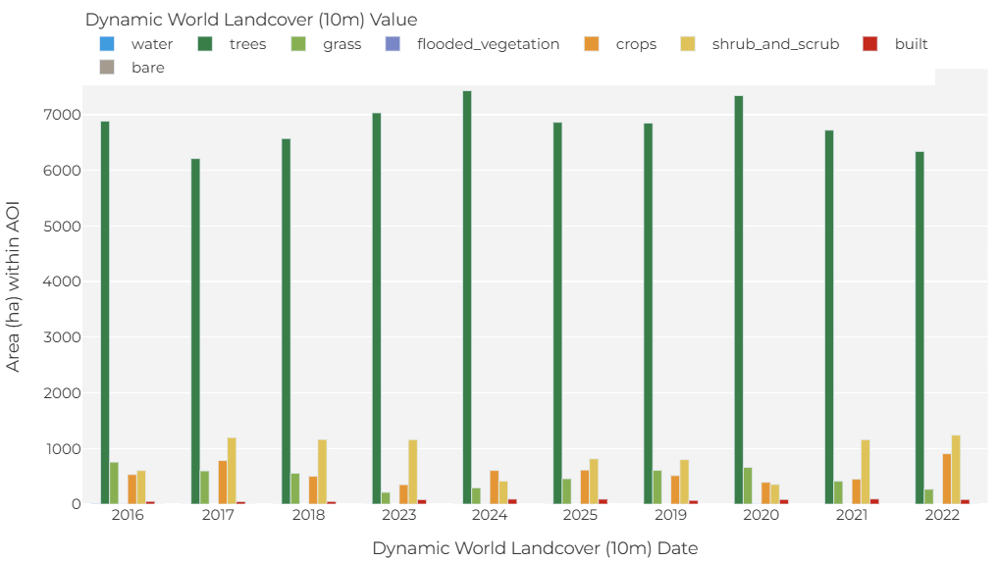
Landcover (Dynamic World)
According to Dynamic World approximately ~100 ha has been classified as built-up 2025, according to Dynamic World data. Dynamic World has a spatial resolution of 10 meters and provides near real-time land cover classification. However, it may not reliably detect small or low-density built-up features, especially in rural or mixed-use landscapes. Over visual check with OSM and satellite data, it can be concluded these areas are mixed human activities. These areas can be excluded from the area of interest if needed.

Slide 11
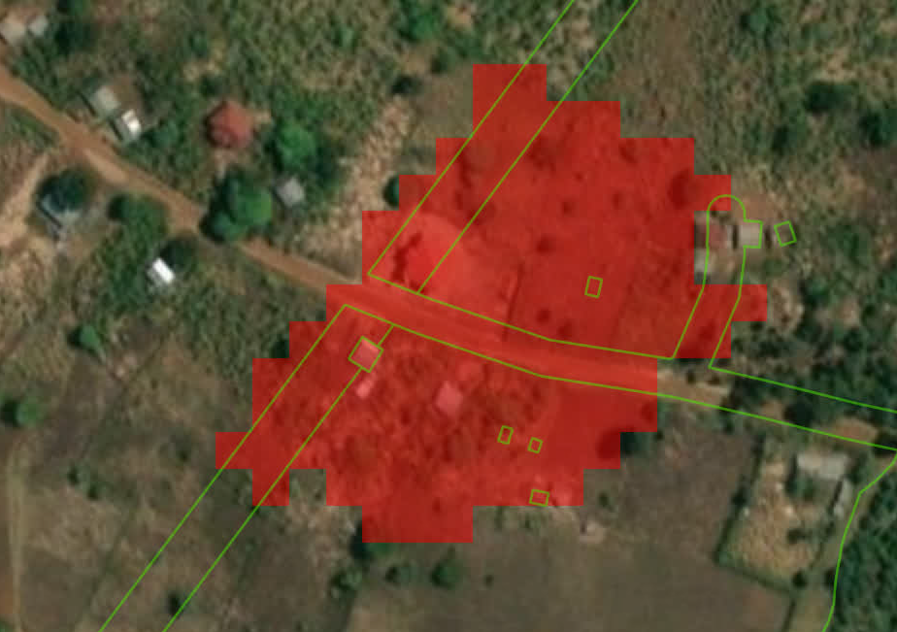
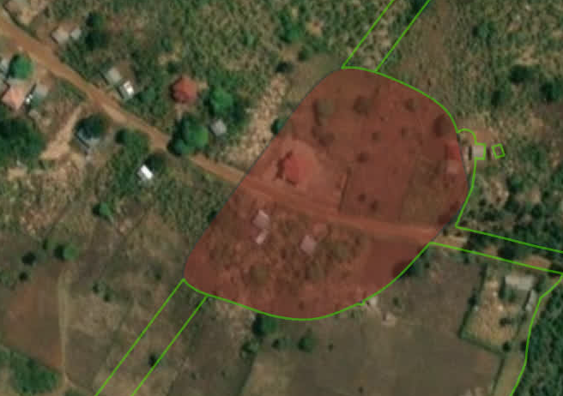
Excluding Built-Up Areas (Dynamic World) from the Project Area
To refine the analysis and exclude built-up areas from the project zone, the following steps were taken:
Extracted Built-Up Pixels
Using the Dynamic World dataset, only pixels classified as built-up were selected.
Applied Focal Statistics
A focal filter was used to remove isolated pixels, ensuring spatial coherence.
Converted to Polygons
The filtered raster was transformed into vector polygons for further processing.
Smoothed Polygon Boundaries
A smoothing algorithm was applied to reduce jagged edges and improve shape quality.
Removed Small Areas (< 0.04 ha)
Small, scattered polygons were excluded to eliminate likely misclassifications.
Clipped to Project Area
The cleaned built-up polygons were subtracted from the project boundary.
Result:
A total of ~100 ha of built-up land was excluded from the project area.
Built pixels in Dynamic world
Result polygon removed from project area

Slide 12
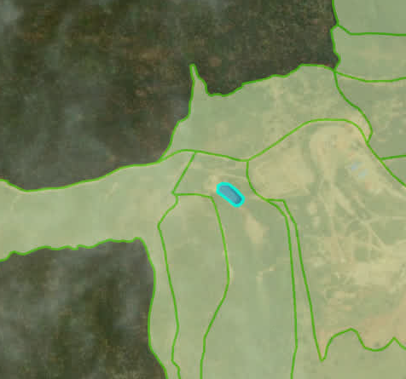
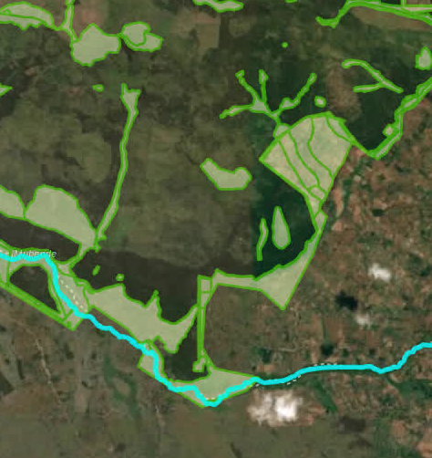
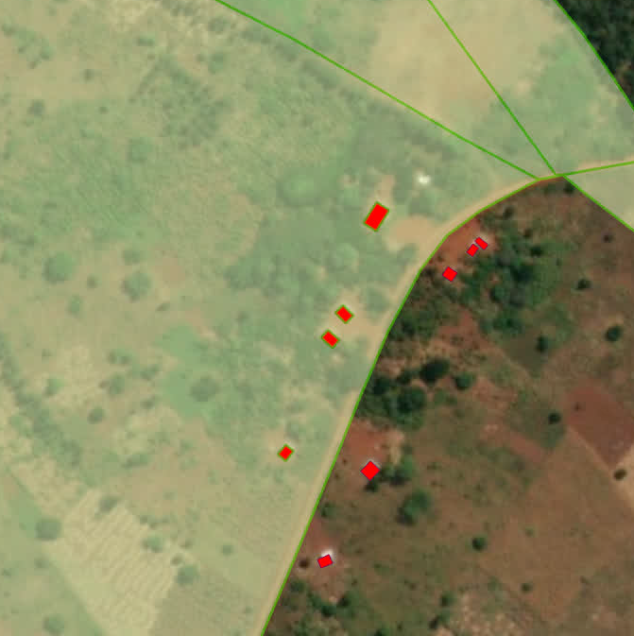
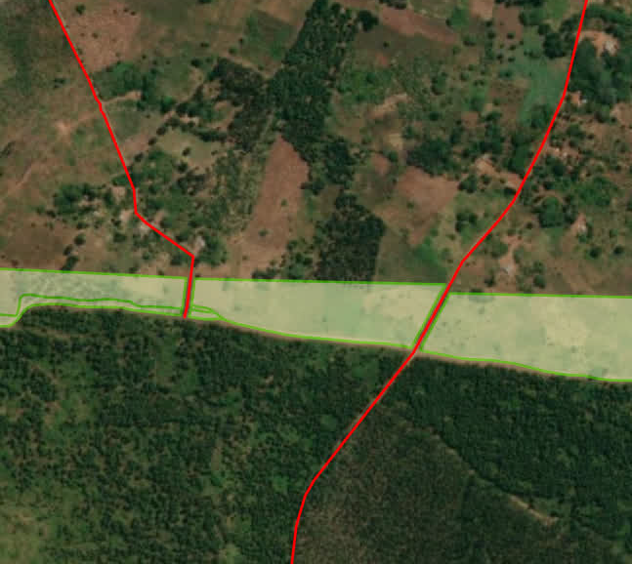
Intersection with OSM data
OpenStreetMap (OSM) data is crowd-sourced and its accuracy varies depending on local contributor activity. It is generally reliable in urban and densely populated areas, but coverage in rural or remote regions may be incomplete or outdated.
Intersections with buildings:
A total of 382 buildings from OpenStreetMap intersect with the project area.
Combined, these buildings cover less than 2 hectares.
Visual checks using satellite imagery confirm the presence of these buildings.
Intersections with roads:
Out of 848 polygons, approximately 270 intersect with roads, based on a 5-meter buffer analysis.
Most of these intersecting areas have already been excluded from the project area.
Satellite imagery confirms the presence of these roads on the ground.
Intersections with lakes and rivers
1 lake (less than 0.5 ha) intersects with 1 polygon.
1 river, buffered at 5 meters, intersects with 1 polygon.

Slide 13
Organic soils
Potential ineligibility criteria related to organic soils were not reviewed, as suitable data for the project area was not available.
Further analysis may be required using specialized soil and hydrological datasets to assess these features accurately.

