Slide 1

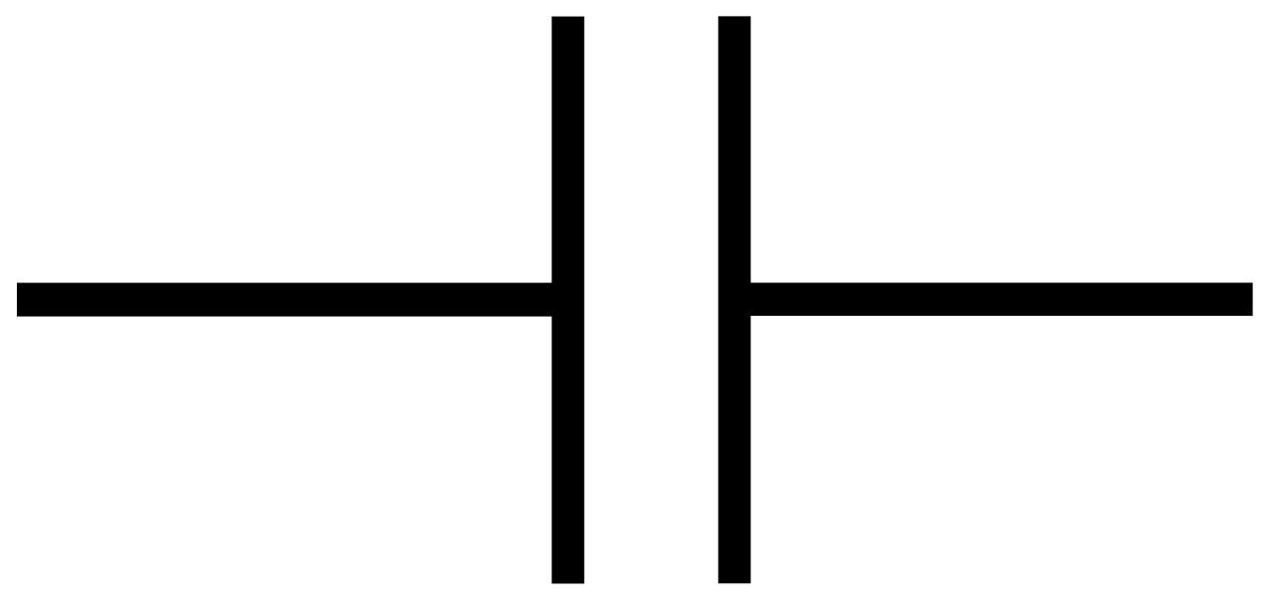
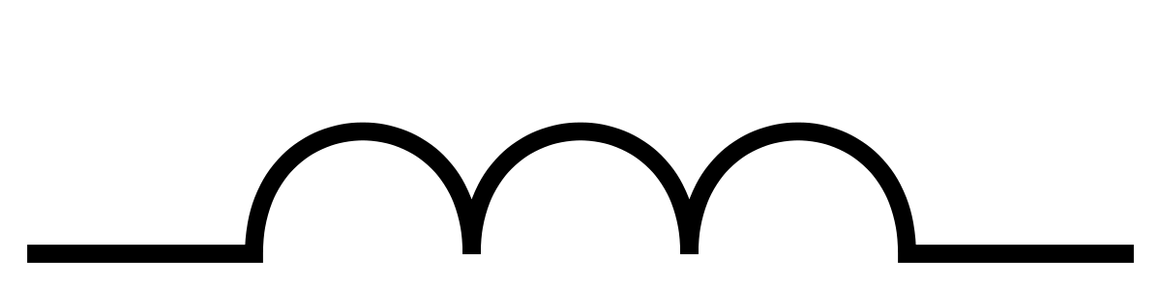
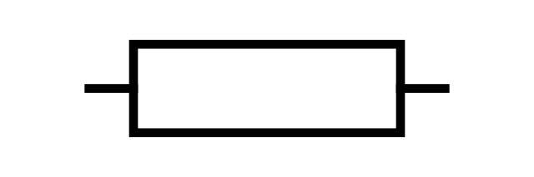

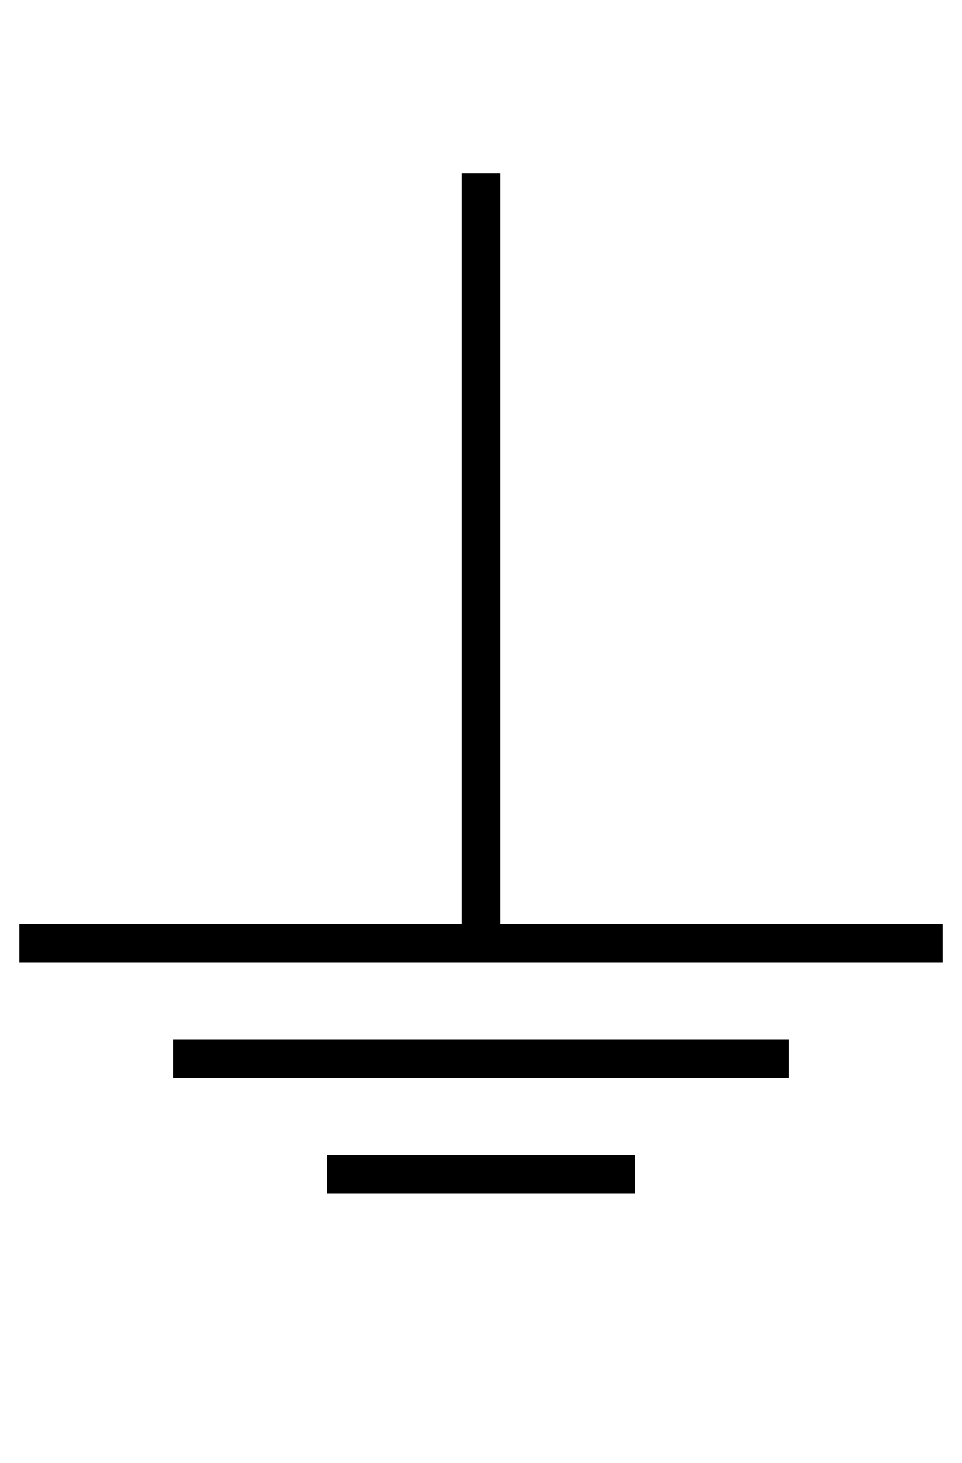

Slide 2
inductor
Oscilloscope
Channel 2
Oscilloscope
Channel 1
generator
RL
L
Rg
Co
Co
R
C
Ro
Ro

Slide 3
Oscilloscope
Channel 2
Oscilloscope
Channel 1
generator
L
Rg
Co
Co
R
C
Ro
Ro

Slide 4
Oscilloscope
Channel 2
Oscilloscope
Channel 1
generator
L
RL
Rg
Co
Co
R
C
Ro
Ro

Slide 5
L
Rg
Co
Co
R
C
Ro
Ro

Slide 6
L
Oscilloscope
Channel 2
Oscilloscope
Channel 1
R
C
generator

Slide 7
L
Oscilloscope
Channel 2
Oscilloscope
Channel 1
R1
C
generator

