Slide 1

Predicting High-Traffic Recipes for the Homepage
Data-Driven Insights & Recommendations
Presented by: Gabriele Vertullo

Slide 2
The Business Need: Driving Traffic with Recipes
The Challenge
Our Goal
Current Situation: Homepage recipes are selected manually.
The Opportunity: Popular recipes significantly boost site traffic (up to +40%) and are key to driving subscriptions.
The Problem: Manual selection can be inconsistent and might miss opportunities to feature high-potential recipes
Objective: Develop a data-driven model to predict which recipes will generate high traffic when featured.
Key Business Targets:
Find the Hits: Correctly identify at least 80% of actual high-traffic recipes (Recall ≥ 80%).
Minimize Misses: Among the recipes predicted as high-traffic, ensure as many as possible truly are popular (Maximize Precision).

Slide 3
Our Approach: From Data to Recommendation
Step 1: Data Preparation
Goal: Ensure data quality and consistency. | Actions: Validated recipe details, handled missing values (like nutritional info), standardized categories, and cleaned 'servings' data.
Step 2: Exploration (EDA)
Goal: Understand the data's characteristics visually. | Actions: Analyzed distributions (like calories) and explored relationships between features (like category counts, nutrition vs. traffic).
Step 3: Modeling
Goal: Build models to predict high-traffic recipes. | Actions: Developed and trained two types of models (Logistic Regression and Random Forest) using the cleaned data.
Step 4: Evaluation
Goal: Select the best model based on business needs. | Actions: Measured how well each model met the target of finding ≥ 80% of popular recipes (Recall) and how accurate those predictions were (Precision). Fine-tuned the best model.
Step 5: Recommendations
Goal: Provide actionable next steps. | Actions: Based on the best model's performance, outlined steps for deployment, monitoring, and future improvements.

Slide 4
Getting the Data Ready Why is this important? Reliable predictions start with reliable data. We needed to ensure the recipe information was accurate and consistent.
Key Cleaning Steps:
Handled Missing Nutrition:
Filled in missing nutritional info (calories, protein, etc.) for 52 recipes using typical values (medians) based on their category.
Ensures all recipes have complete nutritional data.
Standardized Categories:
Grouped similar categories together (e.g., "Chicken Breast" → "Chicken").
Ensures consistency for analysis.
Fixed 'Servings’:
Corrected or removed entries with unclear serving sizes (like "4 as a snack" - 3 recipes removed).
Ensures 'servings' is a usable number.
Interpreted Traffic Data:
Assumed recipes not marked "High" traffic were "Low" (handled 372 missing labels).
Creates a clear target for prediction (High vs. Low).

Slide 5
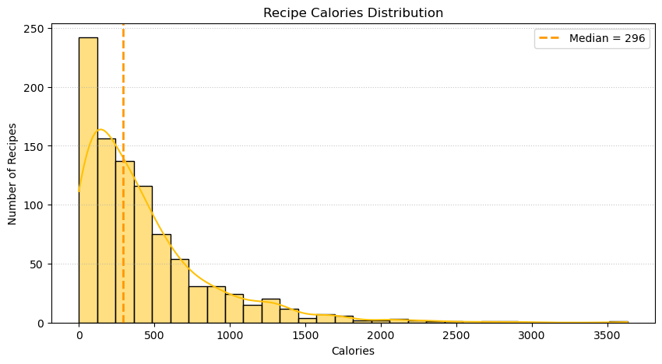
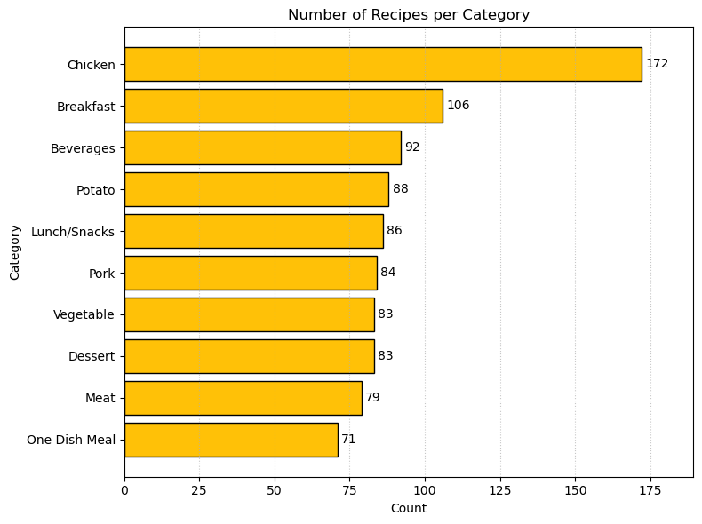
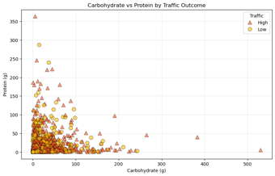
What the Data Tells Us (Key Insights)
Nutritional Profile: Most recipes have moderate calorie counts, though some outliers are very high.
Recipe Categories: Wide variety of categories represented. Chicken, Breakfast, and Beverages are the most frequent types in our data.
No Single Nutrient Predicts Traffic: Neither carbohydrates nor protein clearly distinguish high-traffic recipes from low-traffic ones.

Slide 6
Finding the Best Predictive Model Our Goal: Find a model that reliably identifies high-traffic recipes (Recall ≥ 80%) while being accurate (High Precision)
Models Tested:
Logistic Regression: A standard, interpretable model (our baseline).
Random Forest: A more complex model capable of finding intricate patterns.
Conclusion:
Logistic Regression is the clear winner.
It successfully met the crucial 80% Recall target.
It also had higher Precision, meaning fewer incorrect predictions of high traffic.
How They Performed (default settings):
Model | Recall (Target ≥ 80%) | Precision (Higher is Better) | Overall Performance (AUC)
Logistic Regression | 80.0% | 80.7% | 0.843 (Good)
Random Forest | 70.4% | 76.4% | 0.779 (Okay)
(Recall = % of actual high-traffic recipes found; Precision = % of predicted high-traffic recipes that were correct)

Slide 7

Fine-Tuning the Model for Better Precision The Goal: We met the 80% Recall target with Logistic Regression. Can we also reduce the number of unpopular recipes shown (i.e., increase Precision) without falling below that 80% Recall?
The Action: Adjusting the Decision Point
Instead of the default 50/50 probability cutoff, we slightly adjusted the model's decision threshold.
We looked for the "sweet spot" that gave the highest Precision while keeping Recall at or above 80%.
The Results:
Threshold | Recall (Target ≥ 80%) | Precision (Higher is Better)
Default (0.500) | 80.0% | 80.7%
Optimized (0.520) | 80.0% | 82.9% (Improved!)
Key Message: By slightly adjusting the threshold to 0.520, we improved Precision (fewer unpopular recipes predicted as popular) while still successfully identifying 80% of the actual high-traffic recipes.

Slide 8
Measuring Success Going Forward
The Key Metric: Precision at 80% Recall
What it means:
We ensure we're finding at least 80% of the truly popular recipes (Recall).
At that level, we measure how many of the recipes we flag as popular actually are popular (Precision).
Why this metric?
It directly balances the goals of maximizing high-traffic recipe exposure while minimizing the promotion of unpopular ones.
Current Estimated Performance (Based on Test Data):
Recall: 80.0% (Meeting the target).
Precision: 82.9% (Our current baseline for accuracy when meeting the recall target).
How to Monitor:
Track Live Performance: Regularly calculate "Precision at 80% Recall" using data from recipes featured on the homepage after the model is deployed.
Compare: Compare live results against the 82.9% precision baseline.
Watch Trends: Monitor if performance changes over time (this could indicate a need for model retraining).
Business Impact: Correlate metric performance with overall site traffic and subscription rates.

Slide 9
Recommendations & Next Steps
Based on our analysis, we recommend the following steps to leverage these findings:
1. Deploy the Model:
Implement the Logistic Regression model into the homepage recipe selection process.
Benefit: Start making data-driven decisions immediately.
2. Use the Optimal Threshold:
Set the model's classification threshold to 0.520.
Benefit: Balances finding popular recipes (80% Recall) with improved accuracy (82.9% Precision).
3. Monitor Performance:
Track the key metric: "Precision at 80% Recall" using live data.
Also monitor overall site traffic and subscription impact.
Benefit: Ensures the model remains effective and demonstrates its value.
4. Future Enhancements:
Explore adding features like user ratings, prep time, or image analysis if data becomes available.
Benefit: Potential to further improve prediction accuracy over time.
5. A/B Test (Recommended):
Compare the model's performance directly against the current manual selection process.
Benefit: Quantifies the impact on engagement, traffic, and subscriptions.

Slide 10
Thank You
Questions?

