Slide 1
Scenario 1
Run Time and Design Time
Policy Editor: 2 entry points
Add new policy
Edit existing policy

Slide 2
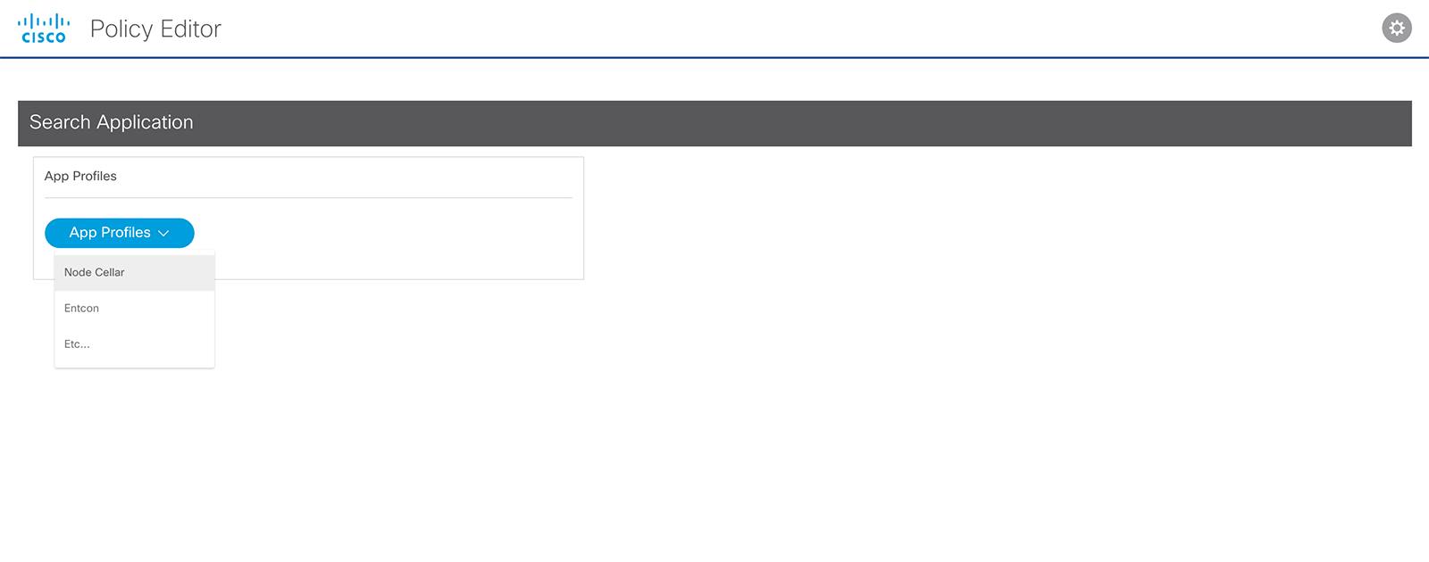
Scenario 1: Run Time – App Profiles Entry Point
Currently running
app profiles from
Data from: CNMPIR
Profile
Profile

Slide 3
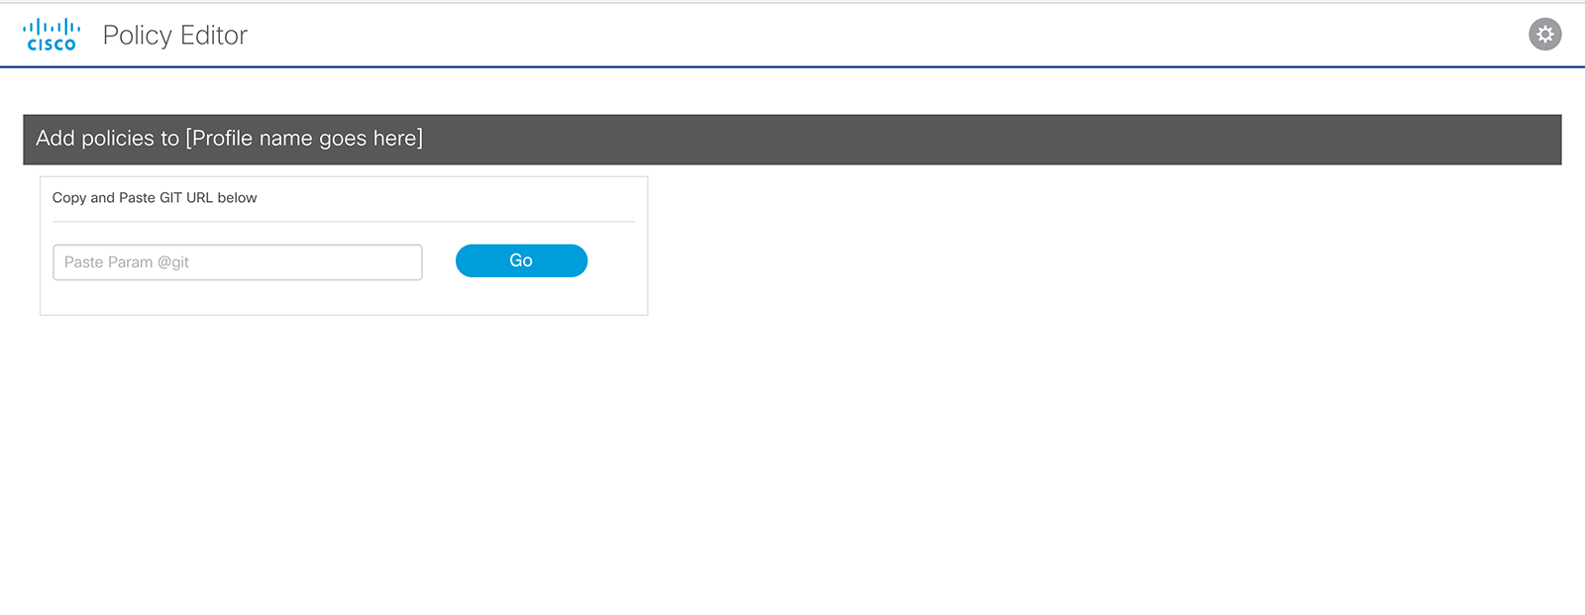
Scenario 1: Design Time – 2 Entry points layout / Alert for GIT URL field
If user enters GIT URL and there is no existing profile the will receive an alert
No profile found
No Profile Alert

Slide 4
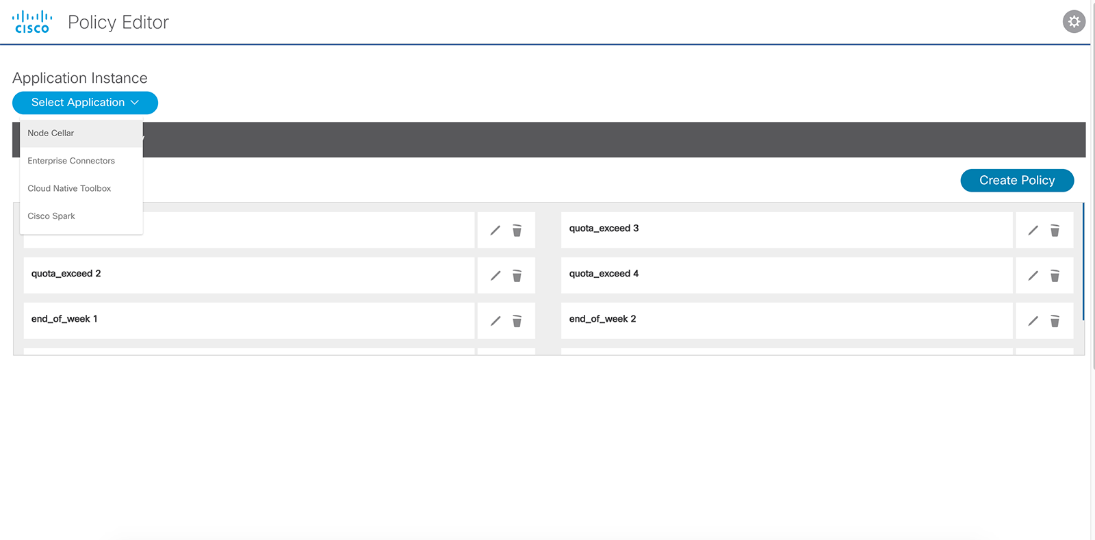
Scenario 1: Design Time - App Instance Dropdown - Node Cellar Selected
User selects from Application
they own from dropdown menu.
(Node Cellar is Selected). List of Profiles returns.

Slide 5
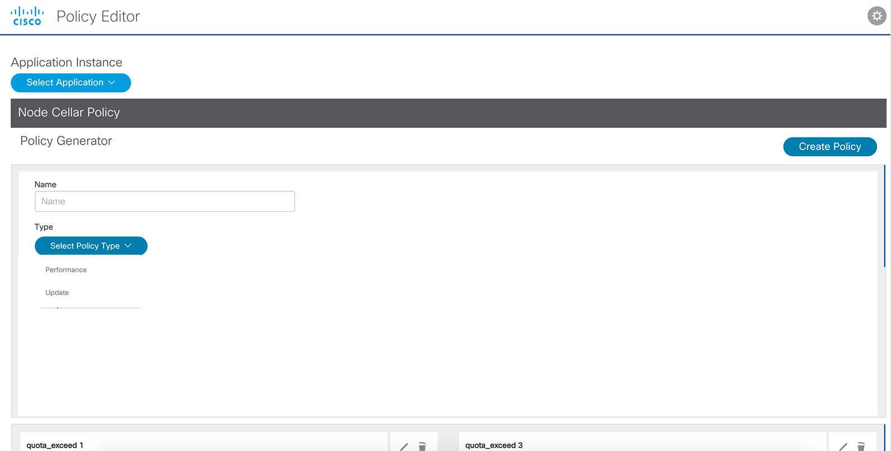
Scenario 1: Design Time – Select Policy type - Performance
User creates new policy
and form slides open.
When policy is created
to the Policy list
Policy form type dropdown
The user selects Performance Policy form
Form will populated based on type selected
Policy List

Slide 6
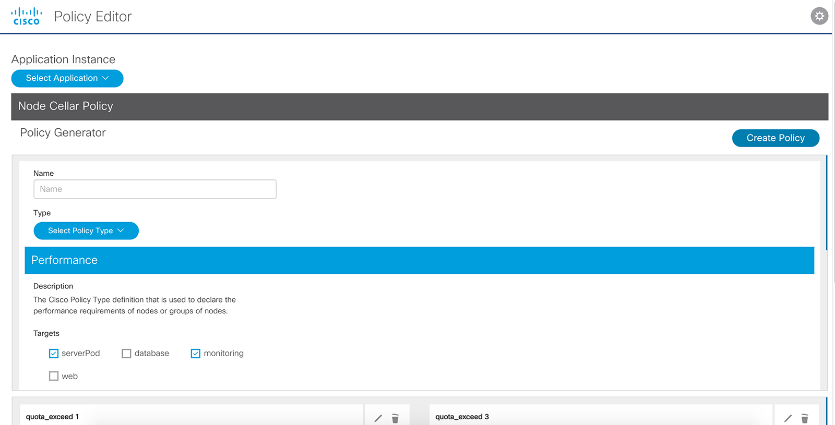
Scenario 1: Design Time - Create new policy
The user selects Performance Policy form
Form will populated based on type selected
Policy List

Slide 7
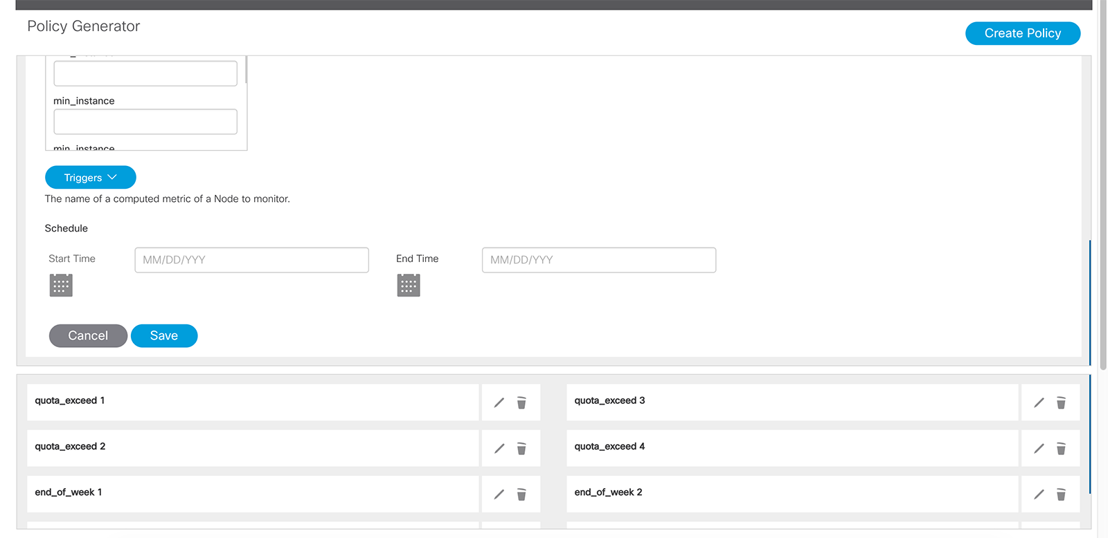
Scenario 1: Design Time – Save Policy
User fills out Policy form and Saves Policy
User can edit or remove existing Policy
New Policy is added to List of Policies

Slide 8
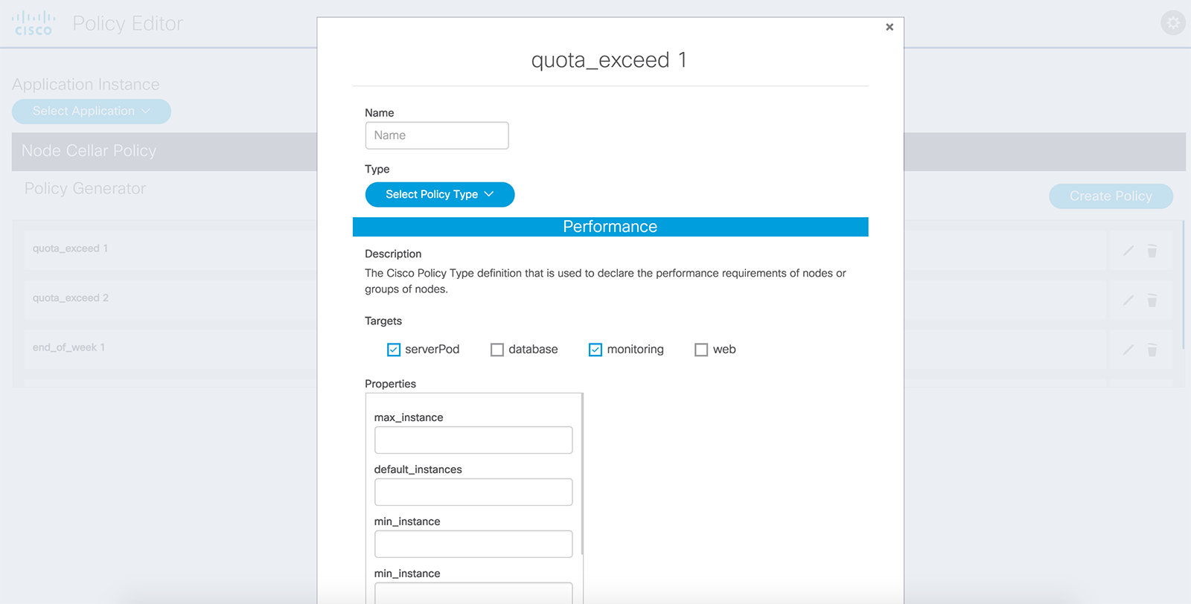
Scenario 1: Design Time – Edit Policy form modal window
Edit Policy icon was selected by user

Slide 9
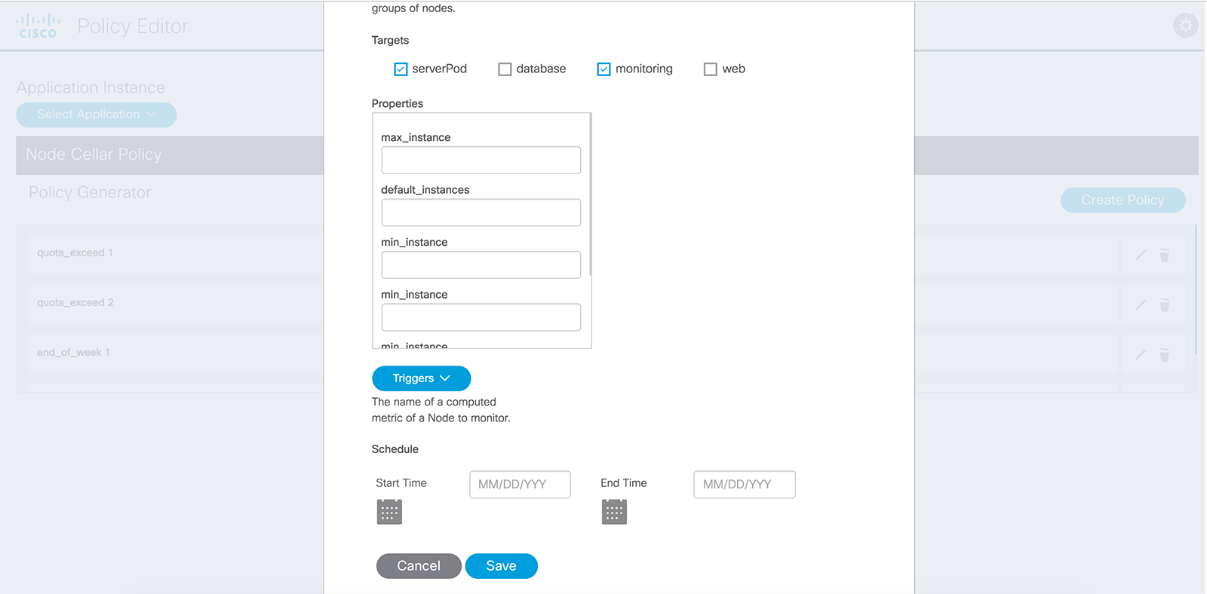
Scenario 1: Design Time – Edit existing policy
Policy was saved and updated to the
Policy list
Policy is saved and updated in the policy list

Slide 10
Scenario 2
Entry Point to add new policy to existing profile
Add new Design Time policy
Edit existing policy

Slide 11
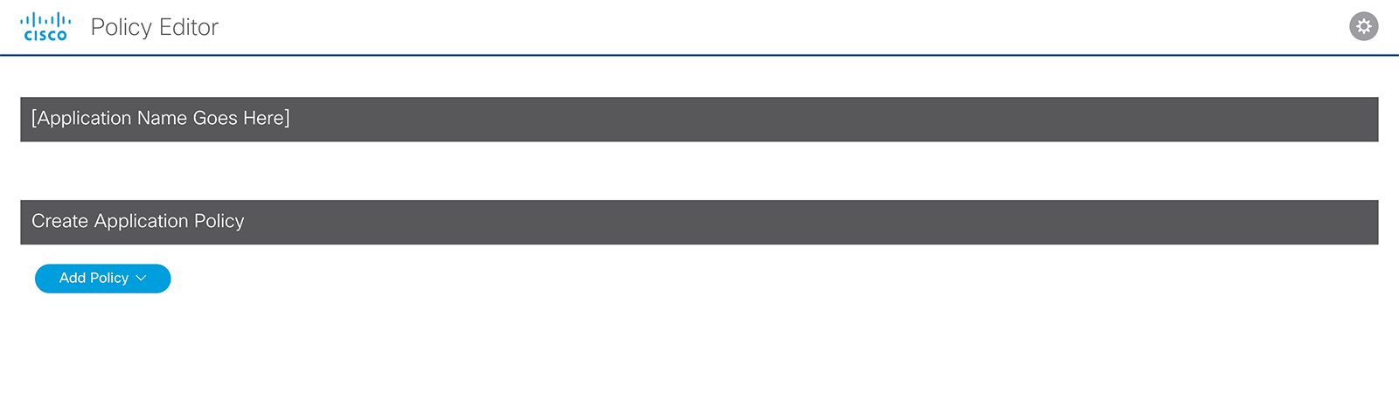
Scenario 2: Entry Point
Placeholder section for
Existing Application profile.
Add new policy and list to
Existing Application profile

Slide 12
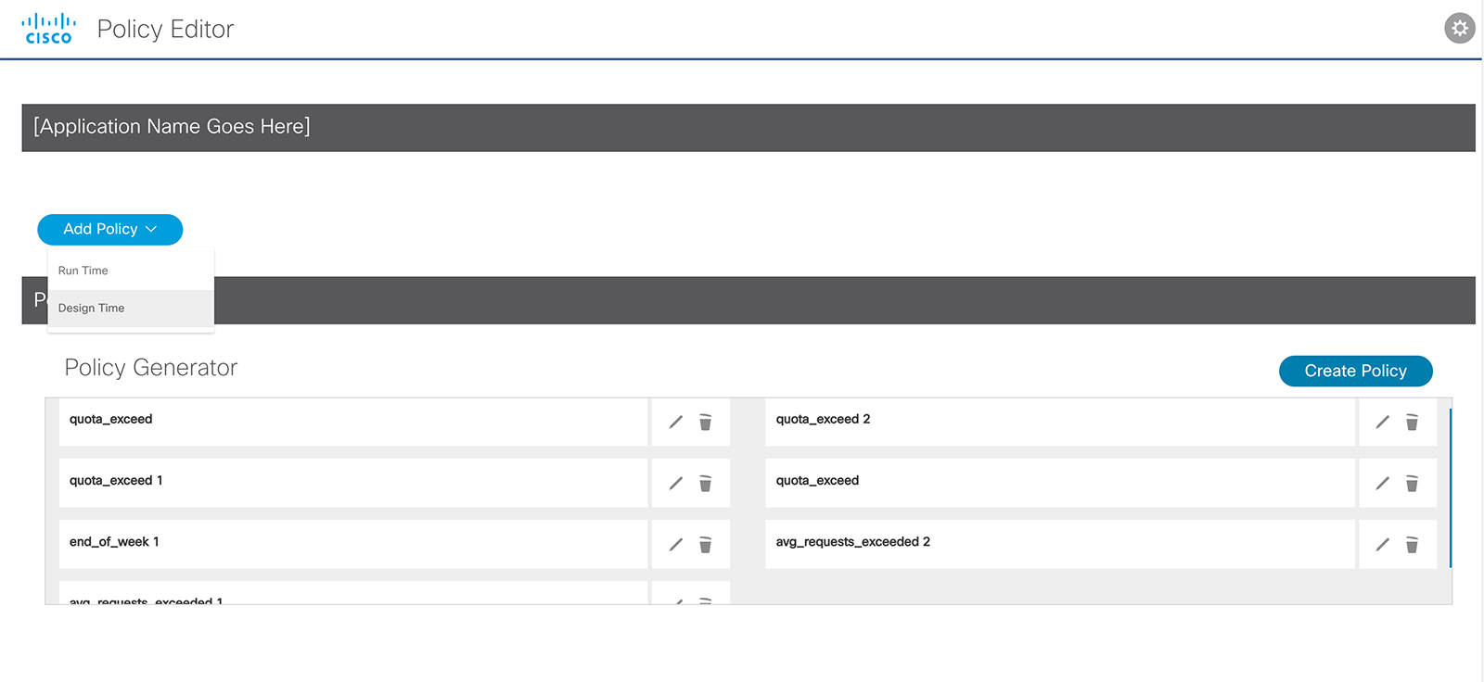
Scenario 2: Entry Point – Create Policy
Placeholder section for
Existing Application profile
User selects Design Time to add a policy to an
already existing list or to create a new
Policy and new list
User Selected Design Time.
Policy Form Generator Slides open
Then clicks on Create Policy button
List of existing policies

Slide 13
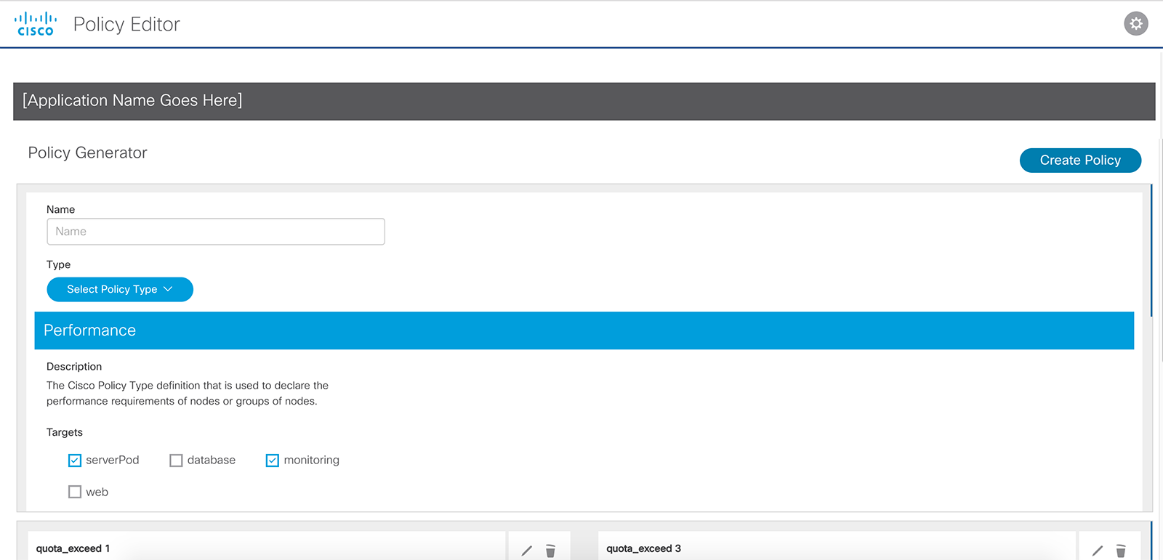
Scenario 2: Create policy form button and form slides open
User can create a new policy by clicking
Create Policy button.
Create Policy button opens slide down window containing new Policy form
User selects Performance Policy
Form populates based on type selected

Slide 14
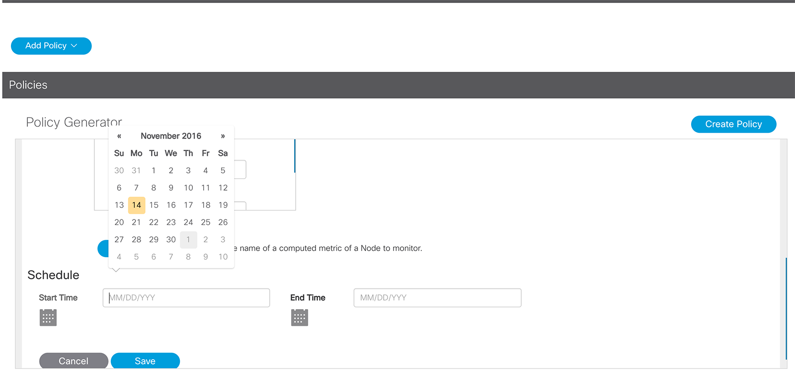
Scenario 2: Policy saved
User saves Policy and the
new Policy is added to the
Policy list in the next slide

Slide 15
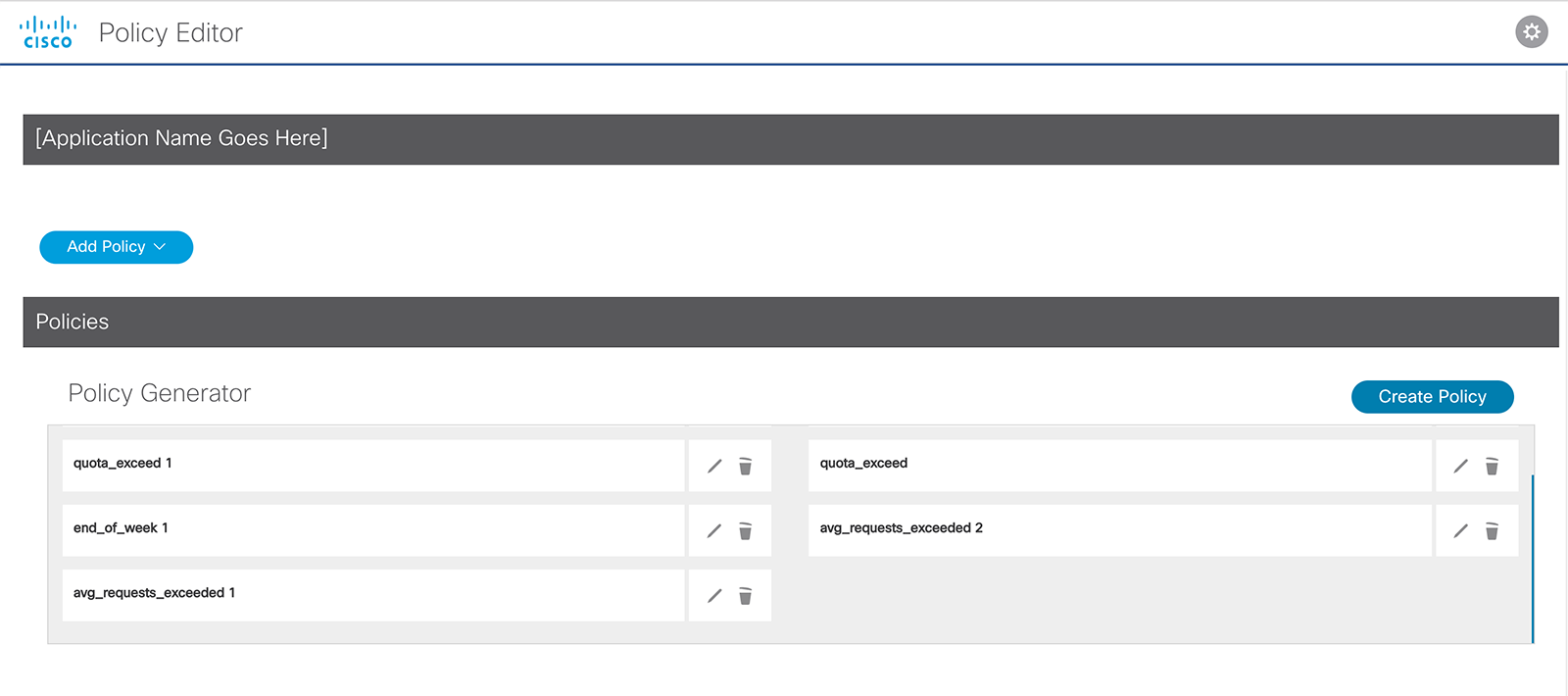
Scenario 2: Policy has been saved and added to list of Policies
New Policy is added to the list

Slide 16
Scenario 2: Policy Edit form – modal window
Edit form for Existing Application profile policy
Opens in modal window when
Edit icon in Policy list was selected

Slide 17
Scenario 1: Design Time – Edit existing policy
Policy was saved and updated to the
Policy list
Policy is saved and updated in the policy list

Slide 18
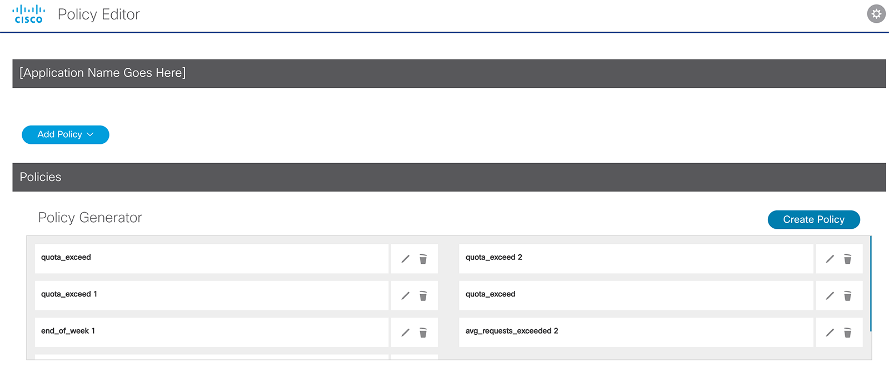
Scenario 2: Policy has been saved and added to list of policies
Edited Existing Application profile form was
saved and updated in the policy list

