Slide 1
Mobile View
Design Time
App
App
Alien 4 Cloud
Policy Editor
PIR
Runtime
Login to App
Policy Editor
PIR

Slide 2
Runtime - Mobile View
Edit existing policy

Slide 3
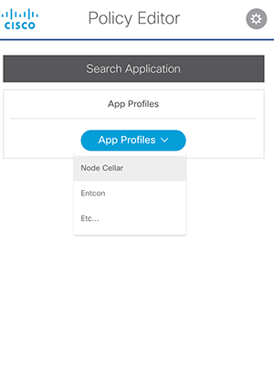
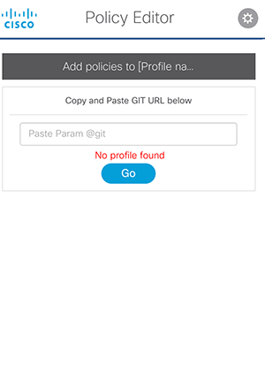
Runtime: App Profile entry point
Currently running
app profiles from
Data from: CNMPIR
If user enters GIT URL and there is no existing profile the will receive an alert
Profile

Slide 4
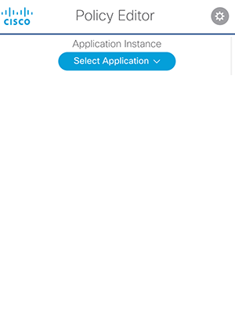
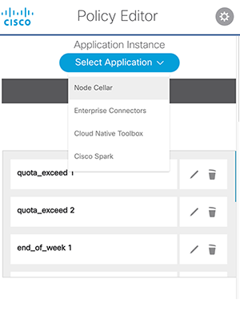
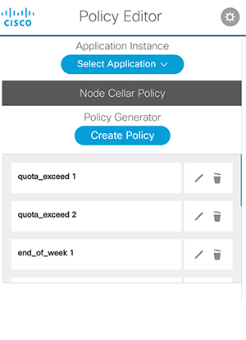
Runtime: App Instance Dropdown - Node Cellar Selected
User creates new policy
and form slides open.
When policy is saved it is added to the
Policy list
User selects from Application they own from dropdown menu.
(Node Cellar is Selected). List of Profiles returns.

Slide 5
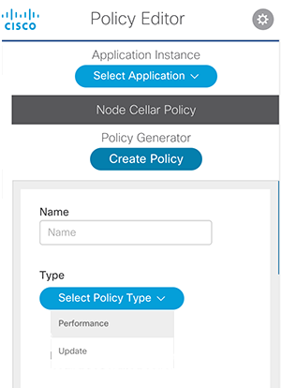
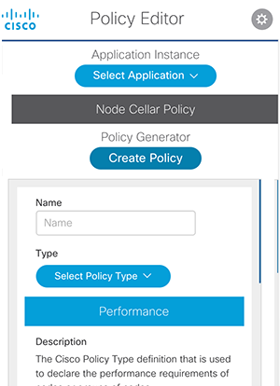
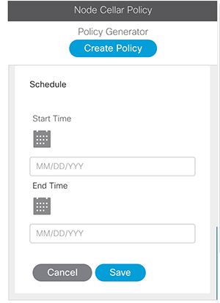
Runtime: Create new policy
User selects type and form populates based on selected for type
Form is scrollable inside window
Performance policy type is selected.
User fills out form and saves policy. Policy is added to list.
Performance label is highlighted and form is populated

Slide 6
Design Time - Mobile View
Entry Point to add new policy to existing profile
Add new Design Time policy
Edit existing policy

Slide 7
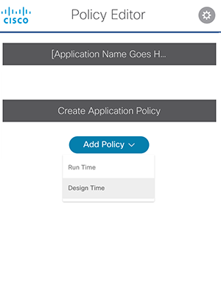
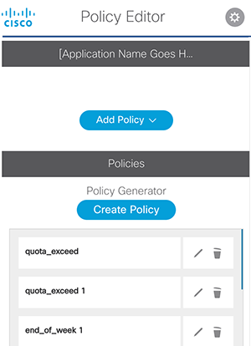
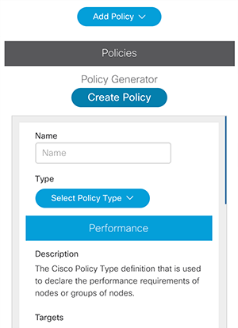
Design time: Entry Point
Edit and Remove
options for existing Policies
Placeholder section for
Existing Application profile.
Performance policy type is selected.
Add new policy and list to
Existing Application profile
User can create a new policy by clicking Create Policy button.
Create Policy button opens slide down window containing new Policy form
Performance label is highlighted and form is populated
User selects Design Time to add a policy to an
already existing list or to create a new
Policy and new list

Slide 8
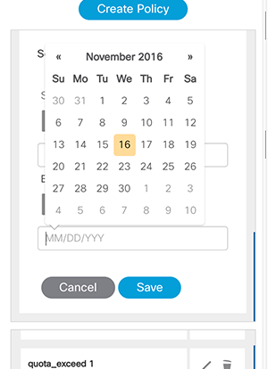
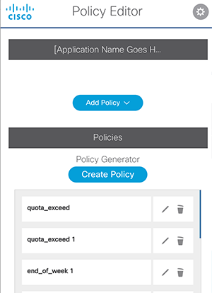
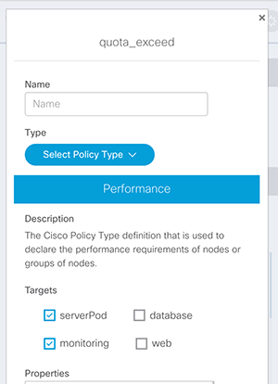
Design time : Form and list
Edit icons. Edit icon opens to modal view with policy form for editing
Policy form for editing
in modal view. When policy is save it will be updated to policy list.
User fills out form and saves policy. Policy is added to list.

