Slide 1
Implicit Uncertainty Visualization: Aligning Perception and Statistics
Michael Correll
Michael Gleicher
Notes:
TODO:
Include “mini charts” on graph slide.
Potentially move graph slides to the end as the punchline.
Use different graph for error bars paper.
Include payoff slide per example?
Replace Wickham example with Cook example
Include some citations for scale slide
Emphasize decision-making
Choose different redundant encoding

Slide 2

Implicit Uncertainty Visualization: Aligning Perception and Statistics
Michael Correll
Michael Gleicher

Slide 3

Implicit Uncertainty Visualization: Aligning Perception and Statistics
Michael Correll
Michael Gleicher

Slide 4
Implicit Uncertainty Visualization: Aligning Perception and Statistics
Michael Correll
Michael Gleicher

Slide 5
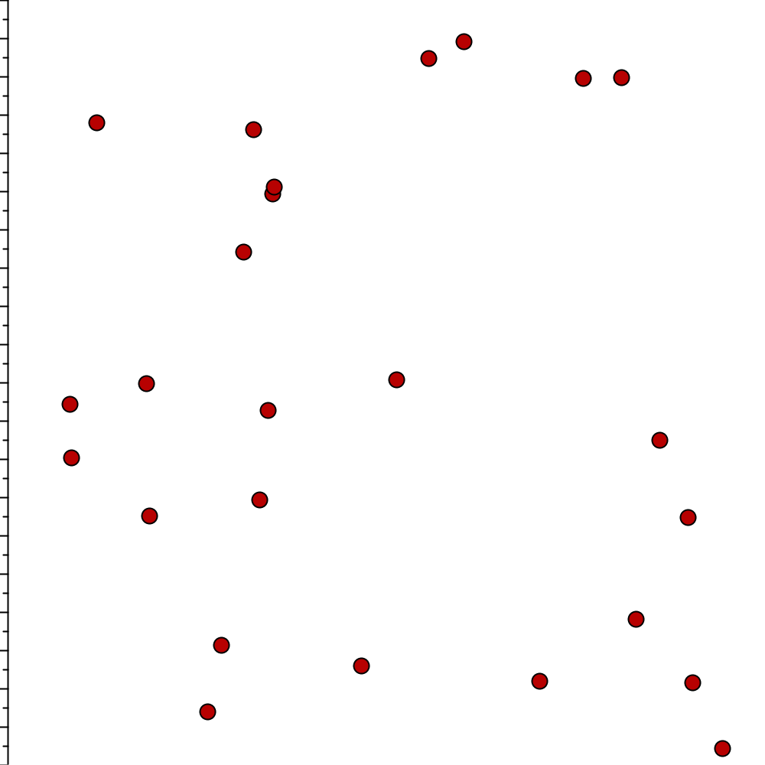
Implicit Uncertainty

Slide 6
Central Idea
If peoples’ estimates of uncertainty are good, then designers may not need to intervene.

Slide 7
Explicit Uncertainty Visualization

Slide 8
Data

Slide 9
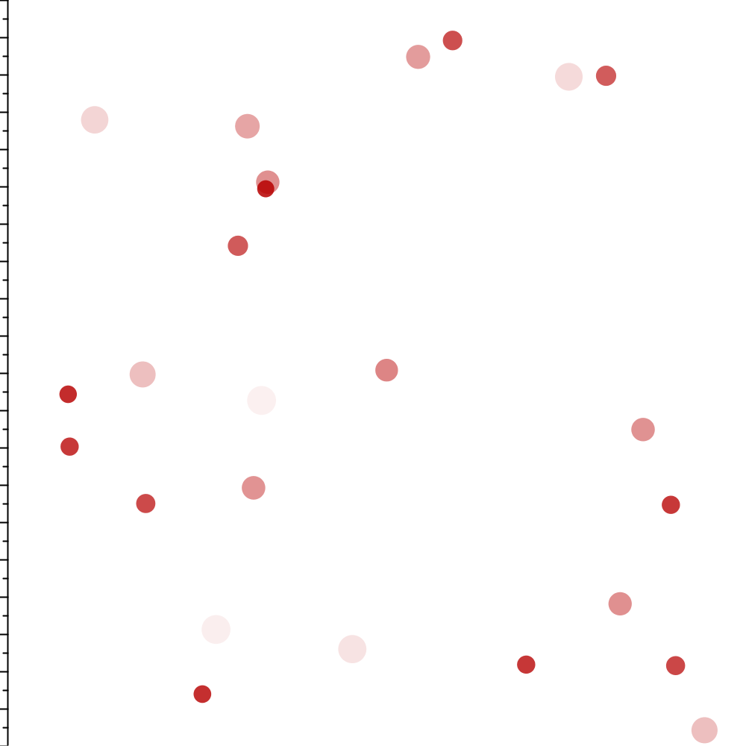
Data+Uncertainty

Slide 10
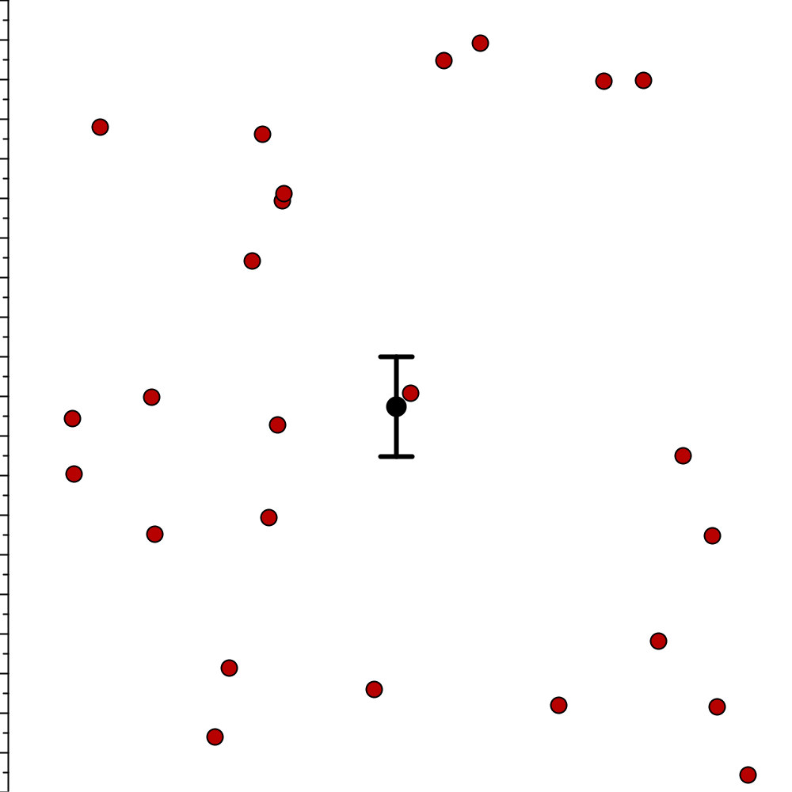
Data+Uncertainty Model

Slide 11
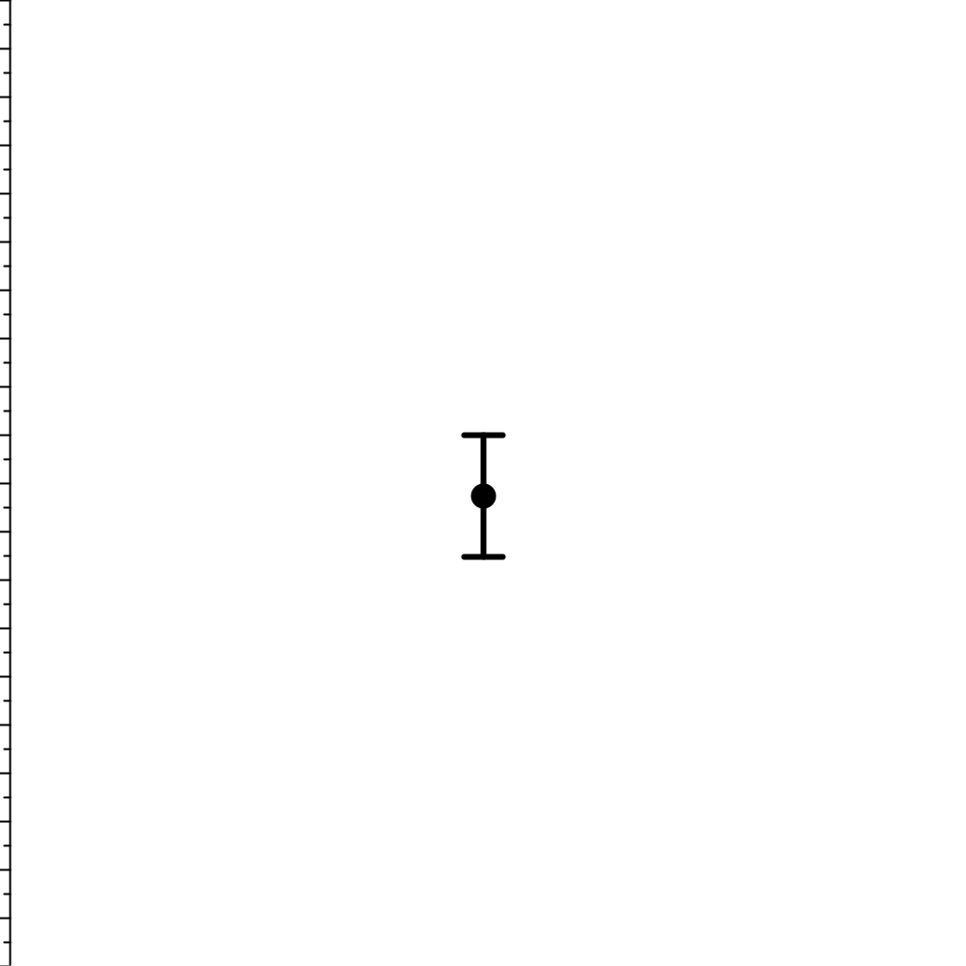
Model

Slide 12
Problems
What Variables?
What Model?

Slide 13

Wrong Model?

Slide 14
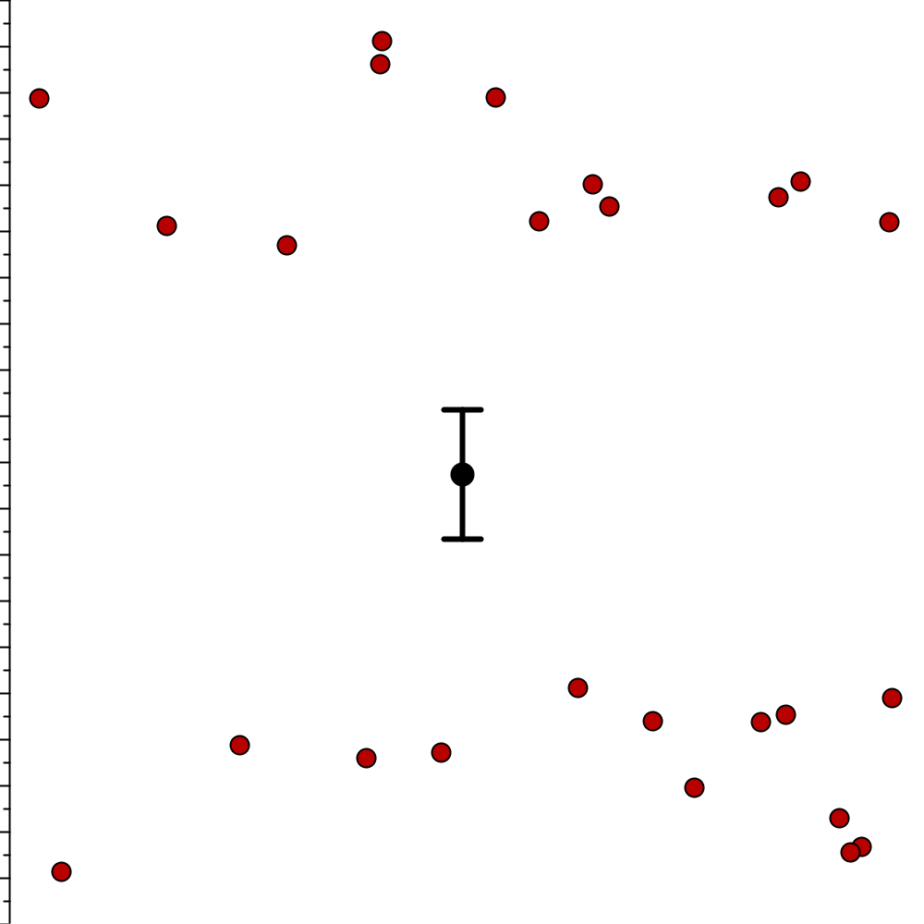
Wrong Model?

Slide 15
Implicit Uncertainty

Slide 16
Central Idea
Statistical models of uncertainty are difficult to make and use.
But perceptual uncertainty can align with statistical uncertainty.
If so, our implicit perception of uncertainty can stand in for the statistics.

Slide 17
Central Idea
If peoples’ estimates of uncertainty are good, then designers may not need to intervene.

Slide 18
Central Idea
If peoples’ estimates of uncertainty are good, then designers may not need to intervene.
Notes:
How good?
Compared to what?

Slide 19
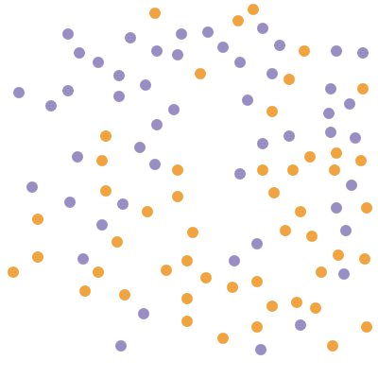
Which color is higher on average?
Gleicher, M., Correll, M., Nothelfer, C. and Franconeri, C. “Perception of Average Value in Multiclass Scatterplots.” VIS 2013.

Slide 20
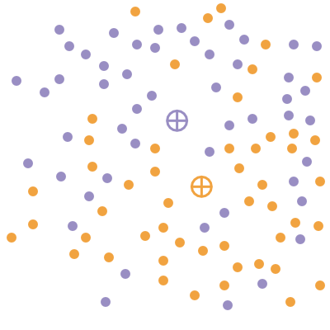
Which color is higher on average?

Slide 21
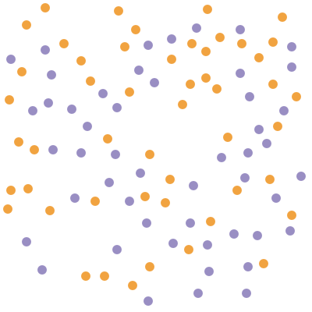
Which color is higher on average?

Slide 22
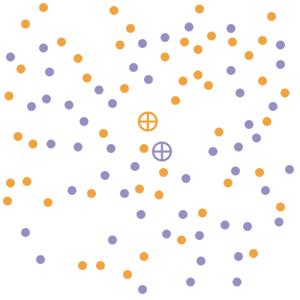
Which color is higher on average?

Slide 23
Perceptual Modeling

Slide 24
Perceptual Modeling

Slide 25
Perceptual Modeling
Notes:
Accuracy here, but can construct these curves for lots of measures

Slide 26
Perceptual Modeling
Notes:
Accuracy here, but can construct these curves for lots of measures

Slide 27
Perceptual Modeling
Notes:
Accuracy here, but can construct these curves for lots of measures

Slide 28
Perceptual Modeling
We can model how statistical certainty impacts human judgments.

Slide 29
Perceptual Uncertainty Modeling

Slide 30
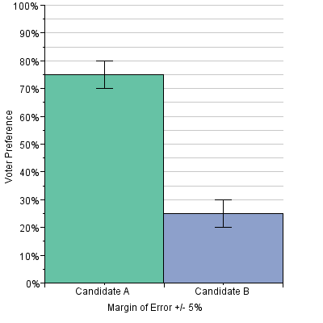
Perceptual Uncertainty Modeling
Correll, M. and Gleicher, M. “Error Bars Considered Harmful: Exploring Alternate Encodings for Mean and Error.” VIS 2014.

Slide 31
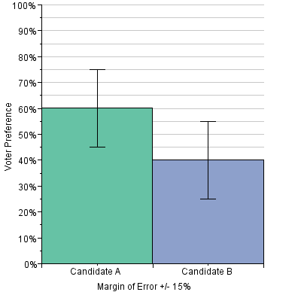
Perceptual Uncertainty Modeling

Slide 32
Perceptual Uncertainty Modeling

Slide 33
Perceptual Uncertainty Modeling

Slide 34
Perceptual Uncertainty Modeling

Slide 35
Perceptual Uncertainty Modeling
Linear decay

Slide 36
Perceptual Uncertainty Modeling
α=0.05 T Test

Slide 37
Perceptual Uncertainty Modeling
We can compare human and statistical decision-making under uncertainty.
Notes:
This gives us guidance on when to intervene.

Slide 38
Zone of “Inaction”

Slide 39
Zone of “Inaction”
ε

Slide 40
Zone of “Inaction”
Zone of Inaction
Notes:
Include central idea slide after

Slide 41
What are we good at?
Mean and error
Regression
Significance testing
Notes:
Mean and error
Regression
Significance testing
Mention Cox House Lindell Hurricane work

Slide 42
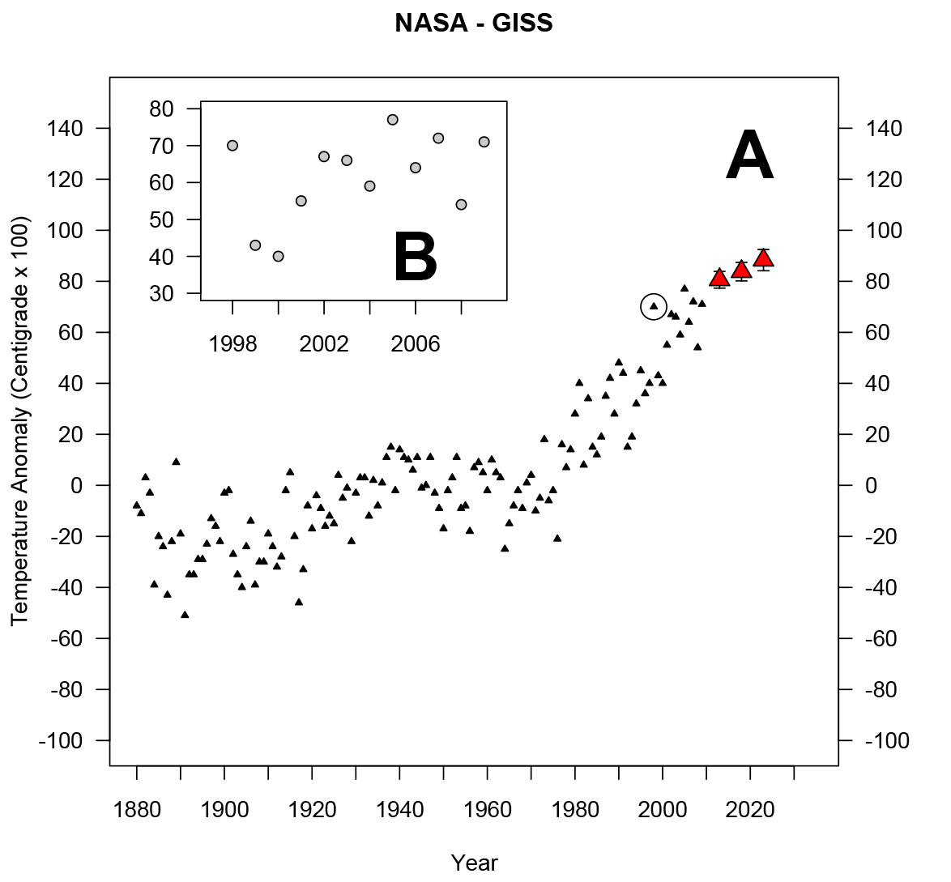
Regression
Lewandowsky, S. (2011). Popular Consensus Climate Change Is Set to Continue. Psychological Science, 1–13.

Slide 43
Regression
Lewandowsky, S. (2011). Popular Consensus Climate Change Is Set to Continue. Psychological Science, 1–13.

Slide 44
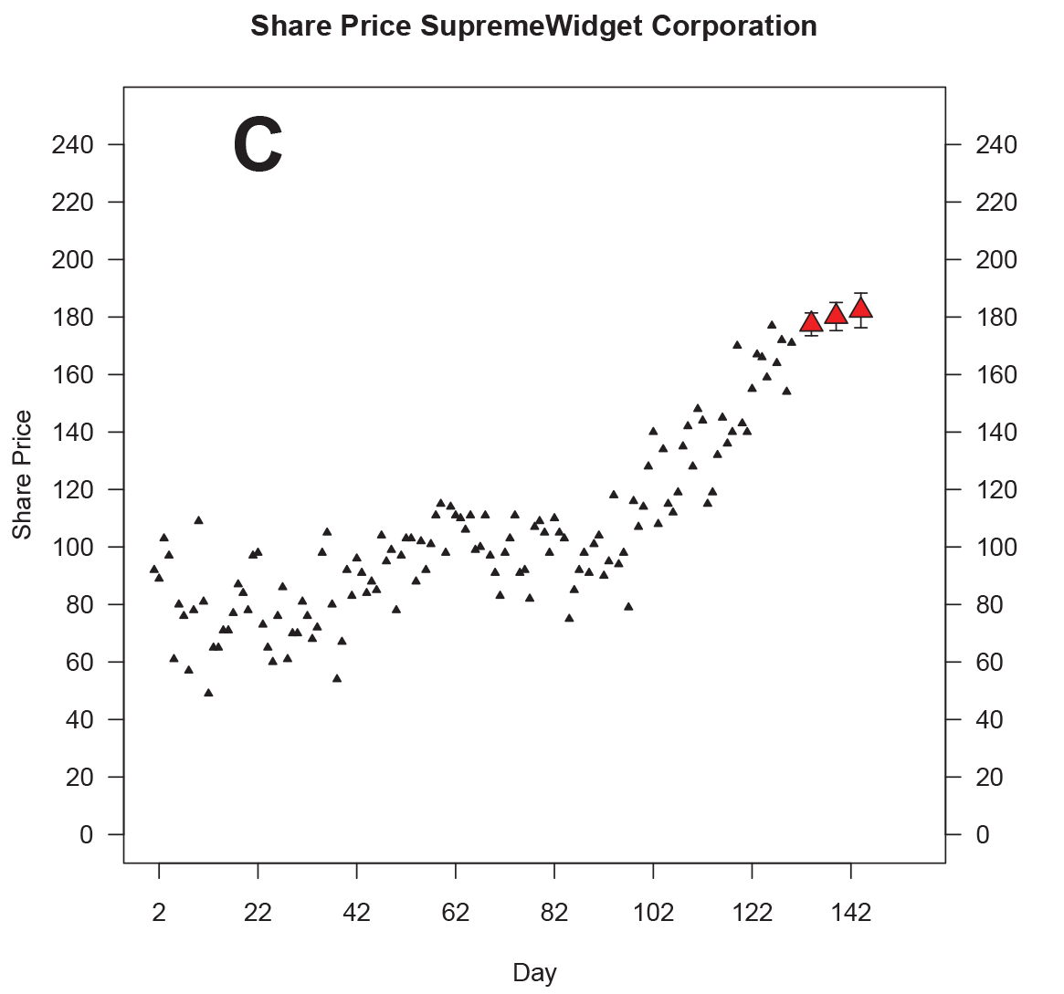
Regression
Lewandowsky, S. (2011). Popular Consensus Climate Change Is Set to Continue. Psychological Science, 1–13.

Slide 45
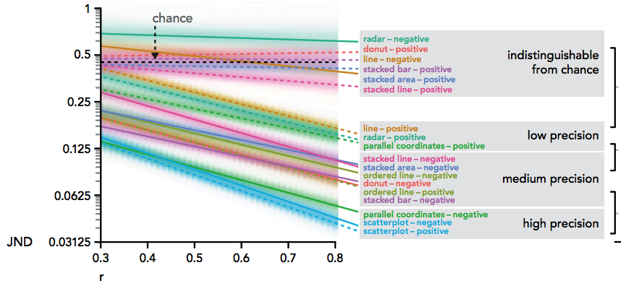
Linear Regression
Kay, M. and Heer, Jeff. “Beyond Wever’s Law: A Second Look at Ranking Visualizations of Correlation.” VIS 2015

Slide 46
Linear Regression
Wednesday, 1400, Grand Ballroom
Kay, M. and Heer, Jeff. “Beyond Wever’s Law: A Second Look at Ranking Visualizations of Correlation.” VIS 2015

Slide 47
NHST
Wickham, Hadley et al. “Graphical inference for Infovis.” IEEE transactions on visualization and computer graphics 16.6 (2010): 973–9.

Slide 48
Notes:
----- Meeting Notes (10/25/15 17:50) -----
Move away from the middle

Slide 49
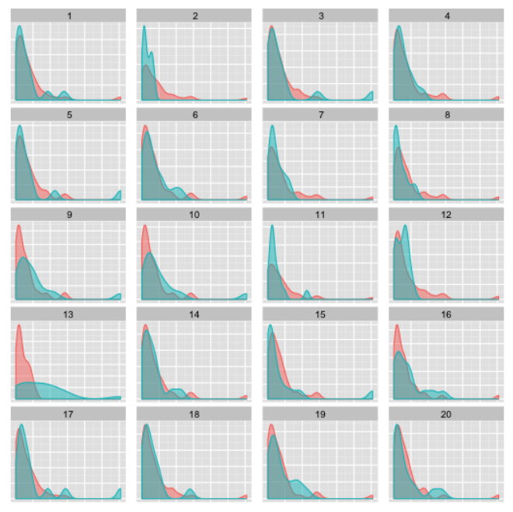
NHST
Hofmann, H. , Follett, L., Majumder, M., and Cook, D. “Graphical Tests for Power Comparison of Competing Designs.” VIS 2012.

Slide 50
Summary
People are good at a wide variety of uncertainty tasks
How we present data matters!

Slide 51
Caveats

Slide 52
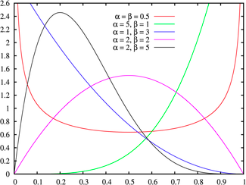
Wrong Statistic?
Notes:
Beta distribution, hyperskewness = 5th standardized moment

Slide 53
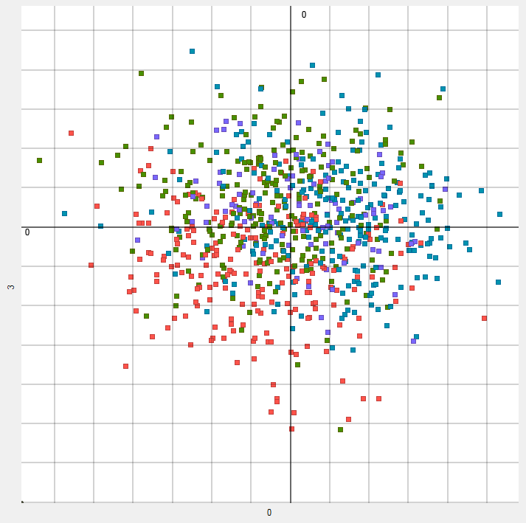
Wrong Scale?

Slide 54
Conclusion
We as designers may not always need to intervene to show uncertainty.
We can let viewers do some of the uncertainty quantification work for us.

Slide 55
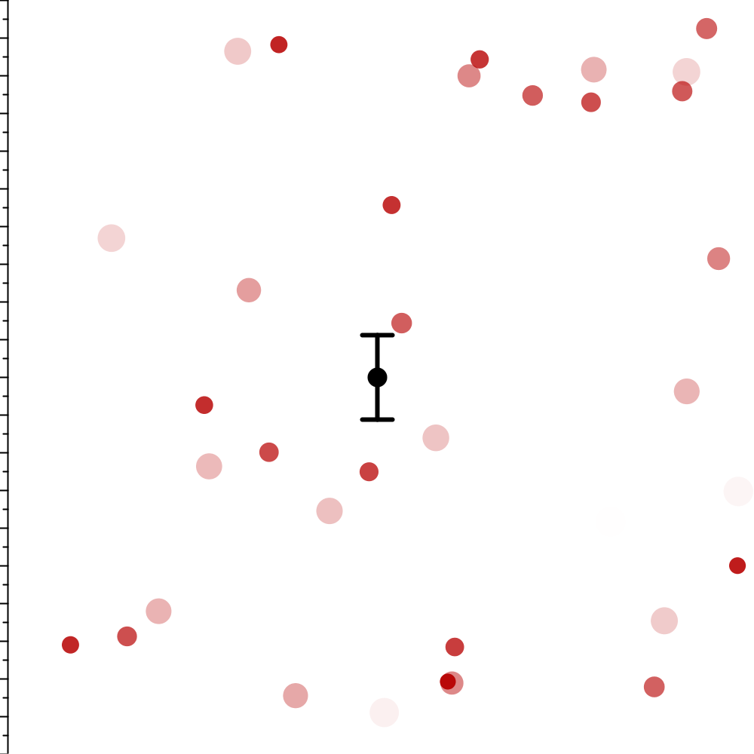
Implicit Uncertainty

Slide 56
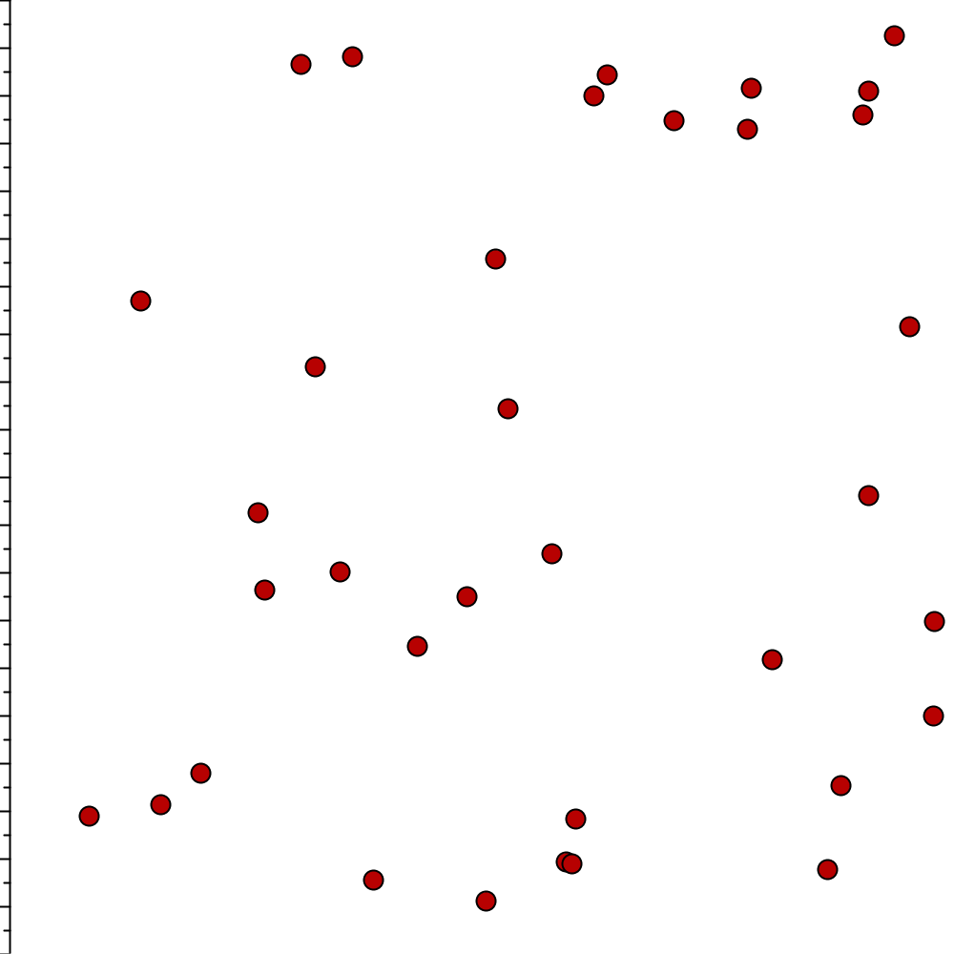
Implicit Uncertainty

Slide 57
Acknowledgments
Work funded by NSF award IIS-1162037 and a Mellon Foundation grant.
We thank Remco Chang and Kristin Potter for their discussion and feedback on this work.
Contact: mcorrell@cs.washington.edu

Slide 59
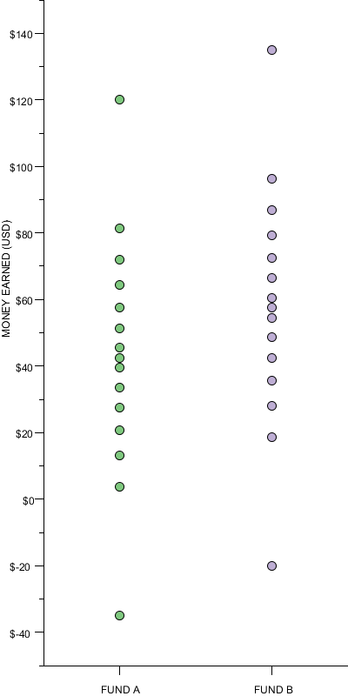
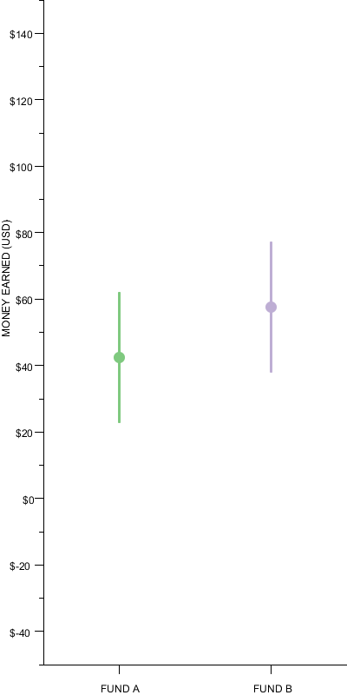
Mean and Error

Slide 60
Implicit Uncertainty

Slide 61
Implicit Uncertainty
Points of Inaction

Slide 62
Implicit Uncertainty
ε

Slide 63
Implicit Uncertainty
dy/dx > 0

Slide 64
Zone of “Inaction”
dy/dx > 0

Slide 65
Zone of “Inaction”
Completely Certain
Completely Uncertain

Slide 66
Interventions
Encode
Substitute
Annotate

