Slide 1
The Alignment Template Approach to Statistical Machine Translation
Franz Josef Och and Hermann Ney

Slide 2


Log-Linear Model
Compute probability of target given source directly
No separation of language model
Allows linear combination of various probability models
Pick most likely target sentence given source

Slide 3
Symmetrization
Compute source to target alignment (A1)
Also computer target to source alignment (A2)
Combine alignments using intersection, union, or:
“Refined Method”
  Compute intersection (A)
  Add alignment to A if horizontal or vertical neighbor of some element in A and it won’t cause A to have alignments with both horizontal and vertical neighbors

Slide 4
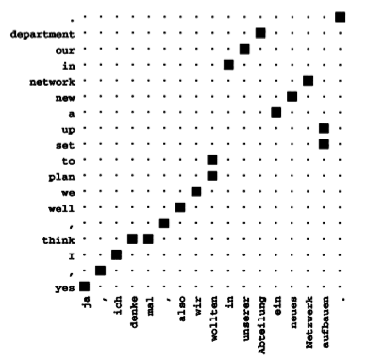
Example
Intersection

Slide 5
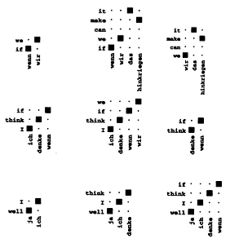
Alignment Templates
Contains alignment information for phrases
Computes all possible subtemplates
Only allows continuous phrases

Slide 6

Translation Model
Sentences
  Source: J words
  Target: I words
K phrases
An alignment template z_k translates between et_k and ft_k
Also K Pi parameters that describe how to permute the prases

Slide 7
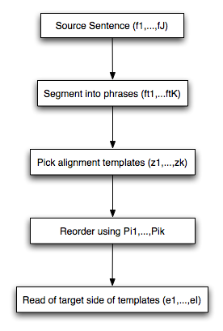
Translation model

Slide 8
Feature Functions
Recall Log-Linear model allows us to include an arbitrary number of feature functions
Can solve previous slide by answering best h(E,F,Pi,Z)
Log-Linear model allows us to decompose this into feature functions for template selection, reordering, word selection, etc
Could have added semantic features like making sure verbs on source and target side have same number of arguments

Slide 9

Alignment Template
Given a series of alignment templates corresponding to phrases
Compute joint probability of that set of phrases
Includes final permutation of phrases
Does not allow insertion or deletion of phrases

Slide 10



Word Selection
Computes joint probability of individual target words given source
Unlike IBM Model, no constraint on multiple source words going to one target
Only allow words to be from predicted word class (?)
Also include dependence on word order
If not enough data available for word order back off to p(e|f)

Slide 11

Phrase Alignment
Measures amount of “monotonicity” between templates
Often consecutive templates in source will correspond to consecutive templates in target
Penalize templates that need to be moved by how much they moved

Slide 12


Language Model
Included as a feature function instead of separate like IBM model
Use backing-off trigram word model
Also use 5-gram word class model
Class model helps take long-range dependencies into account (?)

Slide 13
Word Penalty
Simply equal to the length of the target language sentence
Designed to prevent system from producing sentences that are too short
Not sure how this helps…

Slide 14
Conventional Lexicon
Seems like cheating
Requires a conventional dictionary
Conventional dictionary probably more reliable than induced translation probability
Counts co-occurences of source-target pairs in dictionary

Slide 15
Training - Templates
Both word and alignment template probabilities are computed from relative frequencies
Count up number of times each template occurs
Divide by total number of templates for given source phrase

Slide 16

Training - Feature Weights
Need to parameterize lambdas
Used 2 methods
  Coordinate descent used for Hansard translation
  Generalized Iterative Scaling algorithm used with maximum entropy calculation

Slide 17
Generalized Iterative Scaling
Source: nltk documentation
Guaranteed to converge to best weights
3 Constraints
  Feature values must be boolean (does this apply here?)
  At least one feature must be 1 (can be assured with adding a 1 feature)
  Sum of the feature values must always equal the same number on every iteration (can add correction feature)
Initializes all weights to 1
Updates according to
Runs until convergence

Slide 18
Training - Feature Weights
Need to normalize the sum of all feature functions
This is sum of h(e,f) given all possible translations
There’s too many translations so just use some n-best as an approximation
Compute n-best list given current parameters
Train parameters based on current list
Recompute n-best list and add these to original list
Loop to 2 until n-best list doesn’t change

Slide 19
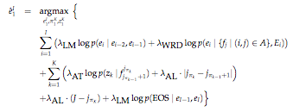
Search
There’s a lot of variables here
Note that we’re taking the argmax of 3 variables
Have to pick best translation, alignment templates, and permutation

Slide 20
Search
Used a form of beam search
Other options for algorithm have problems
  A* or optimal integer programming aren’t efficient on long sentences
  Greedy algorithms have terrible performance
  Other approaches like IBM decoding also make large errors
Search space is digraph of partial source sentences
Each node is a sequence of decisions
Edge between nodes n1 and n2 if n2 is obtained by appending one word to n1
Cost of edge is computed from log-linear model

Slide 21

Search
Instantiate all possible alignment templates for the source sentence
  Unseen words are placed in their own templates
Only source side of template is known, still need to choose translated words
Only allow system to choose 5 most likely words based on formula:

Slide 22
Search
Each time we add a word we can do 1 of 3 things
  Start a new alignment template.
    This can only occur if the previous template is complete and we have a template starting with this word
    Cost is cost of adding word + alignment template
  Extend an alignment template
    Can only occur if this keeps a valid template
    No alignment template added so cost is just word
  Complete the sentence
    This would be super-exciting!
    Cost also includes cost of completing the sentence
Can’t create unknown alignment templates

Slide 23
Search
BFS with pruning
Prune off all nodes with cost worst than some value over the current best cost
Also only maintain the n-best hypothesis
  Aka histogram pruning

Slide 24
Heuristics
In beam search heuristic is used to improve scoring of hypothesis
  Don’t want to accidentally prune away good hypothesis
Authors combine several heuristics
  Language Model
  Alignment Template probability
  Lexicon (word to word translation)

Slide 25
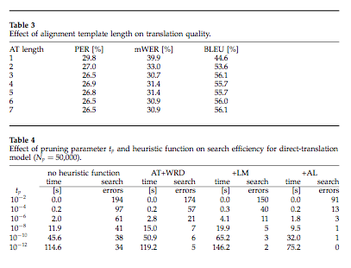
Results

Slide 26
Discussion
Phrase-based vs Word-based
Precision vs recall
Direct translation and log-linear model
Very slow performance

Slide 27
Papers
A hierarchical phrase-based model for SMT (Chiang 2005)
Translating with noncontiguous phrases (Simard et al 2005)
  Create non-contiguous phrases from word-aligned corpora
Statistical phrase-based translation (Koehn, et al 2003)
  Compares phrase-based approaches
Combining linguistic data views for Phrase-based SMT (gimenez and Marquez 2005)
  Exploit linguistic information for phrase-based translation
Discriminitive training and Max Entropy Models for SMT (Och and Ney 2002)
A Phrase-based joint probability model for SMT (Marcu and Wong 2002)
  Earlier phrase-based system

Slide 28
Even More Papers
Do we need phrases? (Quirk and Menezes 2006)
  Compares phrase-based and syntax systems
A smorgasbord of features for SMT (Och et al)
Translating with non-contiguous phrases (Simard et al)
Weighted finite state transducer implementation of the alignment template model for SMT (Kumar and Byrne 2003)

