Slide 1

Translation with Semantics
Tom Torsney-Weir

Slide 2
Motivation
Better machine translation
Want to perform translations that cannot be done easily with current translation systems
  Leave me alone = Laissez moi tranquille NOT Me laisser seul
Can probably write a dissertation on this

Slide 3
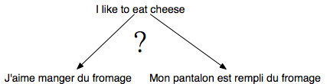
Background - Translation
Based on probability of source text translating into target text.
Pick target text with highest probability of being a translation of the source text.

Slide 4
Background - Early Years
Used state machine to do translation
Hidden Markov Models, etc
Simple to implement and train
Good for languages with similar grammatical structures like French and English
Has difficulty moving phrases around
Will not do as well with languages like Japanese and English

Slide 5
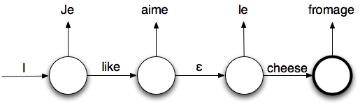
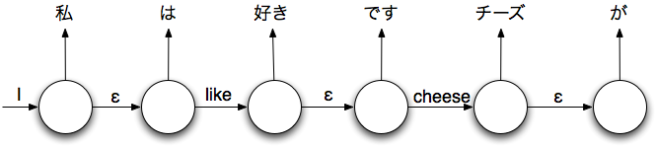
Background - Early years
Good:
Bad:

Slide 6
Background - Later Years
Use context-free grammars and parsers
Parse source sentence
Find target parse that is most likely candidate
Easier to move grammatical structures around
Can’t differentiate between different meanings of same structure
Thrown off by set phrases, for example

Slide 7
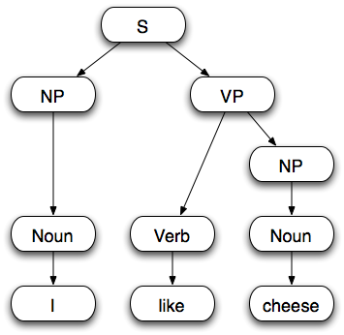
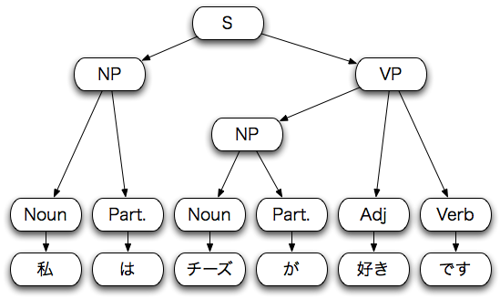
Background - Later Years

Slide 8
Idea
Assign basic meaning to sentences through Compositional Semantics
Translation must have same meaning as source sentence
Structures must also match
One possibility is an extension of a context free parser

Slide 9
Compositional Semantics
Assign first order logic to sentences representing their basic meaning
Done from bottom up during the parsing step
Semantics of parent nodes are based on semantics of immediate children

Slide 10
Advantages
Improve performance with fixed phrases
Can adapt current parsers by adding Compositional Semantics rules into existing grammars
Increased accuracy should outweigh increase in CPU time

Slide 11
Issues
Literature on Compositional Semantics
Annotated corpora for training
Induction of semantics from training examples
Representation semantics internally
Decomposition of semantics and grammar rules

Slide 12
Thanks!
Please don’t ask questions

