Slide 1
K-Nearest Neighbor and Random Forests
Marcin Dudar

Slide 2

Agenda
Objective of workshop
Introduction to Nearest Neighbor algorithm
Practical example of KNN
Introduction to Random Forests
Practical example of Random Forests

Slide 3

Objective
Understand basics of KNN
Being able to implement it
Understand intuition behind Random Forests
Being able to implement Random Forests

Slide 4
K-Nearest Neighbor – basics
Simple, powerful machine learning algorithm used for classification and regression tasks
Instance-based (or memory-based) which means it makes predictions based on specific examples in the training data
„Lazy learning alghoritm”

Slide 5
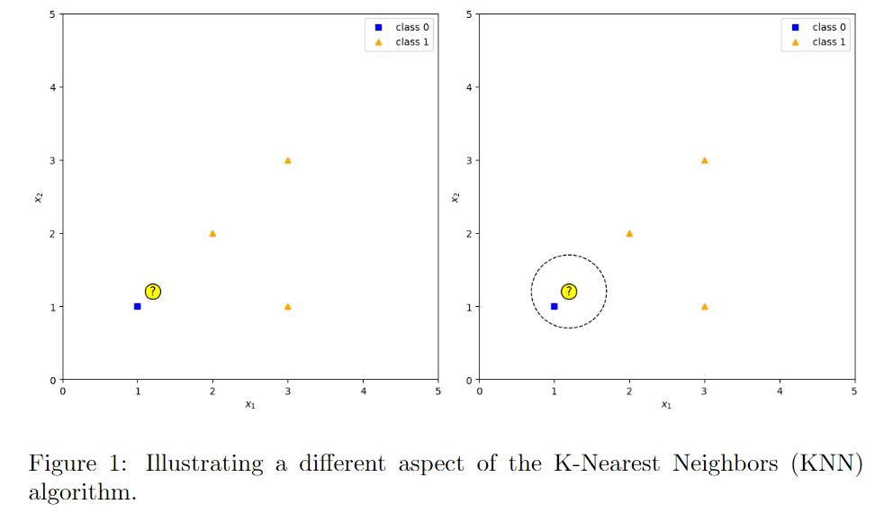
K-Nearest Neighbor – visualization

Slide 6
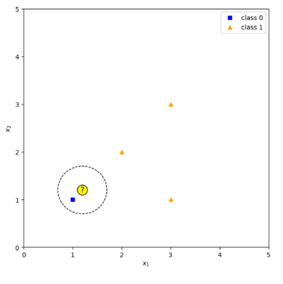
K-Nearest Neighbor – simple interpretation

Slide 7
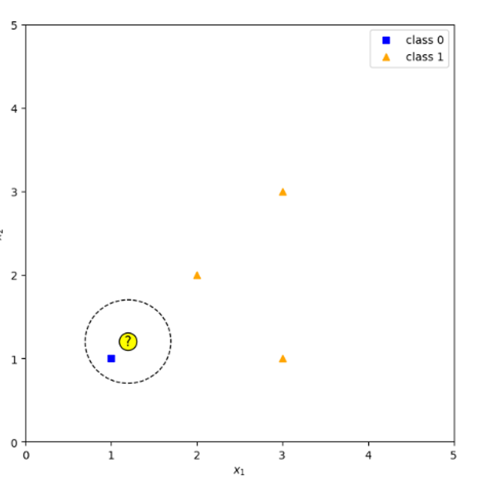
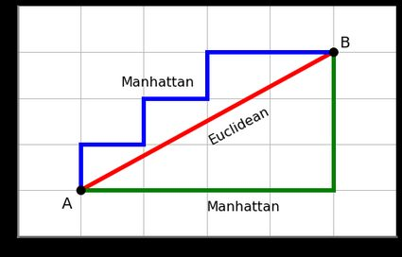
K-Nearest Neighbor – Distance metrics
Dashed circle – distance metric which determines which data points are closest to a given class.
Examples of distance metrics:
Euclidean – mostly used for quantitative data
Manhattan Distance – high dimensional datasets

Slide 8
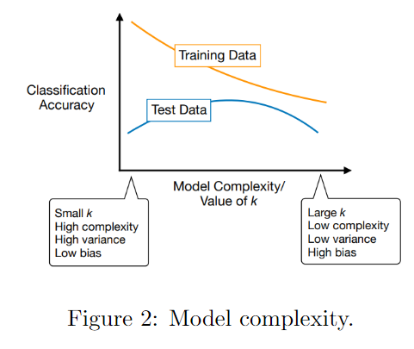
K-Nearest Neighbor – Defining „k”
„K” in Nearest Neighbor is just a parameter that refers to the number of nearest neighbours to include in the majority of the voting process.
Choosing right „k”

Slide 9
K-Nearest Neighbor – Step by step
Selecting the optimal value of K
Calculating distance (algorithm in Python will do it for us)
Take the K nearest neighbors as per the calculated Euclidean distance.
Among these k neighbors, count the number of the data points in each category.
Assign the new data points to that category for which the number of the neighbor is maximum.
Our model is ready

Slide 10
Practical implementation
https://github.com/gacek7/Work-python-workshop

Slide 11
K-Nearest Neighbor – Popular questions
1. What is the intuition behind the KNN algorithm? 2. How do you choose the value of K in the KNN algorithm? 3. What are the different distance metrics used in KNN? 4. What are the advantages and disadvantages of the KNN

Slide 12
Random Forests - basics
Supervised learning method that encompasses two forms, one for classification tasks and the other for regression tasks
Known for its flexibility and simplicity
Each tree generates predictions, and the final outcome is determined through a voting mechanism.

Slide 13
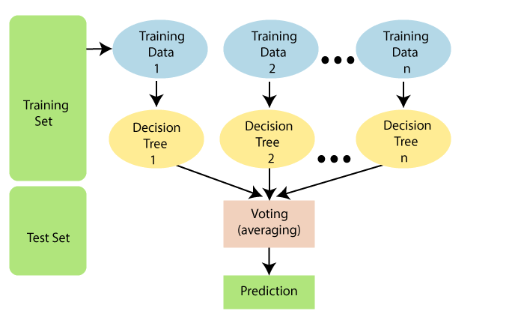
Random Forests - visualization

Slide 14
Random Forests – Step by step
Select random K data points from the training set.
Build the decision trees
Choose the number N for decision trees that you want to build.
Repeat Step 1 and 2
For new data points, find the predictions of each decision tree, and assign the new data points to the category that wins the majority votes.

Slide 15
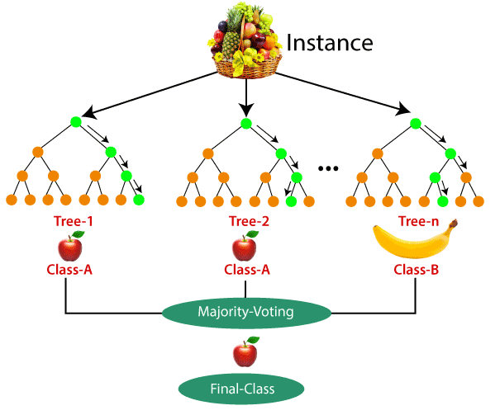
Random Forests – How does it work?

Slide 16
Random Forests – Practical implementation
https://github.com/gacek7/Work-python-workshop

