Slide 1
QRISE 2024
UnitaryFund Challenge
Mitiq
Team QMitra:
Anand Kumar, Ph.D. (Physics)
Dhawal Yogesh Bhanushali, M.Tech CSE, Masters QT
Jaishree R Devaru, M.Tech
Shreya Satsangi, B.Sc. Physics

Slide 2
Problem Statement
We had to explore the efficacy of stacking multiple quantum error mitigation techniques leveraging the Mitiq Python toolkit. The goal was to compare different combinations of error mitigation strategies in simulation to achieve the lowest possible error rate.

Slide 3
Mitigation Techniques from mitiq
ZNE: Zero-noise extrapolation (ZNE) functions as an error mitigation approach by computing an expectation value across various noise levels. Subsequently, it extrapolates the observed outcomes to deduce the ideal expectation value at the zero-noise threshold.
PEC: Probabilistic error cancellation (PEC) is an error mitigation technique in which ideal operations are represented as linear combinations of noisy operations. In PEC, unbiased estimates of expectation values are obtained by Monte Carlo averaging over different noisy circuits.
DDD: Digital Dynamical Decoupling (DDD) is an error mitigation technique in which sequences of gates are applied to slack windows, i.e. single-qubit idle windows, in a quantum circuit. Such sequences of gates can reduce the coupling between the qubits and the environment, mitigating the effects of noise.
QSE: Quantum Subspace Expansion (QSE) is an error mitigation technique in which we define a small subspace around the output state, then search this subspace for the state with the least amount of error. Regardless of the output state, the same procedure applies. The subspace is defined by a set of operators that act on the output state called the check operators. Subspace expansion can be used in conjunction with a stabilizer code, in which case the stabilizers, or a subset of them, can be used as the check operators.

Slide 4
PEC
+
DDD
+
ZNE
Run a basic circuit with a depolarizing error.
single qubit - XX operation
single qubit - H- H - H operation
Apply the mitigation strategies.
PEC
ZNE
DDD
ZNE+DDD
ZNE+PEC
ZNE+PEC+DDD
Compare the mitigation values

Slide 5
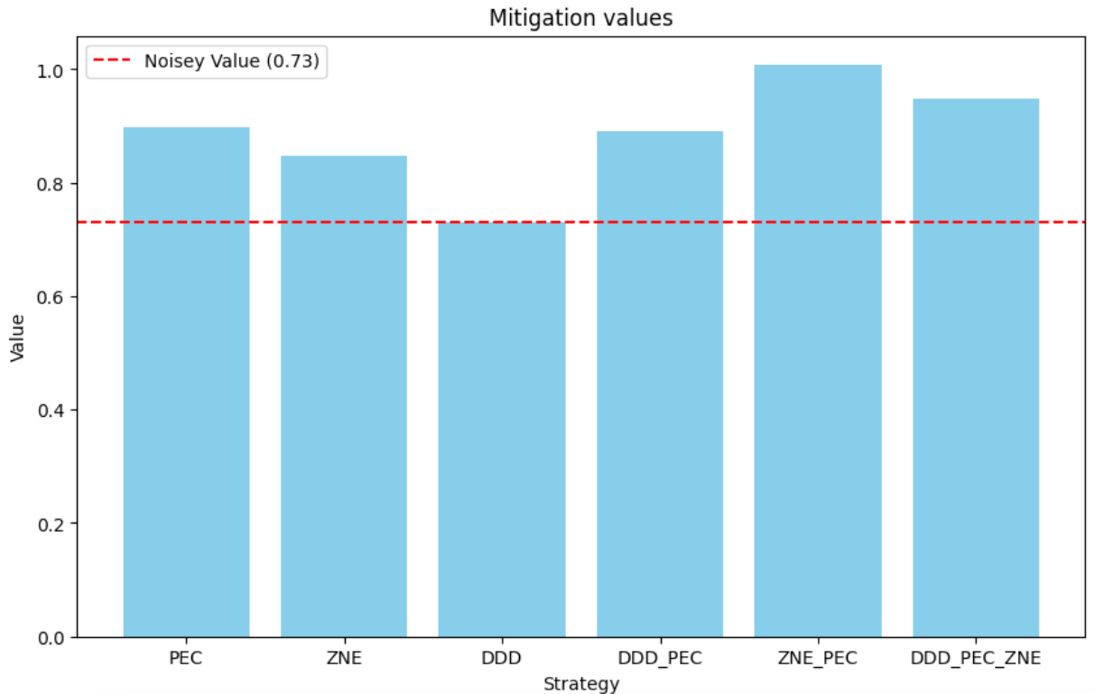
Depolarizing error = 0.2
Amplitude Damp = 0.1
ZNE+PEC provides the best mitigation (for the test scenario.

Slide 6
Future Work
Stack measurement errors and QSE Mitigation technique.
Use a variety of circuits (like GHZ, RB) and multitude of errors.
Investigate sampling in PEC and how to speed it up.
Run it on non-cirq frontends and real backends.
References
API-doc
Noise Scaling Method
PEC
ZNE
DDD
QSE
https://github.com/gachchami/qmitra

