Slide 1

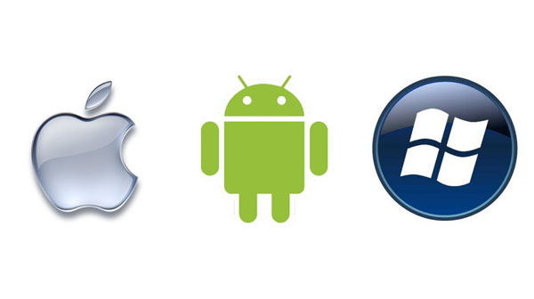

XPlatformCloudkit
+
=
+
MVVM Cross
A Hands-on lab for creating your very own multi-platform app with Azure Mobile Services as a backend
Paul DeCarlo
pdecarlo@Microsoft.com
@pjdecarlo
windotnet.blogpsot.com

Slide 2
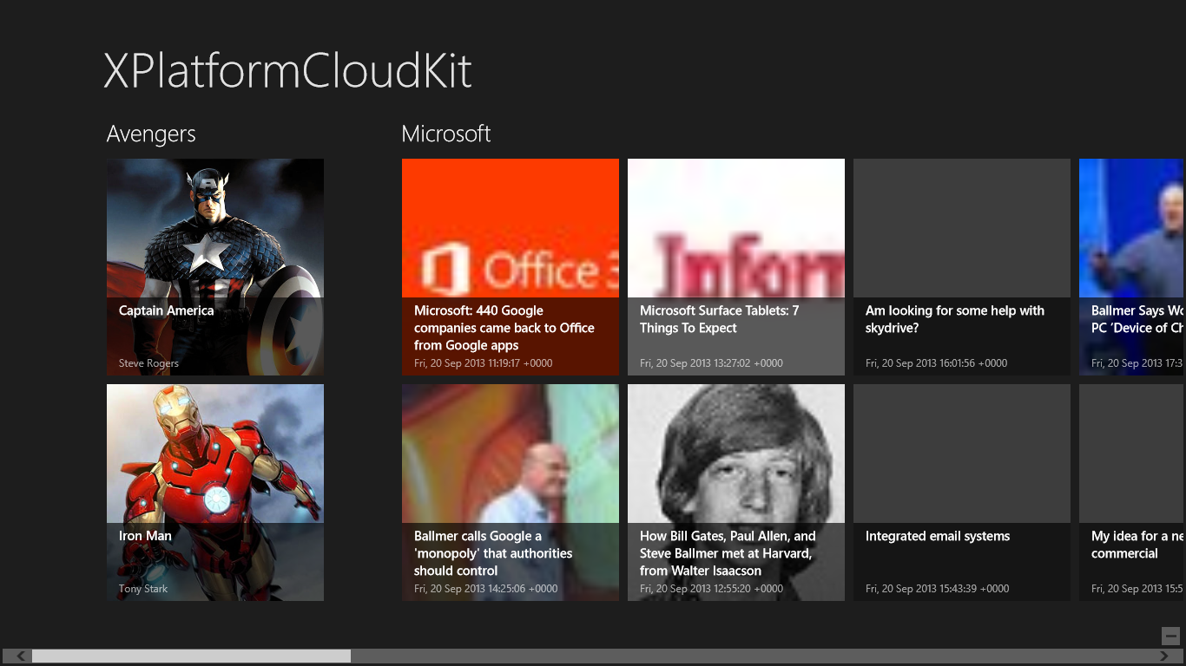
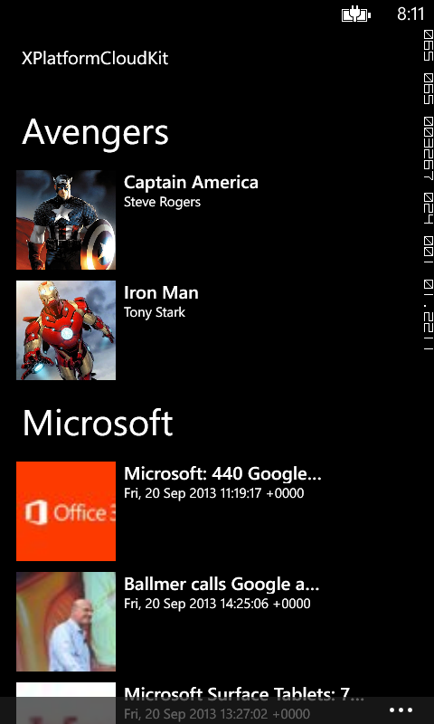
What type of app are we going to make
For the Info XPlatformCloudKit Lab we will create an application that can consume grouped data from an Azure Mobile Service table and/or RSS feed(s) and/or Local Data in an included xml file. The app supports live tile update upon viewing an item and sharing on both Windows 8 and Windows Phone 8. Try to think of a topic that is well suited for this type of content i.e. a collection of super heroes, universities, TV shows, game consoles.

Slide 3

Students get signed up with Dreamspark!
What is DreamSpark?
DreamSpark is a Microsoft Program that supports technical education by providing access to Microsoft software for learning, teaching and research purposes.
As a Student: simply create an account, verify your student status and download software through this website at no cost. If your school/university has a subscription, you can also get access to more software titles.
Dreamspark Signup Link

Slide 4
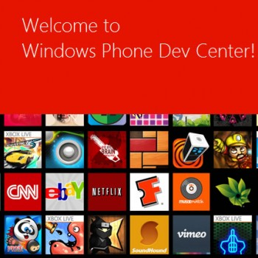
Need a store account?
Good news if you are student! Jared Bienz has written up an article explaining how to get free access to the Windows Phone and Windows 8 store at his blog:
http://jaredbienz.wordpress.com/2013/02/05/student-store-accounts-free/
Once you are set up, we can get started with development!

Slide 5
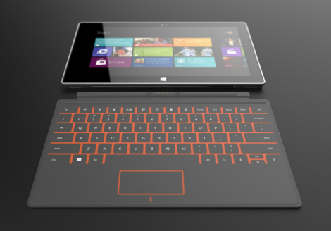
Getting Started On Your Own Device
Software Requirements:
64-Bit Windows 8 Pro OS (available free to students through Dreamspark.com)
Visual Studio 2012 (Professional or above) – Dreamspark Link or 90 Day Trial
Windows Phone 8 SDK (if you wish to build WP8 project)
Hardware Requirements:
Full List – BIOS support for SLAT, DEP, and Hardware Assisted Virtualization

Slide 6

Using CloudShare
If you do not meet the requirements in the previous slide, you can use a free trial of the CloudShare service to create a virtual environment with all of the Software Requirements Pre-Installed and satisfactory Hardware Requirements. Be aware that this service will only be available to you for 7 days per registration. Just follow the 10 minute lab in the link below and you will be all set! Do not forget to save your work to a local device regularly!
Get Started With CloudShare

Slide 7
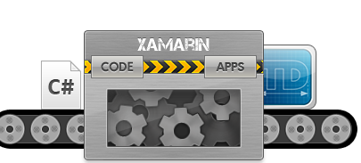
Note on included Android Project
Xamarin is a tool that allows you to write cross-platforms applications in C# and call native platform APIs directly from C#. The Xamarin compiler bundles the .NET runtime and outputs a native ARM executable, packaged as an iOS or Android app.
The XPlatformCloudKit solution includes a Xamarin Android project. In order to build this application in Visual Studio requires a Xamarin business license available @ https://store.xamarin.com/
You may proceed without installing Xamarin, Visual Studio will warn with a dialog explaining that it can not open the project and ignore it.

Slide 8
Let’s look at the XPlatformCloudKit.PCL Project
The Portable Class Library project enables you to write and build managed assemblies that work on more than one .NET Framework platform. You can create classes that contain code you wish to share across many projects, such as shared business logic, and then reference those classes from different types of projects.
Using the Portable Class Library project, you can build portable assemblies that work without modification on the .NET Framework, Silverlight, Windows Phone 7, or Xbox 360 platforms. Without the Portable Class Library project, you must target a single platform and then manually rework the class library for other platforms. The Portable Class Library project supports a subset of assemblies from these platforms, and provides a Visual Studio template that makes it possible to build assemblies that run without modification on these platforms.

Slide 9
One file to configure All Projects
It is important to note that going forward, the only file you will need to edit in this template will be the AppSettings.cs file located in the XPlatformCloudKit.PCL project. All changes to it will be accessible to all of the included projects which consume it. We can make high reuse of code by incorporating our application logic and configuration logic in a PCL. This is the primary benefit of Portable Class Libraries.

Slide 10
And 3 included DataServices
This kit includes DataServices to obtain data in multiple ways.
These include:
LocalItemsFileService – obtains items from included “LocalItemsFile.xml”
RssDataService – obtains items from RSS 2.0 feeds
AzureMobileService – obtains items from an Azure Mobile Service
All of these are configured in AppSettings.cs in the XplatformCloudKit.PCL project
You may wish to use all, or only some by setting the associated bool in AppSettings.cs

Slide 11
Everything is an “Item”
Each DataService is capable of retrieving a list of type Item. Everything you see in you app is represented by the Item Class located in the Models folder of XPlatformCloudKit.PCL
An Item has 5 Properties:
Title – The name of the Item
Subtitle – A short property of the Item (maybe price, county of origin, etc.)
Description- A text description of the item (Note: The value entered for this field will be rendered as html, thus you can get very creative here!)
Image- An http:// url to an image indicative of the Item
Group- The Group to which the Item belongs, all Items are sorted into their associated Group

Slide 12
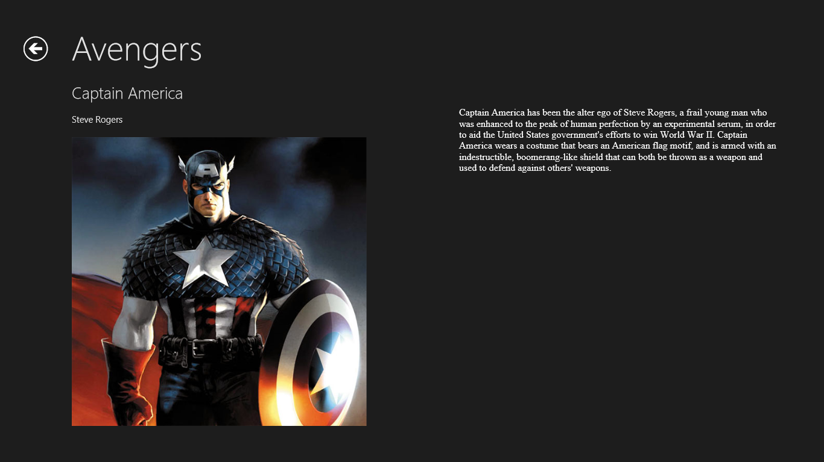
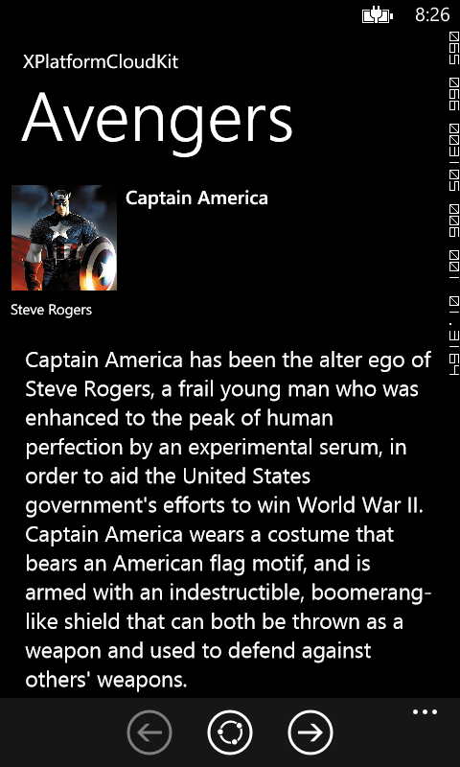
The two view states of our app
<- ApplicationName
<- ApplicationName
<- Group
<- Group
The ItemsShowcaseView
<- Title
<- Title
<- Subtitle
<- Subtitle
<- ApplicationName
<- Group
<- Group
The ItemDescriptionView
<- Title
<- Subtitle
<- Title
<- Description
(rendered as HTML)
<- Description
(rendered as HTML)
Blue values are configured in AppSettings.cs in the PCL project
Green values come from DataService – Local, RSS, or AzureMobileService

Slide 13
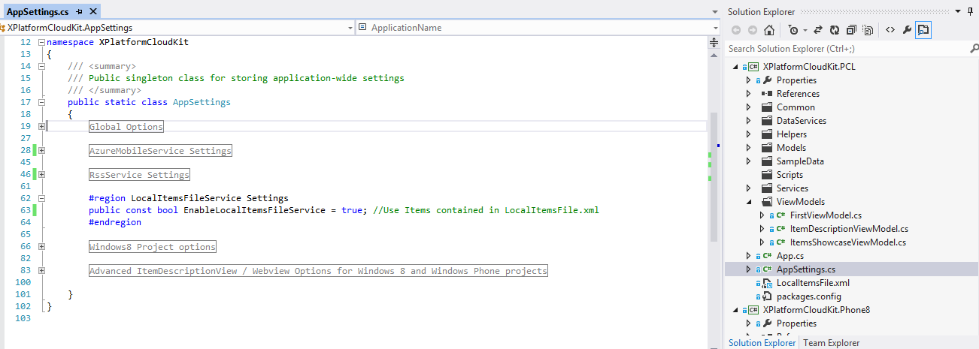
Using the LocalItemsFile DataService
1. To enable use of local data in an .xml file within your application, simply set
EnableLocalItemsFileService = true in AppSettings.cs
2. Then open the LocalIemsFile.xml (in your favorite xml editor) and add the items you wish to load locally. Use this handy tool to convert any html to xml (https://sites.google.com/site/infivivek/resourse-centre/online-resources/html-to-xml-converter)
1.
2.

Slide 14
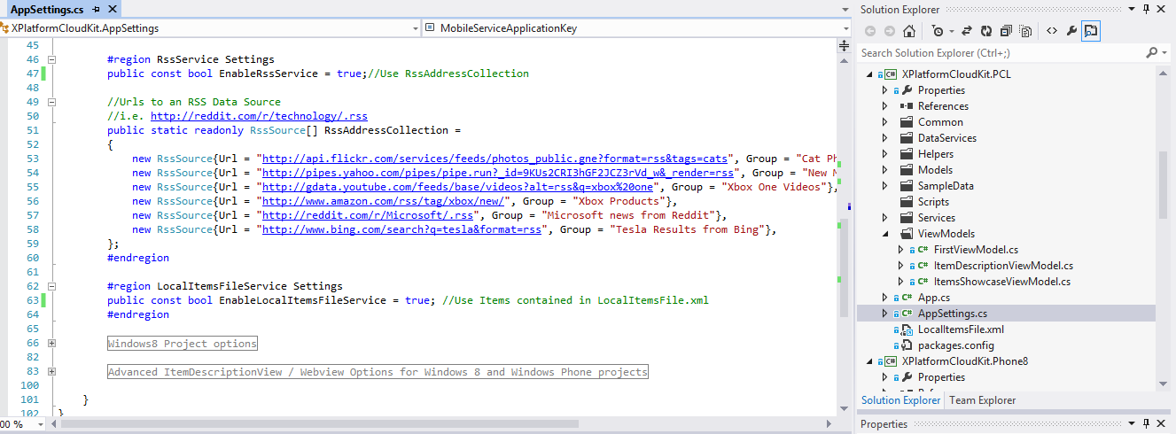
Using the RSS DataService
1. To enable use of RSS feeds in your application, simply set
EnableRssService = true in AppSettings.cs
2. Then configure the RSS sources and name to use for the source by adding to the RssAddressCollection array in AppSettings.cs within XPlatformCloudKit.PCL, a few examples should already exist.
1.
2.

Slide 15
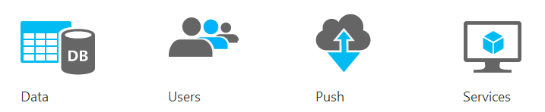
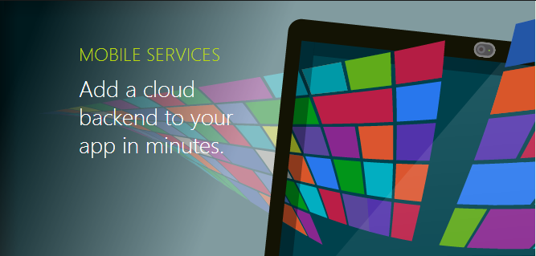
Using the AzureMobileService
http://www.windowsazure.com/en-us/develop/mobile/

Slide 16
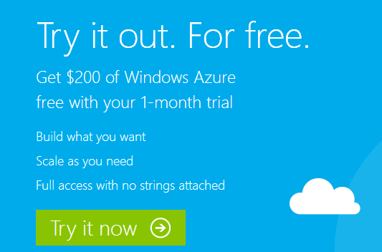
Create A Trial Windows Azure Account
Create a Windows Azure account
Open a web browser and browse to http://www.windowsazure.com
To get started with a free account, navigate to the Windows Azure Free Trial page and follow the steps to create your trial account. You'll need a credit card number and a mobile phone number for proof of identity, but you will not be billed.
If you do not want to set up a Windows Azure account, you can use an optional RSSDataSource instead of Azure and simply ignore any content related to the AzureMobileServices

Slide 17

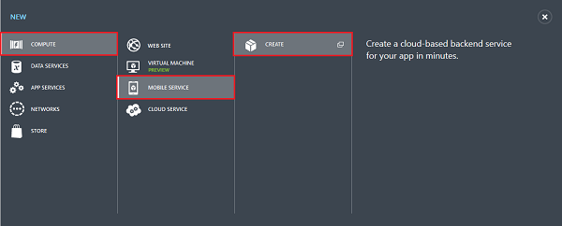
Create a new Mobile Service
Log into the Management Portal.
At the bottom of the navigation pane, click +NEW.
Expand Compute and Mobile Service, then click Create.

Slide 18
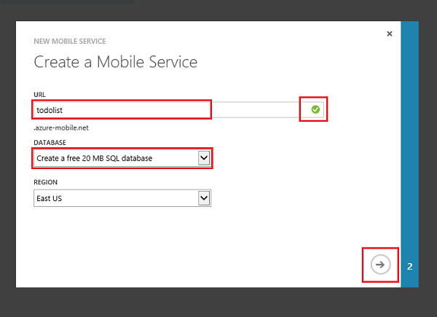
Create a new Mobile Service continued…
In the Create a mobile service page, select Create a free 20 MB SQL Database, then type a subdomain name for the new mobile service in the URL textbox and wait for name verification. Once name verification completes, click the right arrow button to go to the next page.
<- Use a name that describes your app
(i.e. Dallas Cowboys, Xmen, or Dog_Breeds)

Slide 19
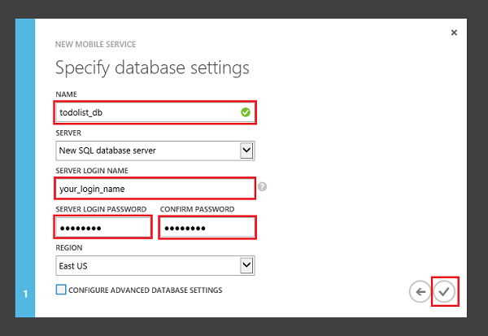
Specify a database
In Name, type the name of the new database, then type Login name, which is the administrator login name for the new SQL Database server, type and confirm the password, and click the check button to complete the process.
<- Use a generic name like “My_Apps”
or “XPlatformCloudKit_Apps”

Slide 20
A Note regarding existing databases and reuse
NOTE
As part of this tutorial, you create a new SQL Database instance and server. You can reuse this new database and administer it as you would any other SQL Database instance. This is why you want to give it a generic name, because a single server can be used for multiple Mobile Services i.e. apps. If you already have a database in the same region as the new mobile service, you can instead choose Use existing Database and then select that database. The use of a database in a different region is not recommended because of additional bandwidth costs and higher latencies.

Slide 21
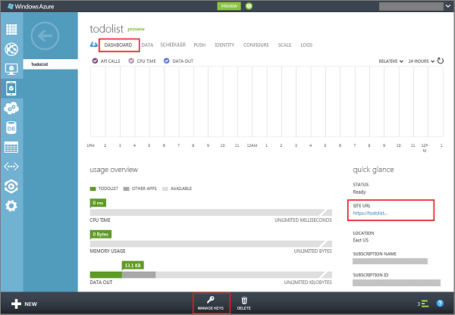
Let’s configure the PCL to use our Azure Mobile Service
1.
With your mobile service selected, go to the Dashboard
Make note of your Site URL and set “MobileServiceAddress” in AppSettings.cs to this value.
Click Manage Keys and make note of the Application Key value and set “MobileServiceApplicationKey” in AppSettings.cs to this value.
2.
3.

Slide 22
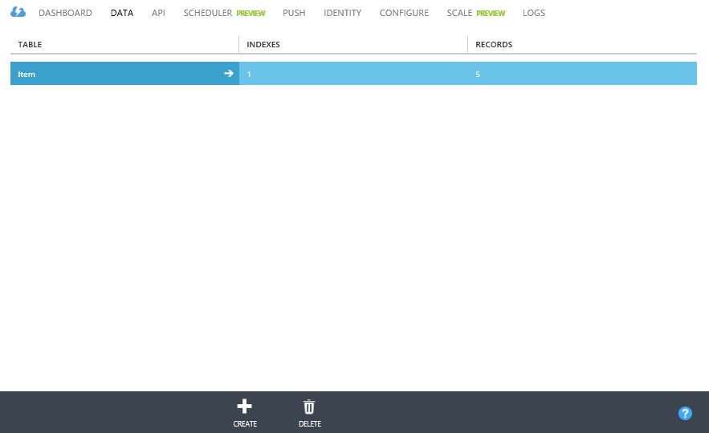
Create the “Item” Table
1.
With your mobile service selected, click “Data”
Next, click “Create” at the bottom and follow the instructions on the next slide to create a new table
2.

Slide 23
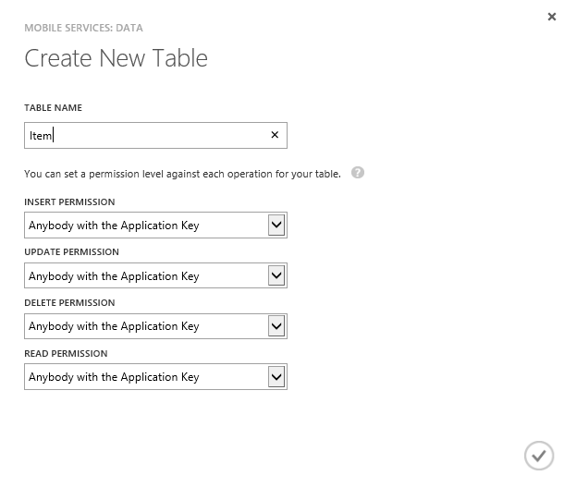
Create the “Item” Table continued…
1.
When the dialog pops up, create a new table named “Item”. NOTE: Your table must be named “Item” in order to work with this kit. Make sure you leave the permissions as depicted in the image
Click the check mark and wait for your table to be created
2.

Slide 24
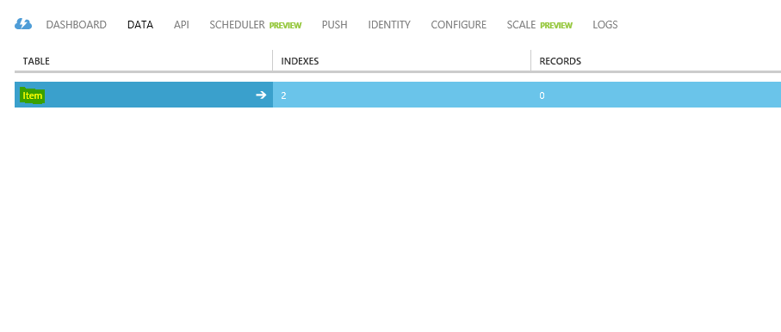
Delete extraneous columns
1.
2.
Click the ‘DATA’ Heading
Click the ‘Item’ table

Slide 25
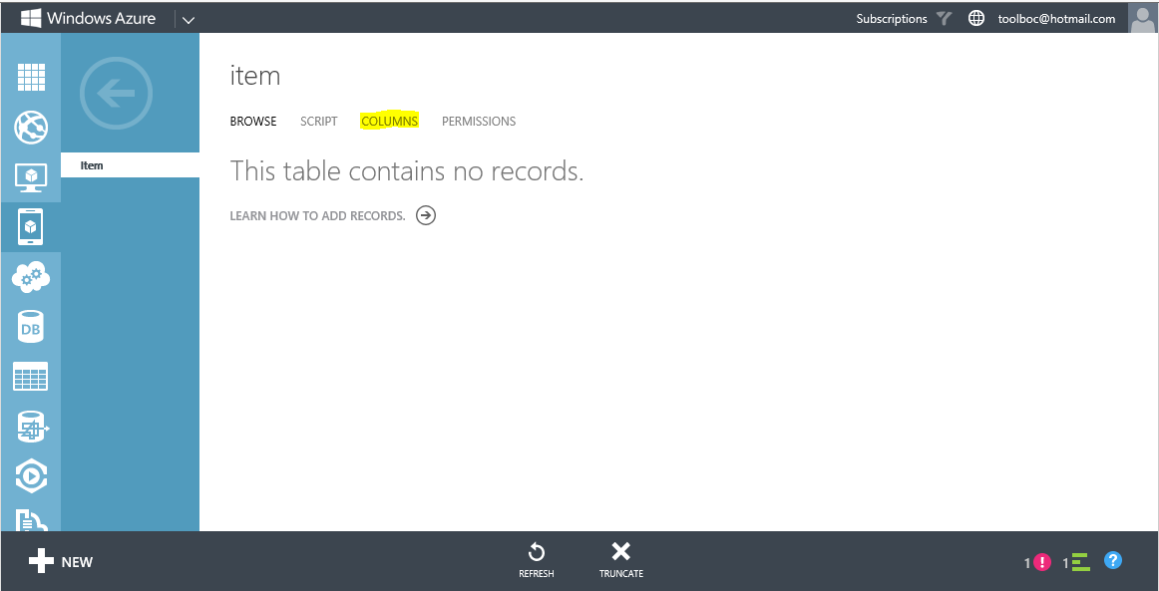
Delete extraneous columns…
1.
Click the ‘Columns’ Heading

Slide 26
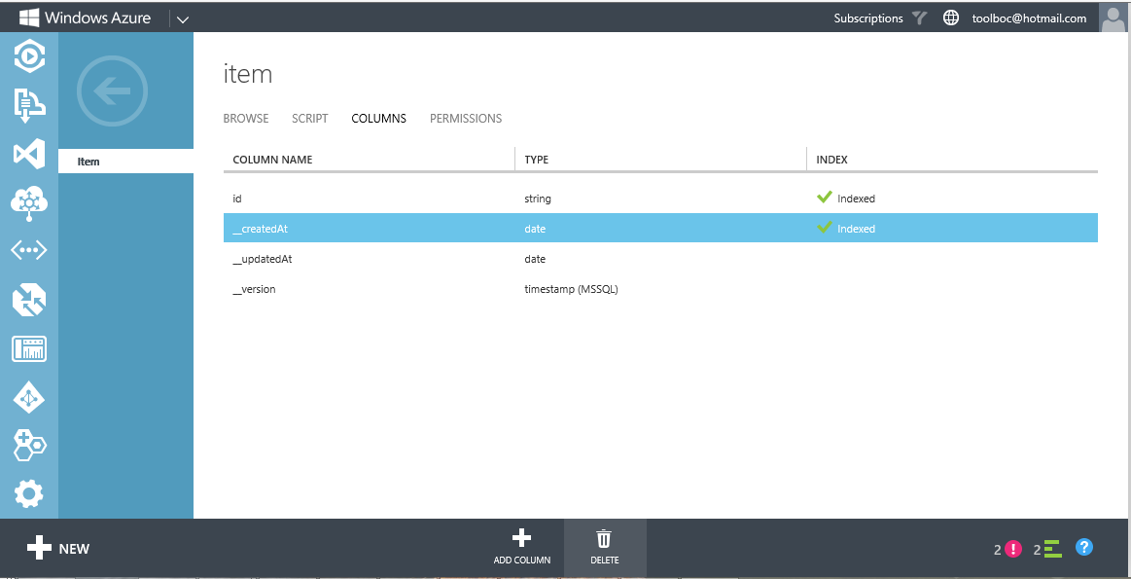
Delete extraneous columns…
1.
Delete the __createdat, __updatedat, and __version columns by selecting the column and clicking delete at the bottom of the screen.

Slide 27
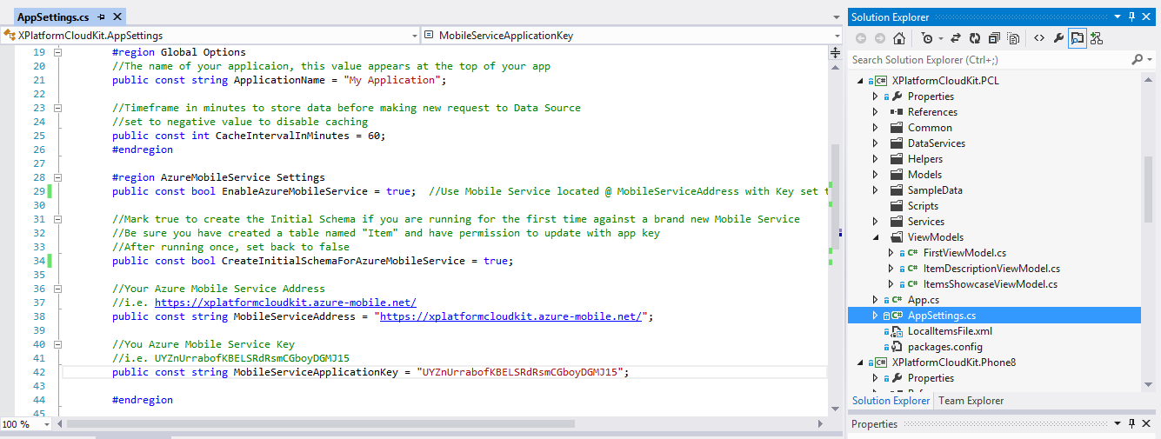
Generate the “Item” table schema
1.
Open AppSettings.cs in the XPlatformCloudKit.PCL project and set “CreateInitialSchemaForAzureMobileService” in AppSettings.cs to “true”
NOTE: We will set this value immediately back to
“false” after initial success. We will only ever have
to do this step once in the lifetime of the app.

Slide 28
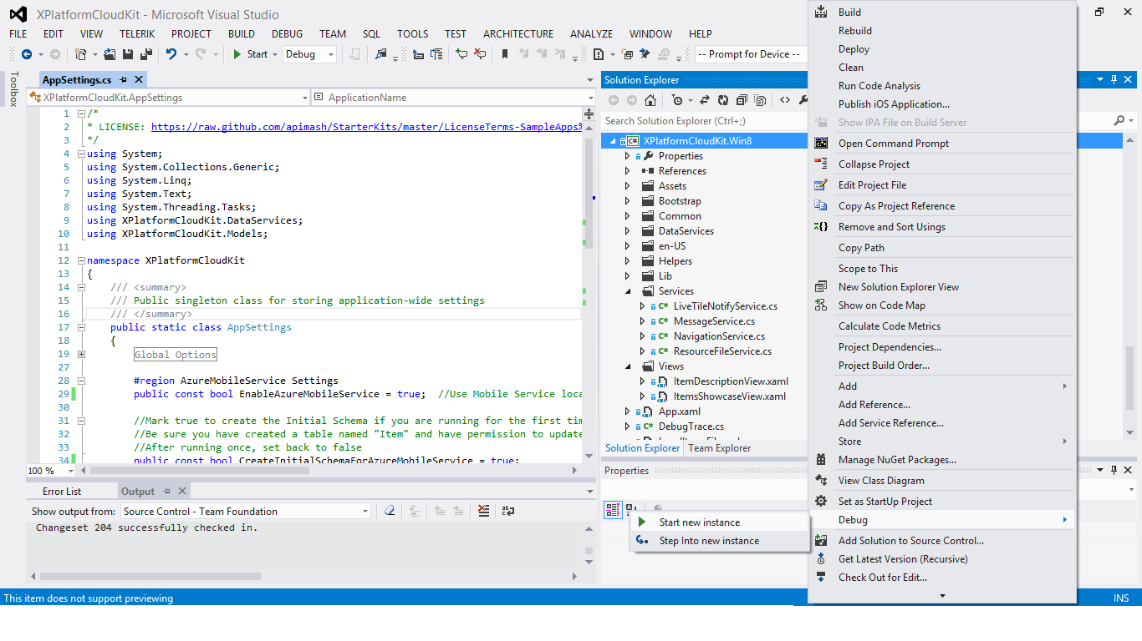
Generate the “Item” table schema continued…
Build and deploy the XPlatformCloudKit.Win8 project (The .Phone8 project should work too, but we will use the Win8 project in the slide deck)
1.

Slide 29
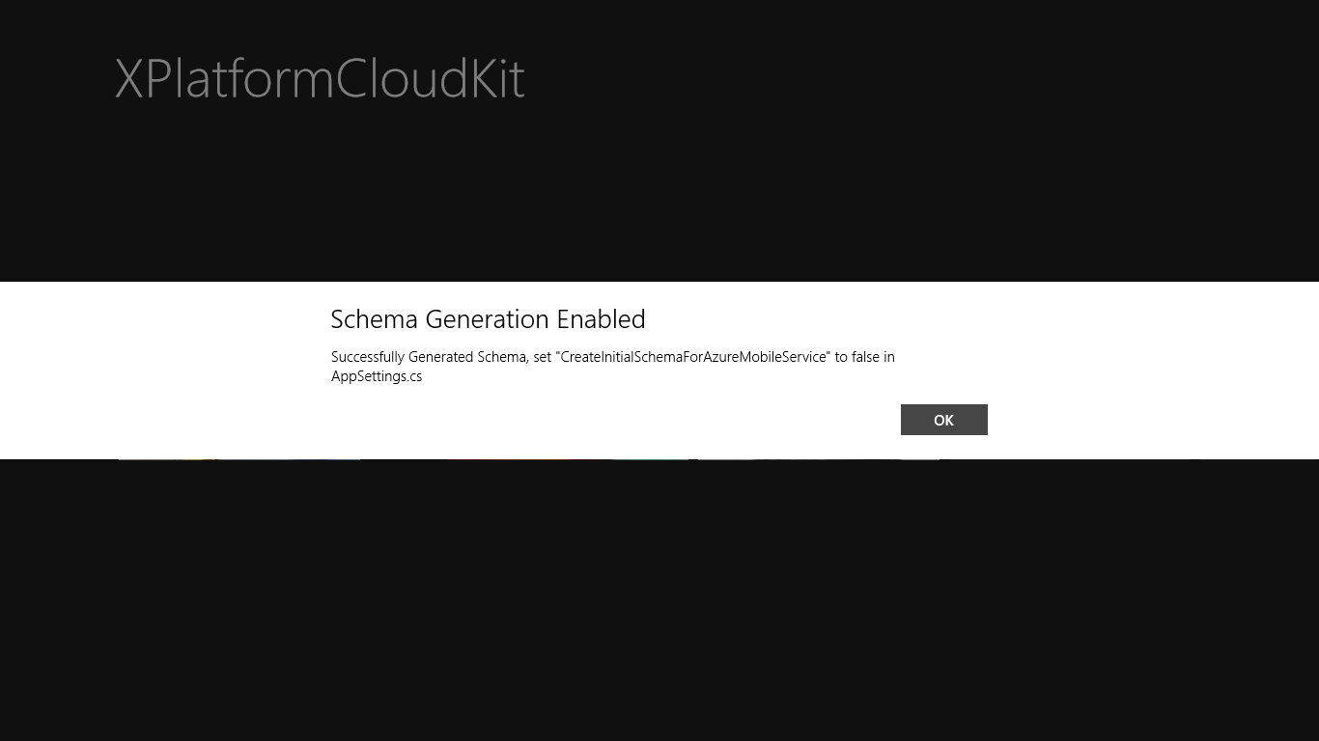
Generate the “Item” table schema continued…
Upon deploy of the Windows 8 application you should see the following message. Make note and
be sure to set “CreateInitialSchemaForAzureMobileService” in AppSettings.cs back to “false”.

Slide 30
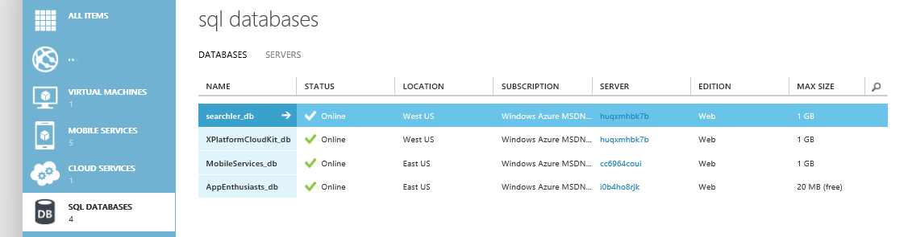
Verify the Schema was generated
In your Azure portal, click “SQL DATABASES” and select the database you assigned your Mobile Service to

Slide 31
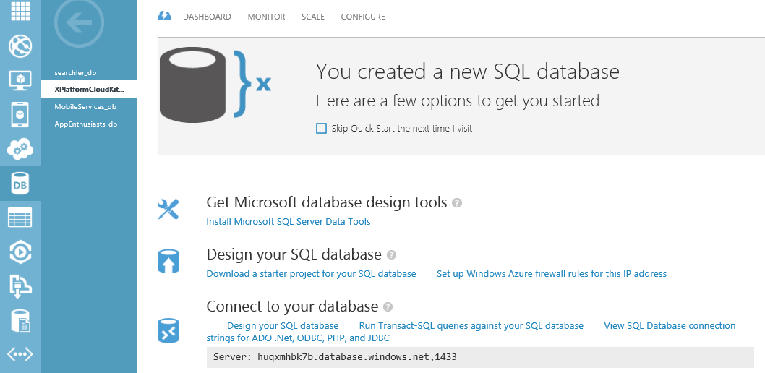
Verify the Schema was generated continued…
On the resulting screen, select “Design your SQL database:” underneath “Connect to your database”
If prompted to add your ip to firewall rules, click “Yes”

Slide 32
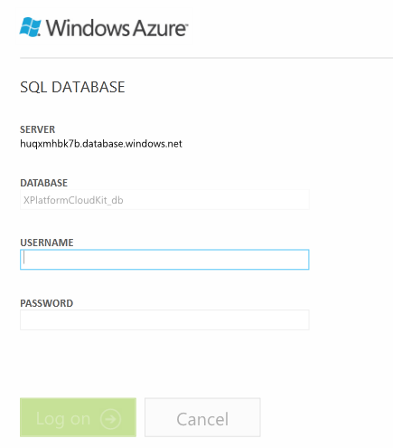
Verify the Schema was generated continued…
On the resulting screen, log in using your credentials that you set earlier

Slide 33
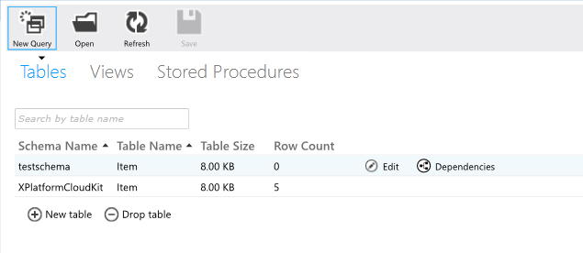
Verify the Schema was generated continued…
Locate your table and select “Edit”

Slide 34
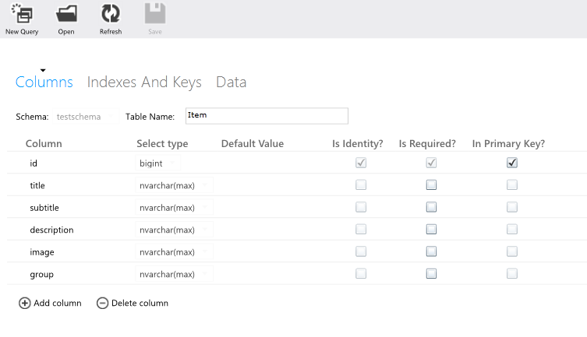
Verify the Schema was generated continued…
Verify your table is named “Item”
and that your schema looks like above

Slide 35
Whoah, we just auto-generated a table schema, how the heck did that happen?
Azure Mobile services allows us to auto-generate a table schema when a new item is inserted into a brand new table that does not contain any items. When “CreateInitialSchemaForAzureMobileService” is set to true, we insert and then immediately delete an object of type “Item” which sets up the schema to support the properties of the “Item” Class. See “Item.cs” in the “Models” folder of XPlatformCloudKit.PCL, note that it has a “Title”, “Subtitle”, “Description”, “Image”, and “Group” property

Slide 36
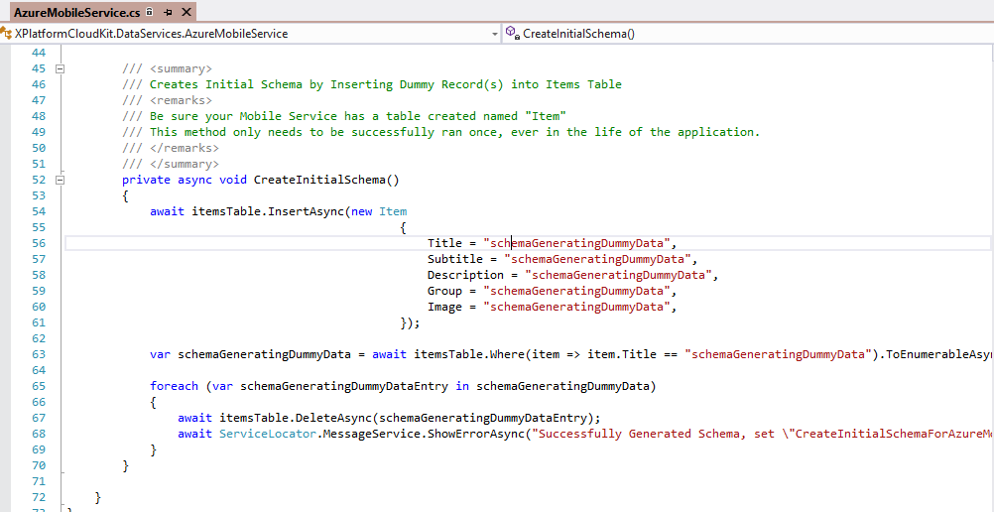
The code for creating the initial schema

Slide 37
Adding data to the “Item” table
In the table-edit screen, click “Data”

Slide 38
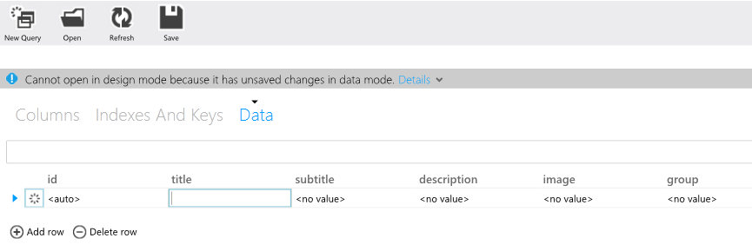
Adding data to the “Item” table continued…
Click “Add row” and begin filling in some data! Make sure to click “Save” when you are done!
NOTE: All columns accept string values. For image, you will want to use a url to a remote hosted image. The description field offers the ability to render html, thus if you paste html into this field it will properly render in the Win8 and WinPhone applications. This can allow for some custom modifications to the way description is presented in your apps.

Slide 39
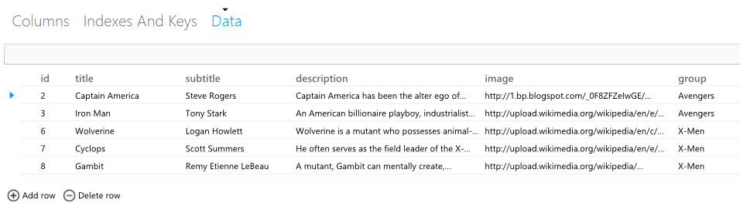
Example table
Here is an example of a table with some Marvel Comics Super Heroes entered

Slide 40
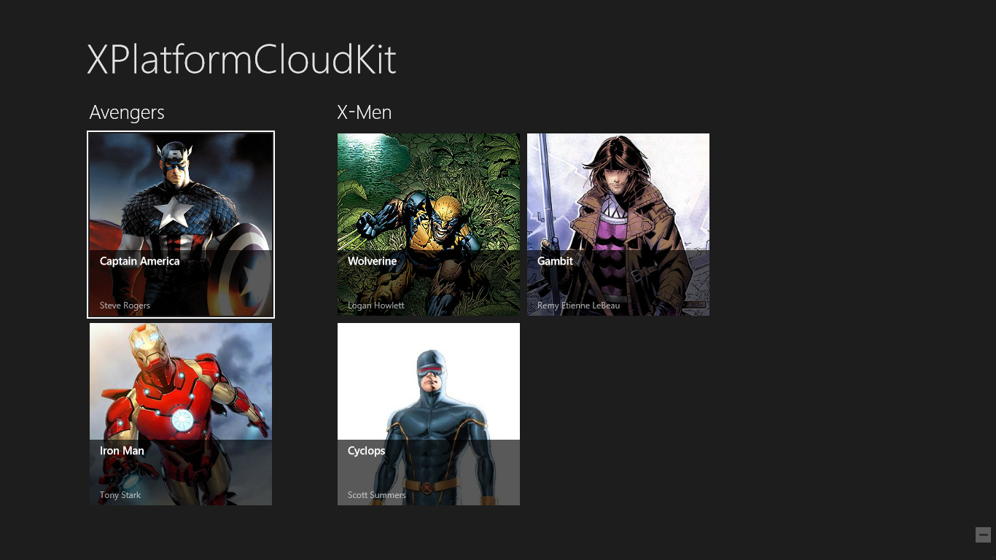
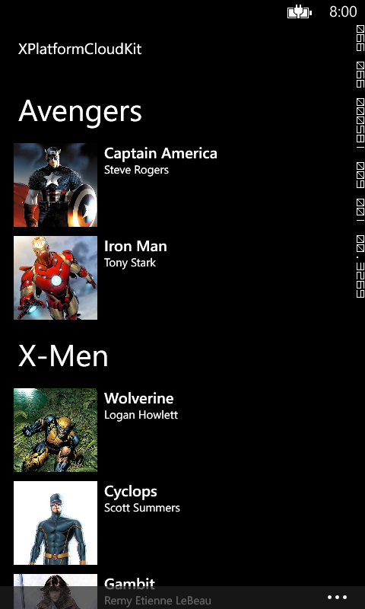
Show me the data!
If everything went right and you have followed all instructions up to this point, go ahead and build your Windows Phone and Windows 8 applications, and you should see your data come back from Azure! (Note: To ensure that data is not cached - bring up the app bar (right-click or swipe up from bottom in windows 8 or press the ‘…’ in bottom right for Windows phone) and click the “Refresh” button.)

Slide 41
Example using RSS and Azure DataService
Note that Avengers are coming from Azure and Microsoft data is coming from Bing Rss feed! Simply enable both DataServices in AppSettings.cs

Slide 42
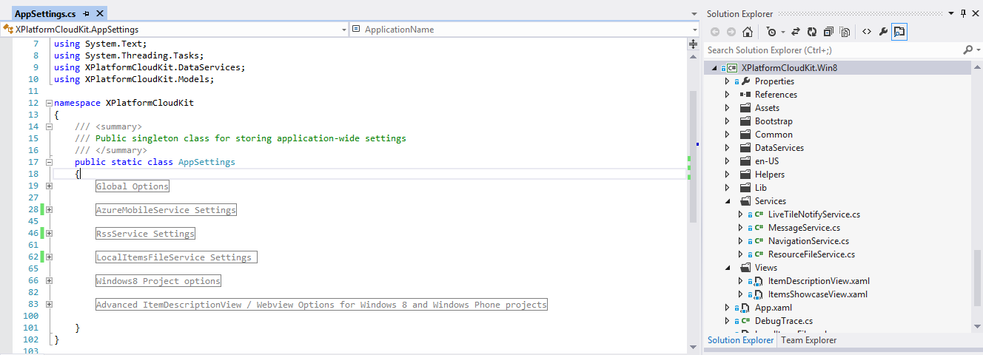
Further Customization – AppSetting.cs (located in XPlatformCloudKit.PCL)
Here you can edit your app display name, time to cache retrieved data, theme to use for Windows 8, privacy policy url, and more. This is the single point of configuration to make the app your own!

Slide 43
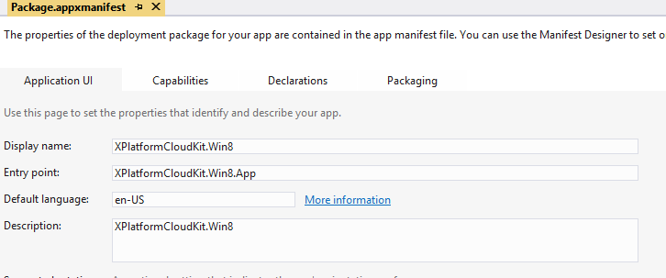
Further Customization - Windows 8
You will also want to open up Package.Appxmanifest in the root of the XPlatformCloudKit.Win8 project.
Here you can edit your app name, description, and set the tile sizes you wish to use and the default image to display on them.

Slide 44
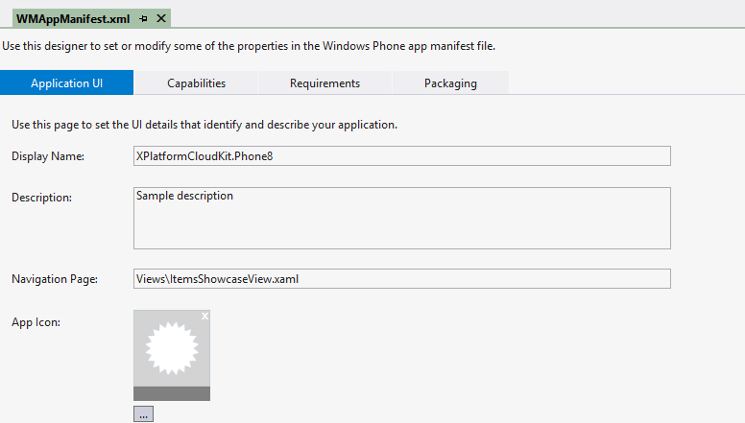
Further Customization – WP8
You will also want to open up WMAppManifest.xml in the “Properties” folder of the XPlatformCloudKit.Phone8 project.
Here you can edit your app name, description, and set the tile sizes you wish to use and the default image to display on them.

Slide 45
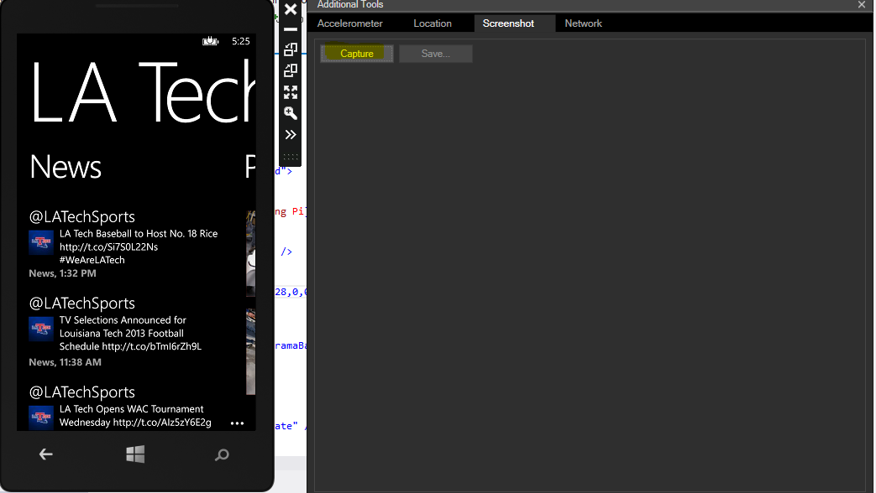
Capturing Screenshots – WP*
Make sure you are deploying to the WXGA emulator
DO NOT CAPTURE IMAGES WITH DEBUGGING ENABLED
The Marketplace will immediately fail your app
To capture screenshots :
click the double arrows (>>) in the emulator -> Screenshot -> Capture -> Save

Slide 46
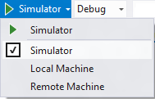
Capturing Screenshots – Windows 8
You may use the Print Screen button on your keyboard to capture screenshots (which must be saved as a .png) if and only if you are running in a resolution of 1366 x 768.
If not, you will want to deploy your app to the Simulator
Then follow the Guide to taking screenshots with Win8 Simulator

Slide 47
Ready to Submit – WP8!
Take a look at the app submission requirements, and make sure you have everything required to submit.
Next, log in with your developer account at https://dev.windowsphone.com/ and click ‘Submit App’ then follow the steps online to submit your application.
You will need your .xap file, at least one screenshot, and a 300x300 PNG for submission. The .xap file is automatically created when your project is built and can be found in your projects directory in the bin\Debug or bin\Release folders.
.

Slide 48
Ready to Submit – Windows 8!
After you have reserved your app's name, set up your payout account, built your app's packages, and tested the app with the Windows App Certification Kit, you're ready to begin the submission process.
To submit an app, you'll need to sign in to your Windows Store Dashboard. (You can get there by clicking the "Dashboard" link near the top of any page in the Windows Store apps Developer Center.)
If you need step-by-step instructions, you can follow this guide to submitting Windows 8 application to the Windows Store.
.

Slide 49
Reward yourself, you earned it!
Be sure to submit your apps to App Builder Rewards and DVLUP for the opportunity to receive prizes (Phones, Xbox games, and more!)

Slide 50
Further Help and Assistance
If you are having trouble with any portion of this lab, please contact Paul DeCarlo at pdecarlo@microsoft.com and I will do my best to help get your application coded, tested, and submitted to the Windows marketplace!

