Slide 1

Computer Science Department University of Crete
HY335. Computer Networks
(Spring 2016)
Instructor: Christos Liaskos, Postdoc Researcher, FORTH
cliaskos@ics.forth.gr

Slide 2
Outline
Routing algorithms:
link state (Dijkstra)
distance vector (Bellman-Ford)
Discussion (optional exercise)

Slide 3
Graph abstraction
5
v
3
w
2
5
u
2
1
z
3
1
2
x
y
1
graph: G = (N,E)
N = set of routers = { u, v, w, x, y, z }
E = set of links ={ (u,v), (u,x), (v,x), (v,w), (x,w), (x,y), (w,y), (w,z), (y,z) }
aside: graph abstraction is useful in other network contexts, e.g.,
P2P, where N is set of peers and E is set of TCP connections

Slide 4
Graph abstraction: costs
5
c(x,x’) = cost of link (x,x’)
e.g., c(w,z) = 5
cost could always be 1, or
inversely related to bandwidth,
or inversely related to
congestion
v
3
w
2
5
u
2
1
z
3
1
2
x
y
1
cost of path (x₁, x₂, x₃,…, x_{p}) = c(x₁,x₂) + c(x₂,x₃) + … + c(x_{p-1},x_{p})
key question: what is the least-cost path between u and z ?
routing algorithm: algorithm that finds that least cost path

Slide 5
Routing algorithm classification
Q: global or decentralized information?
global:
all routers have complete topology, link cost info
“link state” algorithms
decentralized:
router knows physically-connected neighbors, link costs to neighbors
iterative process of computation, exchange of info with neighbors
“distance vector” algorithms
Q: static or dynamic?
static:
routes change slowly over time
dynamic:
routes change more quickly
periodic update
in response to link cost changes

Slide 6
Chapter 4: outline
4.1 introduction
4.2 virtual circuit and datagram networks
4.3 what’s inside a router
4.4 IP: Internet Protocol
datagram format
IPv4 addressing
ICMP
IPv6
4.5 routing algorithms
link state
distance vector
hierarchical routing
4.6 routing in the Internet
RIP
OSPF
BGP
4.7 broadcast and multicast routing

Slide 7
A Link-State Routing Algorithm
Dijkstra’s algorithm
net topology, link costs known to all nodes
accomplished via “link state broadcast”
all nodes have same info
computes least cost paths from one node (‘source”) to all other nodes
gives forwarding table for that node
iterative: after k iterations, know least cost path to k dest.’s
notation:
c(x,y): link cost from node x to y; = ∞ if not direct neighbors
D(v): current value of cost of path from source to dest. v
p(v): predecessor node along path from source to v
N': set of nodes whose least cost path definitively known

Slide 8
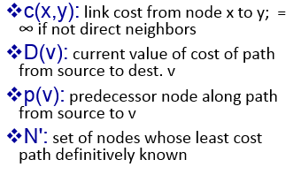
Dijsktra’s Algorithm
1 Initialization:
2 N' = {a}
3 for all nodes v
4 if v adjacent to a
5 then D(v) = c(u,v)
6 else D(v) = ∞
7
8 Loop
9 find w not in N' such that D(w) is a minimum
10 add w to N'
11 update D(v) for all v adjacent to w and not in N' :
12 D(v) = min( D(v), D(w) + c(w,v) )
13 /* new cost to v is either old cost to v or known
14 shortest path cost to w plus cost from w to v */
15 until all nodes in N'
D(b)=2, D(c)=1, D(d)=5
D(e)=Inf
D(f)=Inf
5
b
3
d
2
5
a
2
1
f
3
1
2
c
e
1

Slide 9
Dijkstra’s algorithm: example
D(v)
p(v)
D(w)
p(w)
D(x)
p(x)
D(y)
p(y)
D(z)
p(z)
Step
N'
1
u
7,u
3,u
5,u
∞
∞
2
uw
6,w
5,u
11,w
∞
3
uwx
6,w
11,w
14,x
4
uwxv
10,v
14,x
5
uwxvy
12,y
6
uwxvyz
x
9
notes:
construct shortest path tree by tracing predecessor nodes
ties can exist (can be broken arbitrarily)
5
7
4
8
u
3
w
y
z
2
3
7
4
v

Slide 10
Dijkstra’s algorithm: another example
Step
1
2
3
4
5
6
N'
u
ux
uxy
uxyv
uxyvw
uxyvwz
D(v),p(v)
2,u
2,u
2,u
D(w),p(w)
5,u
4,x
3,y
3,y
D(x),p(x)
1,u
D(y),p(y)
∞
2,x
D(z),p(z)
∞
∞
4,y
4,y
4,y
5
v
3
w
2
5
u
2
1
z
3
1
2
x
y
1

Slide 11
Dijkstra’s algorithm: example (2)
resulting shortest-path tree from u:
v
w
u
z
x
y
resulting forwarding table in u:
destination
link
v
(u,v)
x
(u,x)
y
(u,x)
w
(u,x)
z
(u,x)

Slide 12
Dijkstra’s algorithm, discussion
algorithm complexity: n nodes
each iteration: need to check all nodes, w, not in N
n(n+1)/2 comparisons: O(n²)
more efficient implementations possible: O(nlogn)
oscillations possible:
e.g., support link cost equals amount of carried traffic:
O( (e+logn) n )
A
A
A
A
1
1+e
2+e
0
0
2+e
2+e
0
D
B
D
B
D
B
D
B
0
0
1+e
1
0
0
1+e
1
0
C
e
0
0
1
0
0
1
C
C
1+e
C
1
e
initially
given these costs,
find new routing….
resulting in new costs
given these costs,
find new routing….
resulting in new costs
given these costs,
find new routing….
resulting in new costs

Slide 13
Chapter 4: outline
4.1 introduction
4.2 virtual circuit and datagram networks
4.3 what’s inside a router
4.4 IP: Internet Protocol
datagram format
IPv4 addressing
ICMP
IPv6
4.5 routing algorithms
link state
distance vector
hierarchical routing
4.6 routing in the Internet
RIP
OSPF
BGP
4.7 broadcast and multicast routing

Slide 14
Distance vector algorithm
Bellman-Ford equation (dynamic programming)
let
d_{x}(y) := cost of least-cost path from x to y
then
d_{x}(y) = min {c(x,v) + d_{v}(y) }
1
d₁(y)
c_{(x,1)}
2
x
c_{(x,2)}
d₂(y)
y
c_{(x,3)}
3
d₃(y)
c_{(x,4)}
4
d₄(y)
v
cost from neighbor v to destination y
cost to neighbor v
min taken over all neighbors v of x

Slide 15
Bellman-Ford example
5
clearly, d_{v}(z) = 5, d_{x}(z) = 3, d_{w}(z) = 3
v
3
w
2
5
u
z
B-F equation says:
2
1
3
1
2
d_{u}(z) = min { c(u,v) + d_{v}(z),
c(u,x) + d_{x}(z),
c(u,w) + d_{w}(z) }
= min {2 + 5=7,
1 + 3=4,
5 + 3=8} = 4
x
y
1
node achieving minimum is next
hop in shortest path, used in forwarding table

Slide 16
Distance vector algorithm
D_{x}(y) = estimate of least cost from x to y
x maintains distance vector D_{x} = [D_{x}(y): y є N ]
node x:
knows cost to each neighbor v: c(x,v)
maintains its neighbors’ distance vectors. For each neighbor v, x maintains D_{v} = [D_{v}(y): y є N ]

Slide 17
Distance vector algorithm
key idea:
from time-to-time, each node sends its own distance vector estimate to neighbors
when x receives new DV estimate from neighbor, it updates its own DV using B-F equation:
D_{x}(y) ← min_{v}{c(x,v) + D_{v}(y)} for each node y ∊ N
under minor, natural conditions, the estimate D_{x}(y) converge to the actual least cost d_{x}(y)

Slide 18
Distance vector algorithm
iterative, asynchronous: each local iteration caused by:
local link cost change
DV update message from neighbor
distributed:
each node notifies neighbors only when its DV changes
neighbors then notify their neighbors if necessary
each node:
wait for (change in local link cost or msg from neighbor)
recompute estimates
if DV to any dest has changed, notify neighbors

Slide 19
D_{x}(z) = min{c(x,y) + D_{y}(z),
c(x,z) + D_{z}(z)}
= min{2+1 , 7+0} = 3
D_{x}(y) = min{c(x,y) + D_{y}(y), c(x,z) + D_{z}(y)} = min{2+0 , 7+1} = 2
node x
table
cost to
cost to
x y z
x y z
x
0 2 7
x
0
2
3
y
y
2 0 1
from
∞
∞
∞
from
z
∞
∞
∞
z
7 1 0
node y
table
cost to
x y z
y
2
1
x
∞
∞
z
∞
2 0 1
x
from
y
7
z
∞
∞
∞
node z
table
cost to
x y z
x
∞ ∞ ∞
from
y
∞
∞
∞
z
7
1
0
time

Slide 20
D_{x}(z) = min{c(x,y) + D_{y}(z), c(x,z) + D_{z}(z)}
= min{2+1 , 7+0} = 3
D_{x}(y) = min{c(x,y) + D_{y}(y), c(x,z) + D_{z}(y)} = min{2+0 , 7+1} = 2
node x
table
cost to
cost to
cost to
x y z
x y z
x y z
x
0 2 7
x
0
2
3
x
0 2 3
y
y
2 0 1
from
∞
∞
∞
from
y
2 0 1
z
z
from
∞
∞
∞
7 1 0
z
3 1 0
node y
table
cost to
cost to
cost to
x y z
x y z
x y z
y
2
1
x
∞
∞
x
0 2 7
∞
2 0 1
x
0 2 3
x
z
from
y
y
2 0 1
y
7
from
from
2 0 1
z
∞
∞
∞
z
7 1 0
z
3 1 0
node z
table
cost to
cost to
cost to
x y z
x y z
x y z
x
∞ ∞ ∞
x
0 2 7
x
0 2 3
y
y
2 0 1
from
y
∞
∞
from
2 0 1
from
∞
z
z
3 1 0
z
3 1 0
7
1
0
time
time

Slide 21
Distance vector: link cost changes
link cost changes:
node detects local link cost change
updates routing info, recalculates distance vector
if DV changes, notify neighbors
1
y
4
1
x
z
5
t₀ : y detects link-cost change, updates its DV, informs its neighbors.
“good
news
travels
fast”
t₁ : z receives update from y, updates its table, computes new least cost to x , sends its neighbors its DV.
t₂ : y receives z’s update, updates its distance table. y’s least costs do not change, so y does not send a message to z.

Slide 22
Distance vector: link cost changes
link cost changes:
node detects local link cost change
bad news travels slow - “count to infinity” problem!
44 iterations before algorithm stabilizes: see text
60
y
4
1
x
z
50
Before the damage: D_{y}(x)=4, D_{y}(z)=1, D_{z}(x)=5
t₀: The link breaks!
poisoned reverse:
If Z routes through Y to get to X :
Z tells Y its (Z’s) distance to X is infinite
(so Y won’t route to X via Z)
will this completely solve count to infinity problem?
“Y” finds out, updates its D() and FWs it:
Y→ D_{y}(x)=60, D_{y}(z)=1, D_{y}(x)=6
“Z” now believes that Y has a path to “x” with cost “6”!!!

Slide 23
Comparison of LS and DV algorithms
message complexity
LS: with n nodes, E links, O(nE) msgs sent
DV: exchange between neighbors only
convergence time varies
speed of convergence
LS: O(n logn) algorithm requires O(nE) msgs
may have oscillations
DV: convergence time varies
may be routing loops
count-to-infinity problem
robustness: what happens if router malfunctions?
LS:
node can advertise incorrect link cost
each node computes only its own table
DV:
DV node can advertise incorrect path cost
each node’s table used by others
error propagate thru network

Slide 24
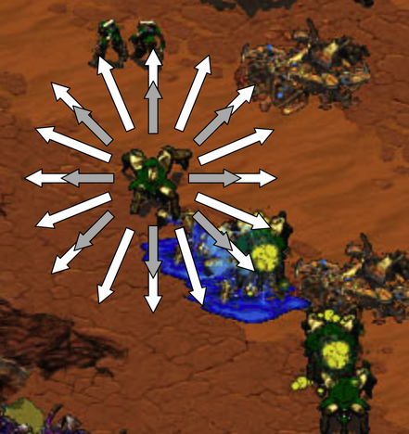
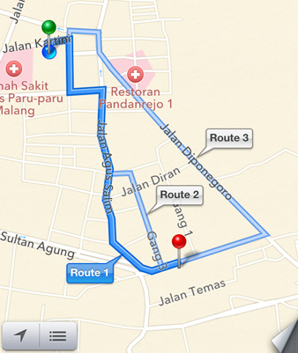
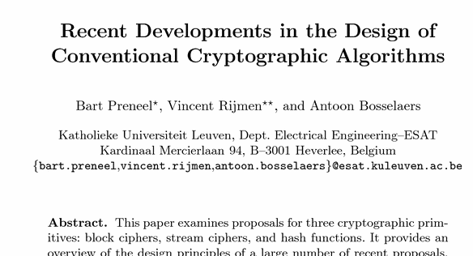
Discussion
Dijkstra
A* Algorithm

