Slide 1

Computer Science Department
University of Crete
HY335. Computer Networks
(Spring 2016)
Instructor:
Christos Liaskos, Postdoc Researcher, FORTH
cliaskos@ics.forth.gr

Slide 2
Chapter 5: The Data Link Layer
Our goals:
understand principles behind data link layer services:
  error detection, correction
  sharing a broadcast channel: multiple access
  link layer addressing
  reliable data transfer, flow control: done!
instantiation and implementation of various link layer technologies
5: DataLink Layer
5-<number>

Slide 3
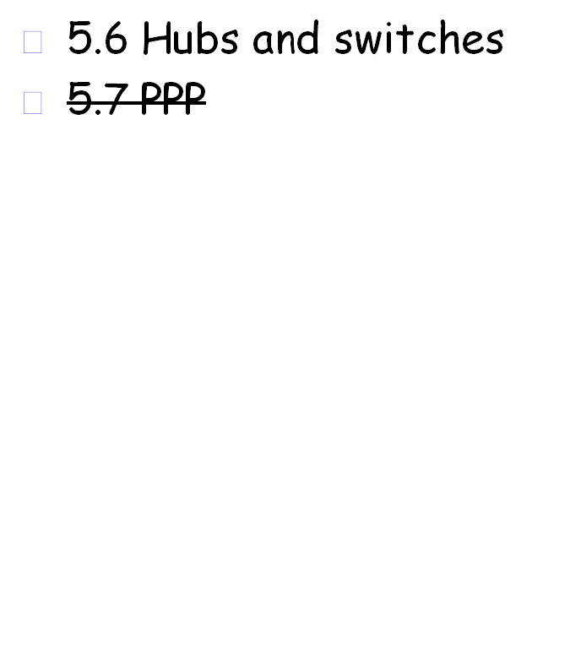
Link Layer
5.1 Introduction and services
5.2 Error detection and correction
5.3Multiple access protocols
5.4 Link-Layer Addressing
5.5 Ethernet
5: DataLink Layer
5-<number>

Slide 4





Link Layer: Introduction
“link”
Some terminology:
hosts and routers are nodes
communication channels that connect adjacent nodes along communication path are links
  wired links
  wireless links
  LANs
layer-2 packet is a frame, encapsulates datagram
data-link layer has responsibility of
transferring datagram from one node
to adjacent node over a link
5: DataLink Layer
5-<number>

Slide 5
Link layer: context
Datagram transferred by different link protocols over different links:
  e.g., Ethernet on first link, frame relay on intermediate links, 802.11 on last link
Each link protocol provides different services
  e.g., may or may not provide rdt over link
transportation analogy
trip from Princeton to Lausanne
  Princeton to JFK by car
  JFK to Geneva by plane
  Geneva to Lausanne by train
tourist = datagram
transport segment = communication link
transportation mode = link layer protocol
travel agent = routing algorithm
5: DataLink Layer
5-<number>

Slide 6
Link Layer Services
Framing, link access:
  encapsulate datagram into frame, adding header, trailer
  channel access, if shared medium
  “MAC” addresses used in frame headers to identify source, dest
    different from IP address!
Reliable delivery between adjacent nodes
  we learned how to do this already (chapter 3)!
  seldom used on low bit-error link (fiber, some twisted pair)
  wireless links: high error rates
    Q: why both link-level and end-end reliability?
5: DataLink Layer
5-<number>

Slide 7
Link Layer Services (more)
Flow Control:
  pacing between adjacent sending and receiving nodes
Error Detection:
  errors caused by signal attenuation, noise.
  receiver detects presence of errors:
    signals sender for retransmission or drops frame
Error Correction:
  receiver identifies and corrects bit error(s) without resorting to retransmission
Half-duplex and full-duplex
  with half duplex, nodes at both ends of link can transmit, but not at same time
5: DataLink Layer
5-<number>

Slide 8
Adaptors Communicating
datagram
link layer protocol
rcving
node
sending
node
frame
frame
adapter
adapter
link layer implemented in “adaptor” (aka NIC)
  Ethernet card, PCMCI card, 802.11 card
sending side:
  encapsulates datagram in a frame
  adds error checking bits, rdt, flow control, etc.
receiving side
  looks for errors, rdt, flow control, etc
  extracts datagram, passes to rcving node
adapter is semi-autonomous
link & physical layers
5: DataLink Layer
5-<number>

Slide 9
Link Layer
5.1 Introduction and services
5.2 Error detection and correction
5.3Multiple access protocols
5.4 Link-Layer Addressing
5.5 Ethernet
5.6 Hubs and switches
5.7 PPP
5: DataLink Layer
5-<number>

Slide 10

Error Detection
EDC= Error Detection and Correction bits (redundancy)
D = Data protected by error checking, may include header fields
Error detection not 100% reliable!
  protocol may miss some errors, but rarely
  larger EDC field yields better detection and correction
5: DataLink Layer
5-<number>

Slide 11


Parity Checking
Single Bit Parity:
Detect single bit errors
Two Dimensional Bit Parity:
Detect and correct single bit errors
0
0
Forward Error Correction (FEC)
5: DataLink Layer
5-<number>

Slide 12
Internet checksum
Goal: detect “errors” (e.g., flipped bits) in transmitted segment (note: used at transport layer only)
Sender:
treat segment contents as sequence of 16-bit integers
checksum: addition (1’s complement sum) of segment contents
sender puts checksum value into UDP checksum field
Receiver:
compute checksum of received segment
check if computed checksum equals checksum field value:
  NO - error detected
  YES - no error detected. But maybe errors nonetheless? More later ….
5: DataLink Layer
5-<number>

Slide 13
Internet Checksum Example
Example: adding several 16-bit integers
1 1 1 1 0 0 1 1 0 0 1 1 0 0 1 1 0
1 1 1 0 1 0 1 0 1 0 1 0 1 0 1 0 1
1 0 1 1 1 0 1 0 1 1 1 0 1 0 0 0 1
1 1 1 0 1 0 0 1 0 0 0 0 1 0 1 1 0
0 0 1 0 1 0 1 1 0 0 1 1 0 0 1 0
1 1 0 1 1 0 1 0 1 1 0 0 1 1 0 1
0 1 1 0 0 1 0 1 1 0 1 1 0 0 1 0
1 b₀ b₁ b₂ b₃ b₄ b₅ b₆ b₇ b₈ b₉ b₁₀ b₁₁ b₁₂ b₁₃ b₁₄ b₁₅1
...
5: DataLink Layer
5-<number>

Slide 14

Checksumming: Cyclic Redundancy Check
view data bits, D, as a binary number
choose r+1 bit pattern (generator), G
goal: choose r CRC bits, R, such that
  <D,R> exactly divisible by G (modulo 2)
  receiver knows G, divides <D,R> by G. If non-zero remainder: error detected!
  can detect all burst errors less than r+1 bits
  can detect burst of length > r+1 with prob 1-0.5^{r}
widely used in practice (Ethernet, ATM)
5: DataLink Layer
5-<number>

Slide 15
Link Layer
5.1 Introduction and services
5.2 Error detection and correction
5.3Multiple access protocols
5.4 Link-Layer Addressing
5.5 Ethernet
5: DataLink Layer
5-<number>

Slide 16

Multiple Access Links and Protocols
Two types of “links”:
point-to-point
  PPP for dial-up access
  point-to-point link between Ethernet switch and host
broadcast (shared wire or medium)
  traditional Ethernet
  802.11 wireless LAN
5: DataLink Layer
5-<number>

Slide 17
MAC Protocols: a taxonomy
Three broad classes:
Channel Partitioning
  divide channel into smaller “pieces” (time slots, frequency, code)
  allocate piece to node for exclusive use
Random Access
  channel not divided, allow collisions
  “recover” from collisions
“Taking turns”
  Nodes take turns, but nodes with more to send can take longer turns
5: DataLink Layer
5-<number>

Slide 18

Channel Partitioning MAC protocols: TDMA
TDMA: time division multiple access
access to channel in "rounds"
each station gets fixed length slot (length = packet transmission time) in each round
unused slots go idle
example: 6-station LAN, 1,3,4 have pkt, slots 2,5,6 idle
TDM (Time Division Multiplexing): channel divided into N time slots, one per user; inefficient with low duty cycle users and at light load.
FDM (Frequency Division Multiplexing): frequency subdivided.
5: DataLink Layer
5-<number>

Slide 19
Channel Partitioning MAC protocols: FDMA
FDMA: frequency division multiple access
channel spectrum divided into frequency bands
each station assigned fixed frequency band
unused transmission time in frequency bands go idle
example: 6-station LAN, 1,3,4 have pkt, frequency bands 2,5,6 idle
TDM (Time Division Multiplexing): channel divided into N time slots, one per user; inefficient with low duty cycle users and at light load.
FDM (Frequency Division Multiplexing): frequency subdivided.
time
frequency bands
5: DataLink Layer
5-<number>

Slide 20
Code Division Multiple Access (CDMA)
unique “code” assigned to each user; i.e., code set partitioning
  all users share same frequency, but each user has own “chipping” sequence (i.e., code) to encode data
  allows multiple users to “coexist” and transmit simultaneously with minimal interference (if codes are “orthogonal”)
encoded signal = (original data) X (chipping sequence)
decoding: inner-product of encoded signal and chipping sequence
Wireless, Mobile Networks
6-<number>

Slide 21
Random Access Protocols
When node has packet to send
  transmit at full channel data rate R.
  no a priori coordination among nodes
two or more transmitting nodes ➜ “collision”,
random access MAC protocol specifies:
  how to detect collisions
  how to recover from collisions (e.g., via delayed retransmissions)
Examples of random access MAC protocols:
  slotted ALOHA, ALOHA
  CSMA, CSMA/CD
5: DataLink Layer
5-<number>

Slide 22
Slotted ALOHA
Assumptions
all frames same size (L)
time is divided into equal size slots, time to transmit a frame (L/R)
nodes start to transmit frames only at beginning of slots
nodes are synchronized
if two or more nodes transmit in slot, all nodes detect collision
Operation
when node obtains fresh frame, it transmits in next slot
if no collision, node can send new frame in next slot
if collision, node retransmits frame in each subsequent slot with prob. p until success
5: DataLink Layer
5-<number>

Slide 23

Slotted ALOHA
Pros
single active node can continuously transmit at full rate of channel
highly decentralized: only slots in nodes need to be in sync
simple
Cons
collisions, wasting slots
idle slots
nodes may be able to detect collision in less than time to transmit packet
clock synchronization
5: DataLink Layer
5-<number>

Slide 24
Slotted Aloha efficiency
Efficiency is the long-run
fraction of successful slots
when there are many nodes, each with many frames to send
For max efficiency with N nodes, find p* that maximizes
Np(1-p)^{N-1}
For many nodes, take limit of Np*(1-p*)^{N-1} as N goes to infinity, gives 1/e = .37
Suppose N nodes with many frames to send, each transmits in slot with probability p
prob that node 1 has success in a slot = p(1-p)^{N-1}
prob that any node has a success = Np(1-p)^{N-1}
At best: channel
used for useful
transmissions 37%
of time!
5: DataLink Layer
5-<number>

Slide 25

Pure (unslotted) ALOHA
unslotted Aloha: simpler, no synchronization
when frame first arrives
  transmit immediately
collision probability increases:
  frame sent at t₀ collides with other frames sent in [t₀-1,t₀+1]
5: DataLink Layer
5-<number>

Slide 26
Pure Aloha efficiency
P(success by given node) = P(node transmits) .
P(no other node transmits in [t₀-1,t₀] .
P(no other node transmits in [t₀,t₀+1]
= p . (1-p)^{N-1 .} (1-p)^{N-1}
= p . (1-p)^{2(N-1)}
… choosing optimum p and then letting n -> infty ...
^{= 1/(2e) = .18}
Even worse !
5: DataLink Layer
5-<number>

Slide 27
CSMA (Carrier Sense Multiple Access)
CSMA: listen before transmit:
If channel sensed busy: defer transmission
If channel sensed idle: transmit entire frame
Human analogy: don’t interrupt others!
5: DataLink Layer
5-<number>

Slide 28

CSMA collisions
spatial layout of nodes
collisions can still occur:
propagation delay means
two nodes may not hear
each other’s transmission
collision:
entire packet transmission
time wasted
t₂
note:
role of distance & propagation delay in determining collision probability
5: DataLink Layer
5-<number>

Slide 29
CSMA/CD (Collision Detection)
CSMA/CD: carrier sensing, deferral as in CSMA
  collisions detected within short time
  colliding transmissions aborted, reducing channel wastage
collision detection:
  easy in wired LANs: measure signal strengths, compare transmitted, received signals
  difficult in wireless LANs: receiver shut off while transmitting
human analogy: the polite conversationalist
5: DataLink Layer
5-<number>

Slide 30

CSMA/CD collision detection
5: DataLink Layer
5-<number>

Slide 31
“Taking Turns” MAC protocols
channel partitioning MAC protocols:
  share channel efficiently and fairly at high load
  inefficient at low load: delay in channel access, 1/N bandwidth allocated even if only 1 active node!
Random access MAC protocols
  efficient at low load: single node can fully utilize channel
  high load: collision overhead
“taking turns” protocols
  look for best of both worlds!
5: DataLink Layer
5-<number>

Slide 32
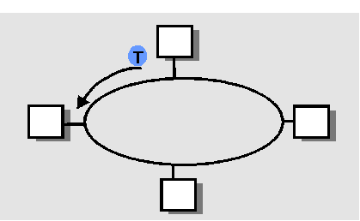
“Taking Turns” MAC protocols
Polling:
master node “invites” slave nodes to transmit in turn
concerns:
  polling overhead
  latency
  single point of failure (master)
Token passing:
control token passed from one node to next sequentially.
token message
concerns:
  token overhead
  latency
  single point of failure (token)
5: DataLink Layer
5-<number>

Slide 33
Summary of MAC protocols
What do you do with a shared media?
  Channel Partitioning, by time, frequency or code
    Time Division, Frequency Division
  Random partitioning (dynamic),
    ALOHA, S-ALOHA, CSMA, CSMA/CD
    carrier sensing: easy in some technologies (wire), hard in others (wireless)
    CSMA/CD used in Ethernet
  Taking Turns
    polling from a central site, token passing
5: DataLink Layer
5-<number>

Slide 34
Questions?
5: DataLink Layer
5-<number>

