Slide 1

Computer Science Department
University of Crete
HY335. Computer Networks
(Spring 2016)
Instructor:
Christos Liaskos, Postdoc Researcher, FORTH
cliaskos@ics.forth.gr

Slide 2
Chapter 6 outline
Introduction
IEEE 802.11 wireless LANs (“Wi-Fi”)
Wireless, Mobile Networks
6-<number>

Slide 3
Wireless Link Characteristics (1)
important differences from wired link ….
  decreased signal strength: radio signal attenuates as it propagates through matter (path loss)
  interference from other sources: standardized wireless network frequencies (e.g., 2.4 GHz) shared by other devices (e.g., phone); devices (motors) interfere as well
  multipath propagation: radio signal reflects off objects ground, arriving ad destination at slightly different times
…. make communication across (even a point to point) wireless link much more “difficult”
Wireless, Mobile Networks
6-<number>

Slide 4
Wireless Link Characteristics (2)
SNR: signal-to-noise ratio
  larger SNR – easier to extract signal from noise (a “good thing”)
SNR versus BER tradeoffs
  given physical layer: increase power -> increase SNR->decrease BER
  given SNR: choose physical layer that meets BER requirement, giving highest thruput
    SNR may change with mobility: dynamically adapt physical layer (modulation technique, rate)
10⁻¹
10⁻²
10⁻³
BER
10⁻⁴
10⁻⁵
10⁻⁶
10⁻⁷
10
20
30
40
SNR(dB)
QAM256 (8 Mbps)
QAM16 (4 Mbps)
BPSK (1 Mbps)
Wireless, Mobile Networks
6-<number>

Slide 5


Wireless network characteristics
Multiple wireless senders and receivers create additional problems (beyond multiple access):
A
B
C
C
A’s signal
strength
C’s signal
strength
B
A
Hidden terminal problem
B, A hear each other
B, C hear each other
A, C can not hear each other means A, C unaware of their interference at B
space
Signal attenuation:
B, A hear each other
B, C hear each other
A, C can not hear each other interfering at B
Wireless, Mobile Networks
6-<number>

Slide 6
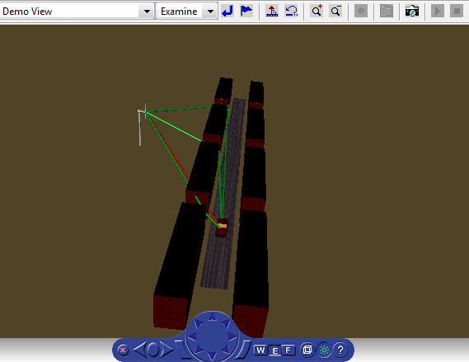
IEEE 802.11 Wireless LAN
802.11b
2.4-5 GHz unlicensed spectrum
up to 11 Mbps
direct sequence spread spectrum (DSSS) in physical layer
  all hosts use same chipping code
802.11a
  5-6 GHz range
  up to 54 Mbps
802.11g
  2.4-5 GHz range
  up to 54 Mbps
802.11n: multiple antennae
  2.4-5 GHz range
  up to 200 Mbps
all use CSMA/CA for multiple access
all have base-station and ad-hoc network versions
Wireless, Mobile Networks
6-<number>

Slide 7






802.11 LAN architecture
wireless host communicates with base station
  base station = access point (AP)
Basic Service Set (BSS) (aka “cell”) in infrastructure mode contains:
  wireless hosts
  access point (AP): base station
  ad hoc mode: hosts only
Internet
hub, switch
or router
BSS 1
BSS 2
Wireless, Mobile Networks
6-<number>

Slide 8
802.11: Channels, association
802.11b: 2.4GHz-2.485GHz spectrum divided into 11 channels at different frequencies
  AP admin chooses frequency for AP
  interference possible: channel can be same as that chosen by neighboring AP!
host: must associate with an AP
  scans channels, listening for beacon frames containing AP’s name (SSID) and MAC address
  selects AP to associate with
  may perform authentication
  will typically run DHCP to get IP address in AP’s subnet
Wireless, Mobile Networks
6-<number>

Slide 9
802.11: passive/active scanning
BBS 1
BBS 2
BBS 1
BBS 2
1
AP 2
AP 1
1
1
AP 2
AP 1
2
2
2
3
3
4
H1
H1
passive scanning:
beacon frames sent from APs
association Request frame sent: H1 to selected AP
association Response frame sent from selected AP to H1
active scanning:
Probe Request frame broadcast from H1
Probe Response frames sent from APs
Association Request frame sent: H1 to selected AP
Association Response frame sent from selected AP to H1
Wireless, Mobile Networks
6-<number>

Slide 10




IEEE 802.11: multiple access
avoid collisions: 2⁺ nodes transmitting at same time
802.11: CSMA - sense before transmitting
  don’t collide with ongoing transmission by other node
802.11: no collision detection!
  difficult to receive (sense collisions) when transmitting due to weak received signals (fading)
  can’t sense all collisions in any case: hidden terminal, fading
  goal: avoid collisions: CSMA/C(ollision)A(voidance)
A
B
C
C
B
A’s signal
strength
C’s signal
strength
A
space
Wireless, Mobile Networks
6-<number>

Slide 11
IEEE 802.11 MAC Protocol: CSMA/CA
802.11 sender
1 if sense channel idle then
  transmit entire frame (no CD)
2 if sense channel busy then
  start random backoff time
  timer counts down while channel idle
  transmit when timer expires
  if no ACK, increase random backoff interval, repeat 2
802.11 receiver
- if frame received OK
return ACK (ACK needed due to hidden terminal problem)
sender
receiver
data
ACK
Wireless, Mobile Networks
6-<number>

Slide 12
Avoiding collisions (more)
idea: allow sender to “reserve” channel rather than random access of data frames: avoid collisions of long data frames
sender first transmits small request-to-send (RTS) packets to BS using CSMA
  RTSs may still collide with each other (but they’re short)
BS broadcasts clear-to-send CTS in response to RTS
CTS heard by all nodes
  sender transmits data frame
  other stations defer transmissions
avoid data frame collisions completely
using small reservation packets!
Wireless, Mobile Networks
6-<number>

Slide 13


Collision Avoidance: RTS-CTS exchange
A
B
AP
RTS(B)
RTS(A)
reservation collision
RTS(A)
CTS(A)
CTS(A)
DATA (A)
defer
time
ACK(A)
ACK(A)
Wireless, Mobile Networks
6-<number>

Slide 14
802.11 frame addressing
frame seq #
(for RDT)
duration of reserved
transmission time (RTS/CTS)
2
2
6
6
6
2
6
0 - 2312
4
frame
control
duration
address
1
address
2
address
3
seq
control
address
4
payload
CRC
2
2
4
1
1
1
1
1
1
1
1
Protocol
version
Type
Subtype
To
AP
From
AP
More
frag
Retry
Power
mgt
More
data
WEP
Rsvd
frame type
(RTS, CTS, ACK, data)
Wireless, Mobile Networks
6-<number>

Slide 15
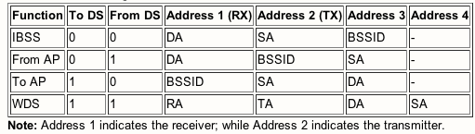
802.11 frame addressing++
2
2
6
6
6
2
6
0 - 2312
4
frame
control
duration
address
1
address
2
address
3
seq
control
address
4
payload
CRC
Address 4: used only in ad hoc mode
Address 1: MAC address
of wireless host or AP
to receive this frame
Address 3: MAC address
of router interface to which AP is attached
Address 2: MAC address
of wireless host or AP
transmitting this frame
DA: Dest. Address
RA: Receiver Address
TA: Transmitter Address
SA: Source Address
BSSID: “Name” of WiFi
Wireless, Mobile Networks
6-<number>

Slide 16
802.11 frame: addressing
Internet
H1
R1
router
R1 MAC addr H1 MAC addr
dest. address
source address
AP MAC addr H1 MAC addr R1 MAC addr
address 1
address 2
address 3
802.11 frame
Wireless, Mobile Networks
6-<number>

Slide 17











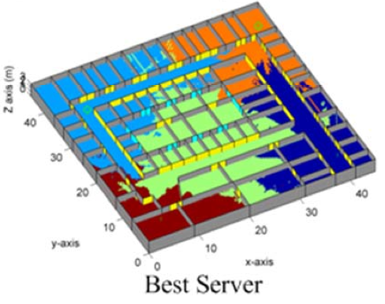
802.11: mobility within same subnet
H1 remains in same IP subnet: IP address can remain same
switch: which AP is associated with H1?
  self-learning (Ch. 5): switch will see frame from H1 and “remember” which switch port can be used to reach H1
BBS 1
H1
BBS 2
Wireless, Mobile Networks
6-<number>

Slide 18
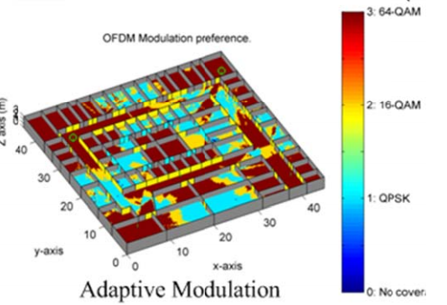
802.11: advanced capabilities
QAM256 (8 Mbps)
QAM16 (4 Mbps)
BPSK (1 Mbps)
Rate adaptation
base station, mobile dynamically change transmission rate (physical layer modulation technique) as mobile moves, SNR varies
operating point
10⁻¹
10⁻²
10⁻³
BER
10⁻⁴
10⁻⁵
10⁻⁶
10⁻⁷
10
20
30
40
SNR(dB)
1. SNR decreases, BER increase as node moves away from base station
2. When BER becomes too high, switch to lower transmission rate but with lower BER
Wireless, Mobile Networks
6-<number>

Slide 19
802.11: advanced capabilities
power management
node-to-AP: “I am going to sleep until next beacon frame”
  AP knows not to transmit frames to this node
  node wakes up before next beacon frame
beacon frame: contains list of mobiles with AP-to-mobile frames waiting to be sent
  node will stay awake if AP-to-mobile frames to be sent; otherwise sleep again until next beacon frame
Wireless, Mobile Networks
6-<number>

Slide 20
Questions?
5: DataLink Layer
5-<number>

