Slide 1
How to apply pay divided of tuition fee

Slide 2
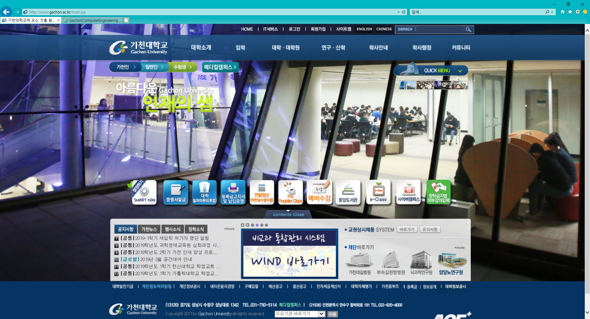
1. Log in and click the Red circle’s button

Slide 3
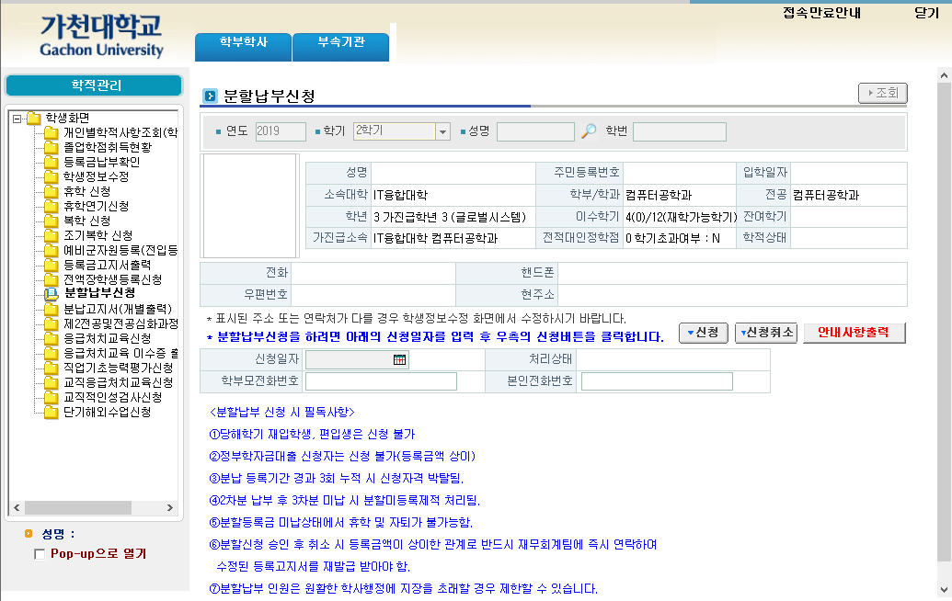
2. Click registration button(1) and input your Mobile phone number(2), and click the register button(3)
1
3
2

