Slide 1
How to print out tuition fees

Slide 2
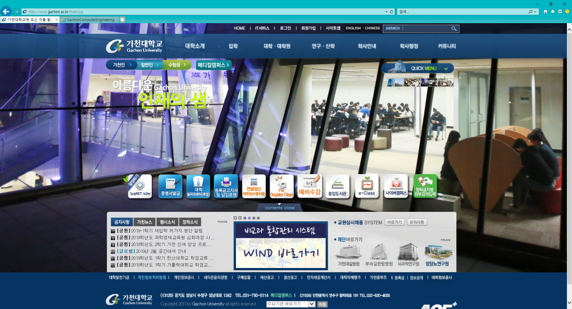
1. Click button in red circle

Slide 3
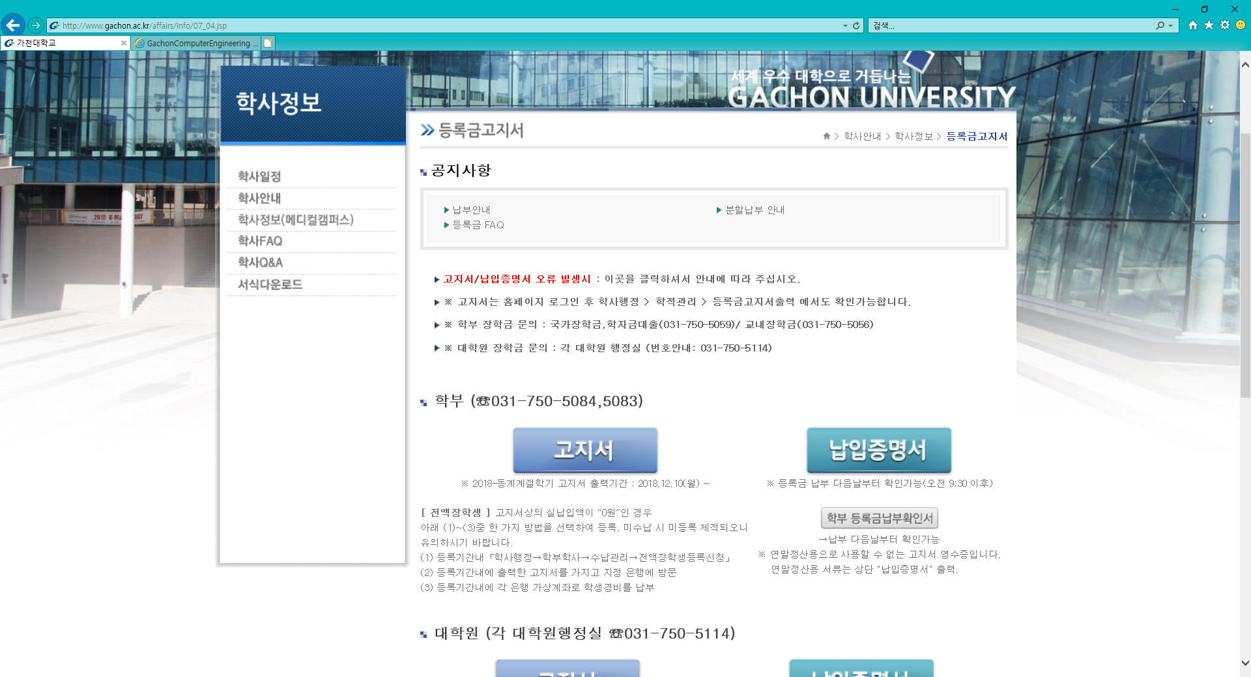
2. Click bills button in red circle

Slide 4
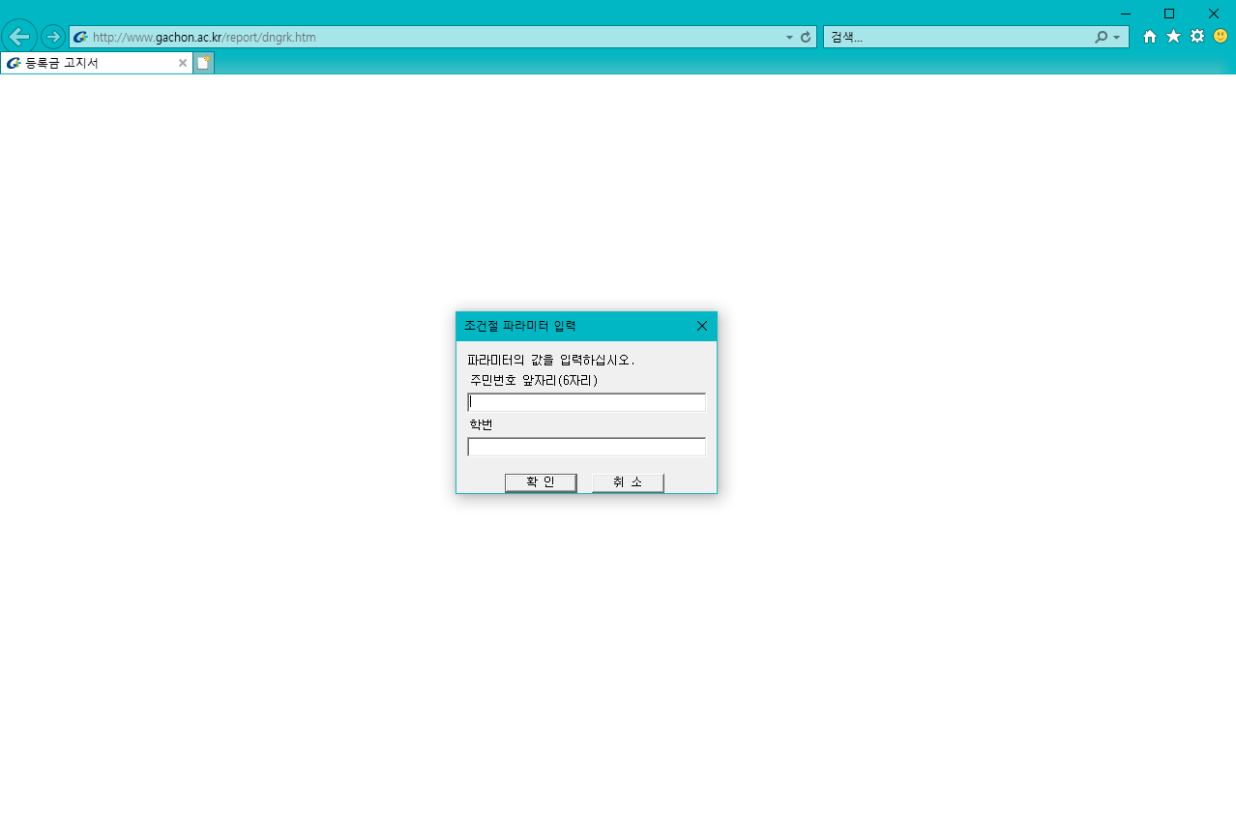
3. Fill out that 2 inputs and click confirm button
1999.10.21
Birth date 6 digit -> 991021
Student number

Slide 5
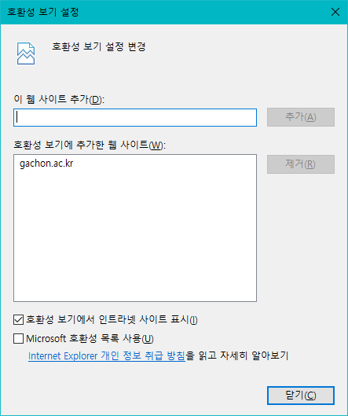
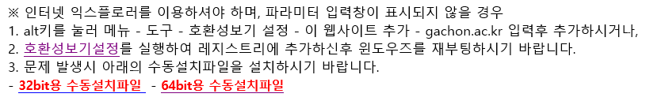
※ If the input form doesn’t show up
Warning! You must start at ‘Internet Explorer’
Solution 1.
- Press ‘Alt’ -> ‘T’ -> ‘B’
- Write down ‘gachon.ac.kr’ in the red circle’s input
- Click ‘add(A)’ and ‘exit(C)’
Solution 2.
- Click one of red link texts(left:32bit / right:64bit)
- Run the ‘CX60 ~.exe’
- Restart the progress

Slide 6
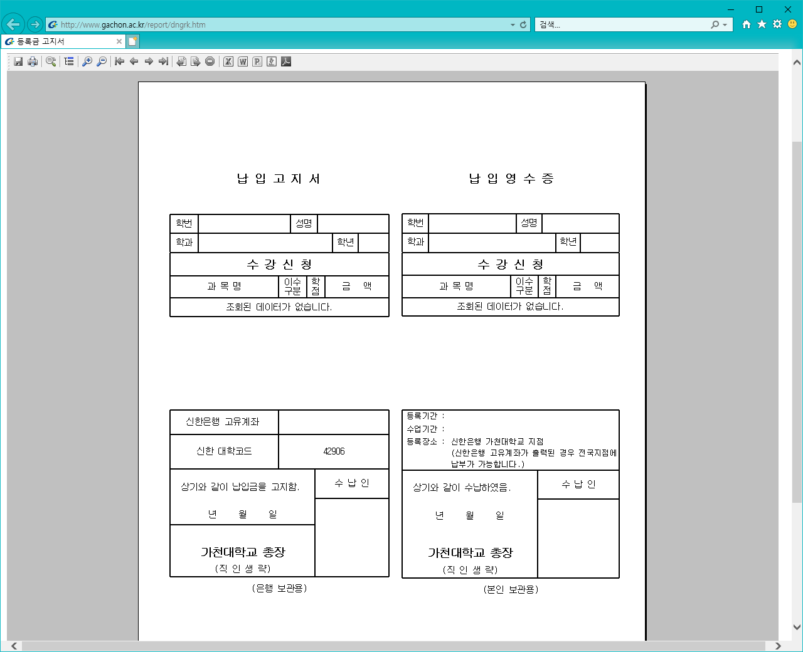
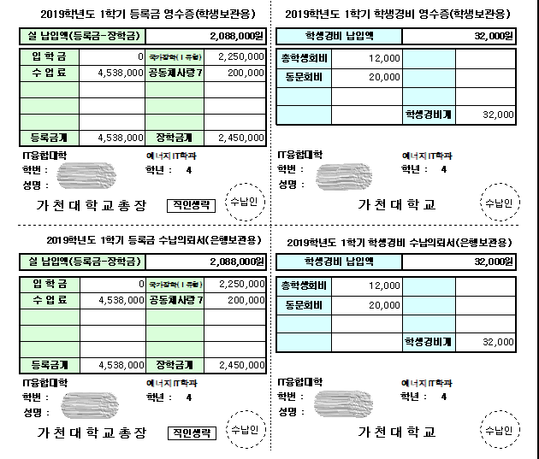
4. Check your fees and click the ‘Printer’ button
This is about student fee like student council, alumni association. If you don’t want to pay this, you can skip .
This is ‘Printer’ button
This part is final tuition fee.
※ You must pay the fee in this circle!
This is for you to keep receipt
This part is total tuition fee
This part is total scholarship
This is for bank to keep receipt
※ This is just sample. So, although you get the different tuition fee notice, it doesn’t matter about your tuition fee.

