Slide 1
Lab 4 Nematode Experiment Data Collection and DNA Extraction

Slide 2
Housekeeping
Today
Lab 4 Pre-Lab
Annotated Bibliography
Article Discussion
Skills Demonstrations
Next Week
Lab 5 Pre-Lab
Midterm Exam – Monday, October 28 @ 7PM in LINC 228

Slide 3
Lab Objectives
Conduct biological experiments and demonstrate scientific skills
Use molecular biology skills including DNA extraction and using micropipettes

Slide 4
Part 1: Annotated Bibliography – Article Discussion
Discuss your articles (8 minutes)
Take turns (2 minutes per person) to summarize the article you found for your Annotated Bibliography Assignment
How does the article relate to the group QHP?
What information might you cite in your Individual Product assignment at the end of the term?

Slide 5
Part 2: Nematode Diversity and Abundance Data Collection
Find your plate from last week
Examine nematodes on plate
Examine under the microscope using black paper for contrast
Manipulate amount of light by adjusting the iris diaphragm
Record observations (# nematodes per sample (abundance), # of species (richness), size, appearance of mouthparts, movement (fast/slow)
**Note** Despite our best efforts, it is possible that given the number of steps between nematode observations and sequencing, something could go awry and you may not have sequence data to work with. It is in your best interest to collect this data thoroughly so that you have data to use for your project in the event that you do not obtain sequence data**

Slide 6
Part 2: Nematode Diversity and Abundance Data Collection
Types of data to collect
Table 4-1
Collection Location
# of nematodes (abundance)
# of species (richness)
Observations (speed, morphology)
Enter this data into the shared spreadsheet on Canvas

Slide 7
Parts 3 & 4: DNA Extraction
Learning how to extract DNA from samples is a broadly applicable skill!
What is DNA Extraction?
A method of purifying DNA using physical and/or chemical methods from a sample to separate the DNA from the cell membranes, proteins, and other cellular components

Slide 8
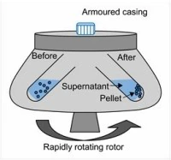
Part 3: Extraction Prep – Centrifugation
Centrifuges isolate different components based on size or density (commonly used laboratory technique)
In this step, we will create a pellet from our nematodes and move them to a new solution for DNA extraction (keep pellet)
Make sure to balance the centrifuge!
TA Demo

Slide 9
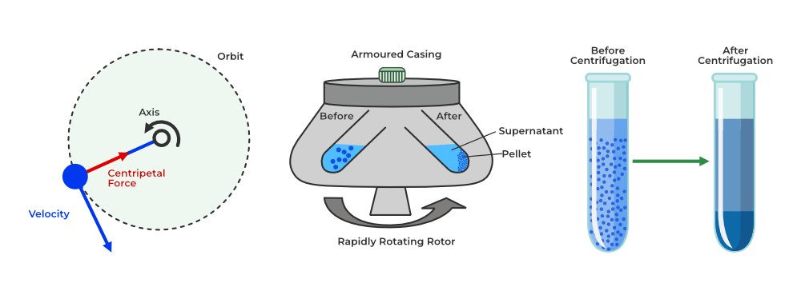
Centrifuge - it’s all about balance…

Slide 10
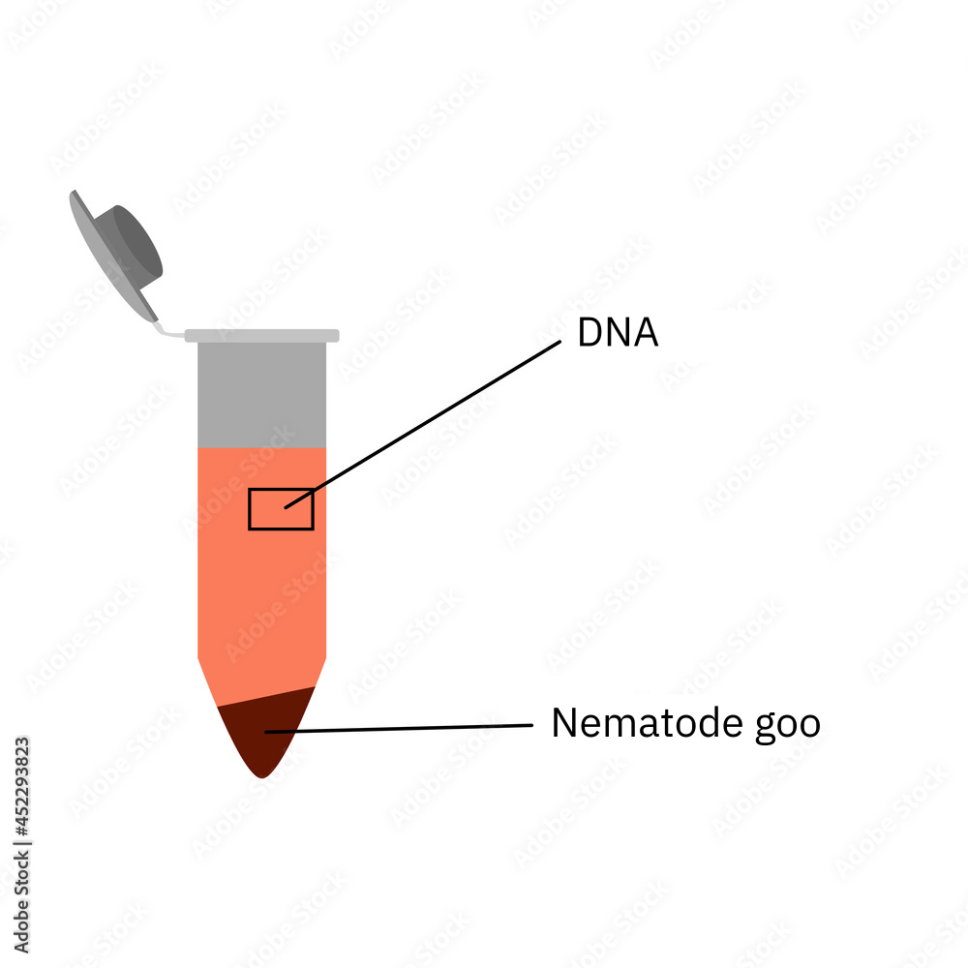
Supernatant has the DNA

Slide 11
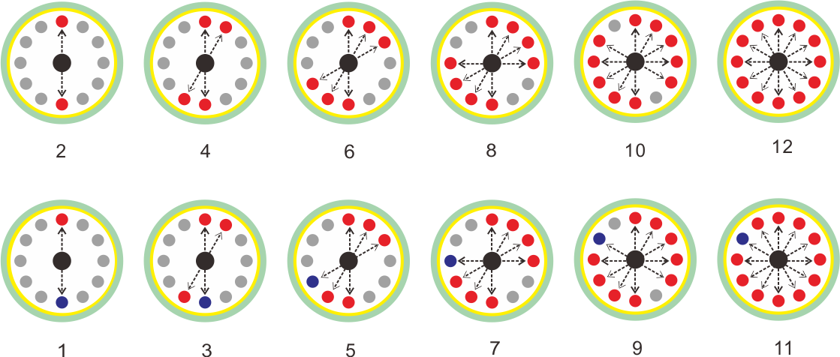

Slide 12
Part 4: Nematode DNA Extraction
Method:
Add lysis buffer – what does lysis buffer do?
Breaks open the cell to release contents (chemical disruption)
Grind sample using micro pestle (physical disruption)*
*Sterile technique: use a new tip each sample
Spin sample in microcentrifuge
Debris will fall to the bottom, sample will remain in suspension
Label PCR tube (0.2 ul tube) with sample identifier
Place in thermocycler for incubation

Slide 13
Part 5: Data Analysis in Excel
Guiding question: Is there a relationship between abundance or diversity (richness) of nematodes and the species or size of local slugs?
We will test using a linear regression
A linear regression finds the best-fitting line through your data points
The line describes the relationship between your explanatory and response variables
In this case – what is the explanatory and what is the response?

Slide 14
Part 5: Data Analysis in Excel
Download the Excel spreadsheet from Canvas – do not use the shared Google sheet for your analyses
Create a scatter plot – what does a scatter plot look like?
How to make a scatter plot in Excel
Quick demo!
Notes:
https://www.youtube.com/watch?v=gBbGBrHTMrM
You can skip the add legend portion of the video and go straight to add a trendline
You can either do this by having them watch a v

Slide 15
Part 5: Data Analysis in Excel
Figure captions should be standalone, i.e., descriptive enough to be understood without having to refer to the main text. Effective captions typically include the following elements:
A declarative title that summarizes the results or major findings of the ata you are presenting in the figure;
A brief description of the methods necessary to understand the figure without having to refer to the main text;
Statistical information, for example, number of replicates, asterisks denoting P-values, statistical test, etc.
https://www.internationalscienceediting.com/how-to-write-a-figure-caption/
Notes:
https://www.youtube.com/watch?v=gBbGBrHTMrM
You can skip the add legend portion of the video and go straight to add a trendline
You can either do this by having them watch a v

Slide 16
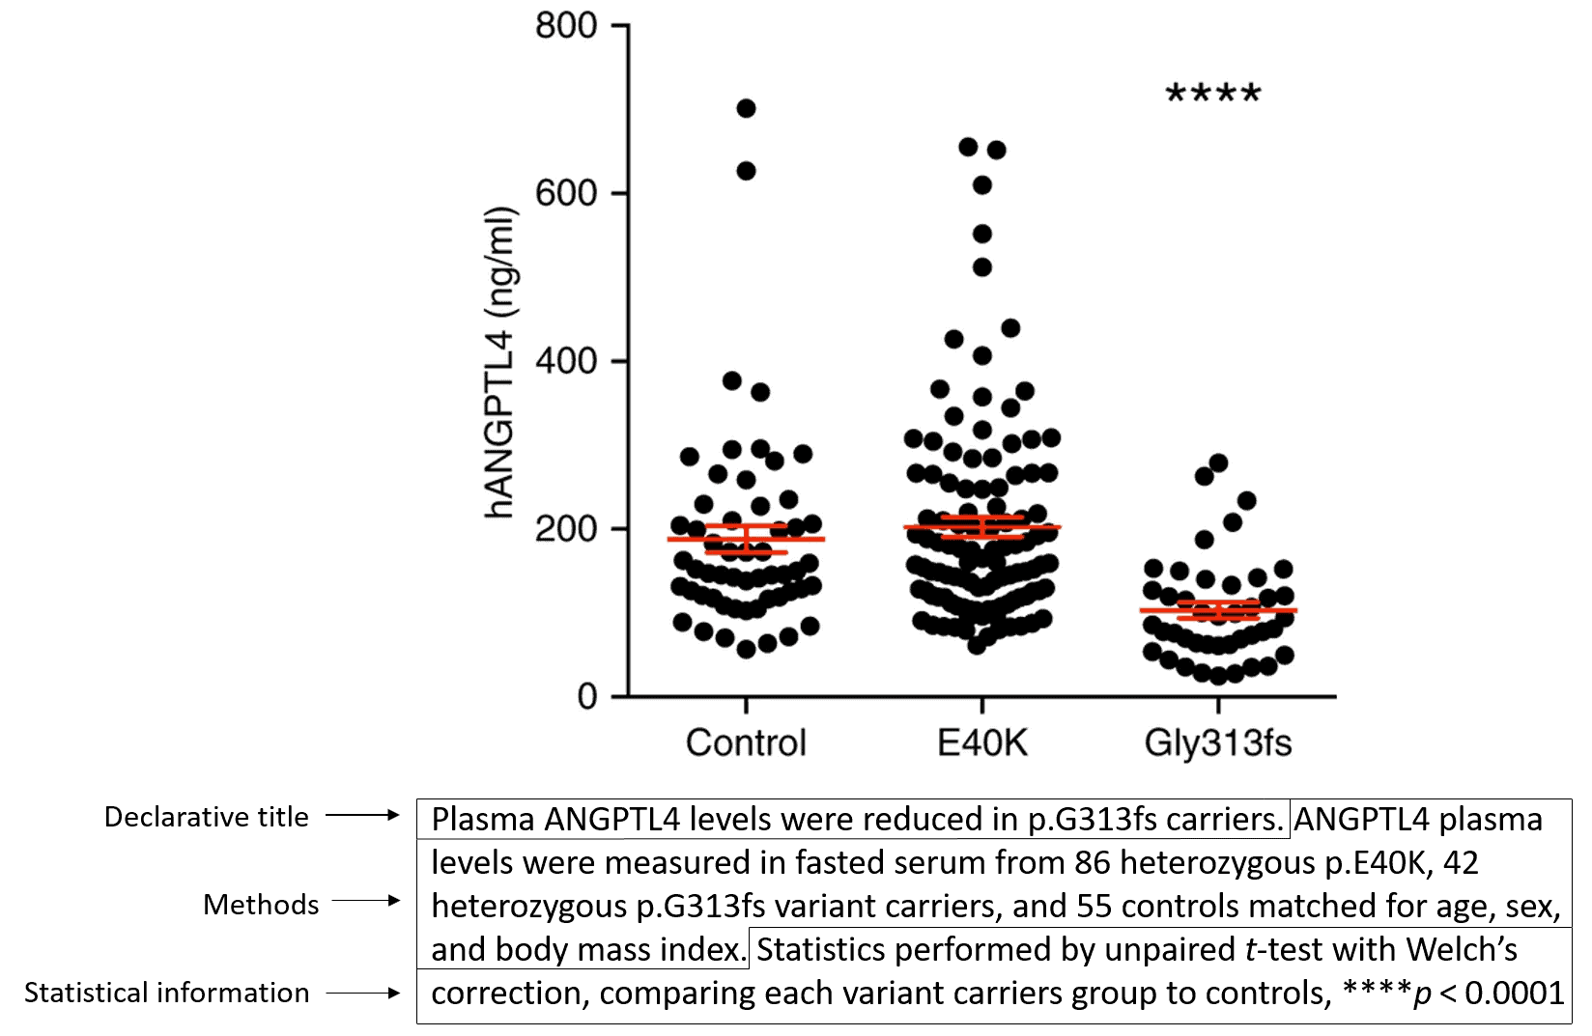
Part 5: Data Analysis in Excel
https://www.internationalscienceediting.com/how-to-write-a-figure-caption/
Notes:
https://www.youtube.com/watch?v=gBbGBrHTMrM
You can skip the add legend portion of the video and go straight to add a trendline
You can either do this by having them watch a v

Slide 17
Clean Up
Clean up properly!!

