Slide 1
Lab 7: Impacts of False Brome on the Oak Creek Watershed
Data Analysis and Final Project Preparation

Slide 2
Housekeeping
Due This Week:
Annotated Bibliography and Discussion Post
Pre-lab 7
Due Next Week:
Pre-lab 8 – Collect Lichen
First Attempt of Skills Demo
Rough Draft of Final Report

Slide 3
Let’s Talk About Writing!
AHHHHHH
How?
...and also
why?

Slide 4
Final Report
Instructions and rubric on Canvas
3 pages, double spaced, 12 pt. font, 1” margins
No cover page
Include citations and literature cited (at least 3 peer reviewed – use the article summaries)
At least one computer generated figure
Self-evaluation
Include as the last page in your final report submission
Submit to TurnItIn
You will receive a 0 If you do not submit to TurnItIn or have a similarity score >30%,

Slide 5
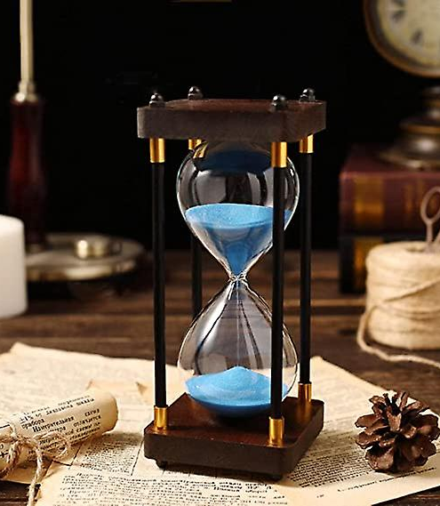
General Outline
Introduction
General to specific
Purpose, question, hypothesis, and prediction (last 4 sentences)
Methods
Basic description - use the Oak Creek sampling protocol
Specify treatments
Data analysis
Results
Figures and graphs with figure captions
“There is convincing/no evidence that …..”
Discussion
Support or not support hypothesis
How does your science relate to previous knowledge

Slide 6

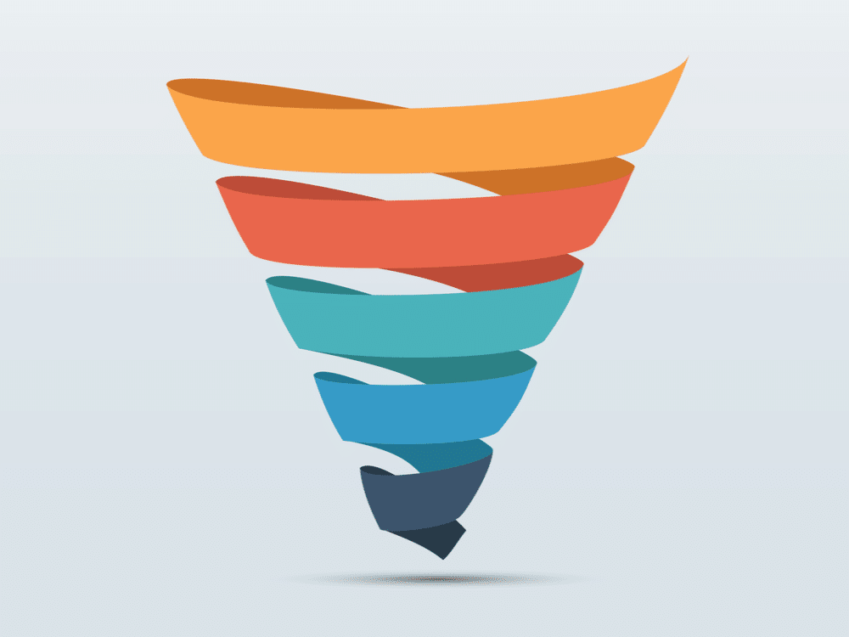
Title and Introduction
Background!
Title that describes the experiment
General to specific
Topic of interest
Background information
At least 2 journal article citations
Importance
Your study
Purpose
Question
Hypothesis
Prediction (if … then)
QHP

Slide 7

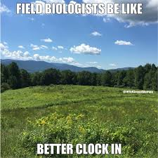
Methods
We are here
Past tense
Repeatable, concise instructions on exactly how the data was collected.
You only need to describe data collected that is used in your data analysis.
NO LISTS ☹
Describe data analysis methods in one or two sentences at the end.
“We compared means and 95% confidence intervals to test for differences between groups.”

Slide 8
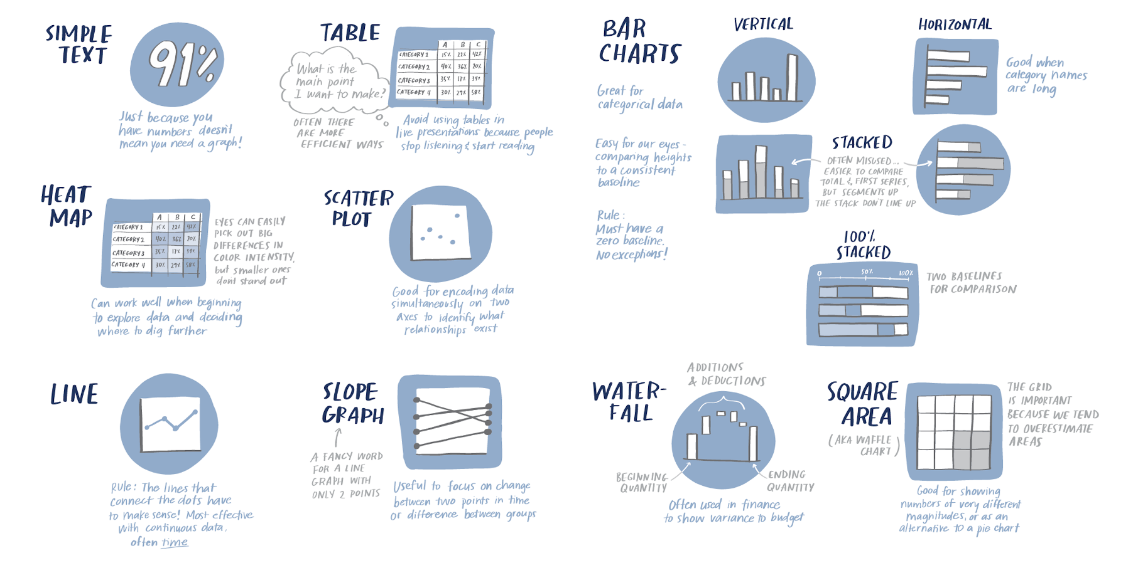
Results
We are here
Correctly choose graph type scatter plot (continuous) vs. bar graph (categorical)
Summarize your findings
Describe general trends
Increasing/decreasing/no relationship
Describe significance
Do not interpret results
Refer to your figures using figure numbers:
“There was a significant, positive relationship between light intensity and percent cover of herbaceous material (figure 1).“

Slide 9
Figures and Tables
Axes contain units
Has error bars
Is labeled with a figure number
Has a description that includes:
Broad description of figure and the data
Description of graph colors/features if needed
Significance/takeaway
Figure 1: Average percent cover of False Brome (Brachypodium sylvaticum) in the woodland and riparian habitats along the Oak Creek Watershed. The purple bar represents the woodland habitat, and the blue bar represents the Riparian habitat. There is a greater percent coverage of false brome in the woodland habitat, although it is not significant.

Slide 10

Discussion
Now we’re here
citation
Interpret your results
Reject or fail to reject your null hypothesis?
How does this compare to the results of other primary research? Cite 3 peer reviewed articles
Identify possible errors in methods design
Identify improvements (e.g. sample size, extrapolation)
Create a new research question inspired by your results

Slide 11
Broader Impacts
(AKA why do we care?)
Highlight the potential societal, educational, and economic impacts of this research.
Elaborate on how the research outcomes can benefit the broader community beyond the scientific community itself.
Based on your experiences in the field, what is the potential for applying this treatment to the McDonald-Dunn forest?
Develop a management plan for treating false brome
Should include:
Cost (monetary & ecological)
Details of the plan
Benefits of the plan
Alternatives
Yay, we’re at the end!

Slide 12
Citations- In Text
1 AUTHOR:
Species richness is significantly reduced in the presence of insecticides and herbicides (Relyea 2005).
2 AUTHORS:
Whether biodiversity loss has a positive or negative effect on the spread of emerging infectious diseases is still debated and is often highly case dependent (Wood and Lafferty 2013).
GREATER THAN 2 AUTHORS:
Amphibians are at the forefront of this biodiversity loss, with population declines estimated to be more severe than those of birds and mammals (Stuart et al. 2004).

Slide 13
Citations
See “citations are hard” document on Canvas for citation guidance.
GENERAL FORMAT
Authors listed with last names followed by first initial(s). Year of publication. Title. Journal published in journal edition(volume if there is one): pages.
EXAMPLES
Example with one author: Lynn B. 2022. Cats are incredible, but especially Pancake. The Journal of Cats Are Awesome 2: 23-46.
Example with two authors: Pride W and Lightyear B. 1995. To infinity and beyond. The Secret Life of Toys 11: 22-33.
Example with three authors: Potter H, Granger H, and Weasley R. 2000. How to tickle a whomping willow. The Journal of Advanced Magic 6: 26-42.
Example with greater than three authors: Brown M, Bunton E, Halliwell G, et al. 1996. Spice up your life. Wannabe Journal 97: 1-33.

Slide 14
Self-Evaluation***
NOT TURNING THIS IN WILL RESULTS IN A 25% REDUCTION OF YOUR GRADE!
1. Use the rubric to critically evaluate your paper
2. Make any corrections to your paper based on your evaluation.
Make note of these corrections on a separate page
3. Turn in your self-evaluation rubric (1) and list of changes (2) as the last page of your assignment

Slide 15

Questions?

Slide 16
False Brome Removal Research
Taylor Fjeran
OSU MS Student Forest Engineering, Resource and Mgt.
Previous TA
Notes:
https://media.oregonstate.edu/media/t/0_8lgf61hg

Slide 17
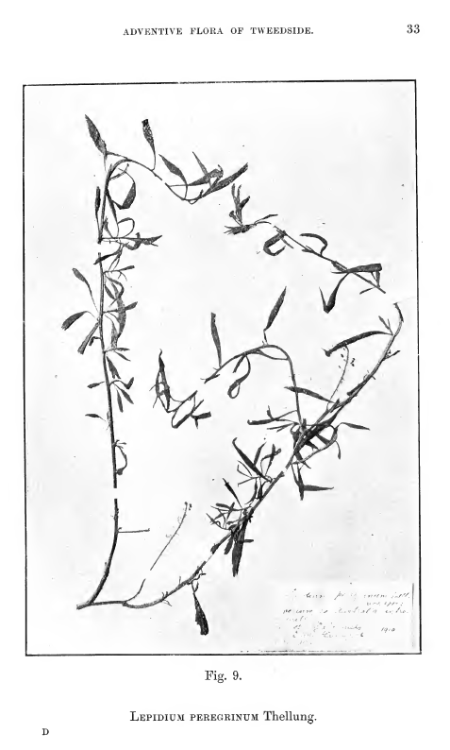
The Wide World of Science!
Ida Hayword
1872 - 1949
Her family imported wool from Australia and South America
She noticed that the seeds nested in the wool would germinate and thrive in the countryside where she lived in Scotland
The seeds grew into mustard weed that had originated in Australia and had never been documented in Scotland before
She donated her herbarium of adventive plants to the Royal Botanic Garden Edinburgh, along with her scrapbook and letters relating to the Flora
She was one of the first to detail human-assisted intercontinental movements of huge numbers of seeds
Notes:
Notes from slide
Her family imported wool from Australia and South America
She noticed that the seeds nested in the wool would germinate and thrive in the countryside where she lived in Scotland
The seeds grew into mustard weed that had originated in Australia and had never been documented in Scotland before
She donated her herbarium of adventive plants to the Royal Botanic Garden Edinburgh, along with her scrapbook and letters relating to the Flora
She was one of the first to detail human-assisted intercontinental movements of huge numbers of seeds
Additional Notes
She and George Druce published "The Adventive Flora of Tweedside", published in 1919
Her work should be taught alongside Charles Elton’s work on non-native species
She toured Scottland displaying exhibits and giving presentations to such societies as the Botanical Society of Edinburgh, the Linnean Society of London, the Royal Scottish Geographical Society and the Botany Section of the British Association at Dundee
The image is of the mustards she found growing in Scotland, though they had never been seen or documented before
Despite her contributions to our understanding of adventive plants and their ecological relevance, she is often overlooked.
Another one of her collaborators, Albert Thellung, sought to replace terminology in invasion ecology to create more neutral, and accurate terms than “native”, “alien”, or “invasive”. For example: “anthropochores” (beneﬁtting from human activities), “neophytes” (introduced, persisting independently), and “epœkophytes” (weeds of plowed or cleared ground)
Sources
https://projectbiodiversify.wpcomstaging.com/2019/07/04/ida-hayward/
https://archiveshub.jisc.ac.uk/search/archives/4ca12ea3-4f9c-3552-8417-93457717fd68
Invasion Biology: Historical Precedents - Matt Chew https://www.academia.edu/462830/Invasion_Biology_Historical_Precedents

Slide 18
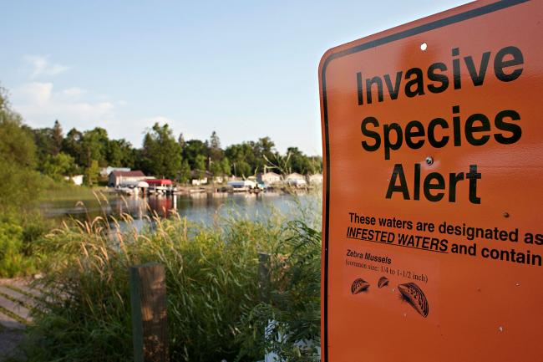
Part 1: False Brome Management Plan
Using the efficacy table provided, come up with a plan to control false brome in the Oak Creek Watershed.
Take notes and outline your broader impacts section (you can create the outline together as a group, but your written work in your final report needs to be in your own words).

Slide 19
Part 2: Graphing and Analysis
Test your hypothesis using the course-wide dataset from Oak Creek.
Select the data you will need to answer your question
Use RStudio to generate figures that provide evidence for or against your hypothesis and the null hypothesis.
Generate a figure caption
Conduct a statistical test (t-test or correlation depending on your data) and report results (i.e., p-value or r^2 value)

Slide 20
Null vs. Alternative Hypotheses
Null Hypothesis
Hѳ= no significant difference between treatments
Alternative Hypothesis
Ha= significant difference between treatments
Notes:
This is am important idea that they may not have grasped yet.

Slide 21
Part 3: Results and Discussion Outline
Create an outline for what you will include in these two sections
Your group can share the figure you created in lab today BUT
Your caption should be in your own words
All written components of the results and discussion should be in your own words

Slide 22

Part 4: Lab Skills and Resume Biulding!
Integrating lab skills into your resume is important!
Provides evidence of your technical expertise, helps you stand out, demonstrates problem-solving abilities, and increases your changes of securing relevant opportunities in scientific fields.
Reflect on the skills that you learned throughout this experience.

Slide 23
Questions?

Slide 24
Today’s roadmap and tips:
Part 1: Management plan
Needs to include: costs ($ and ecological), benefits, details, alternatives
Part 2: Data analysis
Only use the data needed to answer your question
Use the code you developed in Lab 4 as a starting point
Part 3: Results and discussion draft
Create an outline for these sections
Part 4: Resume development
Goal: Brainstorm what skills you learned, what is transferable?
To leave
All skills demos!
Clean: log off computers

