Slide 1
Lab 4 - Nematodes!
Giovanni Alberto Crestani

Slide 2
Lab 4: Data Collection and DNA Extraction

Slide 3
Housekeeping
Skills demo (week 4)
Due today
Lab 4 pre-lab
Annotated Bibliography Assignment
Due next week
Lab 5 pre-lab
Midterm Exam - Monday, Oct 30th, 7 p.m. at KIDDER 364

Slide 4

Dr. Shantá D. Hinton

Slide 5
Annotated Bibliography
Discuss your articles (8 min, 2 min each) - take home message and how to incorporate the article in the project

Slide 6
Lab 4 Objectives
Start your experiment (data collection)
DNA extraction (new molcular bio skill)
Practice Excel Data Analysis

Slide 7
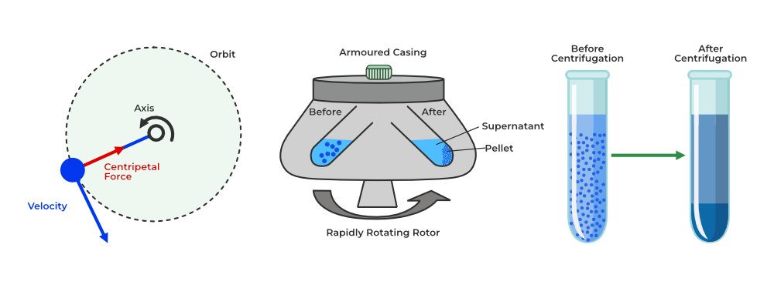
Centrifuge - it’s all about balance…

Slide 8
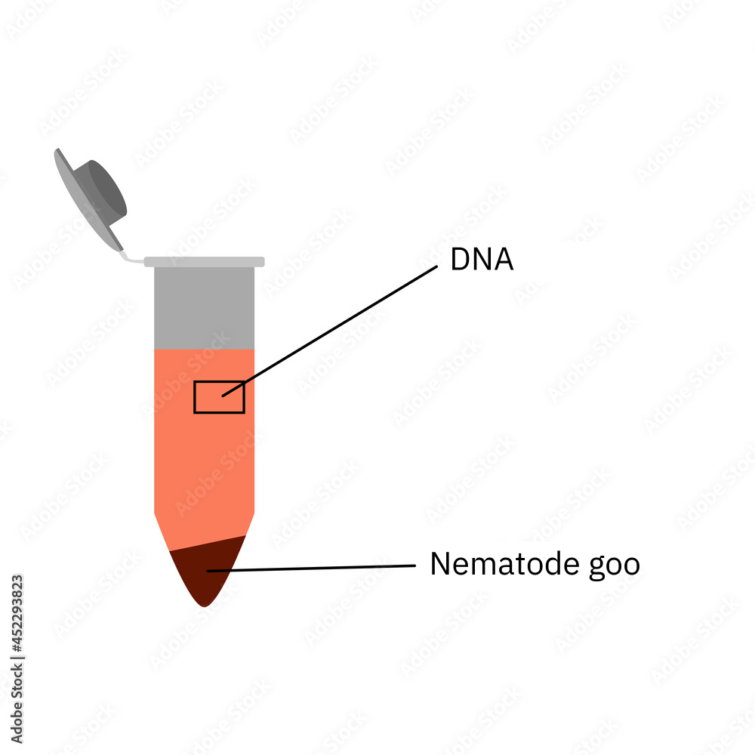
Supernatant has the DNA

Slide 9
Today’s Activities
Use the dissecting microscope to find/isolate nematodes. Collect data about them!
Nematode counts (abundance)
Different species (richness)
Behaviour (speed, movement)
Morphology (mouthparts, size)
Be careful when doing the burrito surgery! Do not disturb the bottom of the falcon tube.
Careful with the pipette - don’t blow air inside your sample. Squeeze before putting it inside the tube.

Slide 10
I found a nematode! Now what?
VERY CAREFULLY, using a micropipette (set it to 20 uL), “fish” the nematode.
Label a 1.5 mL microcentrifuge tube with your sample identifier. Put the nematode inside the tube. Add WLB and grind. Spin down. Remove fluid. Put it on ice until all samples are complete.
Optional: if you have more than one nematode, put it in a mount slide. Observe it under the compound light microscope. Remember the iris!!

Slide 11
DNA Extraction - LABEL EVERYTHING
Wear gloves! (to protect your samples, not you)
Add the Worm Lysis Buffer - it breaks the cells of the nematodes.
Grind the nematodes with the micropestle. Use a sterile tip. Be careful with the tools, they break easily!
Spin down in microcentrifuge
Collect supernatant and transfer it to a labeled PCR tube.
Put tubes on ice.

Slide 12
Part IV - Data Analysis in Excel
Guiding question: Is there a difference in the abundance and richness of nematodes in the two different soil collection locations?
Let’s test it (statistically) using a t-test.
Comparison between means of two groups.
We need mean, sample size, and standard deviation
Excel is an excellent tool, both in science and industry, for several different positions and tasks.
We will use Excel this term, and Rstudio on BI 222.

Slide 13
Let’s use Excel together
Title bar
Ribbon
Name box and formula bar
Column, rows, cells
Worksheet tabs
Data types
Formulas
Cell ranges
Insert graphs

Slide 14
p-value?
The p-value is a number, calculated from a statistical test, that describes how likely you are to have found a particular set of observations if the null hypothesis were true.
Usually, your null hypothesis (H0) is that there is no difference between your samples - it is the simplest configuration you can imagine!
The alternative hypothesis is that there is a difference between your samples.

Slide 15
p-value!
If the p-value is lower than a specified threshold (usualy 0.05), we reject our null hypothesis. If it is higher, we accept our null hypothesis. wait, what?
WE CAN NEVER ACCEPT/PROVE A HYPOTHESIS! WE CAN ONLY REJECT/FAIL TO REJECT IT!!
If the p-value is lower than a specified threshold (usualy 0.05), we reject our null hypothesis. If it is higher, we fail to reject our null hypothesis.

Slide 16
Data!!
Let’s test if there’s any difference in abundance between your samples. What is your H0?
We are using Excel for this. Follow your manual’s instructions for the formulas.
We will later graph it. Show us your graph so we can give you the signature!

Slide 17
Clean-up
Wash all glassware and Falcon tubes
Dispose of soil and kimwipes in the garbage
Keep the meshes!
Dispose of sharp, glass and garbage in appropriate places
Organize items on trays, as they were prior you started

