Slide 1
Mathematical Formulation and Implementation of Query Inversion Techniques in RDBMS for Tracking Data Provenance
Authors:
Anika Tabassum
Anannya Islam Nady
Mohammad Rezwanul Huq

Slide 2
Data Provenance
Provenance means ‘to come from’. It has been used to denote the source of data.
Provenance information describes the origin and the history of data in its lifecycle
It also describes the relations between origin and output by explaining from where output data came, describing in detail how an output record was produced.

Slide 3
Introduction
It is important to have the ability to trace back the source data because sometimes we may need to know where the derived data came from .
So that in case of any unexpected tuples, we will be able to detect those ambiguous tuples using data provenance techniques.
Our main goal is to develop the inverse technique dynamically to find the provenance of data (source of data) so that people can track the source data in the easiest and fastest way.

Slide 4
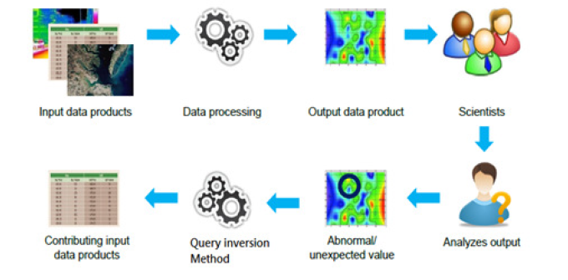
Overview of Query Inversion Technique
Query inversion is basically a process of tracking back the origin data.

Slide 5
Problem Addressed
The problem that this paper address is that most of the time people do not know the origin of data.
Transparency and confidence are some prominent issues in cloud-based systems today.
To solve these problems, cloud providers should have a high level of assurance and accountability in order to maintain trust between them and users. That trust can be achieved through data provenance.

Slide 6
Proposed Method
In this paper, first, we provide mathematical formulations of query inversion mechanism to find data provenance.
Afterward, we implement the formula in SQL and propose an algorithm for creating an output table and another algorithm for inserting the results into the output table so that we can find provenance in an automated manner.
Notes:
To retrieve specific data from the database, we use the SQL query.

Slide 7
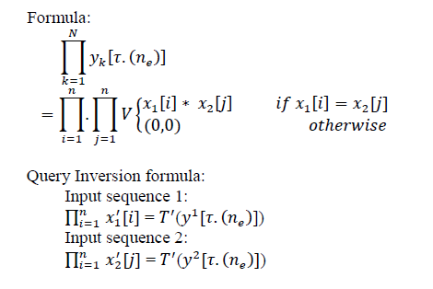
Mathematical Formulation of Inverse Operation on traditional data for JOIN operation
V represents the pair of join.
𝑥1[𝑖] and 𝑥2[𝑗] are two input sequence
𝑦𝑘[𝜏.(𝑛𝑒)] is the output sequence
𝜏 is the trigger rate
𝑛𝑒 is the execution time
𝑇′ is the reverse transformation
N - total number of transformation
n - particular point in time in the output sequence
k represents the particular output
and its value goes to 1, 2, 3….N.
Notes:
V represents the pair of join.

Slide 8
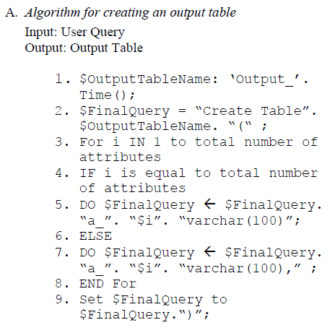
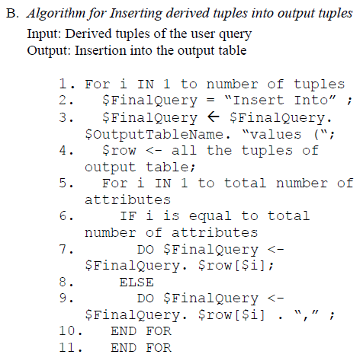
Algorithms to degenerate dynamic outputs
Notes:
INSERT INTO table_name (column1, column2, column3, ...)
VALUES (value1, value2, value3, ...);

Slide 9
QUERY INVERSION FLOWCHARTS
A prototype to find the source data from the user query.
Here the user can execute any query to find data from the database and then can track data provenance through inverse queries.
The following flowcharts show the mechanism for different types of queries.

Slide 10
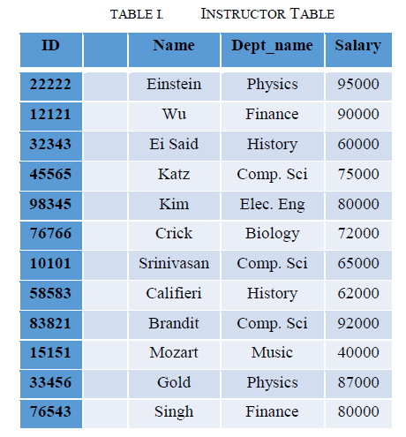
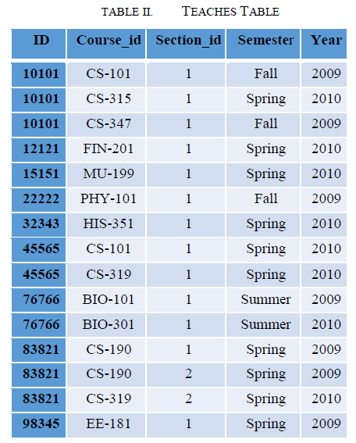
We may consider two sample relations INSTRUCTOR and TEACHES for further demonstrations

Slide 11
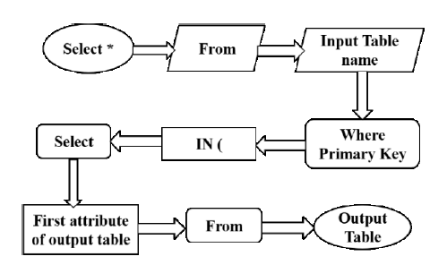
Single Table Queries:
Figure shows the flowchart for inversion of the most simple single table queries.
User will provide the source table name and then based on the row id of the output table, we find the input data, contributing to producing the output.

Slide 12

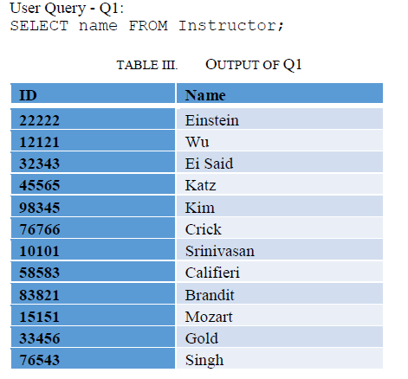
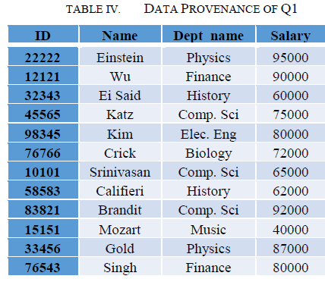
For Single Table Query:

Slide 13
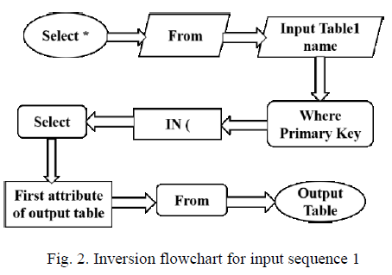
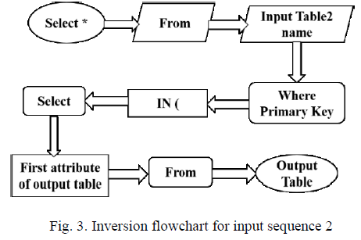
Multiple Table Queries:
Figures show the flowchart for the inversion of multi-table queries.
Fig. 2 explains the process of obtaining input data contributing to produce output data from the first table (input sequence 1)
Fig. 3 shows the same as Fig. 2 for the second table (input sequence 2).
Notes:
Fig. 3 explains the process of obtaining input data contributing to produce output data from the first table (input sequence 1) which is the same as Fig. 1.

Slide 14
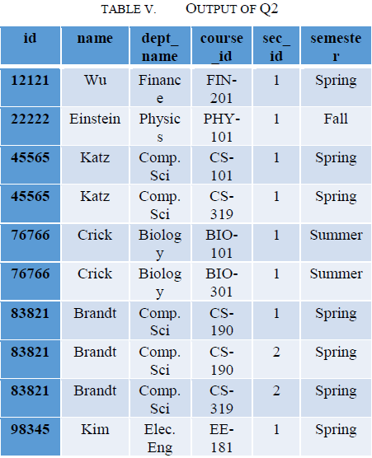
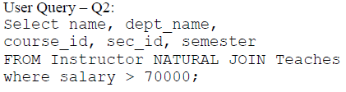
For Multiple Table Query:

Slide 15
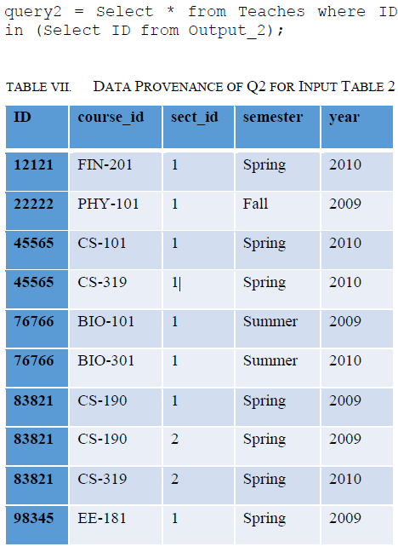

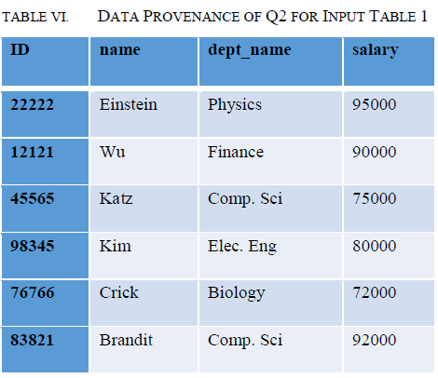

Slide 16
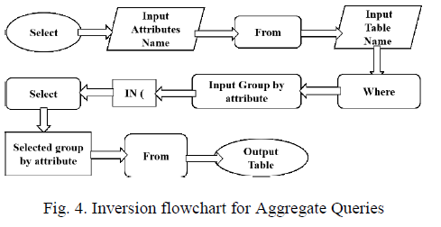
Aggregate Queries:
Figure shows the inversion flowchart for inversion of aggregate queries,
where the user has to provide the source table name and the group by attribute.
Then the proposed inverse query would able to obtain input data, that contributed to producing the output.

Slide 17


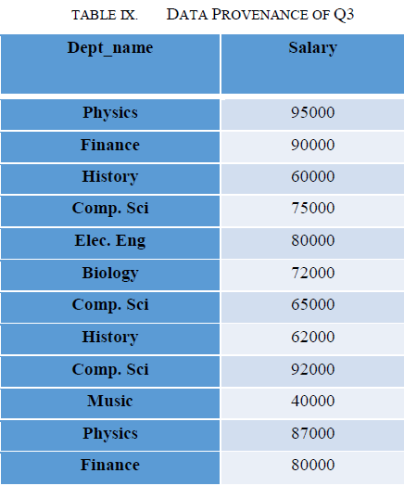
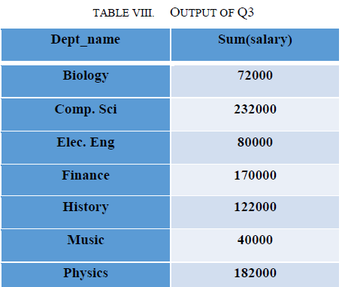
For Aggregate Query:

Slide 18
Strategy for Implementation
We may consider two sample relations INSTRUCTOR and TEACHES mentioned previously.
We will then write inverse queries using the previously mentioned flowcharts and sample queries for different types of queries:
i)Single Table
ii)Multiple Table
iii)Aggregate
After executing the SQL queries , we can compare the source inputs with the output of the inverse queries to check whether the objective was achieved or not.

Slide 19
Summary
In our paper, we proposed query inversion techniques to track the origin of data.
First, we discussed different types of the formulation of transformation properties in traditional data.
Then, we applied our developed inversion mechanism over a relational database.
We proposed a generalized system that works for all single table query, multiple table query, and aggregate function query.
We applied our mechanism on some relational operations such as selection operation, projection operation, aggregate functions.

Slide 20
Conclusion
Our inversion technique is working for single table query, multiple table query, and an aggregate function.
Specified technique does not work for the nested queries.
Our experimental analysis has shown much promise to find data provenance especially for data-intensive applications with ease.
Future Work
Our main target is to improve our algorithm so that it can also satisfy nested queries.
Also, we will apply our query inversion mechanism on streaming data.

Slide 21
Bibliography
http://ieeexplore.ieee.org.library.somaiya.edu/document/8835290
https://airccj.org/CSCP/vol8/csit88102.pdf
https://library.somaiya.edu/home
https://rrcns.readthedocs.io/en/latest/provenance_tracking.html

