Slide 1
Finding a fuel-efficient car
An Exercise in Data Exploration

Slide 2
The Problem
Automobiles represent a major drain on petroleum reserves, and those reserves are being rapidly depleted.
According to americanenergyindependence.com, the U.S. uses approximately 20,000,000,000 barrels of oil every day, 9,000,000,000 in the form of gasoline.

Slide 3
Alternatives?
There have been attempts to use alternative fuel sources for automobiles.
Air
Electric battery
Hydrogen
Nitrogen
Ammonia
Etc.

Slide 4
Not Yet Feasible For Most
But many of these models (a) remain in the prototype stage, (b) are too expensive, or both.
Hence there is still a very real need to find gasoline—powered but fuel-efficient cars.

Slide 5
Many Variables
Automobiles differ along many dimensions:
Manufacturer
Engine type / Number of cylinders
Weight
Displacement / Volume of pistons
Horsepower
Acceleration
Model year

Slide 6
The Dataset
The dataset was available for free, courtesy of UC Irvine, at http://archive.ics.uci.edu/ml/datasets/Auto+MPG.
It contains 398 (“observations” of) automobiles.

Slide 7
Data Cleaning
The dataset was relatively clean. But I broke apart the “car name” column into two (“make” and “model”) and added a new column for the country of origin (“Country”).
The “horsepower” column had some “?”s that I replaced with “NA”s.

Slide 8
More Cleaning
I had also to correct some misspellings and alternative spellings.
Ex. I classed the “VW”s with the “Volkswagen”s.
I changed the “Datsun”s to “Nissan”s, since they are really the same company.

Slide 9
Adding a New Column
I suspected from the beginning that MPG rating would be a function of the car’s manufacturer.
But since there were so many manufacturers (29), I decided to group them by country of origin.

Slide 10
The “Country” Column
France
Peugeot, Renault
Germany
Audi, BMW, Mercedes, Opel, Volkswagen
Japan
Honda, Mazda, Nissan, Subaru, Toyota
Sweden
Saab, Volvo
USA
AMC, Buick, Cadillac, Chevrolet, Chrysler, Dodge, Ford, Mercury, Oldsmobile, Plymouth, Pontiac
“XX – Other”
Capri, Fiat, HI, Triumph

Slide 11
Early Results
I first plotted MPG vs. the number of cylinders, color-coded by manufacturer’s country of origin.
Several points were already discernible from the graph.

Slide 12
The Relation Between MPG and No. of Cylinders
First, there was a clear inverse relationship between MPG and no. of cylinders. That is, there was a clear general decline in MPG as the no. of cylinders increased.
Second, the USA dominated the production of 8-cylinder cars; European manufacturers inclined much more toward 4-cylinder cars.
Third, the USA lagged behind European and Japanese cars in MPG.

Slide 13
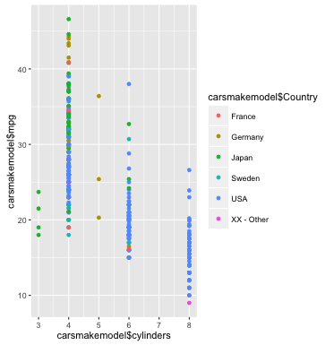
MPG Vs. No. of Cylinders (by country)

Slide 14
The Relation Between MPG and Year of Production
Next I plotted MPG vs. model year, again color-coded by country.
Besides the recurring evidence of the USA’s clear lag behind other countries, another point emerged: MPG got higher as the models got younger.
Notes:
Note this is likely due to improvement in technology, as opposed to any decline in MPG as cars age. This latter idea may be mythical. See http://blog.cochran.com/wordpress/index.php/10-myths-fuel-economy-gas-mileage/.

Slide 15
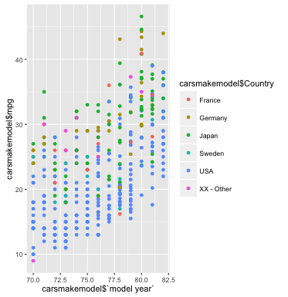
MPG Vs. Model Year

Slide 16
The Relation Between MPG and Weight
Then I plotted MPG vs. the weight of the automobile.
The first result of interest was that there was a definite inverse relationship here as well: Higher weight meant lower MPG.
Second, the USA’s cars were significantly heavier than their European counterparts, which could easily explain the USA’s lower MPG ratings.

Slide 17
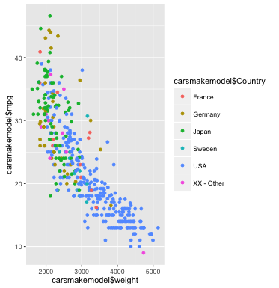
MPG Vs. Weight

Slide 18
The Relation Between MPG and Acceleration
Finally I plotted MPG vs. Acceleration. There seemed to be very little correlation here.
There was perhaps a very slight correlation between high MPG and high acceleration. Very likely this is a matter of a car’s weight being a common cause of both values.
There were a few German cars with very high ratings both of MPG and of acceleration.
There were several American cars with very low ratings both of MPG and of acceleration.

Slide 19
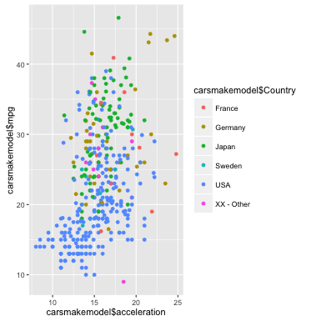
MPG Vs. Acceleration

Slide 20
USA High on Weight, Low on MPG
The USA scored high on weight but low on MPG.
Presumably, this was no accident.
Let us first verify that the USA is unusually high on weight and unusually low on MPG.

Slide 21
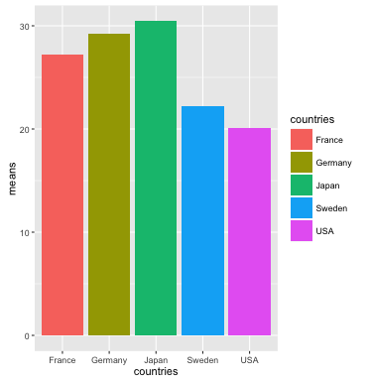
MPG Means by Country
MPG Means
France: 27.22
Germany: 29.21
Japan: 30.45
Sweden: 22.23
USA: 20.11

Slide 22
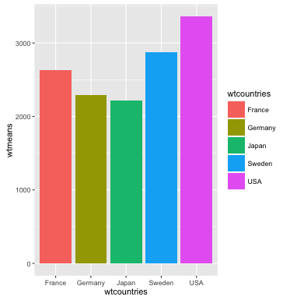
Weight Means by Country
Weight Means (lbs)
France: 2627.15
Germany: 2293.05
Japan: 2221.23
Sweden: 2869.70
USA: 3359.58

Slide 23
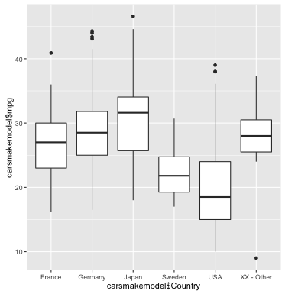
MPG Vs. Country

Slide 24
Bracketing the Cylinder Variable
It was clear that the number cylinders was relevant to a car’s MPG rating.
However:
The limited range of this variable would make for modeling problems.
The vast majority of cars with a large (>4) number of cylinders were American.

Slide 25
Cylinder-Groups
Even if we keep the cylinder variable out of our linear modeling, we can still illustrate some important relations between MPG and no. of cylinders.
Let’s carve up the cars into groups based on number of cylinders in their engines.
The graph for four-cylinders is worth including here.

Slide 26
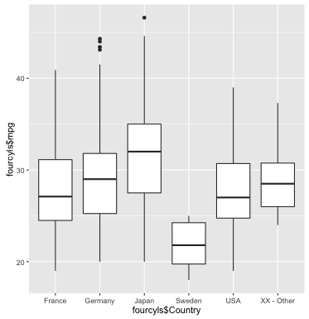
Four-Cylinder MPG Vs. Country

Slide 27
Comparisons of MPG by Manufacturer
It proves instructive to examine MPG ratings by make (“inter-manufacturer variability”).
Two important general trends emerge (with exceptions).
First, MPG ratings for each manufacturer rise with the model year.
Second, there is great variability in MPG among the different models of a given make (“intra-manufacturer variability”).
Chrysler is typical.

Slide 28
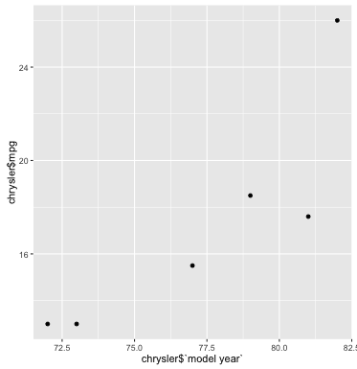
Chrysler MPG Vs. Model Year

Slide 29
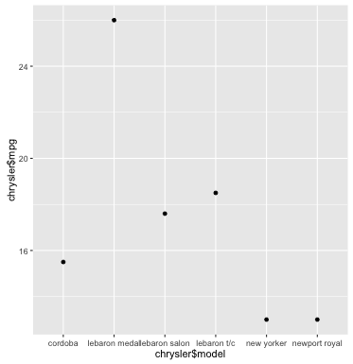
Chrysler MPG Vs. Model

Slide 30
High-Scoring Manufacturers
But despite the similarities, there were a few manufacturers whose MPG ratings were consistently and significantly higher than the rest.
Honda, Nissan, Renault, and Volkswagen were the most noteworthy.
I show here the results also for Pontiac, a typical American manufacturer.

Slide 31
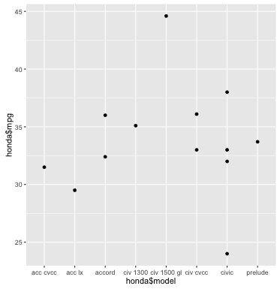
Honda MPG
Honda MPG mean
33.76

Slide 32
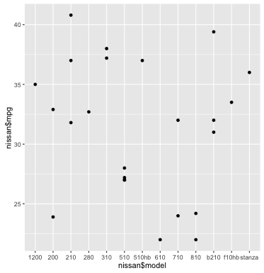
Nissan MPG
Nissan MPG mean
31.32

Slide 33
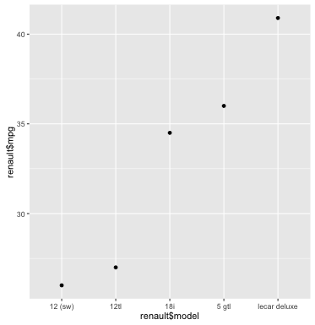
Renault MPG
Renault MPG mean
32.88

Slide 34
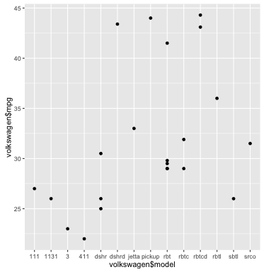
Volkswagen MPG
Volkswagen MPG mean
31.84

Slide 35
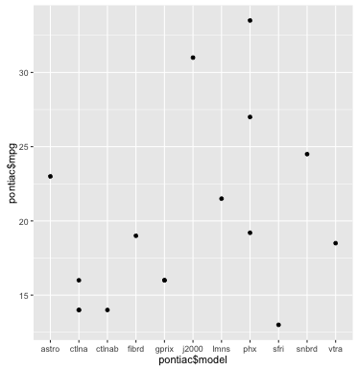
Pontiac MPG
Pontiac MPG mean
20.01

Slide 36
Intra-National Variation
I broke up the dataset by country and then plotted MPG vs. each country’s manufacturer.
It was revealed that in fact there is quite a bit of “intra-national variation” across manufacturers.
I here use box-and-whisker plots to show the significant “intra-manufacturer” variation.

Slide 37
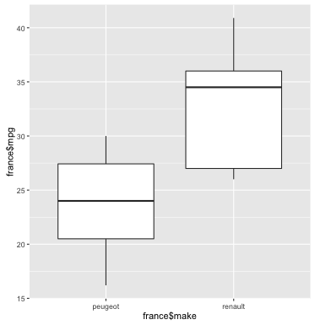
France MPG Vs. Make

Slide 38
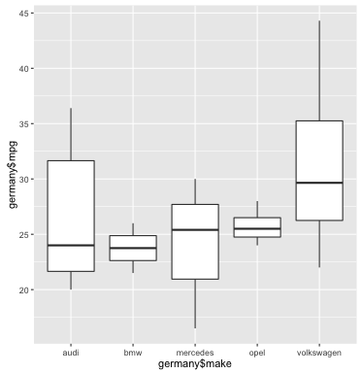
Germany MPG Vs. Make

Slide 39
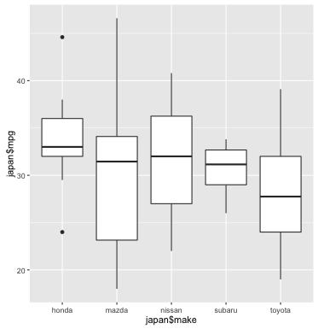
Japan MPG Vs. Make

Slide 40
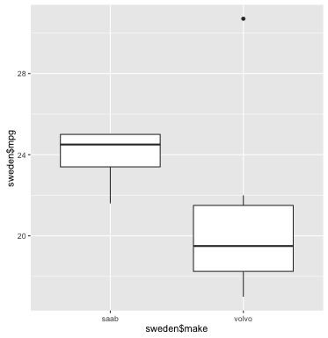
Sweden MPG Vs. Make

Slide 41
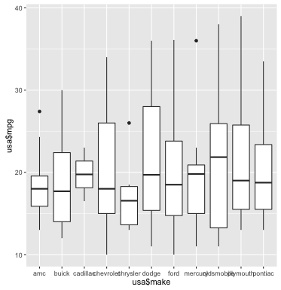
USA MPG Vs. Make

Slide 42
Linear Modeling
Finally, I wanted to construct a few linear models (with MPG as dependent variable) to see if some useful predictive set of variables could be produced.
First, I tried “cylinders”, “model year”, “weight” and “make” as independent variables:
model1 <- lm(mpg ~ cylinders + `model year` + weight + make, data = carsmakemodel)

Slide 43
Model 1 Summary
What show up as significant in the model summary (***) are the “model year” and “weight” variables.
R² = 0.8387; Adj. R² = 0.825.
Also significant, not surprisingly, are the Honda, Nissan, Renault, and Volkswagen makes.

Slide 44
Dropping Cylinders
As predicted, the “cylinders” variable did not show up as significant.
We’ve already discussed the “cylinders” variable, so we drop it now.

Slide 45
Model 2 Summary
Next I tried a model without the “cylinders” variable:
model2 <- lm(mpg ~ `model year` + weight + make, data = carsmakemodel)
The “model year” and “weight” variables still counted as highly significant (***).
R² = 0.8387; Adj. R² = 0.8255.

Slide 46
Model 3 Summary
Next I tried a model with “weight” as the only independent variable:
model3 <- lm(mpg ~ weight, data = carsmakemodel)
The “weight” variable still counted as highly significant (***).
However, our fit got worse:
R² = 0.6918; Adj. R² = 0.691.

Slide 47
Predictions with Training Sets and Test Sets
I made two different predictive experiments with training sets and test sets.
The first experiment, despite the relatively low R², used Model 3: only “weight” as the independent variable.
This was just for exploratory purposes.

Slide 48
Experiment #1
For this experiment I took means of MPG and weight for each manufacturer.
The model suggested the following prediction of MPG for the test set:
MPG ~ weight* -0.0077672 + 46.6415132

Slide 49
Experiment #1 Plots
I plotted the actual average MPG for each manufacturer against the prediction made by using the above approximation.
I also plotted the relative errors for each manufacturer.

Slide 50
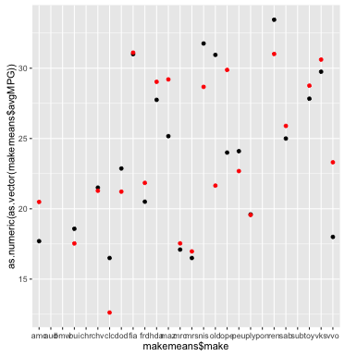
Experiment #1 Results: Comparison

Slide 51
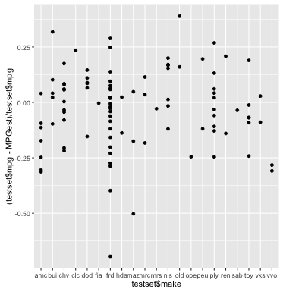
Experiment #1 Results: Relative Error x = testset$make, y = (testset$mpg - MPGest)/testset$mpg

Slide 52
Model 4, and Experiment #2
For this experiment I took means of MPG, weight and model year for each manufacturer. This corresponded to a new experimental model, our chief model of interest.
The model suggested the following prediction of MPG for the test set:
MPG ~ wt * -0.006704 + (mdl yr – 1900) * 0.7087 - 10.45
Notes:
Two notes here: First, this is actually the fifth model I explored; model 4 took only model year as variable, and, having poor statistical measures, was discarded immediately. Second, the model years in the dataset are entered as “actual model year” – 1900 (e.g. ‘80’ for 1980).

Slide 53
Experiment #2 Plots
Again I plotted the actual average MPG for each manufacturer against the prediction made by using the above approximation.
And again I plotted the relative errors for each manufacturer.

Slide 54
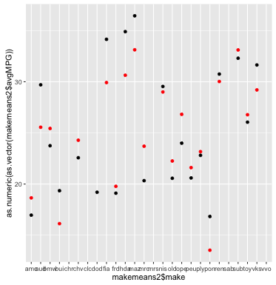
Experiment #2 Results: Comparison

Slide 55
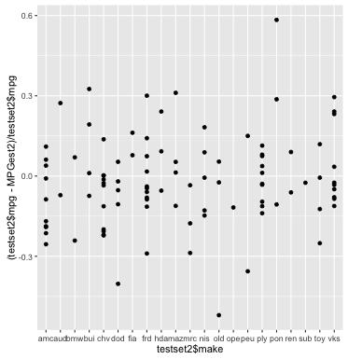
Experiment #2 Results: Relative Error x = testset2$make, y = (testset2$mpg - MPGest2)/testset2$mpg

Slide 56
Results and Recommendations
First, weight kills.
Heavier cars consistently had lower MPG ratings.
Second, buy a foreign car.
American cars consistently had lower MPG ratings.
Third, buy a four-cylinder car.
Six- and eight-cylinder cars consistently had lower MPG ratings.

Slide 57
Defeasible Predictions
You can estimate the MPG of an automobile fairly accurately if you know its weight:
MPG ~ wt * -0.0077672 + 46.6415132
You can do better if you also know its model year:
MPG ~ wt * -0.006704 + (mdl yr - 1900) * 0.7087 - 10.45

