Slide 1


Machine Learning in Legal Practice
Bill Vander Lugt J.D., Ph.D.

Slide 2
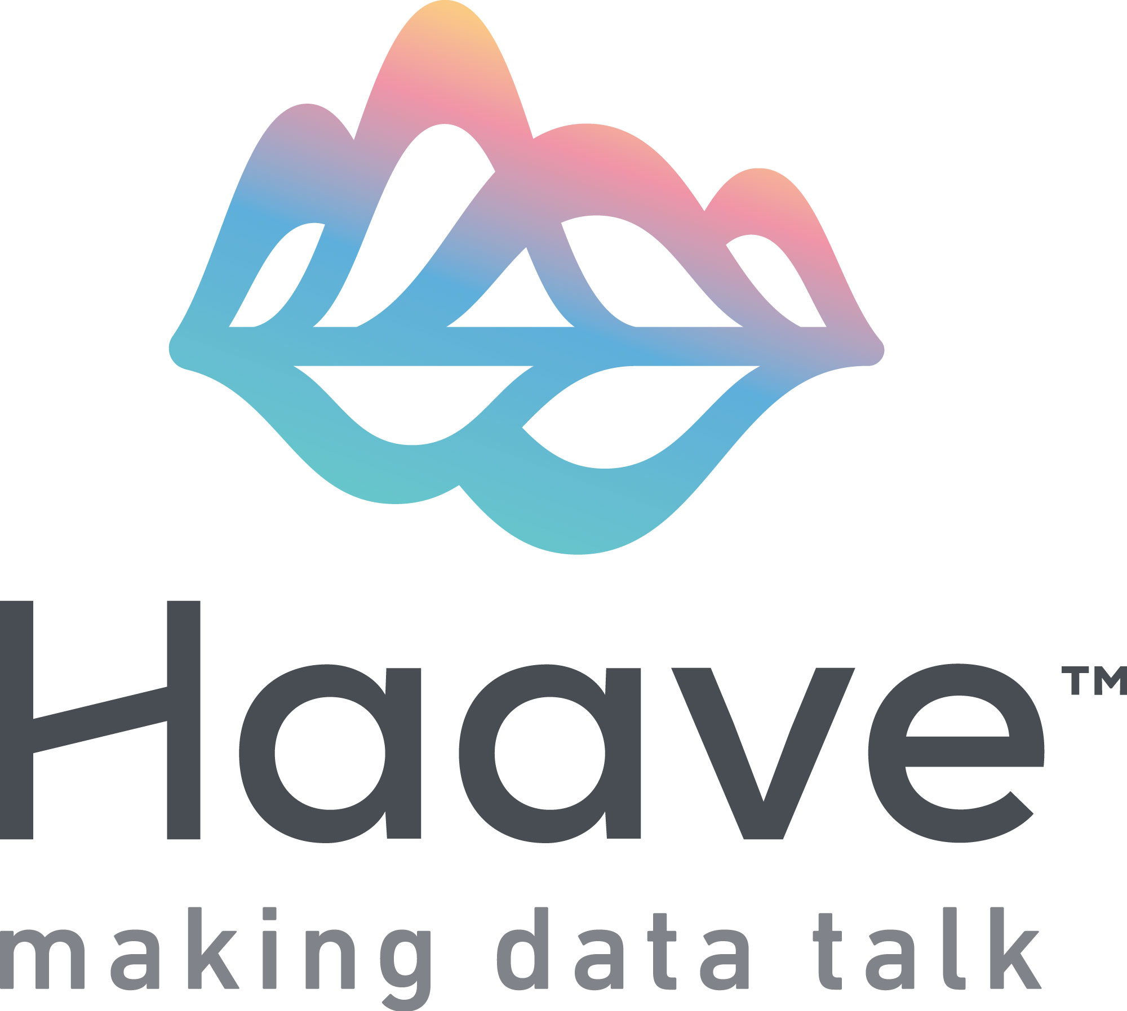
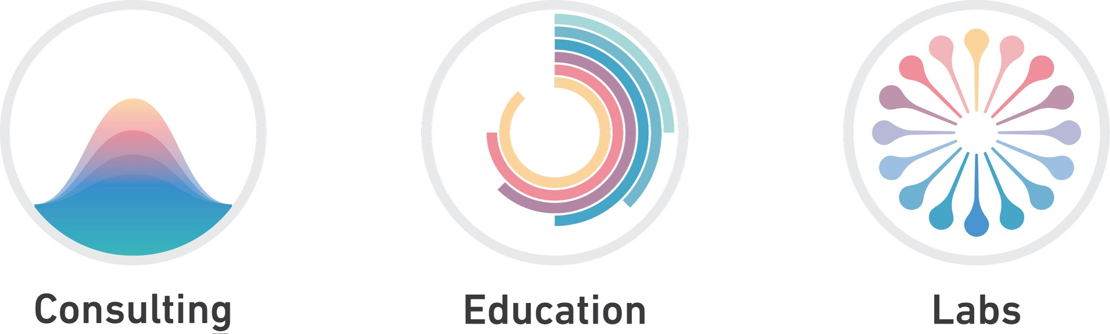
Notes:
‘Haave’ loosely translates from Finnish to ‘an ideal or goal toward which one aspires’.
‘Making Data Talk’ – Most customers understand that their data is valuable however many are unaware of how to maximize this value on their own. Haave has the skills and experience to help customers develop and implement a data analytics strategy to make their data talk and realize true business value. We are comfortable with Big Data and the associated architectures.
Haave has 3 solution offerings: Consulting – This is the core of our business. We work with customers to build advanced data science models to solve the most complex business problems. Education – AI and ML are hot topics in business today. We can develop a custom curriculum to help your organization understand AI, ML and other aspects of data science. Labs – Haave Labs can help you turn your product idea into reality. From product specification to launch. We are comfortable with designing and implementing a data architecture and management plan.
We can also help you build your data science staff, from identifying key skills required to locating qualified individuals. We can offer temporary or permanent staffing.

Slide 3


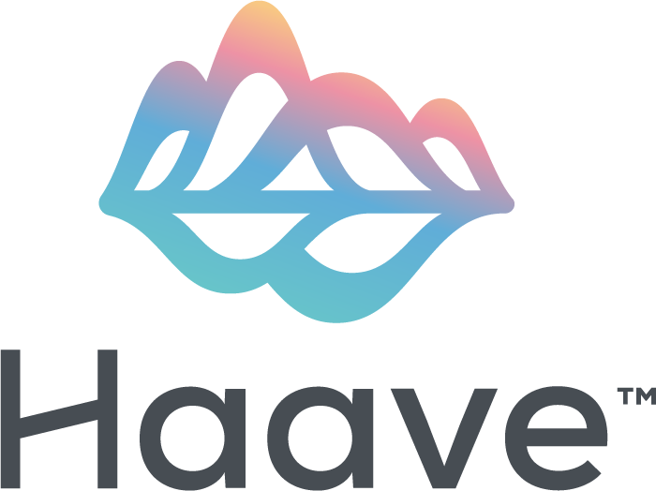
About Me.
JD University of Chicago Law School
PhD English/Linguistics, Indiana University
Litigating high-stakes data science cases – including one that culminated in a $500M verdict against Facebook and Oculus VR - at Skadden, Arps, Slate, Meagher, & Flom LLP in New York convinced me to become a full-time data scientist and consultant, specializing in Natural Language Processing.

Slide 4
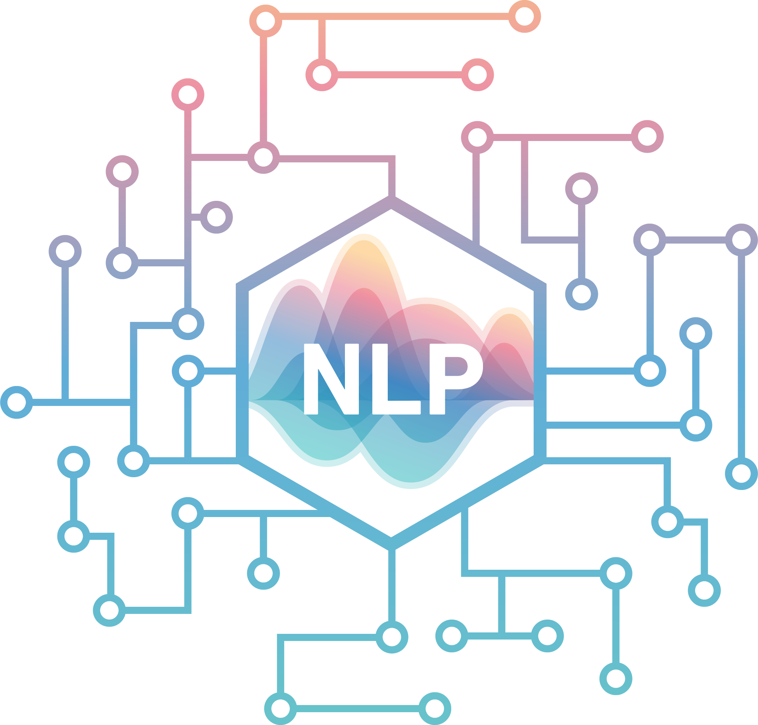
What is Natural Language Processing (NLP)?
By teaching computers to process
human language, NLP enables:
Google to search over a billion websites
Westlaw and LexisNexis to search millions of sources
Top firms like Cravath and Wachtell to master their clients’ documents

Slide 5
Legal Applications of NLP
Litigation
Early Case Analysis
Predictive Coding / Technology-Assisted Review
Deal-Making
Due Diligence
Contract Analysis

Slide 6
Early Case Assessment
Lawyers are increasingly relying on NLP tools to gauge clients’ strengths and weaknesses on emerging issues.
Just as Google can direct us to relevant public facts, NLP empowers prospective litigants to identify key documents quickly.

Slide 7
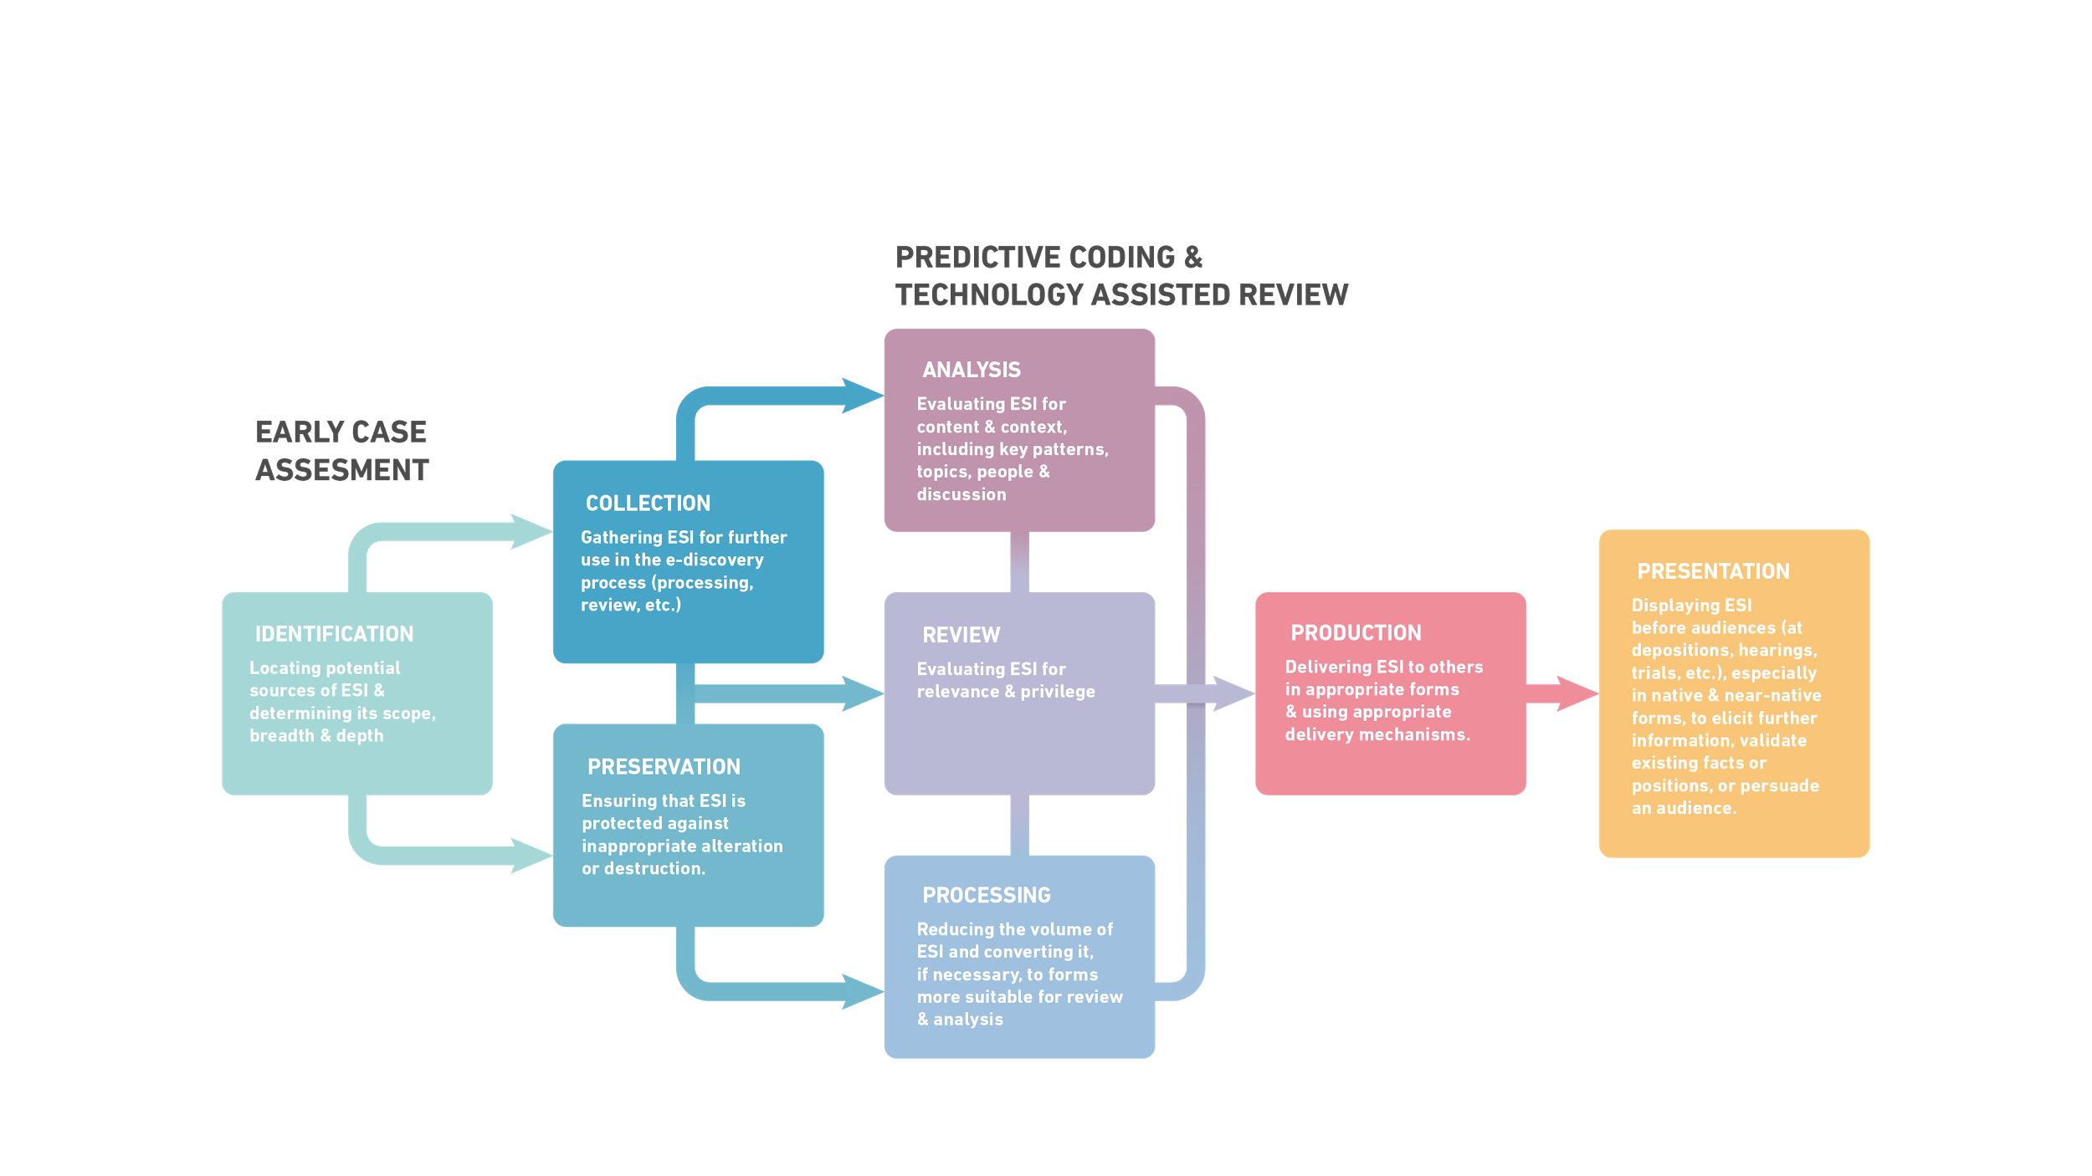
Electronic Discovery Reference Model

Slide 8
Predictive Coding &
Technology-Assisted Review
During discovery, NLP enables litigants to:
Identify documents relevant to an adversary’s requests
Identify privileged documents
Assist human reviewers by ranking the significance of as-yet-unreviewed documents

Slide 9

Due Diligence
M&A lawyers rely on NLP to extract from large sets of contracts all provisions bearing on a particular issue - for example, all the change of control and assignment provisions.

Slide 10
Contract Analysis
Because NLP tools can generalize from examples, they can, like junior attorneys, learn from expert attorneys.
As a result, NLP technologies can learn to review, compare, and evaluate large sets of contracts more efficiently than junior attorneys.

Slide 11

Contact info
LinkedIn https://www.linkedin.com/in/billvanderlugt
Email bill@haave.io

