Slide 1
STEPPED FOOTING DESIGN AND
DRAFTING USING AUTOCAD
By
GADASANDULA SRIKAR (26X01A0104)
Department of Civil Engineering
Narsimha Reddy Engineering College | 2026–2027
Department of Civil Engineering | Stepped Footing Design using AutoCAD | 1

Slide 2
ABSTRACT
A stepped footing is a reinforced concrete foundation in which the footing depth or width is arranged in steps to transfer column loads safely to the soil.
AutoCAD is used to prepare accurate 2D plans, sections, dimensions and reinforcement details of the footing.
The project demonstrates a typical stepped footing layout with assumed design data, structural detailing and drafting procedures.
Clear dimensioning and reinforcement detailing improve communication between the designer and construction team and help reduce drafting errors.
Department of Civil Engineering | Stepped Footing Design using AutoCAD | 2

Slide 3
INTRODUCTION
Footings transfer loads from columns or walls to the supporting soil.
Stepped footings are useful where a change in level or a larger foundation depth is required while maintaining a practical foundation geometry.
The design must satisfy bearing-capacity, bending, one-way shear and punching-shear requirements.
AutoCAD provides precise tools for preparing foundation plans, sections, reinforcement layouts and construction dimensions.
Department of Civil Engineering | Stepped Footing Design using AutoCAD | 3

Slide 4
OBJECTIVES OF THE PROJECT
To understand the purpose and geometry of a stepped footing.
To prepare a basic structural design using assumed load and soil parameters.
To calculate footing size, thickness and reinforcement requirements for an illustrative example.
To draft the plan, section and reinforcement details in AutoCAD.
To apply professional dimensioning, labeling, hatching and layer-management practices.
Department of Civil Engineering | Stepped Footing Design using AutoCAD | 4

Slide 5
DESIGN DATA – STEPPED FOOTING
Values taken from the provided stepped-footing drawing. Dimensions are in mm.
Neck Column: 525 mm
Footing 1: 3500 mm width × 450 mm thick
Footing 2: 2200 mm width × 550 mm thick
Footing 3: 1300 mm width × 650 mm thick
PCC: 100 mm thick
Ground Level to upper column: 800 mm
Ground Level to Footing 1: 750 mm
Plan overall size: 3700 × 2700 mm
Department of Civil Engineering | Stepped Footing Design using AutoCAD | 5

Slide 6
DIMENSION CALCULATION
Required footing area ≈ Service load / SBC = 600 / 200 = 3.00 m².
Adopt a square footing of 1.80 m × 1.80 m = 3.24 m².
The adopted area provides a practical margin over the calculated minimum area.
Illustrative stepped geometry: lower slab 1.80 m × 1.80 m × 250 mm; upper step 1.20 m × 1.20 m × 200 mm.
Overall depth of the stepped footing = 250 + 200 = 450 mm, excluding any PCC layer.
Department of Civil Engineering | Stepped Footing Design using AutoCAD | 6

Slide 7
REINFORCEMENT DETAILING – ILLUSTRATIVE
Member | Proposed detailing
Bottom main steel | 12 mm dia @ 150 mm c/c both directions
Top/step steel | 10 mm dia @ 200 mm c/c both directions
Column starter bars | As required by structural design
Clear cover | 50 mm to footing reinforcement
PCC below footing | 100 mm thick (drafting assumption)
Note: Reinforcement must be checked by structural calculations before construction.
Department of Civil Engineering | Stepped Footing Design using AutoCAD | 7

Slide 8
AUTOCAD DRAWING TOOLS USED
Drawing tools: Line, Polyline, Rectangle, Circle, Hatch, Text, MText and Dimension.
Modify tools: Move, Copy, Offset, Mirror, Trim, Extend, Rotate, Scale and Array.
Annotation tools: Leader, Multileader, dimension styles and text styles.
Layer management is used to separate concrete outline, reinforcement, dimensions, center lines and annotations.
The final drawing should include plan, section, reinforcement notation and all important dimensions.
Department of Civil Engineering | Stepped Footing Design using AutoCAD | 8

Slide 9
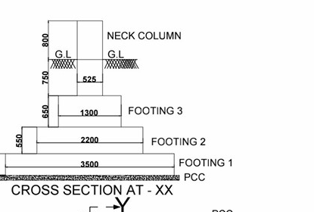
DRAWING – CROSS SECTION AT - XX
Department of Civil Engineering | Stepped Footing Design using AutoCAD | 9

Slide 10
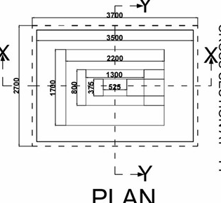
DRAWING – PLAN
Department of Civil Engineering | Stepped Footing Design using AutoCAD | 10

Slide 11
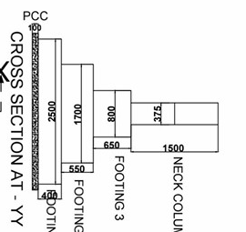
DRAWING – CROSS SECTION AT - YY
Department of Civil Engineering | Stepped Footing Design using AutoCAD | 11

Slide 12
DRAWING DETAILING WITH MEASUREMENTS
Item | Dimension / Detail
Footing 1 | 3500 × 3500 mm; thickness = 450 mm
Footing 2 | 2200 × 2200 mm; thickness = 550 mm
Footing 3 | 1300 × 1300 mm; thickness = 650 mm
Neck Column | 525 × 525 mm
PCC | 100 mm thick
Plan Overall Size | 3700 × 2700 mm
Ground Level / Neck Height | 800 mm
Department of Civil Engineering | Stepped Footing Design using AutoCAD | 12

Slide 13
TECHNOLOGY USED & DESIGN REFERENCES
Software: AutoCAD 2024 or later.
Operating system: Windows 10 / Windows 11.
IS 456:2000 – Plain and Reinforced Concrete (general RCC design provisions).
IS 1904 – Design and construction of foundations in soils: general requirements.
SP 34 – Handbook on Concrete Reinforcement and Detailing (for reinforcement detailing practice).
Final structural design should use the applicable current codes and a qualified structural engineer's verification.
Department of Civil Engineering | Stepped Footing Design using AutoCAD | 13

Slide 14
APPLICATIONS & ADVANTAGES
Applications: residential buildings, institutional buildings, small commercial structures and other low-rise RCC frames where stepped footing geometry is suitable.
Advantages: economical use of concrete, clear load transfer, practical geometry for level changes, accurate AutoCAD drafting and easy future modifications.
Good detailing improves construction communication and reduces errors in setting out and reinforcement placement.
Department of Civil Engineering | Stepped Footing Design using AutoCAD | 14

Slide 15
CONCLUSION
The project demonstrates the design concept and AutoCAD drafting procedure for a stepped RCC footing.
The illustrative example includes footing dimensions, stepped geometry, reinforcement notation, plan and section details.
AutoCAD improves drafting accuracy, dimensioning, modification and presentation of foundation drawings.
A final construction design must be verified for soil conditions, load combinations, settlement, bending, shear, development length and reinforcement requirements.
Department of Civil Engineering | Stepped Footing Design using AutoCAD | 15

