Slide 1


DIGITAL PLATFORM PROPOSAL
Kitui Institute
of Professionals
One integrated college management system — public website, online admissions, student and lecturer portals, an administrative console, and an AI study assistant.
➤
LIVE DEMO INSIDE
OCTOBER 2026
PREPARED FOR KITUI INSTITUTE OF PROFESSIONALS

Slide 2
AGENDA
▤
What we will cover
01
About KIP College
02
The challenge and the opportunity
03
The solution at a glance
04
Live demo — see it running today
05
Platform tour
06
Technology and security
07
Investment, recurring costs and timeline
08
Why this platform and next steps
⚡
The platform is already built and deployed — everything in this deck can be tested live today.

Slide 3
ABOUT THE INSTITUTION
Kitui Institute of Professionals
▿Tertiary college serving Kitui County and eastern Kenya
▣21+ programmes across 3 categories: Technical (ICT, engineering, hairdressing & beauty), Business, and KASNEB professional (CPA, CAMS/ATD)
✓Examined by KASNEB, KNEC, NITA and TVET-CDACC
🏛Three campuses, one college — a central system keeps every location on the same page
✦
Main Campus
100 m from Wikililye, Mulango Road, Kitui
🏪
Town Campus
Muli Mall Building, Kitui CBD
✦
Mwingi Campus
Sunrise Building, Mwingi Town

Slide 4
THE CHALLENGE
Manual processes slow the college down
▤
Paper applications
▤
Manual fee records
Forms travel to campus; no tracking reference, no status visibility
Balances reconciled by hand across three campuses
⎘
Results on paper
◔
Office-hours only
Marks copied and re-copied between offices and campuses
Families cannot check progress without travelling to a campus
The opportunity: students and parents live on their phones. A college that answers at midnight and accepts applications on Sunday wins the next intake.
↗

Slide 5
THE SOLUTION
One platform, six modules, one database
◯
✦
▿
Public website
Online admissions
Student portal
Programmes, campuses, news, contact
Guided wizard, unique application reference numbers
Fees, results, timetable, materials
✦
⛨
✦
Lecturer workspace
Admin console
AI study assistant
Rosters, marks entry with draft-to-publish
Students, applications, courses, fees, results, news, timetable
On-demand study help inside the portal
⚿
Role-based access: every user sees exactly their own workspace — nothing more.

Slide 6
SEE IT LIVE
The platform is running today
↗
https://kip-college-system.vercel.app
⛨
Administrator
✦
Lecturer
☻
Student
admin@kipskitui.com
lecturer@kipskitui.com
student@kipskitui.com
Admin@123
Lecturer@123
Student@123
⚡
Live on Vercel with a persistent PostgreSQL (Prisma Postgres) database — works on any phone, tablet or computer.

Slide 7
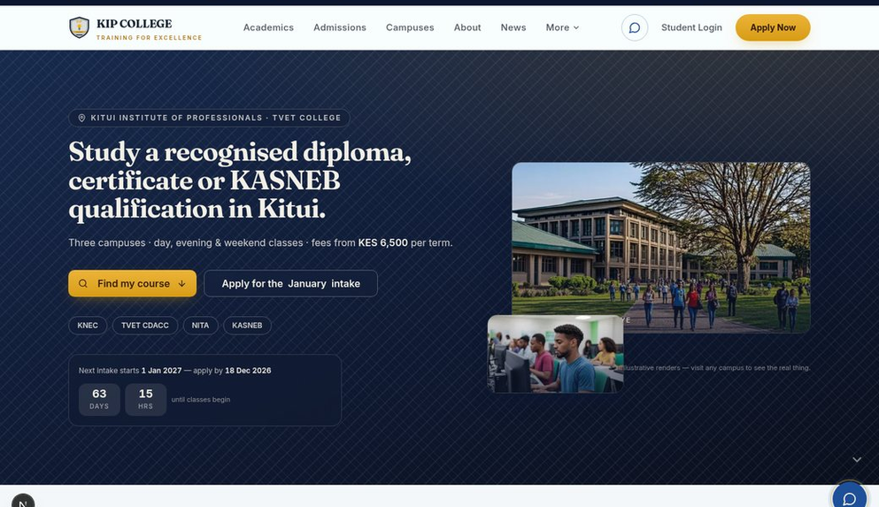
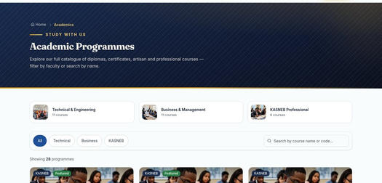

PLATFORM TOUR · 1 / 5
The public website
kip-college-system.vercel.app
/academics
2
Programme finder — filter by grade, campus, cost
/course/CPA
1
Homepage — sapphire & gold identity, live intake countdown, course finder
3
Course pages — fees, duration, exam body, apply CTA
✓
28 programmes, 3 categories
✓
News & events from the CMS
✓
Campus pages & directions
✓
Apply CTA on every page

Slide 8
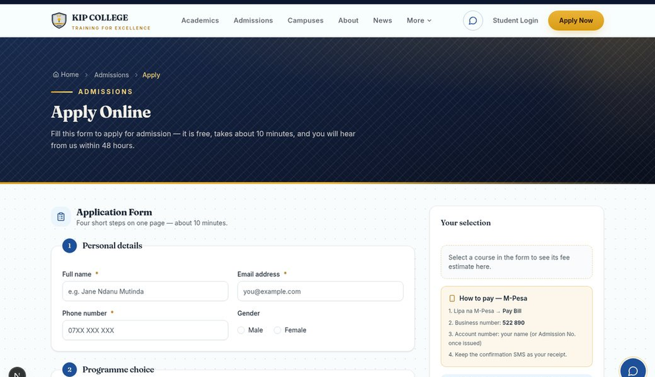
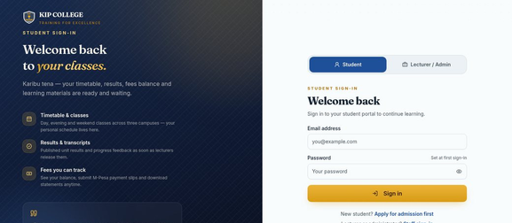
PLATFORM TOUR · 2 / 5
Online admissions, start to finish
/apply
/login · /login/staff
2
Split sign-ins — students and staff, each branded
✦
Every applicant gets a reference number
KIP/APP/2026/SG8JGW
Issued instantly — quote it at any campus to track the application.
1
Application wizard — validated step by step, duplicates prevented
✓
Validation on every field
✓
Duplicate submissions blocked
✓
Accept in admin → student record + fees posted
✓
First sign-in forces a password change

Slide 9
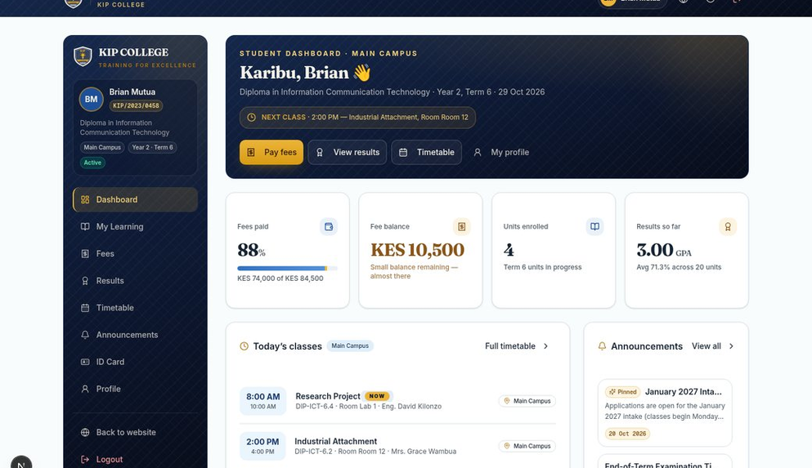
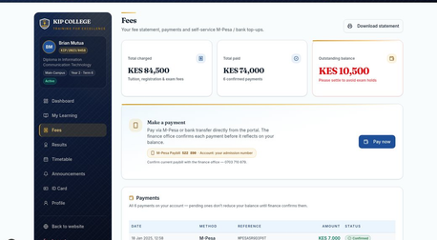
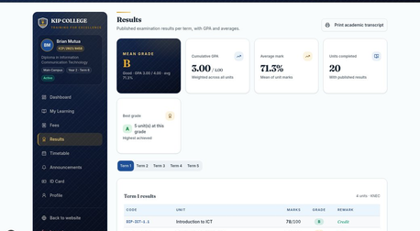
PLATFORM TOUR · 3 / 5
The student portal
/portal — signed in as student
/portal/fees
2
Fees — statement, balance, M-Pesa slip upload
/portal/results
1
Dashboard — fees, results, timetable and announcements at a glance
3
Results — only ever published, reviewed marks
✦
AI study assistant built in
▦
Personal timetable & materials
✦
Digital student ID card
⎙
Printable fee statements & docs

Slide 10
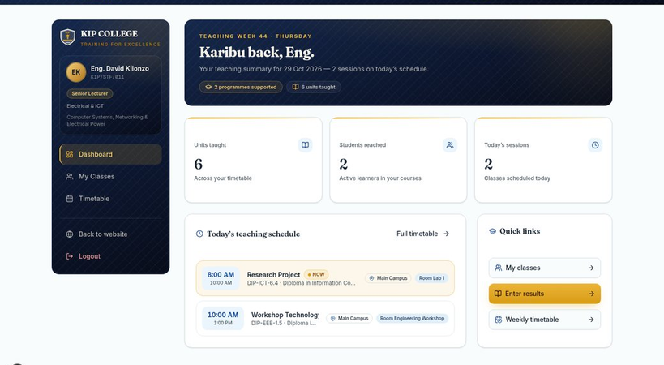
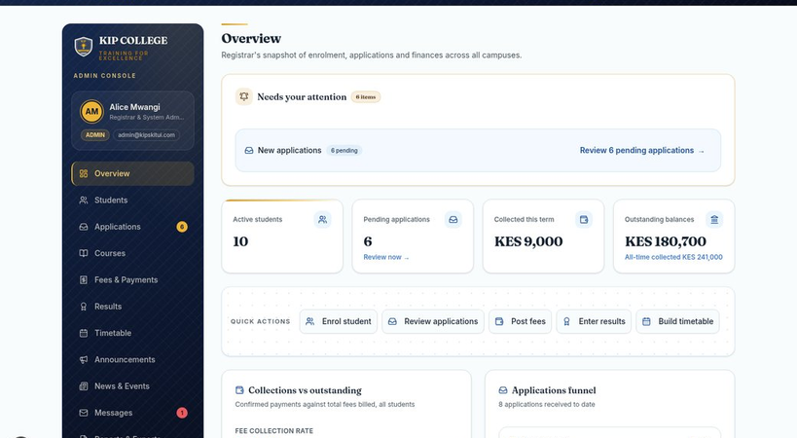
PLATFORM TOUR · 4 / 5
Lecturer and admin workspaces
/lecturer — marks entry
/admin — registrar console
✦
Lecturer workspace
⛨
Admin console
✓Class rosters, always current
✓Marks entry with Save-draft
✓Publish when checked — drafts stay invisible
✓Applications → enrolment in one action
✓Students, courses, fees, timetable, news CMS
✓Ministry-ready exports & reports

Slide 11
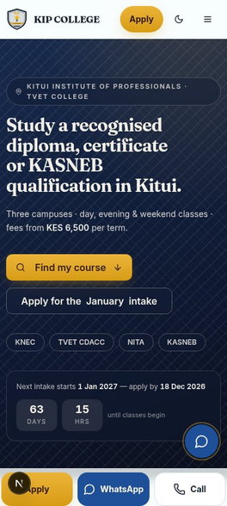
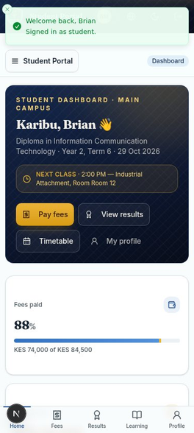
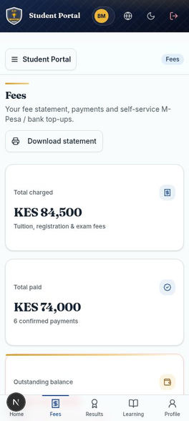
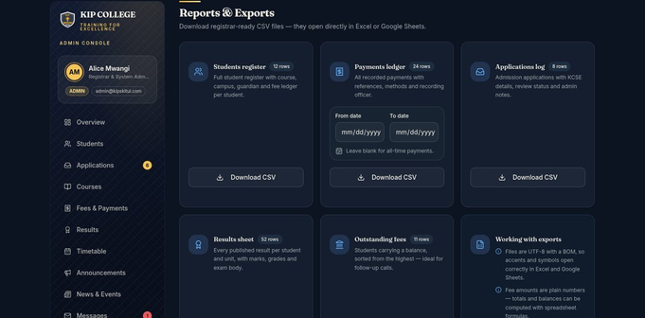
PLATFORM TOUR · 5 / 5
Built for every screen — and after dark
▯
Most students arrive on a phone
Every page adapts — one tap to call, WhatsApp or apply. The portal keeps working on modest connections.
/admin — dark mode
Homepage
Student portal
Fee statement
★
Dark mode across the site and every portal

Slide 12
FOUNDATION
Technology and security
✦
Technology stack
⛨
Security by design
Framework
Next.js 16
⚿Role-based access control enforced server-side
✦Rate limiting on login, passwords and applications
▤Full audit trail of security events
✦Secure, hardened session cookies
⛨Strict input validation and security headers
Language
TypeScript, strict mode
Interface
Tailwind CSS + shadcn/ui
Database
PostgreSQL via Prisma Postgres (persistent)
Hosting
Vercel, continuous deployment
☁
No server room, no on-site hardware, no dedicated IT staff required.

Slide 13
INVESTMENT
One-off cost to own the platform
KES 64,000
Design and branding
15,000
Total one-off investment — no licence fees and no per-student charges.
Platform development
22,000
Content, testing and deployment
18,000
⚿
Full source code and data ownership
Training and handover
9,000
Total
KES 64,000
ⓘ
Fee figures pending verification by the college owner.

Slide 14
AFTER GO-LIVE
Recurring costs and payment milestones
Recurring (per year)
Payment milestones
▦
Hosting
KES 10,000 / year
✦
KES 32,000
Sign-off
Vercel, managed PostgreSQL, domain, SSL
Proposal accepted, Phase 1 begins
50%
✦
Staging delivery
KES 16,000
⚒
Maintenance & support
KES 36,000 / year
Branded, content-loaded review site
25%
KES 3,000 per month — updates, fixes, support channel
✦
KES 16,000
Go-live
✦
Total recurring: KES 46,000 per year
Fully operational, staff trained
25%

Slide 15
DELIVERY
Six phases, six to eight weeks
✦
Week 1
✦
Weeks 1–2
✦
Weeks 2–4
Discovery & sign-off
Branding & design
Configuration & data
Confirm programmes, fees, branding; first milestone
KIP identity across site and portals
Real programmes, staff accounts, fee structures
✦
Weeks 5–6
✦
Week 7
✦
Week 8
Content, testing, staging
Training & handover
Go-live & support
End-to-end tests, review site; second milestone
Staff training, documentation, credentials
Production domain, monitoring; final milestone
⚡
The platform already exists — delivery is branding, content, verification and training, not risky software construction.

Slide 16
DECISION
Why this platform, and what happens next
Why
Next steps
◉Already live — evaluate the real thing before paying
$One-off KES 64,000 — no licences, no per-student fees
✦Modern maintainable stack any developer can take over
⛨Secure by design — RBAC, rate limits, audit trail
1Review the live demo with senior staff
2Verify contacts, fee figures and programme list
3Sign off and pay the first milestone (KES 32,000)
4Supply branding assets and nominate staff for training
5Approve staging and schedule go-live

Slide 17
KITUI INSTITUTE OF PROFESSIONALS
Thank you.
Integrated College Management System — public website, admissions, portals, admin console and AI study assistant.
✉
info@kipskitui.com
☎
+254 703 710 879 (to be verified by owner)
↗
https://kip-college-system.vercel.app
October 2026 · Phone numbers and fee figures pending owner verification.

