Slide 1



WEBSITE & COLLEGE MANAGEMENT SYSTEM — PROJECT PROPOSAL
KIP COLLEGE
Digital Transformation Proposal
One platform for three campuses: a modern public website, a self-service student portal, lecturer tools and a full administrative console — already built, live and demonstrated.
◎
Main Campus · Wikililye
◎
Town Campus · Muli Mall
◎
Mwingi Campus · Sunrise Building
October 2026 · Ref KIP/WEB/2026/01

Slide 2

WHO WE ARE
A college with real scale — and real ambition.
▣
▤
✦
✓
3
28
3
4
Campuses across Kitui County
Academic programmes catalogued
Course streams
National examination bodies
Technical, Business & KASNEB
KNEC · CDACC · NITA · KASNEB
◎
Main Campus
◎
Town Campus
◎
Mwingi Campus
Wikililye, Mulango Road
Muli Mall Building, Kitui Town
Sunrise Building, Mwingi
Every campus, course, fee structure and intake on one platform — the college’s complete academic identity, online.

Slide 3

THE PROBLEM
A great college deserves a greater digital presence.
✎
No online admissions
Applicants must travel to campus for paper forms
◉
Manual fee tracking
Balances live in spreadsheets, invisible to students
The current website is a static brochure. It lists courses, but it cannot serve students, process applications, or support staff. Meanwhile operations run on paper and spreadsheets.
✦
Hand-made documents
Fee statements, transcripts and ID cards produced on request
⎙
▤
◉
▣
No central records
Student data fragmented across campuses
◖
Fragmented communication
Announcements rely on noticeboards
✓
Every one of these gaps is closed by the proposed platform — on day one.

Slide 4

THE SOLUTION
One platform. Four experiences. Every stakeholder served.
◯
Public Website
✦
The front door of the college
▿
Student Portal
MODULE 02
Prospective students & parents
Current students
✓Course catalogue with full fees
✓Online admissions
✓News, events, downloads, FAQ
✓24/7 AI assistant
✓Dashboard & timetable
✓M-PESA fee payments
✓Printable statements, transcripts, ID card
✓AI Study Buddy
◆
Lecturer Workspace
MODULE 03
⛨
Admin Console
MODULE 04
Teaching staff
Registrar, finance & management
✓Class rosters
✓Guided marks entry
✓Class analytics with grade distributions
✓Live analytics
✓Admissions workflow
✓Payments ledger
✓Announcements & CSV exports

Slide 5
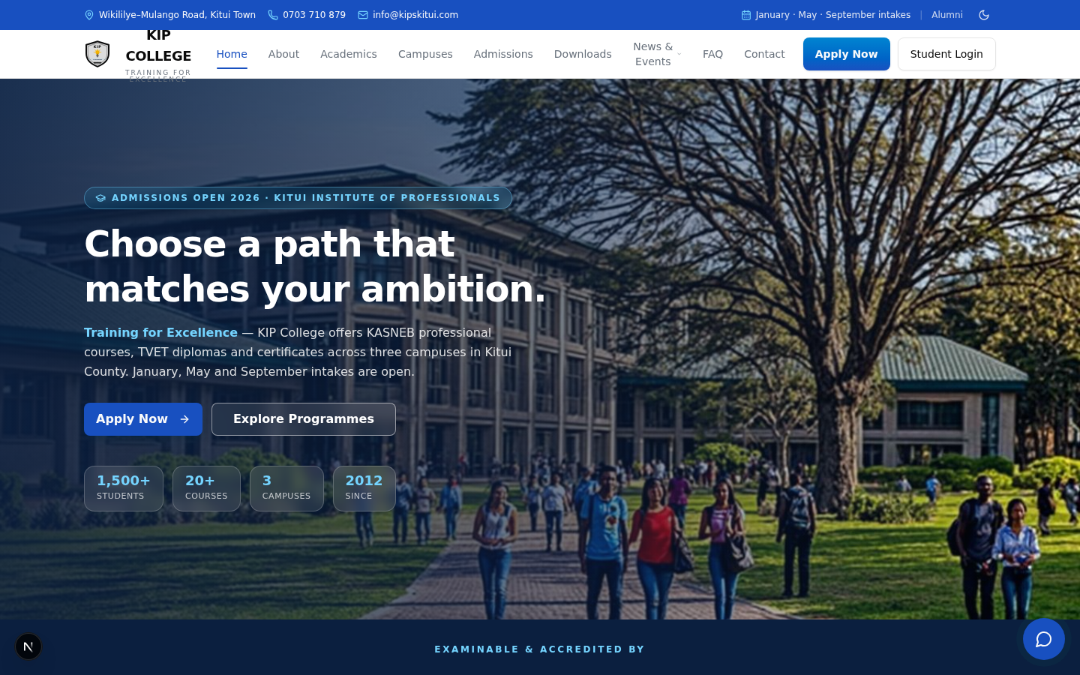

MODULE 01 — PUBLIC WEBSITE
A front door that converts visitors into applicants.
✓
Hero invitation — Choose a path that matches your ambition
KIP College — Public Website
LIVE
✓
All 28 programmes with tuition, registration & exam fees per term
✓
Filtering by Technical, Business & KASNEB streams
✓
Online admissions form feeding straight into the admin console
✓
Accreditation strip: KNEC, CDACC, NITA, KASNEB
✓
News & events, downloadable resources, FAQ and contact pages
✓
Live system — not a mock-up.

Slide 6
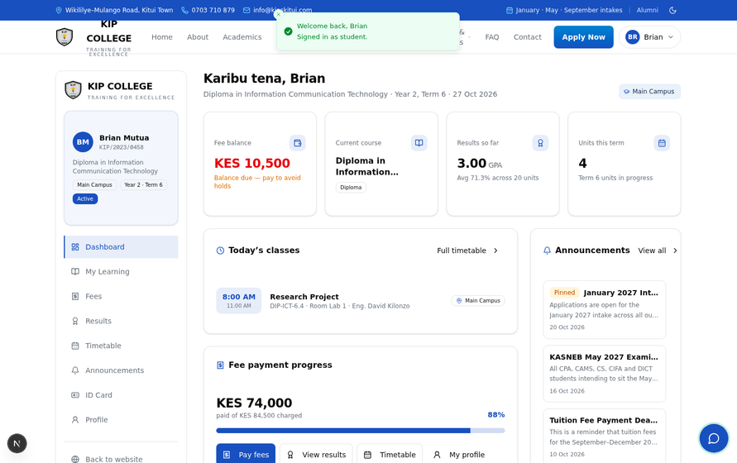
MODULE 02 — STUDENT PORTAL
Everything a student needs, on one sign-in.
LIVE
▦
Personal dashboard: course, year, today’s classes, fee balance
$
Fee payments by M-PESA or bank, with instant balance updates
▤
Official fee statements on college letterhead, printable
▿
Academic transcripts grouped by term with grades & GPA
▦
Weekly timetable and lecturer-uploaded learning materials
✦
Digital student ID card with crest and admission number
✓
Student dashboard — live system.

Slide 7
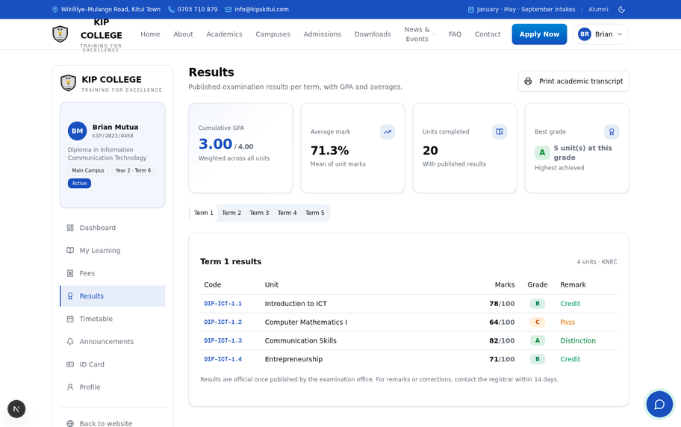
MODULE 02 — OFFICIAL DOCUMENTS
Documents the college can be proud of.
LIVE
▤
Fee statement — full ledger of charges and payments, M-PESA paybill in the footer
✦
Academic transcript — every unit, mark, grade and remark, grouped by term, with examination body of record
✦
Student ID card — crest, admission number, course, campus, validity period, barcode
⎙
All print-ready on ordinary office printers — generated straight from live data, no word-processing, no delays.
✓
Printable transcript view — live system.

Slide 8
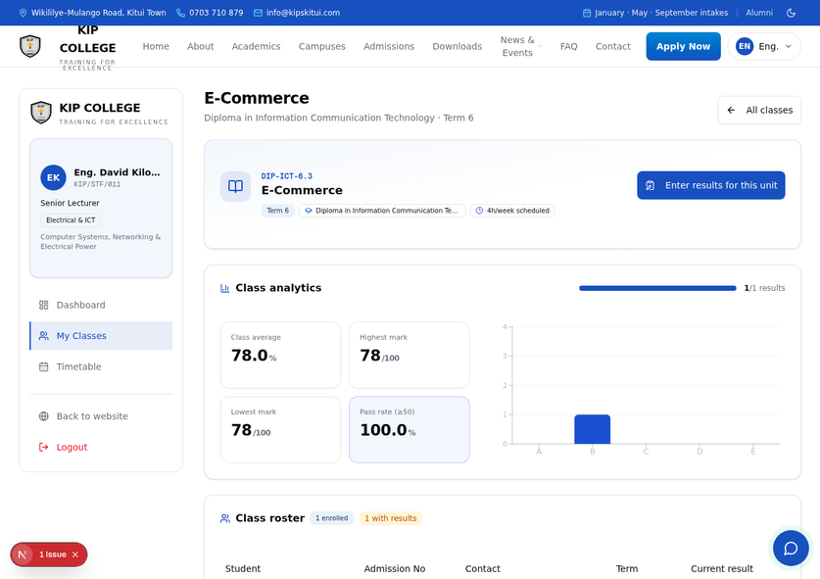

MODULE 03 — LECTURERS
Teaching insight, not paperwork.
LIVE
▦
Today’s teaching schedule at a glance
♟
Class rosters with student counts per unit
✓
Guided marks entry with automatic grading
◆
Class analytics: average, highest, lowest marks
▦
Pass rate and grade distribution charts per unit
⚡
Lecturers see how their classes perform the moment marks are entered.
✓
Class analytics with grade distribution — live system.

Slide 9
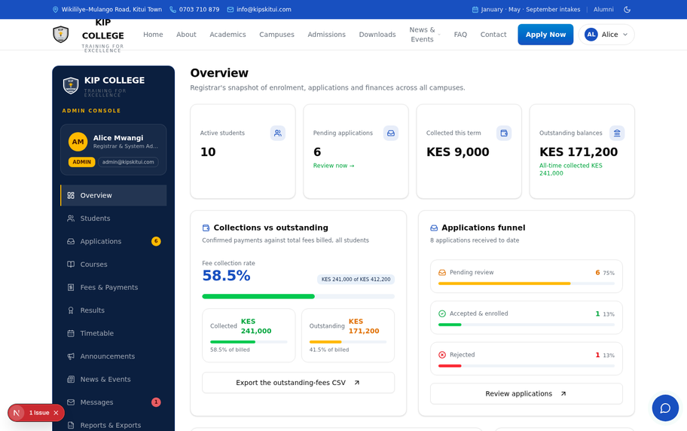
MODULE 04 — MANAGEMENT
The whole college, from one console.
LIVE
▦
Live KPIs: enrolment, fee collection rate, applications funnel
▦
Interactive charts: payment trends and campus distribution
▣
Complete student records with search and detail views
✦
Admissions review: accept or decline with one click
◖
Announcements to students, staff or everyone
↓
Five one-click CSV exports: students, payments, applications, results, outstanding balances
✓
Admin overview — live system.

Slide 10

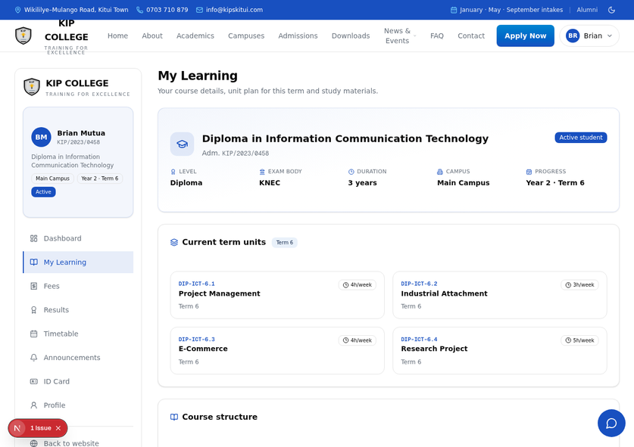
INTELLIGENCE
A 24/7 admissions officer.
A personal tutor for every student.
LIVE
✦
Website AI Assistant
Answers course, fee, intake and campus questions around the clock, drawing answers from the live course database so it never quotes stale fees.
◯
AI Study Buddy
Inside the student portal: knows the student’s actual units and materials; explains concepts, generates practice questions and quiz drills for the exact syllabus being studied.
✦
A regional first for a college platform.
✓
AI Study Buddy in conversation — live system.

Slide 11


UNDER THE HOOD
Modern engineering. Full ownership.
01
02
03
✦
Frontend
▦
Backend
▦
Database
Next.js 16, TypeScript, Tailwind CSS, shadcn/ui
Server-side API routes, nothing sensitive in the browser
Prisma ORM over SQL (PostgreSQL in production)
04
05
06
⛨
Security
✦
☁
Hosting
AI services
bcrypt password hashing, session cookies, role-based access
Server-side large language model SDK
Vercel or Netlify, automatic HTTPS, continuous deployment
✦
Delivered as a complete codebase in a GitHub repository — the college owns the platform outright.

Slide 12


THE ENGAGEMENT
Weeks, not months. Phased, transparent pricing.
WEEK 1
WEEK 2
WEEK 3
WEEK 4
Foundation
Deployment
Data & training
Go-live
brand, content, domain & hosting
website & portals live
records migrated, staff trained
public launch + 30-day hypercare
PHASE
SCOPE
KES
1
Public website
15,000
2
Student & lecturer portals
22,000
3
Admin console, analytics & reports
18,000
4
9,000
AI assistants
✓
Complete platform
64,000
KES
one-time
ⓘ
Recurring: hosting, domain & SSL KES 10,000/yr · support & maintenance KES 36,000/yr · payments 50% / 25% / 25%

Slide 13


SEE IT LIVE TODAY
Every feature is live right now.
⛨
Administrator
▿
Lecturer
✦
Student
EMAIL
EMAIL
EMAIL
admin@kipskitui.com
lecturer@kipskitui.com
student@kipskitui.com
PASSWORD
PASSWORD
PASSWORD
Admin@123
Lecturer@123
Student@123
analytics, students, admissions, payments, exports
classes, marks, analytics
fees, results, ID card, AI Study Buddy
Review
·
·
◉
✦
Explore the demo
✦
Sign
— go live in four weeks.
Training for Excellence.
October 2026 · Ref KIP/WEB/2026/01

