Slide 1
Soft Errors in Semiconductor Memories
Presented By:
Manoj Sai Gadde
Department of Electronics and communication Engineering

Slide 2
OUTLINE
INTRODUCTION
RELATED WORKS
PROPOSED TECHNIQUE
ANALYSIS AND DISCUSSION
CONCLUSION & FUTURE SCOPE

Slide 3
INTRODUCTION
Semiconductor Memory:
Binary information stored in a storage space is called memory.
Memory cells is a combination of transistors and capacitors.
Advantage of using the semiconductor memory is easy to use and less in cost.
Temporary or Permanent Errors:
Temporary errors are called transient errors which are caused because of fluctuations in potential level.
Permanent errors are caused because of defects during manufacturing process or large amount of radiations.

Slide 4
RELATED WORKS
Diagonal Hamming Based Multi-bit Error Detection and Correction technique .
HVD method is used for correction of bits in soft errors and the power consumption is less in this method.
HVDD methods can be used for bit patterns which is in the form of equilateral triangle and any irregular triangle. It can’t be used for patterns in the form of parallelogram.
In HVPDH method number of parity bits is reduced and hence reliability is increased .
In DMC method decimal program is used for identification and correction of errors. The main drawback in this method is it uses more redundant bits for reliability of memory.
MDMC less redundant bits are used and it uses reconfigurable Array Exclusive OR logic for addition in decimal.

Slide 5
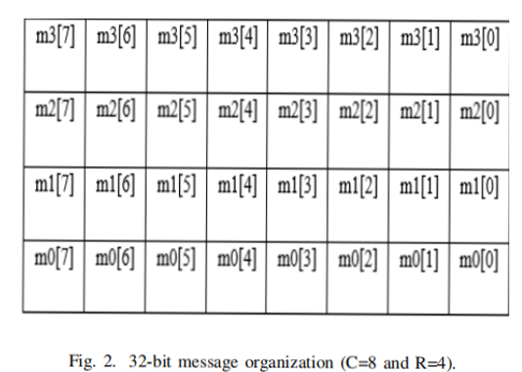
Diagonal Hamming Based Technique
Due to various noise interferences the message bits stored in the memory will be corrupted.
This proposed method is a unique way to correct the corrupted message with the help of Hamming code.
The message is encoded and stored in memory and the same message is retrieved from memory and decoded.
In the encoder, the given message is organized as m row and n column matrix as depicted in Fig.2 .
All these stored message bits in the memory will be given as input to the decoder. Decoder will correct the corrupted message bits and finally gives the actual message bits.

Slide 6
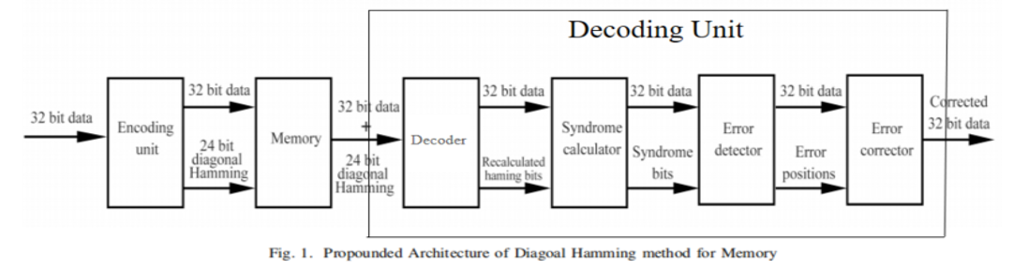
Design of Diagonal Hamming method for memory
Using this approach of diagonal Hamming, the errors can be recognized and can be rectified in the message that is saved in memory. In encoding technique message bits are given as input to the Diagonal Hamming encoder and the Hamming bits are calculated. Message and Hamming bits (32+24 bits) are saved in the memory after the encoding technique. Errors which are occurring in the message bits are saved in the memory and can be recognized and rectified in
the decoding technique

Slide 7
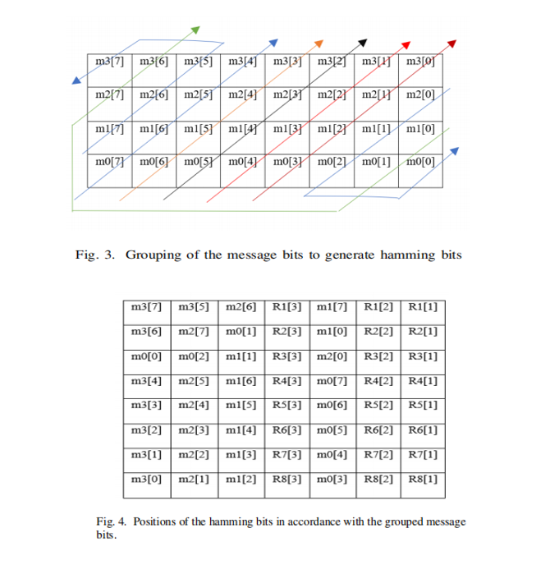
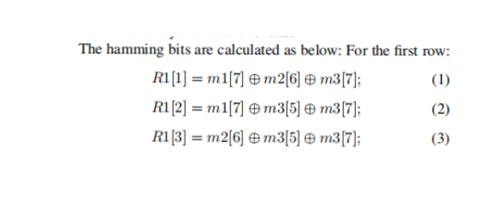
Encoder
For example a message of 32 bit is taken in the proposed diagonal hamming method.
The encoder generates the hamming bits. The hamming bits are obtained by grouping the message bits.
The message bits are patterned as shown in Fig.3
Each one of the diagonals has four message bits.
The positions of the hamming bits with respect to the grouped message bits shown in Fig.4.

Slide 8
Decoding Unit
Decoding unit finds out the corrupted message bits and then rectifies them.
The decoding unit consists of :
Decoder
Syndrome Calculator
Error Detector
Error Corrector
3.The proposed method was designed for detecting and correcting errors in 32-bit message.

Slide 9
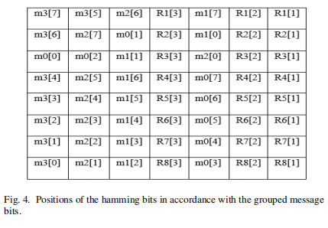
Decoder
Decoder's input comes from memory which may or may not have corrupted bits.
It segregates the message and hamming bits and recalculates the hamming bits and arranges them in the form of Fig.4.
Decoder sends its output to the syndrome calculator.

Slide 10
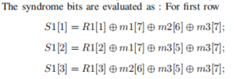
Syndrome Calculator
Syndrome calculator calculates the syndrome bits.
Corresponding to our proposed method the syndrome bits were calculated as:

Slide 11
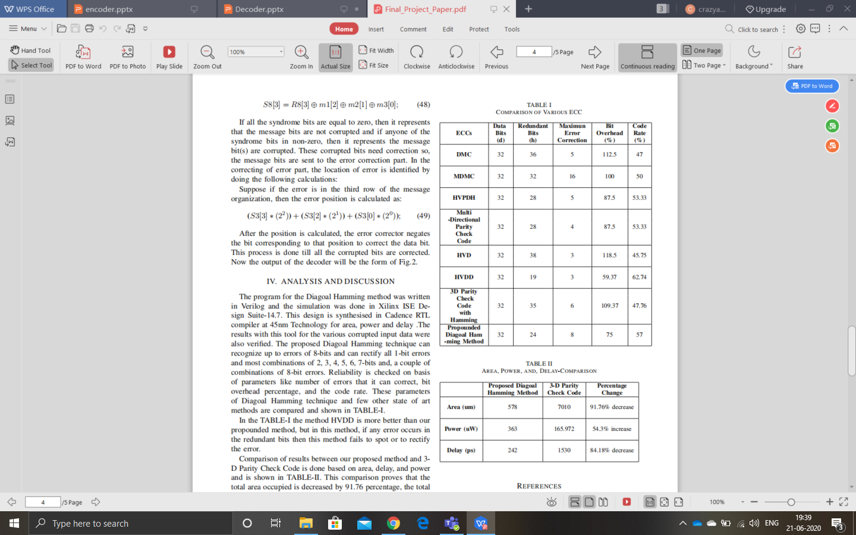
Error Detector & Error Corrector
Error detector receives its input (32+24) from syndrome calculator
Error detector calculates the corrupted bit position in the matrix as shown in Fig.4.
Error position is calculated as:
Its output (32+error bit positions) is given to the error corrector.
Error Corrector negates all the bits in the positions sent by the error detector.

Slide 12
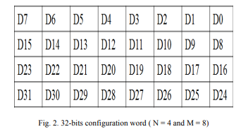
Horizontal-Vertical Parity and Diagonal Hamming Technique
As an example, data word of 32 bit is considered in this work. The data word is organized in the form of a N*M matrix
The horizontal and vertical bitwise XOR operation produces the two parity sets. The third parity set is obtained from grouping the data matrix and obtaining the parities by Hamming code method

Slide 13
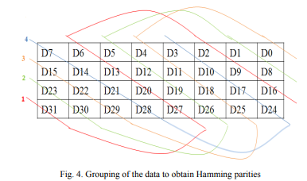
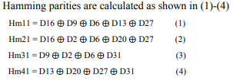
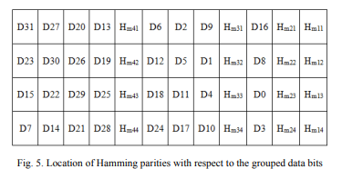
The grouping of the data follows the pattern shown below.

Slide 14
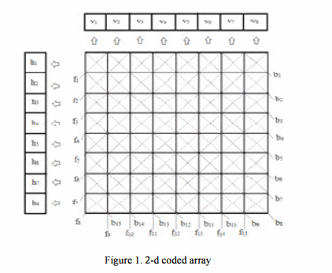
HVD Based Error Detection and Correction of Soft Errors
Parities are generated in the 4 diagonals that are horizontal, vertical, forward slash and back slash diagonals.
The 8 x 8 array is given in figure 1, where the symbols h, v, f and b denote the parity bits in horizontal, vertical, forward slash and backward slash respectively

Slide 15
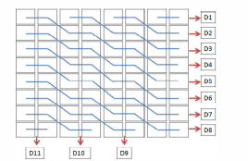
Horizontal-Vertical Double-Bit Diagonal Parity Method
Considered a data block of 64 bit and in a format of 8*8 array.
This method detects and corrects the soft error by using the check bits that are smeared on the double bit diagonal (DO) along with horizontal (H) and vertical (V) parity in forward direction.

Slide 16
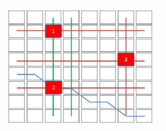
ADVANTAGES:
The proposed method is relatively less complex.
The proposed method consumes lesser memory.

Slide 17
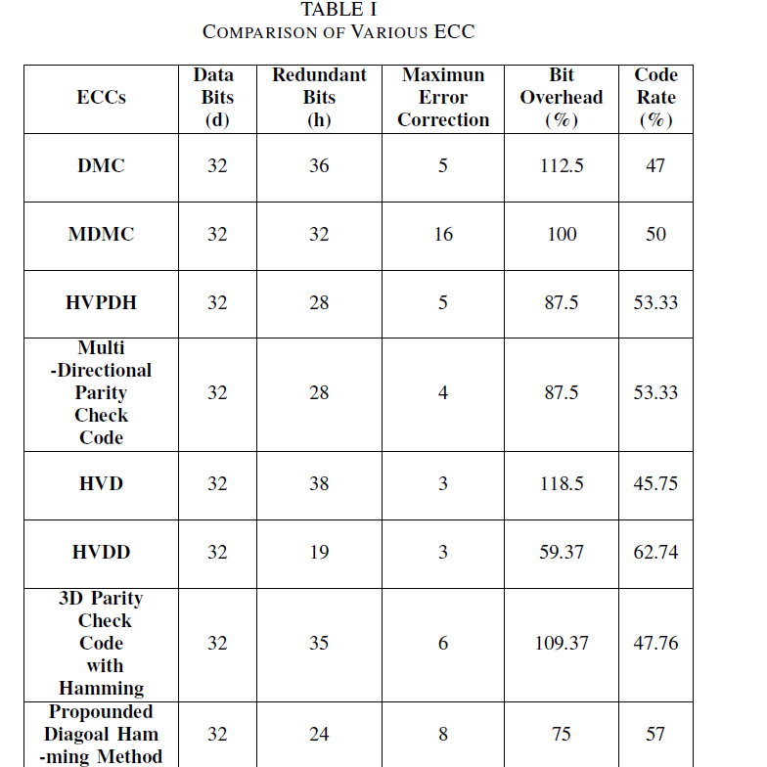
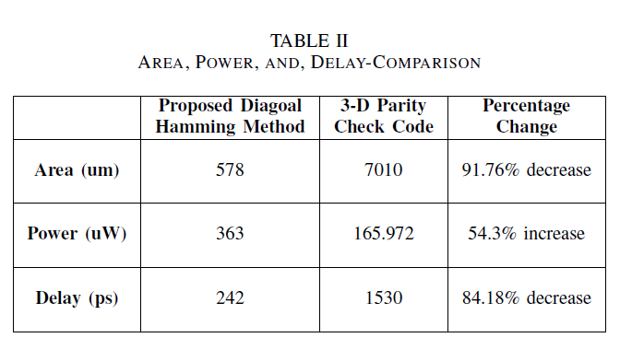
ANALYSIS AND DISCUSSION

Slide 18
CONCLUSION
Diagonal Hamming technique identifies and corrects up to maximum of 8bit errors in a row for 32-bit input.
Diagonal Hamming method ensures less area and delay by 91.76 percentage and 84.18 percentage respectively.

Slide 19
THANK YOU

