Slide 1
Heart Disease
Finding the best classification model to predict heart disease
Presented by Charla Gaddy

Slide 2

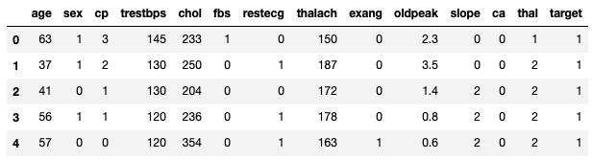
Dataset
https://archive.ics.uci.edu/ml/datasets/heart+Disease
This database contains 76 attributes, but all published experiments refer to using a subset of 14 of them. The “target" field refers to the presence of heart disease in the patient.

Slide 3

Data attributes
age
sex
chest pain
resting blood pressure
cholesterol
fasting blood sugar
resting electrocardiographic
maximum heart rate
exercised induced angina
depression induced by exercise
slope of the peak exercise
major blood vessels
thallium stress test
target

Slide 4
Project Design
The main question to answer is whether a model can accurately predict if a person has heart disease or not, based on the attributes of the data.
The objective is to create the best model by increasing accuracy, in the hold test sample and increasing the AUC -- area under the ROC curve.
The recall and precision will also be calculated to make sure the model isn’t predicting a lot of false positives.
The data will first be run on 6 baseline models and then 4 models will be tuned via gridsearch.

Slide 5
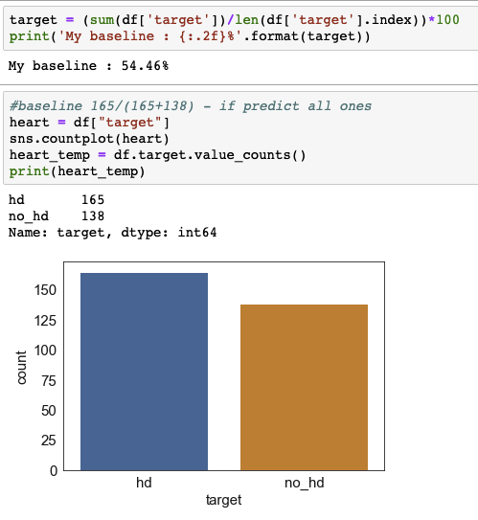
54.46% of the people in the dataset have heart disease.

Slide 6
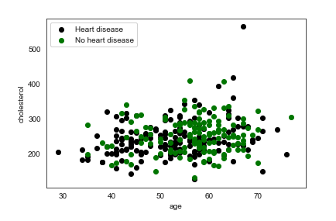
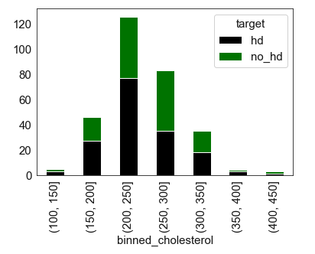
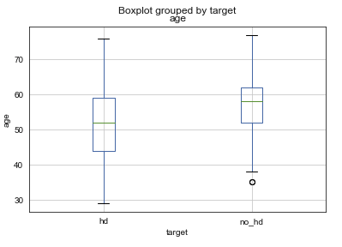
Age and Cholesterol
The average age for heart disease is lower than those who don’t have the disease.
Outliers are minimal.
Cholesterol between 200 and 250 have the highest amount of heart disease patients.

Slide 7
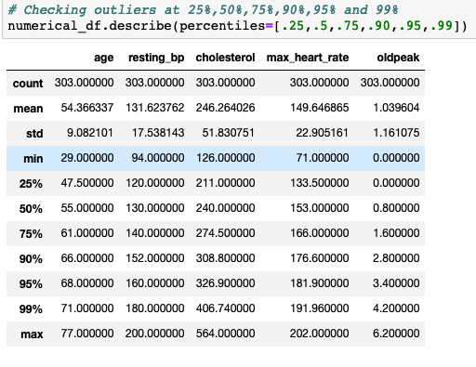
Description of the data
From the distribution shown:
Insignificant outliners
no null values

Slide 8
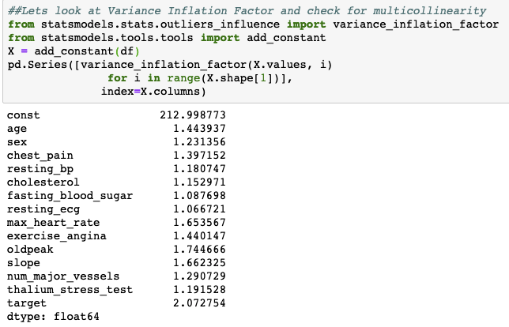
VIF to check for multicolinerity
VIF is low which is an indication of no correlation.

Slide 9
Categorical variables were dummied
Chest Pain Type
0: Typical angina
1: Atypical angina
2: Non-anginal pain
3: Asymptomatic
Resting electrocardiographic results
0: Nothing to note
1: ST-T Wave abnormality Can range from mild symptoms to severe problems Signals non-normal heart beat
2: Possible or definite Left ventricular hypertrophy Enlarged heart's main pumping chamber
slope: the slope of the peak exercise ST segment
0: upsloping
1: flatsloping
2: downsloping
Thalium stress test result - Sees how blood moves through your heart while exercising
1: Normal
6: fixed defect
7; reversible defect

Slide 10
Summary of the data
Variables are not correlated.
There were no null values.
Data was scaled due to the different parameters.
Dummy variables were created for categorical data.
The target variable was balanced.
A 3 fold cross validation was used for all.

Slide 11
Plan
The objective is to create the best model by increasing the accuracy and the area under the curve scores.
A classification model will be used to determine which class a patient belongs.
First we will calculate the baseline score.
Second we will tune the model to get a better baseline score.
Third we will compare the scores of each algorithm to see which has the best score.
Finally we will determine the best algorithm for determining heart disease.

Slide 12
Base Models
Naive Bayes
KNN Classifier
Logistic Regression
Support Vector Machine
Random Forest
XGBoost

Slide 13
Model Tuning
Four models were tuned to see if the score would change for the better. Grid-search was used to find the best combination of parameters with a 3 fold cross validation to yield the best accuracy score.
KNN Classifier
Random Forest
Support Vector Machines
Extreme Gradient boosting

Slide 14
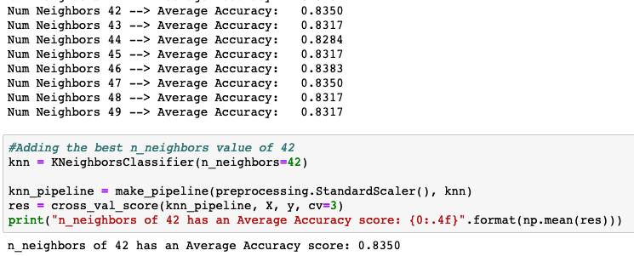
KNN tuning: n_neighbors
A range of n_neighbors were looped through the classifier and 42 produced the best score ~ 0.8350.

Slide 15

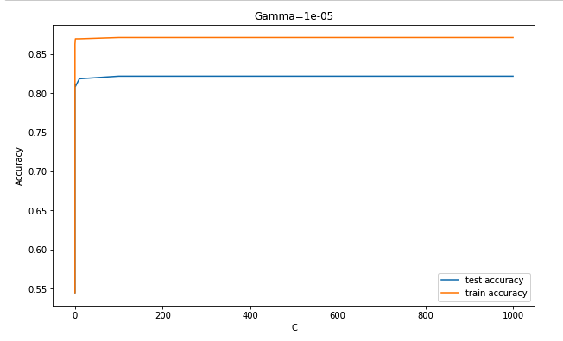
Support Vector Machines tuning
gamma
C
Results

Slide 16
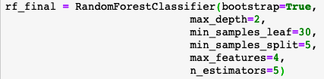
Random Forest tuning
max depth
minimum samples leaf
minimun samples split
n_estimators
max features
Results
AdaBoostClassifier was also used to boost Random Forest but the final results didn’t increase the score. There wasn’t an improvement.

Slide 17
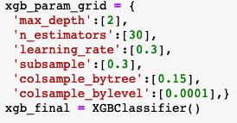
Extreme Gradient Boost tuning
max depth
learning rate
column sample by tree
column sample by level
n_estimators
subsample
Results

Slide 18
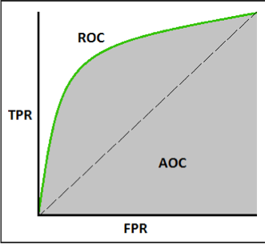
Model Comparison:
The metrics used to evaluate the models are the accuracy score and ROC/AUC.
AUC is the area under the ROC Curve . ROC Curve (receiver operating characteristic) shows the performance of the classification model at all classification thresholds.
True Positive Rate = TP/(TP+FN)
False Positive Rate = FP/(FP+TN)
Our goal is to not tell a person they have heart disease when they don’t and that they don’t have heart disease when they actually have it. So we need rates to be low.

Slide 19
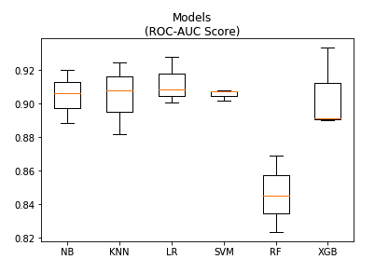
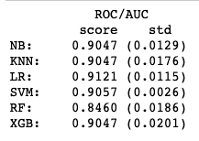
ROC/AUC Model Comparison
All the tuned models were put into a new jupyter notebook and compared side by side.
LR has the best score
SVM is the most stable
3 fold evaluation

Slide 20
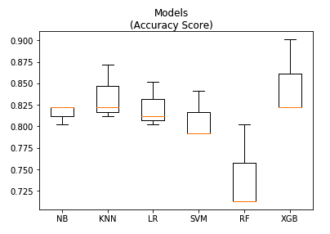
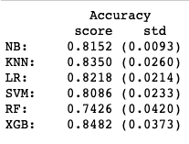
Accuracy Score Model Comparison
XGB has the best score
NB is the most stable
3 fold evaluation

Slide 21
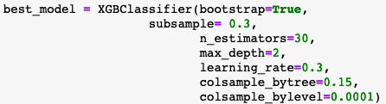
The Best Model
XGB is the winning model
tuned average score was 85%
tuned roc/auc score 90%

Slide 22
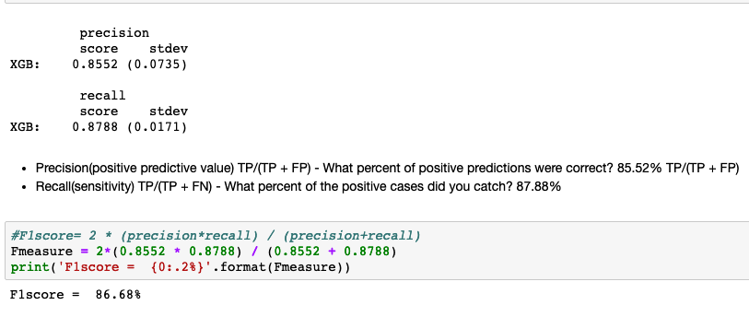
XGB evaluation
85.52% of predictions were correct - TP/(TP + FP)
87.88% of the positive cases were caught - TP/(TP + FN)

Slide 23
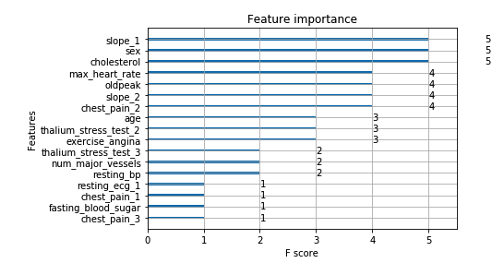
Feature Importance
The most significant features predicted for heart disease using the extreme gradient boost model are seen below.

Slide 24
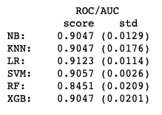
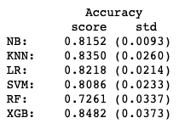
Summary
Naive Bayes scored good in ROC/AUC and wasn’t that far behind in accuracy from XGB.
K-Nearest Neighbor scored good in ROC/AUC and wasn’t that far behind in accuracy from XGB. Based on distances between data point and not on errors like XGB.
Logistic Regression decides on a particular cutoff score for the probabilities and the cutoff boundary will always be linear and therefore misclassifying some data points.
Support Vector Machine did ok. It score ok mostlikely due to the fact that it looks at the distances between the data points.
XGBoost has more parameters to tune, like sub sample (helps with overfitting) and learning rate (reduces the size of the previous loss function gradient). It models on the errors in steps and trees are formed sequentially then combined to form a result.

Slide 25
Some short comings
Maybe include new features for a better prediction such as family history, inflammation and blood sugar for diabetics, as the Reynolds Risk Score* for heart disease suggests.
Check whether any of the original 76 attributes would be beneficial to add back.
A larger dataset or a combined dataset from several states and not just Cleveland.
*http://www.reynoldsriskscore.org/

