Slide 1
Welcome to Selenium Training
by sharath

Slide 2
Course Content
Introduction to JAVA
Installation of Eclipse IDE
Data types
Variables
Control Statements
Strings
Arrays
What are Functions?
Class
Object
Static and non-static variables
Static and non-static functions
Object Oriented Programming
Class
Object
Constructor
Inheritance
Polymorphism
Access Modifiers
Exception Handling
Collections
File Handling

Slide 3
Selenium Course Content
Introduction to Selenium WebDriver
First Program on selenium
Verify Page title in Selenium Webdriver
Navigation in selenium
Radio button and Checkbox in Selenium Webdriver
Handling Autosuggestion
Handling Dropdown List
Handling Drag and Drop in Selenium
Handling Mouse Hover ,Keyword Events using Action class
Synchronization using webdriver(Waits)
How to take screenshot using selenium
How to capture Error message using webdriver
Handling Multiple windows
Handling Alert Messages.
Handling IFrames.
Cross Browsing using selenium
Complete details of Dynamic XPath in Selenium
Complete details on CSS in selenium
How to download files in Selenium Webdriver.
Handling WebTable
How to use Logs File in selenium
How to use Properties File in selenium
Handling File upload using Saluki/Auto IT
TestNG
Apache POI

Slide 4
What is Java
Installing Java
Data types & Variables

Slide 5
What is Java
Java is a high-level programming language was originally developed by Sun Microsystems which was initiated by James Gosling and released in 1995.

Slide 6
Where java is used?
Java is basically used to develop the Software Applications. Below are types of applications
1) Standalone Application
It is also known as desktop application or window-based application. An application that we need to install on every machine such as media player, antivirus etc.
2) Web Application
An application that runs on the server side and creates dynamic page, is called web application. Currently, servlet, jsp, struts, jsf etc. technologies are used for creating web applications in java.

Slide 7
3) Enterprise Application
An application that is distributed in nature, such as banking applications etc. It has the advantage of high level security, load balancing and clustering. In java, EJB is used for creating enterprise applications.
4) Mobile Application
An application that is created for mobile devices. Currently Android and Java ME are used for creating mobile applications.

Slide 8
Java Installation
Steps to install the java:
Open the browser and navigate to URL: http://www.oracle.com/technetwork/java/javase/downloads/jre9-downloads-3848532.html
Click on Accept License Agreement
Select the Platform the and click on download.
Go to the file location and double-click on the saved file to start the installation process.
The installation process starts. Click the Install button to accept the license terms and to continue with the installation
You will get few window with Next button , click the Next button to continue the installation.
A few brief dialogs confirm the last steps of the installation process; click Close on the last dialog. This will complete Java installation process.

Slide 9
8. To verify the weather java is successfully installed, open cmd prompt and type below command
cd:\java –version [Enter]

Slide 10
First Java Program
public class FirstClass {
public static void main(String[] args){
System.out.println("Welcome to Java");
}
}

Slide 11
Data types & Varialbes
Variable:
Variable is name of reserved area allocated in memory. In other words, it is a name of memory location.
Eg : int age=20;
age=40;
//age is variable
RAM
Reserved memory location
10

Slide 12
Types of Variable: There are three types of variables in java
1) Local Variable
A variable which is declared inside the method is called local variable.
2) Instance Variable
A variable which is declared inside the class but outside the method, is called instance variable . It is not declared as static.
3) Static variable
A variable that is declared as static is called static variable. It cannot be local.

Slide 13
class VariablesEg{
int age=20;//instance variable
static int marks=100;//static variable
void localVariable(){
int score=210;//local variable
}
}

Slide 14
Data Types in Java
Data types represent the different values to be stored in the variable. In java, there are two types of data types:
Primitive data types
Non-primitive data types

Slide 15
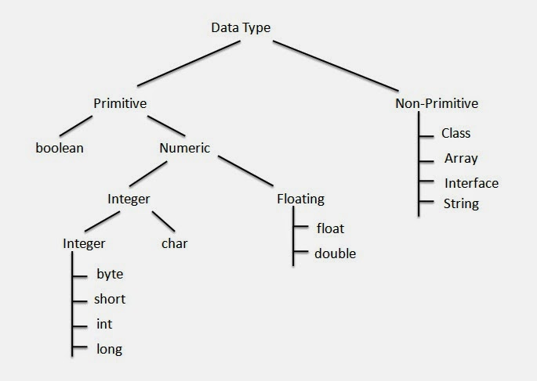

Slide 16
Data Type | Description | Range | Default Value | Default size
byte | Byte datatype is used to save space in large arrays, It is used in place of integer as it is four-time smaller than integer | +127 to -128 | 0 | 1 byte
short | Short data type is also used to save memory as byte datatype. The short data type is 2 times smaller than an int. | +32,767 to -32,768 | 0 | 2 byte
int | Int datatype is used as a default data type for integer values. | +2,147,483,647 to -2,147,483,648. (-2^31) | 0 | 4 byte
long | Long datatype is used when a wider range than int datatype is needed and Default value is OL. | +9,223,372,036,854,775,807 to -9,223,372,036,854,775,808 | 0L | 8 byte
float | Float datatype is used for saving memory in large arrays of floating point numbers. | 3.402,823,5 E+38 to 1.4 E-45 | 0.0f | 4 byte
double | Double datatype is used as a default data type for decimal values | 1.797,693,134,862,315,7 E+308 to 4.9 E-32 13.04, -145.5427, 0,0 | 0.0d | 8 byte
boolean | Boolean datatype is used for simple flags tracks true/false condition | true, false | FALSE | 1 bit
char | Char datatype is used for storing any character | All Unicode characters such as 'a', 's', '%', '9' | '\u0000' | 2 byte

Slide 17
Operators in java
Operator : Operator in java is a symbol that is used to perform operations. For example: +, -, *, / etc. There are many types of operators in java which are given below:
Unary Operator,
Arithmetic Operator,
shift Operator,
Relational Operator,
Bitwise Operator,
Logical Operator,
Ternary Operator and
Assignment Operator.

Slide 18
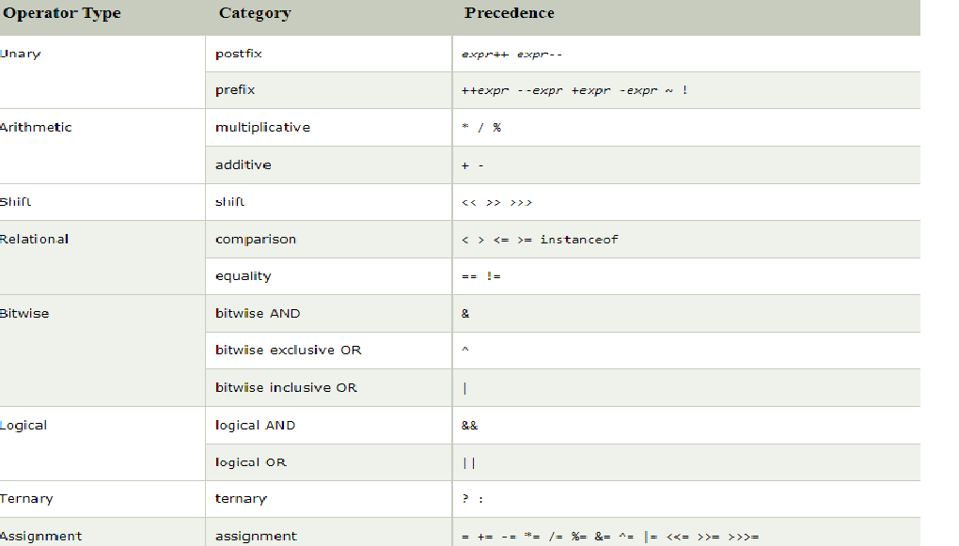

Slide 19
Example for Arithmetic Operator
class Arithmetic Example{
public static void main(String args[]){
int a=10;
int b=5;
System.out.println(a+b);//15
System.out.println(a-b);//5
System.out.println(a*b);//50
System.out.println(a/b);//2
System.out.println(a%b);//0
System.out.println(10*10/5+3-1*4/2);
}}

Slide 20
Example for Logical Operators
class Logical Example{
public static void main(String args[]){
boolean a = true;
boolean b = false;
if(a && b){
System.out.println("true");
}else{
System.out.println("False");
}}}

Slide 21
Example for Relational Operators
class Logical Example{
public static void main(String args[]){
int a=10, b=10;
boolean flag = a==10;
if(a==10){
System.out.println("equal");
}else{
System.out.println("not equal");
}}}

Slide 22
OR Operator Example: Logical || and Bitwise |
class LogicalBitwiseExample{
public static void main(String args[]){
int a=10;
int b=5;
int c=20;
System.out.println(a>b||a<c);//true || true = true
System.out.println(a>b|a<c);//true | true = true //|| vs |
System.out.println(a>b||a++<c);//true || true = true
System.out.println(a);//10 because second condition is not checked
System.out.println(a>b|a++<c);//true | true = true
System.out.println(a);//11 because second condition is checked
}}

Slide 23
Assignment Operator Example
class AssignmentExample{
public static void main(String args[]){
int a=10;
int b=20;
a+=4;//a=a+4 (a=10+4)
b-=4;//b=b-4 (b=20-4)
System.out.println(a);
System.out.println(b);
a+=3;//10+3
System.out.println(a);
a-=4;//13-4
System.out.println(a);
a*=2;//9*2
System.out.println(a);
a/=2;//18/2
System.out.println(a);
}
}

Slide 24
ShiftOperatorts
class BitwiseExample{
public static void main(String args[]){
// RightShift Operators
//For positive number, >> and >>> works same
System.out.println(10>>2);//10/2^2=10/4=2
System.out.println(20>>2);//20/2^2=20/4=5
System.out.println(20>>3);//20/2^3=20/8=2
System.out.println(20>>2);
System.out.println(20>>>2);
//For negative number, >>> changes parity bit (MSB) to 0
System.out.println(-20>>2);
System.out.println(-20>>>2);
// Left Shift Operators
System.out.println(10<<2);//10*2^2=10*4=40
System.out.println(10<<3);//10*2^3=10*8=80
System.out.println(20<<2);//20*2^2=20*4=80
System.out.println(15<<4);//15*2^4=15*16=240
}}

Slide 25
TernaryOperatorts
class TernaryExample{
public static void main(String args[]){
int a=2;
int b=5;
int min=(a<b)?a:b;
System.out.println(min);
}}

Slide 26
Conditional Statement

Slide 27
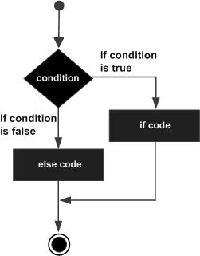
If Condition
public class Test {
public static void main(String args[]) {
int x = 30;
if( x < 20 )
{
System.out.print("This is if statement");
}
} }

Slide 28
if else condition
public class Test {
public static void main(String args[]) {
int x = 30;
if( x < 20 )
{
System.out.print("This is if statement");
}else{
System.out.print("This is else statement");
}
} }

Slide 29
if else condition
public class Test {
public static void main(String args[]) {
int x = 30;
if( x < 20 )
{
System.out.print("This is if statement");
}else if(x==10){
System.out.print("This is else statement");
}
} }

Slide 30
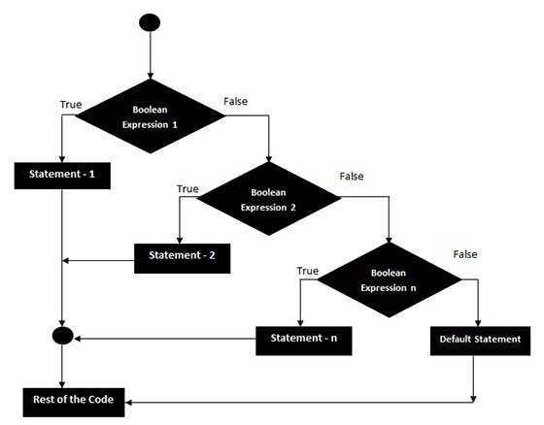
Nested if else condition

Slide 31
public class NestedIfElse {
public static void main(String[] args) {
int marks=65;
if(marks<35){
System.out.println("fail");
}
else if(marks>=35 && marks<50){
System.out.println("D grade");
}
else if(marks>=50 && marks<70){
System.out.println("C grade");
}
else if(marks>=70 && marks<80){
System.out.println("B grade");
}
else if(marks>=80 && marks<100){
System.out.println("A grade");
}else{
System.out.println("Invalid!");
}
}
}

Slide 32
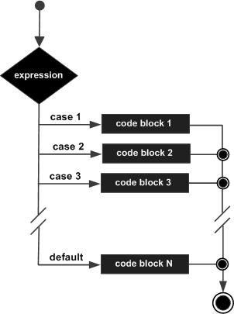
Switch Case
public class SwitchCaseExample {
public static void main(String[] args) {
String Case=Sunday;
switch(Case){
case ”Sunday”:
System.out.println(“Holiday");
break;
case ”Satuarday”:
System.out.println(“Holiday");
break;
default:
System.out.println(“WorkingDay");
}
}
}

Slide 33
LOOPS
loops in java is used to iterate any set of statements several times. The below are the different loops available in java.
For Loop
Normal for loop
Labeled for loop
For each loop
While Loop
Do While

Slide 34
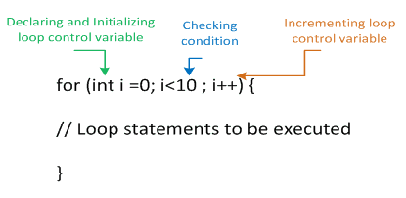
For Loop
If the number of iterations are fixed, it is recommended to use for loop.
There are three types of for loop in java.
For Loop
Labeled For Loop
For-each

Slide 35
Eg For Loop
for(int i=1; i<=10;i++){
System.out.println(i);
}
Break Keyword
for(int i=1; i<=10;i++){
if(i==5){
break;
}
System.out.println(i);
}
In Java break is a keyword used to exit from the loop or switch statement. It breaks the flow of the program. In case of nested loop, it breaks only inner loop.

Slide 36
Continue Keyword
for(int i=1; i<=10;i++){
if(i==5){
continue;
}
System.out.println(i);
}
In Java continue is a keyword used to skip from the step and continue the loop

Slide 37
Labeled For Loop
We can have name of each for loop. To do so, we use label before the for loop. It is useful if we have nested for loop so that we can break/continue specific for loop.
Normally, break and continue keywords breaks/continues the inner most for loop only.
FirstLoop:
for(int i=1;i<=3;i++){
SecondLoop:
for(int j=1;j<=3;j++){
if(i==2&&j==2){
break FirstLoop;
}
System.out.println(i+" "+j);
}
}

Slide 38
For Each Loop
The for-each loop is used to traverse array or collection in java. It is easier to use than simple for loop because we don't need to increment value and use subscript notation.
It works on elements basis not index. It returns element one by one in the defined variable.
int a[] = {1,2,4,5,6,7,8};
for(int i:a){
System.out.println(i);
}

Slide 39
Do While Loop
do-while loop is used to iterate a set of statements several times. If the you have to execute the loop at least once and want to continue the iteration till it satisfies some condition, it is recommended to use do-while loop. do-while loop is executed at least once because condition is checked after loop body
int i=1;
do{
System.out.println(i);
i++;
}while(i<=10);
}

Slide 40
While Loop
while loop is used to iterate a set of statements several times. If the number of iteration is not fixed, it is recommended to use while loop.
int i=1;
while(i<=10){
System.out.println(i);
i=i+1;
}

Slide 41
String
String is basically an object that represents sequence of char values. String class class provides a lot of methods to perform operations on string such as split(), length(), substring()..etc
String str = “JAVA”;
system.out.println(str.length()); OutPut:
JAVA

Slide 42
String Methods
Here are the list of the methods available in the Java String class. These methods are explained in the separate tutorials with the help of examples. Links to the tutorials are provided below:
int length(): It returns the length of a String.
String substring(int beginIndex): It returns the substring of the string. The substring starts with the character at the specified index.
String substring(int beginIndex, int endIndex): Returns the substring. The substring starts with character at beginIndex and ends with the character at endIndex.

Slide 43
String[] Split(): It will split the string and return the array.
String toLowerCase(): It converts string into lower case.
String toUpperCase(): It converts string into upper case
String Replace(String begin, int endIndex): Returns the substring. The substring starts with character at beginIndex and ends with the character at endIndex.
boolean startsWith(String prefix, int offset): It checks whether the substring (starting from the specified offset index) is having the specified prefix or not.
boolean contains(CharSequence s): It checks whether the string contains the specified sequence of char values. If yes then it returns true else false. It throws NullPointerException of ‘s’ is null.

Slide 44
char charAt(int index): It returns the character at the specified index. Specified index value should be between 0 to length() -1 both inclusive. It throws IndexOutOfBoundsException if index<0||>= length of String.
boolean equals(Object obj): Compares the string with the specified string and returns true if both matches else false.
boolean equalsIgnoreCase(String string): It works same as equals method but it doesn’t consider the case while comparing strings. It does a case insensitive comparison.
boolean endsWith(String suffix): Checks whether the string ends with the specified suffix.
int indexOf(int ch): Returns the index of first occurrence of the specified character ch in the string.

Slide 45
Arrays
Normally, array is a collection of similar type of elements that have contiguous memory location.
It is a data structure where we store similar elements. We can store only fixed set of elements in a java array.
Array in java is index based, first element of the array is stored at 0 index

Slide 46
Types of Array in java
There are two types of array.
Single Dimensional Array
Syntax: dataType arr[];
Multidimensional Array
Syntax: dataType arr[][];
Instantiation of an Array in java
Syntax : datatype array=new datatype[size];
datatype array=new datatype[size][size];

Slide 47
Java static keyword
static keyword in java is used for memory management mainly. We can apply java static keyword with variables, methods, blocks and nested class.
Static can be used at below levels:
variable
method
block

Slide 48
static at variable level
Any variable which is declared as static, it is known static variable.
Eg: static int a;
Memory for this variable will be allocated only once at time of loading the class. The static variable can be used to refer the common property of all objects
Eg: static String schoolName; (As school name will be same for all the students)
Eg: int rollNo; (roll no can not be same for all the students)

Slide 49
Sample Program
class TC1{
static String college =“xyz";
int rollno;
String name;
Student (int r,String n){
rollno = r;
name = n;
}
void display (){
System.out.println(rollno+" "+name+" "+college);
}
public static void main(String args[]){
TC1 s1 = new TC1(1,“A");
TC1 s2 = new TC1(2,“B");
s1.display();
s2.display();
}
}

Slide 50
public static void main(String[] args) {
TC2 obj = new TC2();
obj.method1();
System.out.println(a);
TC2 obj1 = new TC2();
obj1.method1();
System.out.println(a);
obj.method2();
System.out.println(obj.b);
obj1.method2();
System.out.println(obj.b);
}
public class TC2 {
static int a;
int b;
void method1(){
System.out.println(a);
a=a+1;
}
void method2(){
System.out.println(b);
b=b+1;
}

Slide 51
School=xyz;
Roll = 1;
Name=A;
Roll = 2;
Name=B;
s3
Roll = 1;
Name=A;
s2
s1
Stack Memory
Heap Memory

Slide 52
static method level
Any method which is declared as static, it is known static method
static method belongs to the class rather than object of a class.
A static method can be invoked without the need for creating an instance of a class.
static method can access static data member and can change the value of it.

Slide 53
static method restrictions
static methods can not use non static data member or call non-static method directly.
this and super cannot be used in static context.
class A{
int a=40;//non static
public static void main(String args[]){
System.out.println(a);
}
}
O/P: compile teim error

Slide 54
Static at block level
public class staticblock {
static {
System.out.println("static block is invoked");
}
public static void main(String[] args) {
// TODO Auto-generated method stub
}
}
Static block will be executed before the main method, at the time of loading the class
Static blocks will be used to initialize the static data member.

Slide 55
Class
A class can be defined as a template or blueprint from which objects are created. It is a logical entity. It can't be physical.
A class in Java can contain:
data members
methods
constructors
blocks
interface
Simple Class Syntax:
class MyClass
{
// field, constructor, and
// method declarations
}

Slide 56
Additional info about class
A class is a logical entity.
Class body surrounded by flower braces i.e, {}.
Class body contains all the code that provides for the life cycle of the objects created from the class.
Modifiers such as public, private will restrict the class usage.
The class name, with the initial letter capitalized by convention.

Slide 57
Object
A object is an instance of class. Object will have state and behaviour.
An object has three characteristics:
state: represents data (value) of an object.
behaviour: represents the (functionality) of an object such as deposit, withdraw etc.
identity: Object identity is typically implemented via a unique ID. The value of the ID is not visible to the external user. But, it is used internally by the JVM to identify each object uniquely.
Simple Class Syntax:
class MyClass
{
// field, constructor, and
// method declarations
Public static void main(String[] args){
MyClass obj = new MyClass();
}

Slide 58
Object and Class Example
class Myclass{
int a=10; // data member
void method_First(){
System.out.println(“Am in method”);
}
public static void main(String[] args){
Myclass o1=new Myclass();//creating an object
System.out.println(o1.id);//accessing member through reference variable
o1.method_First();
Myclass o2=new Myclass();//creating an object
o2.method_First();
}
}

Slide 59
a=10
a=10
o2
o1
Stack Memory
Heap Memory

Slide 60
Constructor
Constructors in java will be used to initialize the object. It is a block of code and it is similar to method. It is called when an instance of object is created and memory is allocated for the object.
It is not necessary to write a constructor for a class. It is because java compiler creates a default constructor if your class doesn't have any.
There are basically two rules defined for the constructor.
Constructor name must be same as its class name
Constructor must have no explicit return type

Slide 61
Java constructors types
There are two types of constructors in java:
Default constructor
A constructor is called "Default Constructor" when it doesn't have any parameter. These constructors will be used to provide the default values to the object like 0, null etc. depending on the type.
Parameterized constructor
A constructor which has a specific number of parameters is called parameterized constructor. It is used to provide different values to the distinct objects.

Slide 62
Example of default constructor
class Default_Constructor{
int a;
String str;
void display()
{
System.out.println(a+" "+str);
}
public static void main(String args[]){
Default_Constructor o1=new Default_Constructor();
Default_Constructor o2=new Default_Constructor();
s1.display();
s2.display();
}
}

Slide 63
Example of parameterized constructor
class Parame_Constructor{
int a;
String str;
Parame_Constructor (int i, String n){
a = i;
str = n;
}
void display(){
System.out.println(a+" "+str);
}
public static void main(String args[]){
Parame_Constructor o1 = new Parame_Constructor(123,“string1");
Parame_Constructor o2 = new Parame_Constructor(234," string2");
o1.display();
o2.display();
}
}

Slide 64
Polymorphism
It is a concept by which we can perform a single action by different ways. We can perform polymorphism in java by method overloading and method overriding.
Method Overloading: Class has multiple methods having same name but different in parameters
Suppose you have to perform addition of the given numbers but there can be any number of arguments, if you write the method such as a(int,int) for two parameters, and b(int, int,int) for three parameters then it may be difficult for you as well as other programmers to understand the behaviour of the method because its name differs. Method Overloading is used for compile time polymorphism
Note: Two ways to overload the method in java
Changing no of arguments
Changing the data type

Slide 65
Method Overloading
class Addition {
void add(int a, int b)
{
System.out.println(a+b) ;
}
int add(int a,int b){ //Invalid
return a+b+c;
}
int add(int a,int b,int c){ //valid
return a+b+c;
}
public static void main(String[] args){
Addition obj = new Addition();
System.out.println(obj.add(10,20));
System.out.println(obj.add(10,20,30));
}
}

Slide 66
Method Overriding :
If subclass (child class) has the same method as declared in the parent class, it is known as method overriding in java.
In other words, If subclass provides the specific implementation of the method that has been provided by one of its parent class, it is known as method overriding.
Method overriding is used to provide specific implementation of a method that is already provided by its super class.
Method overriding is used for runtime polymorphism
Method must have same name as in the parent class
Method must have same parameter as in the parent class.
We cannot override static method

Slide 67
Example of Method Overriding
class Bank{
int RateOfInterest(){
return 0;
}
}
class IDBI extends Bank{
int RateOfInterest(){
return ;
}
public static void main(String args[]){
ICICI i=new ICICI();
System.out.println("ICICI Rate of Interest: "+i.RateOfInterest());
}
}

Slide 68
Difference between method overloading and method overriding
No. | Method Overloading | Method Overriding
1) | Method overloading is used to increase the readability of the program. | Method overriding is used to provide the specific implementation of the method that is already provided by its super class.
2) | Method overloading is performed within class. | Method overriding occurs in two classes that have IS-A (inheritance) relationship.
3) | In case of method overloading, parameter must be different. | In case of method overriding, parameter must be same.
4) | Method overloading is the example of compile time polymorphism. | Method overriding is the example of run time polymorphism.
5) | In java, method overloading can't be performed by changing return type of the method only. Return type can be same or different in method overloading. But you must have to change the parameter. | Return type must be same or covariant in method overriding.

Slide 69
Inheritance
Inheritance in java is a mechanism in which one object acquires all the properties and behaviors of parent object.
The idea behind inheritance in java is that you can create new classes that are built upon existing classes. When you inherit from an existing class, you can reuse methods and fields of parent class, and you can add new methods and fields also.
Why use inheritance in java?
For Method Overriding (so runtime polymorphism can be achieved).
For Code Reusability.
class Subclass-name extends Superclass-name
{
//methods and fields
}
The extends keyword indicates that you are making a new class that derives from an existing class. The meaning of "extends" is to increase the functionality.
In the terminology of Java, a class which is inherited is called parent or super class and the new class is called child or subclass

Slide 70
Inheritance Example
class A{
int val_a = 10;
}
class B extends A{
int val_b =10000;
public static void main(String args[]){
B o=new B();
System.out.println(o.val_b);
System.out.println(o.val_b);
}
}

Slide 71
Abstract class in Java
A class that is declared with abstract keyword, is known as abstract class in java.
It can have abstract and non-abstract methods.
It needs to be extended and its methods should be implemented in subclass.
It cannot be instantiated.
Syntax of abstract class
abstract class Class_Name{}
Syntax of abstract class
abstract ReturnType method_name{}

Slide 72
Example of Abstract class
abstract class Car{
abstract void run();
}
class Honda4 extends Bike{
void run(){
System.out.println("running safely..");
}
public static void main(String args[]){
Bike obj = new Honda4();
obj.run();
}
}

Slide 73
Interface in Java
An interface is just a description of the behaviour an implementing class will have.
It is implemented by a class and its implementing class ensures, that it will have these methods that can be used on it.
The classes which implement the Interface must provide the method definition for all the methods present in interface.
It cannot contain instance fields.
It can consists of public static final variables and public abstract methods.
Instantiating an interface is not possible.
Syntax of Interface:
Interface Interface_Name{}

Slide 74
Example of Interface
public interface WebDriver {
public static int a=10;
void get();
void click();
abstract String set();
}
public class InternetEx implements WebDriver {
@Override
public void get() {
System.out.println("Code to open IE");
}
@Override
public void click() {
}
@Override
public String set() {
return null;
}
}

Slide 75
Difference between abstract class and interface
Abstract class | Interface
1) Abstract class can have abstract and non-abstract methods. | Interface can have only abstract methods. Since Java 8, it can have default and static methods also.
2) Abstract class doesn't support multiple inheritance. | Interface supports multiple inheritance.
3) Abstract class can have final, non-final, static and non-static variables. | Interface has only static and final variables.
4) Abstract class can provide the implementation of interface. | Interface can't provide the implementation of abstract class.
5) The abstract keyword is used to declare abstract class. | The interface keyword is used to declare interface.
6) Example: public abstract class Shape{ public abstract void draw(); } | Example: public interface Drawable{ void draw(); }

Slide 76
Keywords
Super:
The super keyword in java is a reference variable which is used to refer immediate parent class object.
Whenever you create the instance of subclass, an instance of parent class is created implicitly which is referred by super reference variable.
Usage of java super Keyword
super can be used to refer immediate parent class instance variable.
super can be used to invoke immediate parent class method.
super() can be used to invoke immediate parent class constructor.

Slide 77
public class TC1 {
TC1(int a){
System.out.println(a);
}
void m1(){
System.out.println("TC1-Method-1");
}
void m2(){
System.out.println("TC1-Method-1");
}
}
public class TC2 extends TC1 {
TC2(int a) {
super(a);
// TODO Auto-generated constructor stub
}
void m1(){
System.out.println("TC2-Method-1");
}
void m2(){
super.m2();
System.out.println("TC2-Method-1");
}
public static void main(String[] args){
TC1 obj = new TC1(5);
}
}

Slide 78
Final
The final keyword in java is used to restrict the user. The java final keyword can be used in many context. Final can be:
variable
method
class
The final keyword can be applied with the variables, a final variable that have no value it is called blank final variable or uninitialized final variable. It can be initialized in the constructor only. The blank final variable can be static also which will be initialized in the static block only. We will have detailed learning of these. Let's first learn the basics of final keyword.

Slide 79
Access Modifiers
The access modifiers in java specifies accessibility (scope) of a data member, method, constructor or class.
There are 4 types of java access modifiers:
private
default
protected
public

Slide 80
Private access modifier
The private access modifier is accessible only within class. Simple example of private access modifier
In this example, we have created two classes A and B. A class contains private data member and private method. We are accessing these private members from outside the class, so there is compile time error.
class A{
private int data=40;
private void msg(){System.out.println(“Java");}
}
public class B{
public static void main(String args[]){
A obj=new A();
System.out.println(obj.data);//Compile Time Error
obj.msg();//Compile Time Error
}
}

Slide 81
Default access modifier
The default access modifier is accessible only within the package.
If you don’t use any modifier it will treated as default
In this example, we have created two classes A in one package [pack] and Bin another package [mypack]. A class contains default data member and default method. We are accessing these default members from outside the package, so there is compile time error.
package pack;
class A{
default int data=40;
default void msg(){System.out.println(“Java");}
}
package mypack;
import pack.*;
public class B{
public static void main(String args[]){
A obj=new A(); );//CompileTimeError
obj.msg();//Compile Time Error
}
}

Slide 82
Protected access modifier
The protected access modifier is accessible only within package and out side the package, but with inheritance only.
In this example, we have created two classes A and B. A class contains protected data member and protected method. We are accessing these protected members from outside the package, so there is no compile time error.
class A{
protected int data=40;
protected void msg(){
System.out.println(“Java");
}
}
public class B extends A{
public static void main(String args[]){
B obj=new B();
System.out.println(obj.data);
obj.msg();
}
}

Slide 83
Public access modifier
The protected access modifier is accessible everywhere.
In this example, we have created two classes A and B. A class contains public data member and public method. We are accessing these public members from any where, so there is no compile time error.
class A{
public int data=40;
public void msg(){
System.out.println(“Java");
}
}
public class B {
public static void main(String args[]){
A obj=new A();
System.out.println(obj.data);
obj.msg();
}
}

Slide 84
Access Modifiers Table.
Access Modifier | within class | within package | outside package by subclass only | outside package
Private | Y | N | N | N
Default | Y | Y | N | N
Protected | Y | Y | Y | N
Public | Y | Y | Y | Y

Slide 85
Exception Handling
The exception handling in java is one of the powerful mechanism to handle the runtime errors so that normal flow of the application can be maintained.
Types of Exception
Checked Exception
Unchecked Exception

Slide 86
Checked
class A{
public static void main(String[] args) {
FileReader file = new FileReader("C:\\test\\a.txt");
BufferedReader fileInput = new BufferedReader(file);
// Print first 3 lines of file "C:\test\a.txt"
for (int counter = 0; counter < 3; counter++)
System.out.println(fileInput.readLine());
fileInput.close();
}
}
1) Checked: are the exceptions that are checked at compile time. If some code within a method throws a checked exception, then the method must either handle the exception or it must specify the exception using throws keyword.
For example, consider the following Java program that opens file at locatiobn “C:\test\a.txt” and prints first three lines of it. The program doesn’t compile, because the function main() uses FileReader() and FileReader() throws a checked exception FileNotFoundException. It also uses readLine() and close() methods, and these methods also throw checked exception IOException

Slide 87
Unchecked
class A{
public static void main(String[] args) {
int a=10;
System.out.println (a/0);
System.out.println (“hello”);
}
}
1) Unchecked are the exceptions that are not checked at compiled time, so it is not forced by the compiler to either handle or specify the exception. It is up to the programmers to be civilized, and specify or catch the exceptions. In Java exceptions under Error and RuntimeException classes are unchecked exceptions, everything else under throwable is checked.

Slide 88
Try Catch
public class TC1_p2 {
public static void main(String[] args) {
System.out.println("line1");
System.out.println("line2");
System.out.println("line3");
System.out.println("line4");
try {
System.out.println(12/0);
} catch (ArithmeticException e) {
// TODO Auto-generated catch block
e.printStackTrace();
}
System.out.println("line5");
System.out.println("line6");
System.out.println("line7");
System.out.println("line8");
}
}

