Slide 1

Operations & Resource Optimization
19%
of calls went unanswered.
We set out to find why.
A data driven analysis of 5000 calls across 8 agents – from
Raw data to dashboard.
PwC Call Centre Performance - Data Analysis Portfolio Project
Amisha Gadekar | Python • MySQL • Power BI | 2026

Slide 2
Project Overview
ABOUT THIS PROJECT
An end-to-end analysis turning 5,000 raw call records into operational insight
How It Was Built – 3 Stage Workflow
This project analyses Q1 2021 Call Centre operations from PwC's public dataset to identify why nearly one in five calls went unanswered - and where the operation can improve.
F0D6B8
01
Python
Clean & prepare data
02
MySQL
Query & analyse KPIs
03
Power BI
Visualise & Report
▸ 5,000 calls · January- March 2021
▸ 8 agents across 5 call topics
▸ Source: PwC Call Centre Trends Dataset
◆ Outcome: A 2-page interactive dashboard with cross-validated KPIs and 3 actionable recommendations for management.
PwC Call Centre Performance - Data Analysis Portfolio Project
Amisha Gadekar | 2026

Slide 3
Key Findings - The Headline Numbers
FINDING 01
The team resolves nearly 9 in 10 calls it answers - but answers only 4 in 5
Five KPIs summarizing 5,000 calls across Q1 2021
5,000
Total Calls
81%
Answer Rate
89.9%
Resolution Rate
3.40
Avg Satisfaction
67.5s
Avg Speed
Strong resolution, but a costly answer-rate gap.
When a call is answered, it has resolved 89.9% of the time - a genuinely strong service level. The problem is not quality; it is capacity. Nearly one in five calls is never answered, representing lost customers and missed resolution opportunities before an agent ever engages.
946
calls went unanswered
(19% of all calls)
PwC Call Centre Performance - Data Analysis Portfolio Project
Amisha Gadekar | 2026

Slide 4
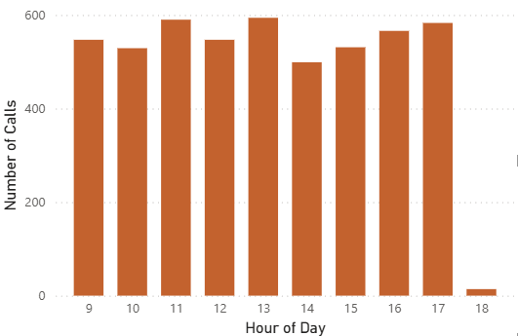
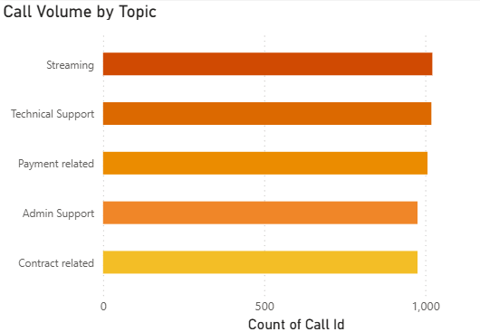
Key Findings - Where the Gap Lives
FINDING 02
The unanswered-call gap isn't a rush hour - it's constant across every hour and topic
◆ What this means: Call volume peaks around 11am & 1pm, yet the answer rate holds near 81% all day - and all five topics carry near-equal volume. Because the gap appears everywhere equally, it points to a baseline capacity shortfall, not a peak-hour or single-topic bottleneck.
PwC Call Centre Performance - Data Analysis Portfolio Project
Amisha Gadekar | 2026

Slide 5
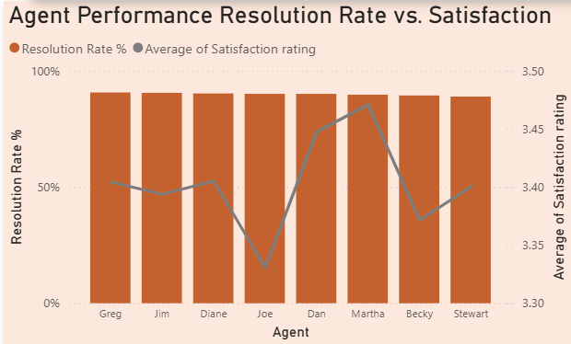
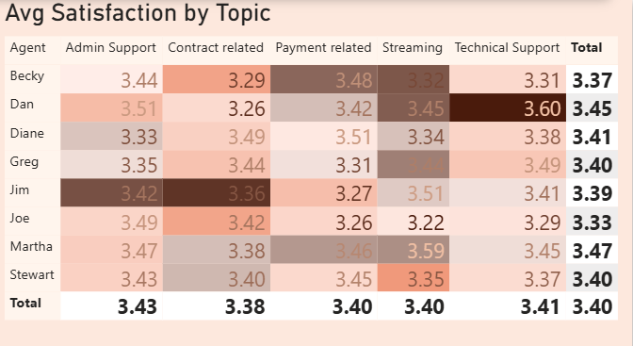
Key Findings - The Hidden Specialists
FINDING 03
Every agent looks alike on resolution - until topic-level data reveals clear strengths and blind spots
◆What this means: Resolution rates sit within a tight 1.7-point band (88.9–90.6%), suggesting agents are interchangeable. But satisfaction by topic tells a different story: Dan leads Technical Support (3.60) yet lags on Contract calls (3.26). This hidden specialisation is invisible in aggregate metrics - and it's a lever for smarter call routing.
PwC Call Centre Performance - Data Analysis Portfolio Project
Amisha Gadekar | 2026

Slide 6
Recommendations
FROM INSIGHT TO ACTION
Three moves to close the answer-rate gap - without sacrificing quality
1
Increase baseline capacity
2
Skills-based call routing
3
Targeted topic coaching
Add front-line headcount or flex scheduling to lift the answer rate. The shortfall is steady all day, so a consistent capacity increase - not peak-only staffing - is the fix.
Route calls to agents who score highest on that topic - e.g. Technical Support to Dan, Contract calls to Diane. Lifts satisfaction using existing staff strengths.
Pair each agent's strongest topic with their weakest for peer coaching - e.g. Dan mentors on Technical Support while improving on Contract calls.
ADDRESSES
Finding 01 & 02 - 19% unanswered, constant across hours
ADDRESSES
ADDRESSES
Finding 03 - hidden topic specialisation
Finding 03 - per-agent blind spots
Impact: Directly recovers a share of 946 lost calls
Impact: Higher satisfaction at zero added headcount
Impact: Narrows the satisfaction spread over time
PwC Call Centre Performance - Data Analysis Portfolio Project
Amisha Gadekar | 2026

Slide 7
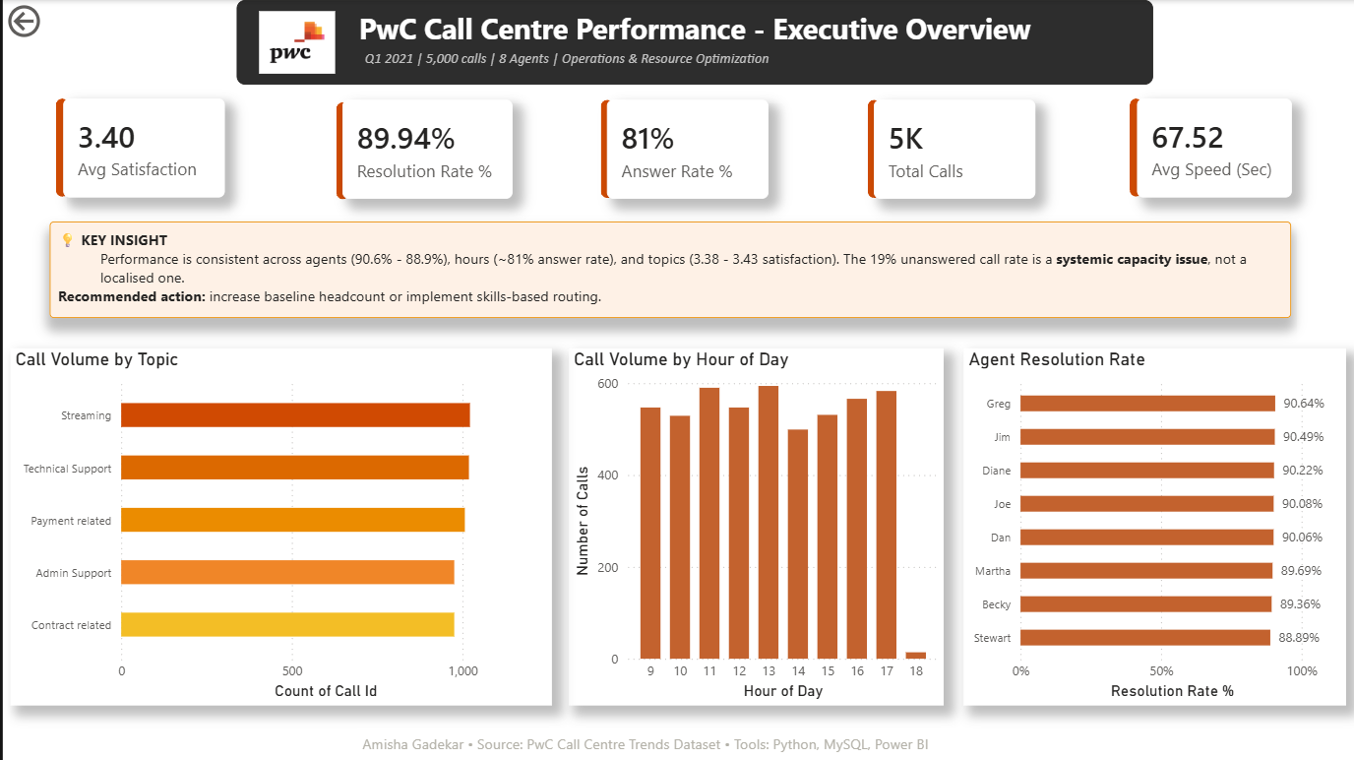
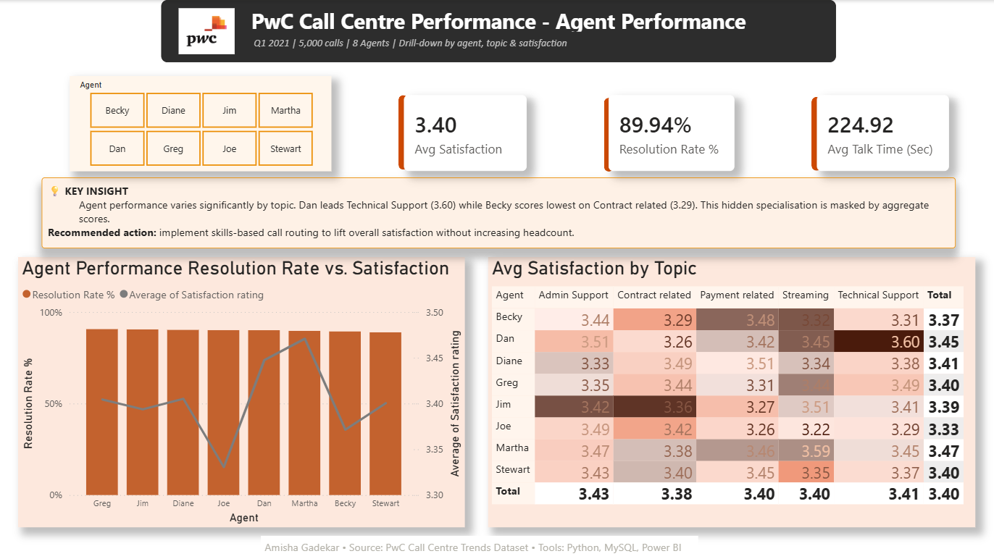
The Interactive Dashboard
BUILT IN POWER BI
A 2-page interactive dashboard that lets managers explore the data themselves
Interactive slicers
Filter any view by agent
Custom DAX measures
Answer & resolution rates
Drill-down detail
Agent × topic heatmap
Cross-validated
Matches Python & SQL
PwC Call Centre Performance - Data Analysis Portfolio Project
Amisha Gadekar | 2026

Slide 8
DATA ANALYSIS PORTFOLIO PROJECT
THANK YOU
From raw data to decision-ready insight.
Amisha Gadekar - Aspiring Business Analyst
This project demonstrates an end-to-end analytics workflow - cleaning and preparing data in Python, querying KPIs in SQL, and building an interactive Power BI dashboard - to turn 5,000 raw call records into three evidence-based recommendations for management.
TOOLS USED
SKILLS DEMONSTRATED
Python
MySQL
Power BI
DAX
Data cleaning
SQL analysis
Data visualisation
Dashboard design
Business storytelling
Amisha Gadekar | gadekaramisha@gmail.com | [LinkedIn : AmishaGadekar / github.com/gadekaramisha-ops
PwC Call Centre Performance · 2026

