Slide 1
Databricks
SESSION2 – Databricks: Reading Data

Slide 2
Overview
Widgets
Databricks File System (DBFS)
Mounting
Secret Management
Demo: Reading Data

Slide 3
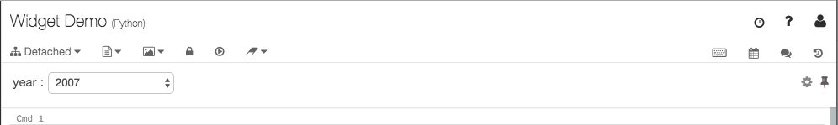
Widgets
Input widgets allow you to add parameters to your notebooks and dashboards;
Widgets are best for:
Building a notebook or dashboard that is re-executed with different parameters;
Quickly exploring results of a single query with different parameters;
https://docs.databricks.com/notebooks/widgets.html
Figure 1. Databricks: Widget Example

Slide 4
Databricks File System (DBFS)
Databricks File System (DBFS) is a distributed file system mounted into a Databricks workspace and available on Databricks clusters;
DBFS is an abstraction on top of scalable object storage and offers the following benefits:
Allows you to mount storage objects so that you can seamlessly access data without requiring credentials.
Allows you to interact with object storage using directory and file semantics instead of storage URLs.
Persists files to object storage, so you won’t lose data after you terminate a cluster.

Slide 5
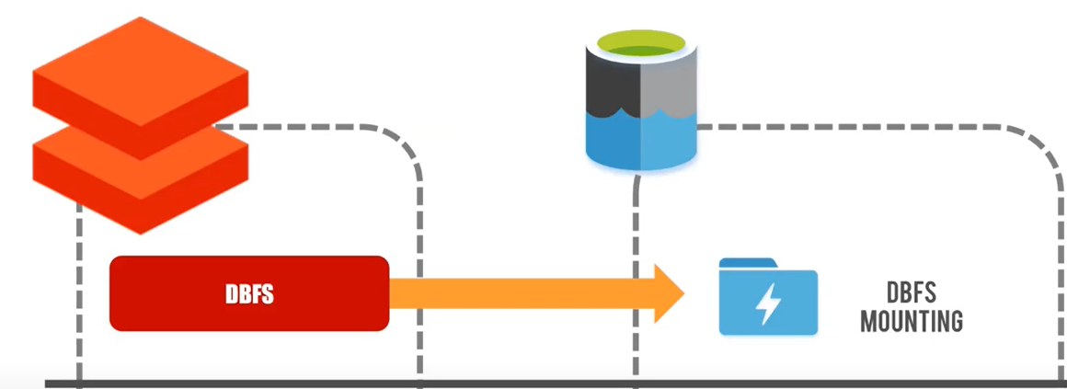
Mount
Mounting object storage to DBFS allows you to access objects in object storage as if they were on the local file system;
To Mount to Data Lake Gen2 we need:
The Service Principal ID – also known as the client ID
The Service Principal Key
The Directory ID – Azure tenant ID
The data lake name
The data lake file system name
Figure 2. Databricks Mounting
https://docs.databricks.com/data/databricks-file-system.html#mount-storage

Slide 6
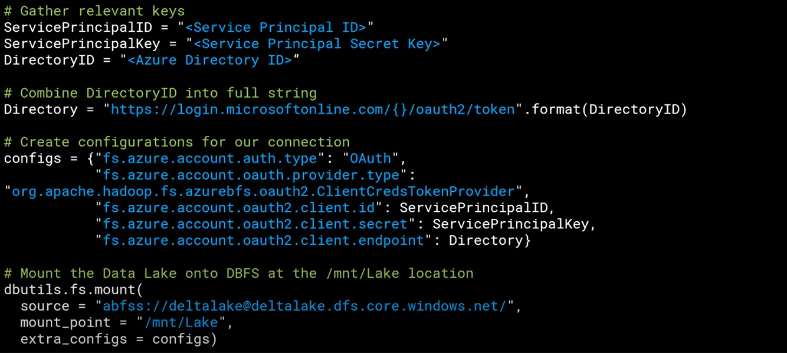
Mount
Figure 3. Databricks Mounting to ADLS

Slide 7
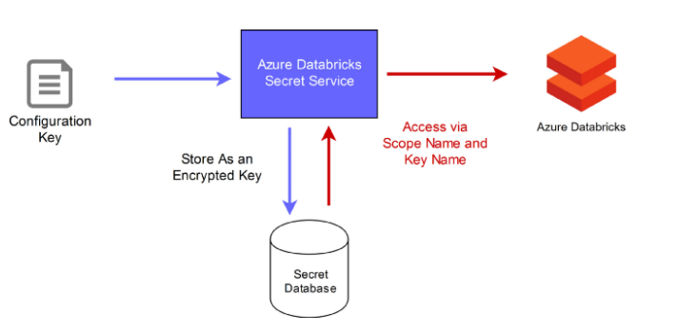
Secret Management
Instead of directly entering your credentials into a notebook, use Azure Databricks secrets to store your credentials and reference them in notebooks and jobs;
There are two types of secret scopes in Azure Databricks:
Azure Key Vault-backed: To reference secrets stored in an Azure Key Vault, you can create a secret scope backed by Azure Key Vault;
Databricks-backed: A Databricks-backed scope is stored in an Azure Databricks database;
Figure 4. Databricks Secret Management: Databricks backed

Slide 8
Secret Management - Concepts
Secret Scopes: identified by its name, unique within a workspace. Non-sensitive and readable by all users in the workspace;
Secrets: key-value pair that stores secret material, with a key name unique within a secret scope;
Secret ACLs: By default, all users can create secrets and secret scopes. Using secret access control, available with the Azure Databricks Premium Plan, you can configure fine-grained permissions for managing access control;
https://medium.com/@ruwansriw/secret-management-in-azure-databricks-acf6ab6a5b2a
https://docs.microsoft.com/en-gb/azure/databricks/security/secrets/secret-scopes#id3

