Slide 1
Databricks
SESSION 3: Transformations and actions

Slide 2
Overview
Transformations vs Actions
Lazy Evaluation;
Partitioning

Slide 3


Transformations vs Actions
Transformations always return a DataFrame;
Data structures are immutable;
Two types: Wide or Narrow;
Actions either return a value or write to disk. For example:
The number of records in the case of count()
Array of objects in the case of collect() or take()
Transformations are LAZY;
Actions are EAGER;
Figure 1. Apache Spark: Transformation
Figure 2. Apache Spark: Action

Slide 4



Lazy Evaluation
FILTER DATA
ADD COLUMN
GROUP DATA
JOIN DATA
APPLY FUNCTION
REMOVE COLUMN
.write()
Figure 3. Apache Spark: Lazy Evaluation

Slide 5
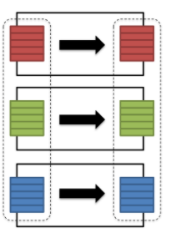
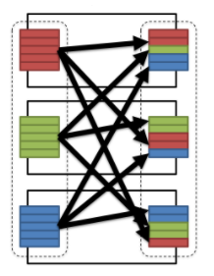
Transformations
There are two types of transformations:
Narrow: the data required to compute the records in a single partition reside in at most one partition of the parent dataset;
Wide: the data required to compute the records in a single partition may reside in many partitions of the parent dataset. Requires shuffle;
filter()
drop()
coalesce()
distinct()
groupBy().sum()
repartition(n)
Figure 5. Apache Spark: Narrow Transformation
Figure 6. Apache Spark: Wide Transformation

Slide 6
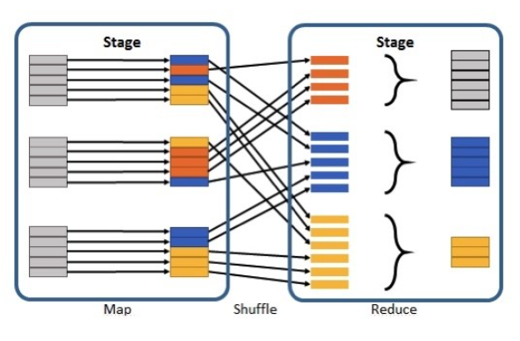
Shuffles
A shuffle refers to an operation when data needs to me move between executors;
It is a costly operation because a lot of data can be sent via the network;
For example, to group by color, it will serve us best if:
All the reds are in one partition;
All the blues are in a second partition;
All the greens are in a third
From there we can easily sum/count/average all of the reds, blues, and greens;
Figure 7. Apache Spark: Shuffle

Slide 7
DEMO: TRANSFORMATIONS AND ACTIONS

Slide 8
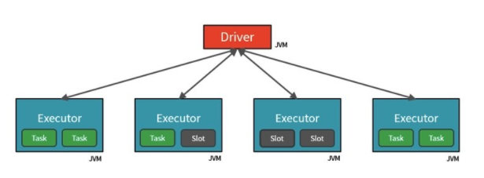
Partitioning: Spark Architecture
Figure 9. Apache Spark: Architecture

Slide 9
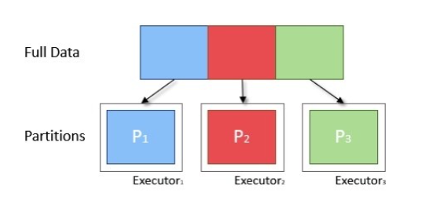
Partitioning
A partition is a collection of rows that sit on one physical machine in our cluster. Data is split into Partitions so that each Executor can operate on a single part, enabling parallelization.
One partition:
Spark will only have a parallelism of one, even if you have thousands of executors;
Many partitions, but one executor:
Spark will still only have a parallelism of one because there iss only one computation resource;
Figure 10. Apache Spark: Partitioning

Slide 10
Partitioning
How many partitions should de data used be partitioned into?
How many slots will be used?
How large is each data partition?
In general, the number of partitions to be a factor of the number of slots;
Each partition of data should have a size of around 128MB;
In general, more numerous partitions allow work to be distributed among more workers, but fewer partitions allow work to be done in larger chunks (and often quicker);
Namely the readers look at the number of slots, the size of the data, and makes a best guess at how many partitions should be created;

Slide 11
Partitioning
repartition() and coalesce() allow the repartition of data to a particular partition count:
repartition() is a wide transformation and can be used to reduce or increase the number of partitions;
coalesce() is a narrow transformation and can only be used to reduce the number of partitions;
repartition() gives a relatively uniform distribution;
coalesce() cannot guarantee even distributions of records across all partitions;

Slide 12
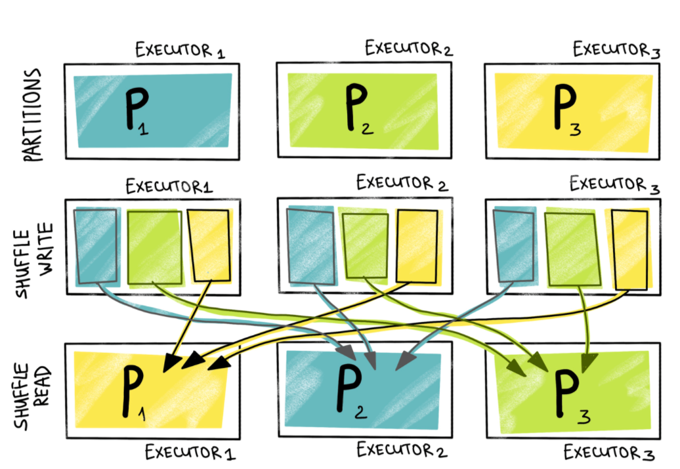
Shuffle Partitioning
Shuffle Partitions are partitions that are used at data shuffle for wide transformation;
The default number of shuffle partitions is set to 200;
spark.sql.shuffle.partitions
Figure 12. Shuffle Partitions

Slide 13
Adaptive Query Execution
Adaptive Query Execution (AQE) is query re-optimization that occurs during query execution;
In Spark 3.0, the AQE framework is shipped with three features:
Dynamically coalescing shuffle partitions
Dynamically switching join strategies
Dynamically optimizing skew joins
AQE applies to all queries that are:
Non-streaming
Contain at least one exchange (usually when there’s a join, aggregate, or window), one sub-query, or both.
SQL config: spark.sql.adaptive.enabled;
https://docs.databricks.com/_static/notebooks/aqe-demo.html
https://docs.databricks.com/spark/latest/spark-sql/aqe.html#enable-and-disable-adaptive-query-execution

Slide 14
Output Partitioning
Saving the partied data on the properly selected condition can significantly speed up the reading and retrieval of the necessary data in the future processing pipelines;
During write Spark will produce one file per task/partition:
We can control the number of files written by doing coalesce or repartition;
When saving a Dataframe to disk, pay attention to partition sizes;

Slide 15
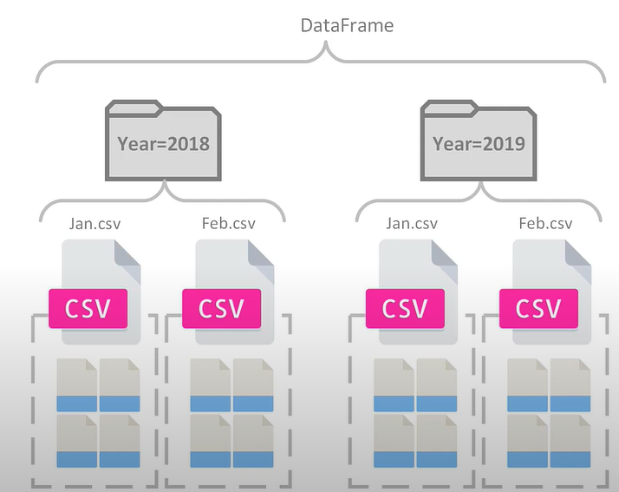
Partition Pruning
Partition Pruning is another optimization method; it exploits query semantics to avoid reading large amounts of data unnecessarily;
Spark supports saving data in a partitioned layout seamlessly, through the partitionBy() method available during data source write operations;
Figure 11. Partition Pruning

Slide 16
DEMO: PARTITIONING

Slide 17
Bibliography
https://www.linkedin.com/pulse/just-enough-spark-core-concepts-revisited-deepak-rajak/
https://luminousmen.com/post/spark-partitions
https://docs.databricks.com/_static/notebooks/aqe-demo.html
https://docs.databricks.com/spark/latest/spark-sql/aqe.html#enable-and-disable-adaptive-query-execution

