Slide 1
Databricks
SESSION1 – Apache Spark and databricks introduction

Slide 2
Overview
Apache Spark
Databricks
Databricks Environment
Databricks Clusters
Demo: Databricks Workspace Tour + Create Cluster and Notebook

Slide 3
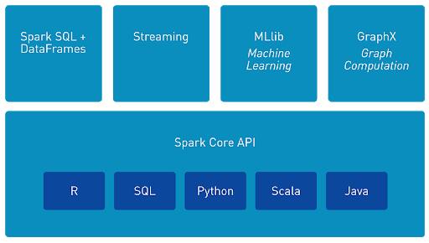
Apache Spark
Apache Spark™ is an open source, distributed processing system used for big data workloads;
Apache Spark runs computation in memory, which allows high-speed access and data processing;
It can analyse big data using SQL, machine learning, graph processing or real-time stream analysis;
Apache Spark supports multiple languages;
Figure 1. Apache Spark API

Slide 4
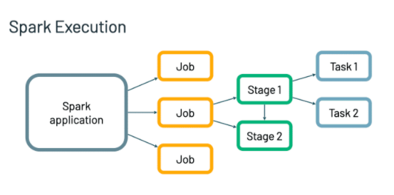
Spark Execution
Spark uses clusters of machines to process big data by breaking a large task into smaller ones and distributing the work among several machines;
The secret to Spark’s performances is parallelism;
Each parallelized action is referred to as a job. Each job is broken down into stages;
Figure 2. Apache Spark Execution

Slide 5
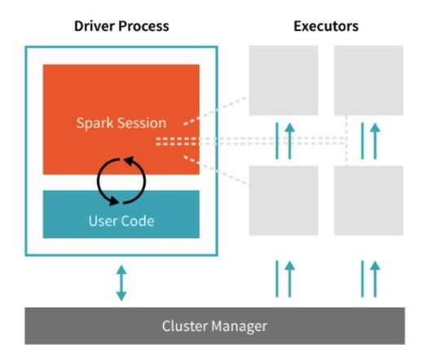
Spark Architecture
Spark Applications consist of a driver process and a set of executor processes;
The Driver process is responsible:
  Maintaining information about the spark applications;
  Responding to the user’s program;
  Analysing, distributing and scheduling work across the executors;
The Executor is responsible:
  Executing code assigned by the driver;
  Reporting the state of the computation back to the driver;
Figure 3. Apache Spark Architecture

Slide 6
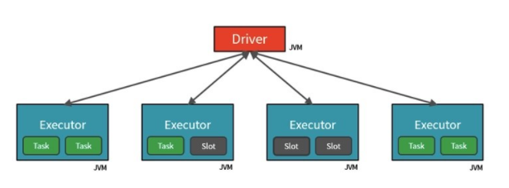
Spark Architecture
Spark parallelizes at two levels:
  Executor
  Slot – determined by the number of cores and CPUs of each node;
Each Executor has a number of slots to which parallelized Tasks can be assigned by the Driver;
Each Task will fetch a Partition of data assigned to it;
Figure 4. Apache Spark Architecture

Slide 7
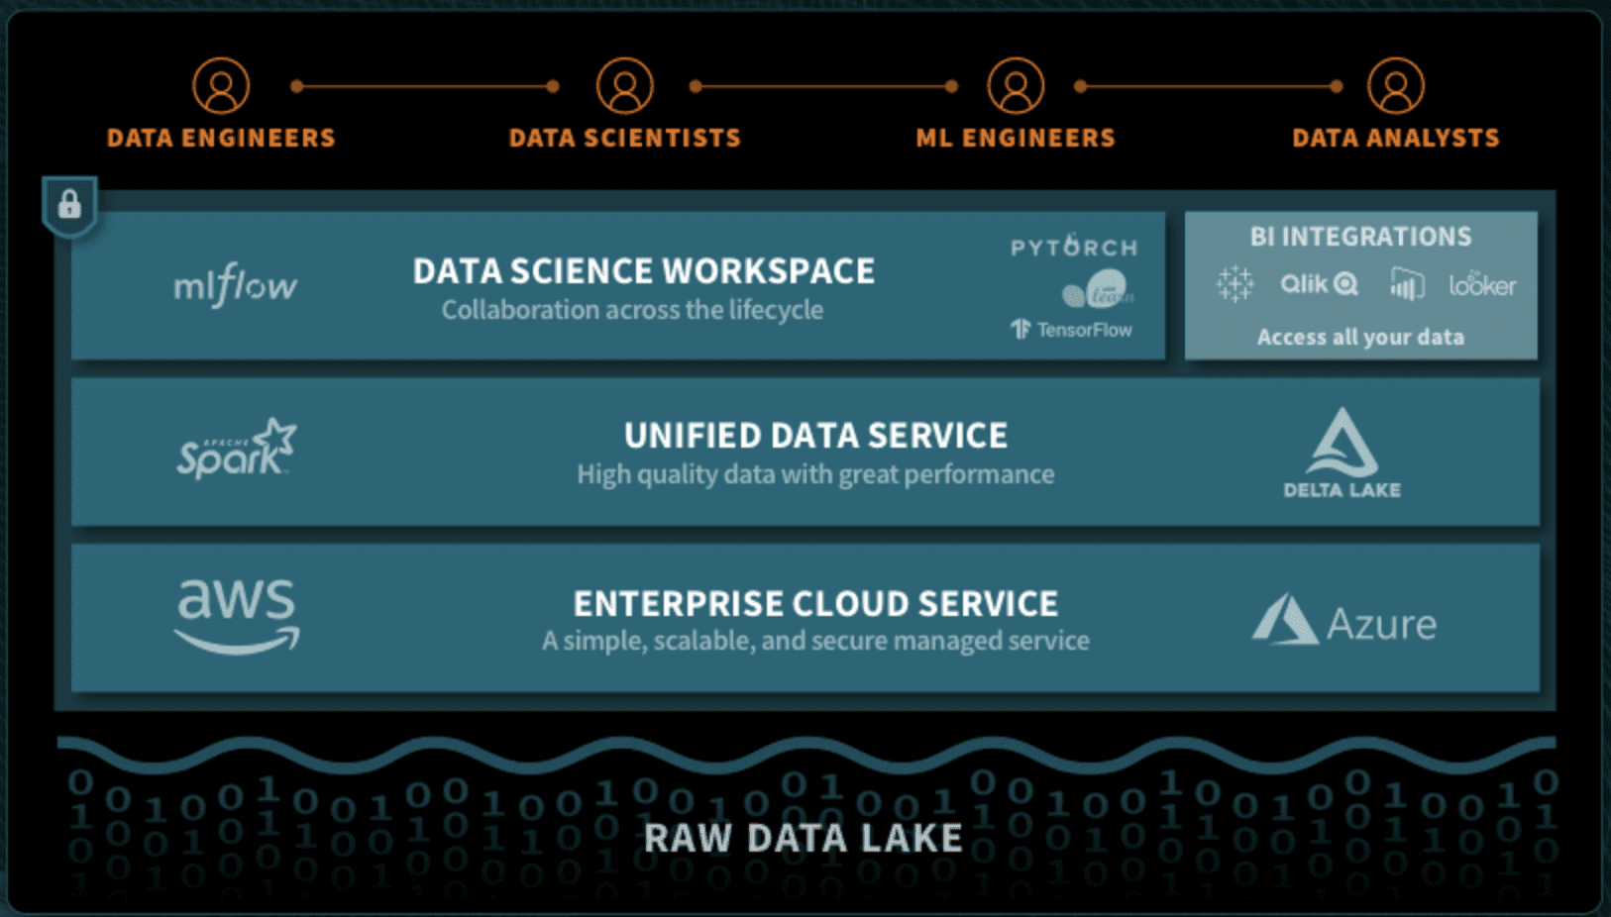
Databricks
Founded in late 2013 by the creators of Spark original team;
Databricks is a managed platform for running Apache Spark in the cloud;
Unified Data Analytics Platform;
Contains a modified Spark instance called Databricks Runtime
  Improved and optimized over base Apache Spark;
BI integration;
Figure 5. Databricks: Unified Data Analytics Platform

Slide 8
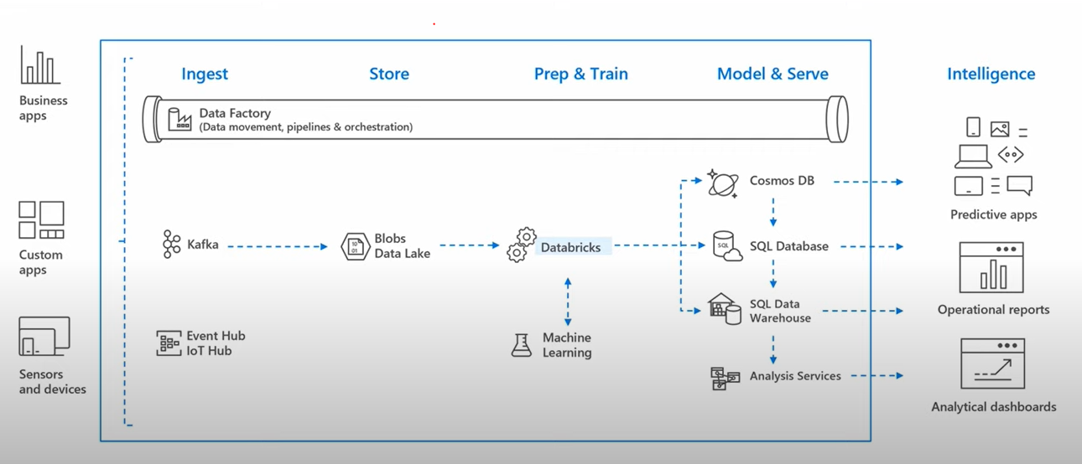
Databricks Scenario
Figure 6. Databricks: Typical Scenario

Slide 9
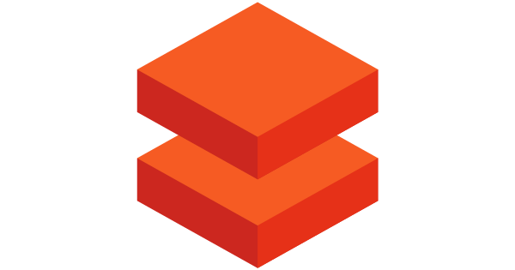





Databricks Environment
Databricks Workspace
Workspaces: allow you to organize all the work you are doing on Databricks. Like a folder structure, it allows you to save notebooks and libraries and share them. It provides access to data objects and computational resources;
Notebook: Set of runnable cells. Supports Scala, Python, R, SQL, or Markdown. It needs to be connected to a cluster. Dashboards can be created from notebooks;
Clusters: Set of computation resources and configurations on which you run workloads. It allows you to execute code from notebooks or libraries on a set of data;
Tables: Structured data for analysis. Tables can be global and local.
Jobs: Tool by which you can schedule an execution. It can be notebooks as well as jars or python scripts;
Notebooks
Clusters
Tables
Figura 7. Databricks Environmet
A Gentle Introduction to Apache Spark on Databricks - Databricks

Slide 10
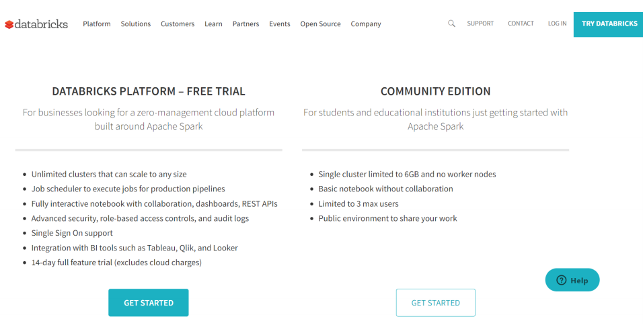
Databricks Community Edition
Free version;
Users can access a micro-cluster, a cluster manager, and notebook environment;
https://community.cloud.databricks.com/login.html
Figure 8. Databricks Community Edition

Slide 11
Databricks Environment
DEMO – DATABRICKS ENVIRONMENT

Slide 12
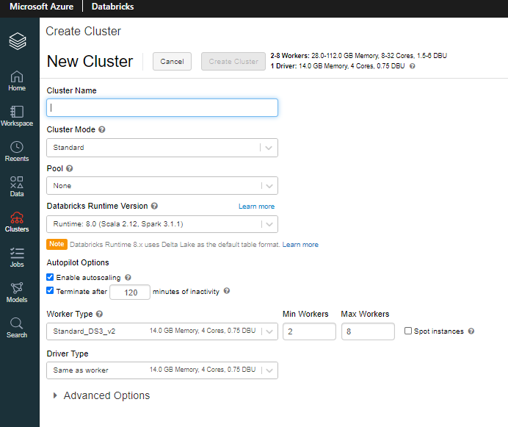
Databricks: Clusters
Cluster Mode: Standard, High Concurrency, and Single Node;
Pool: Set of idle, ready-to-use VM instances. It reduces the cluster start and auto-scaling times;
Databricks Runtime: set of core components that run on clusters. All include Apache Spark and add components and updates that improve usability, performance, and security;
Autopilot Options:
  Auto scaling
  Auto pause
Worker/Driver Types
Figure 9. Databricks: Create Cluster
https://docs.databricks.com/clusters/configure.html

Slide 13
Bibliography
A Gentle Introduction to Apache Spark on Databricks – Databricks
https://docs.databricks.com/clusters/configure.html
https://www.linkedin.com/pulse/just-enough-spark-core-concepts-revisited-deepak-rajak/

