Slide 1
Databricks
SESSION 4: Delta Lake

Slide 2
Overview
Delta Lake Introduction
Delta Key Features
Transactional Log
Table Deletes, Updates, and Merges
Schema Enforcement and Evolution
Time Travel and VACUUM
OPTMIZE and ZORDER
Demo: Delta Lake

Slide 3
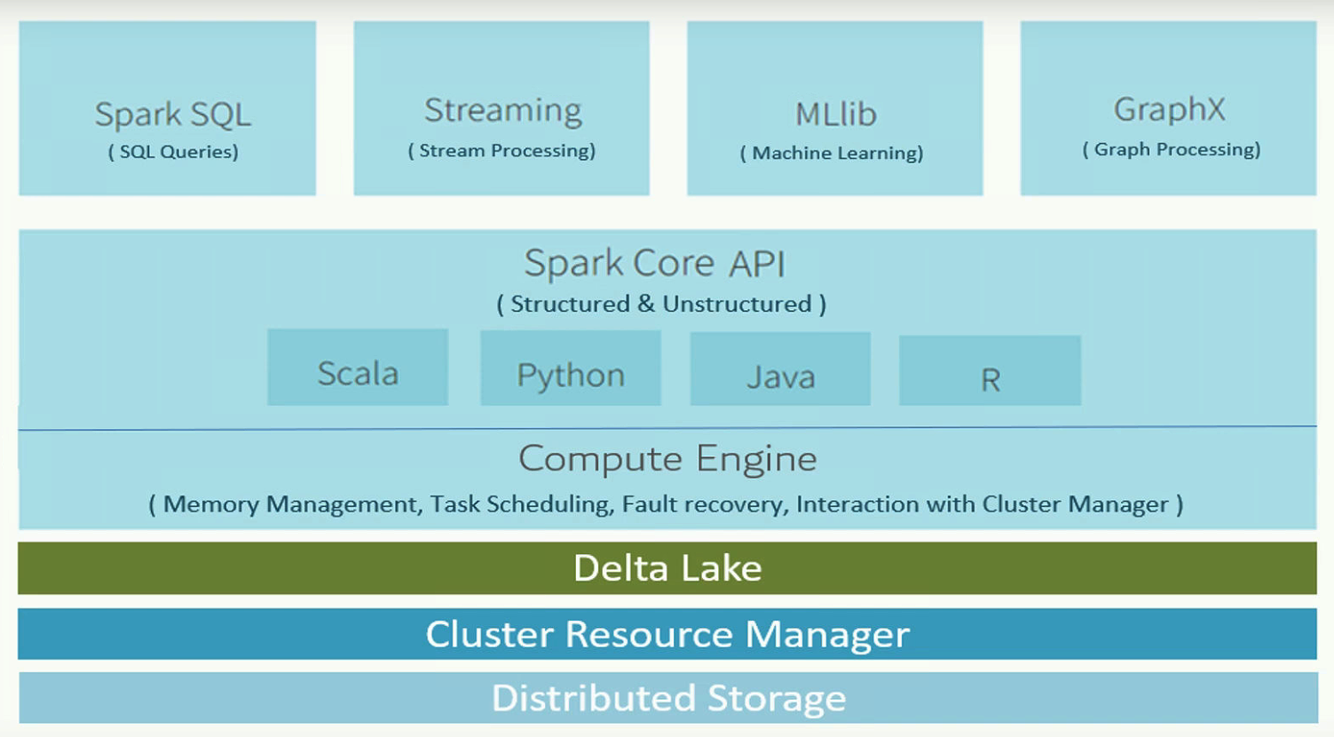
Delta Lake
Delta Lake is an open source storage layer that brings reliability to data lakes;
Compute layer that sits on top of existing storage;
Data is stored as versioned parquet files;
Provides an unified platform to support both batch and streaming processing workloads;
Figure 1. Delta Lake

Slide 4
Delta Lake – Key Features
ACID transactions:
A – Atomicity: all or nothing;
C – Consistency: always in a valid state;
I – Isolation: concurrency control;
D – Durability: once committed, never lost;
Unified Batch and Streaming Process;
Upserts and deletes;
Schema Enforcement and Evolution;
Time Travel;
https://docs.databricks.com/delta/delta-intro.html

Slide 5
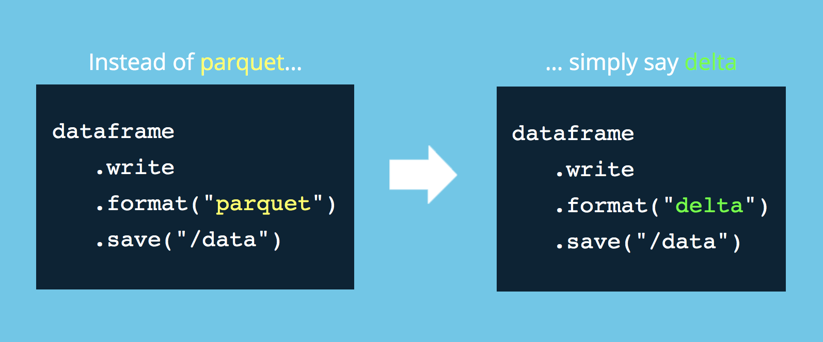
Delta Lake
Figure 2. Delta Lake: Creation

Slide 6
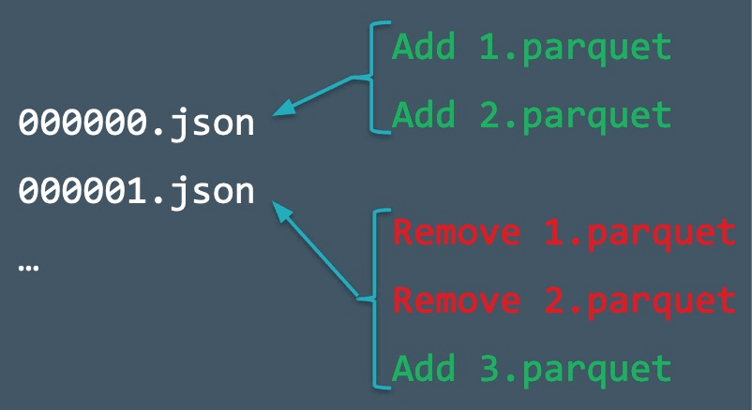
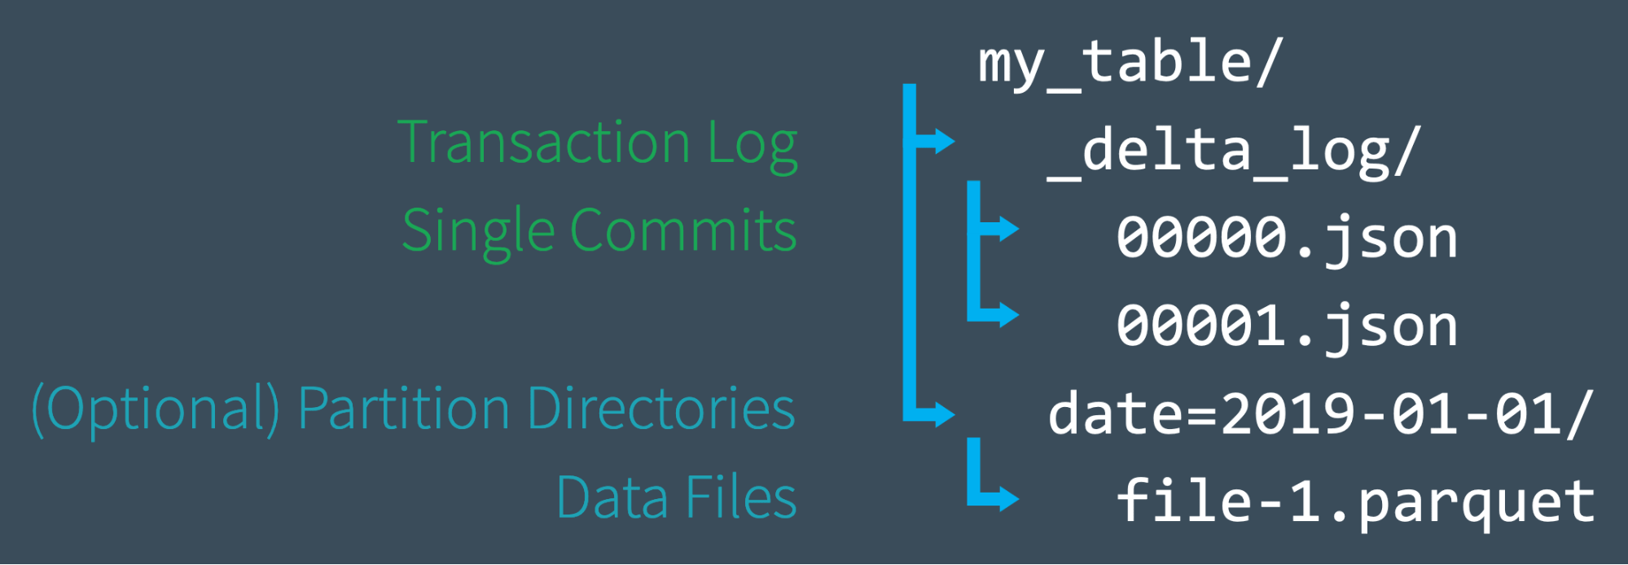
Transactional Log
Transaction logs records every change made to the data, providing a full audit trail of the changes; It’s a single source of truth; Guarantees atomicity;
Figure 3. Delta Lake: Transactional Log
Figure 4. Delta Lake: Transactional Log
https://databricks.com/blog/2019/08/21/diving-into-delta-lake-unpacking-the-transaction-log.html

Slide 7

Table deletes, updates, and merges
Delta Lake supports several statements to facilitate deleting and updating data from Delta tables;
MERGE operation enables upserting data from a source table into a target tables;
Similar operation to the SQL MERGE INTO command but has additional extra conditions in updates, inserts and deletes;
Merge is particularly useful for table consolidation tasks;
Changes
“Before” Table
“After” Table
Figure 5. Delta Lake: Merge Operation
https://docs.databricks.com/delta/delta-update.html#language-python

Slide 8

Schema Enforcement and Evolution
Schema Enforcement automatically handles schema variations to prevent insertion of bad records during ingestion;
Schema enforcement is an excellent tool to use as a gatekeeper of a clean, fully transformed data that is ready for production or consumption;
Schema Evolution allows users to easily change a table’s current schema to accommodate data that is changing over time;
It’s activated by adding .option(‘mergeSchema’, ‘true’) to .write or .writeStream Spark command
Figure 7. Delta Lake: Schema Evolution
https://databricks.com/blog/2019/09/24/diving-into-delta-lake-schema-enforcement-evolution.html

Slide 9
Time Travel and VACUUM
Delta automatically versions the big data that you store in your data lake, and you can access any historical version of that data;
Simplified data pipelines by making it easy to build, roll back data in case of accidental bad writes or deletes, and reproduce experiments and reports;
You can time travel using:
A timestamp;
A version number;
VACUUM cleans up files associated with a table;
The default threshold is 7 days;
Databricks does not automatically trigger VACUUM operations on Delta tables;
https://databricks.com/blog/2019/02/04/introducing-delta-time-travel-for-large-scale-data-lakes.html
https://docs.databricks.com/spark/latest/spark-sql/language-manual/delta-vacuum.html

Slide 10



OPTIMIZE
OPTIMIZE command invokes the bin-packing algorithm to coalesce small files into larger ones. Small files are compacted together into new larger files up to 1GB;
There is a cost associated with OPTIMIZE;
Run it more often if we want better end-user query performance. Run it less often if we want to optimize costs;
Auto Optimize is an optional set of features that automatically compact small files during individual writes to a Delta table; It attempts to write out 128 MB files for each table partition;
Figure 8. Delta Lake: OPTIMIZE command
https://docs.databricks.com/spark/latest/spark-sql/language-manual/delta-optimize.html
https://docs.databricks.com/delta/optimizations/auto-optimize.html

Slide 11

ZORDER
ZORDER is a technique to co-locate related information in the same set of files; Reduces the amount of data that needs to be read (Data Skipping);
If a column is commonly used in query predicates and it has high cardinality then use ZORDER BY;
We can specify multiple columns for ZORDER BY as a comma-separated list. However, the effectiveness of the locality drops with each additional column.
Figure 9. Delta Lake: ZORDER command

Slide 12
Bibliography
https://delta.io/
https://docs.microsoft.com/en-us/azure/databricks/delta/
https://docs.databricks.com/delta/delta-intro.html
https://docs.databricks.com/delta/delta-update.html#language-python

