Slide 1
Mutual Fund Analytics Dashboard
Capstone Project
Tanaji Abasaheb Gade
Python | SQL | SQLite |Power BI

Slide 2
Project Overview
Analyze mutual fund investment data.
Perform data cleaning using Python.
Store data in SQLite database.
Build an interactive Power BI dashboard.
Generate insight into investment trends and investor behavior.

Slide 3
Technology Stack
Python – Data Cleaning & Analysis
SQL – Database Queries
SQLite – Data Storage
Power BI – Dashboard & Data Visualization
Git & GitHub – Version Control & Collaboration

Slide 4
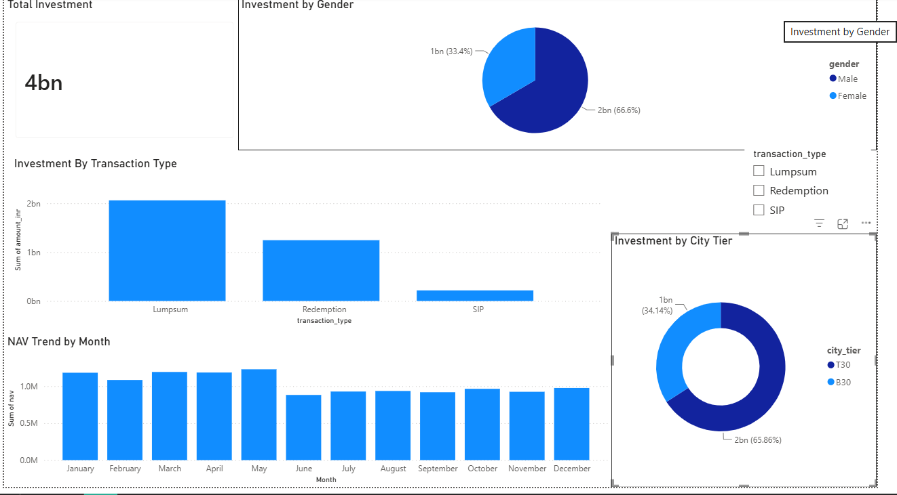
Dashboard Overview
Figure 1: Power BI Dashboard showing key investment insights.

Slide 5
Project Workflow
Raw Data(csv)
Python
(Data Cleaning)
SQLite
(Database)
SQLite
(Data Analysis)
Power BI
(Dashboard & Visualization)
Insights & Recommendations

Slide 6
Key Insights
Total investment analyzed: 4 Billion+
Lumpsum investment contributed the highest amount.
Male investors accounted for a larger share than female investors.
Tier-1 cities showed higher investment activity.
Monthly NAV remained relatively stable throughout the year.

Slide 7
Conclusion
Successfully analyzed mutual fund investment data.
Cleaned and processed the dataset using Python.
Stored data in SQLite and performed SQL analysis.
Developed an interactive Power BI dashboard.
Generated meaningful insights to support investment decisions.
Thank You!
Questions?

