Slide 1

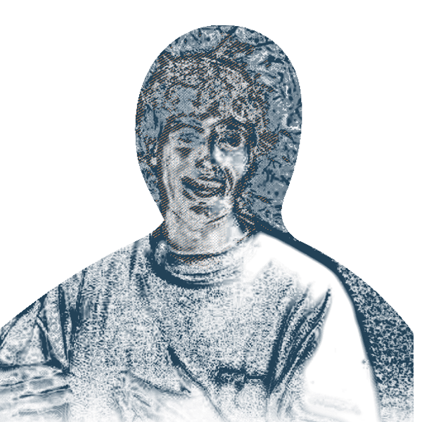
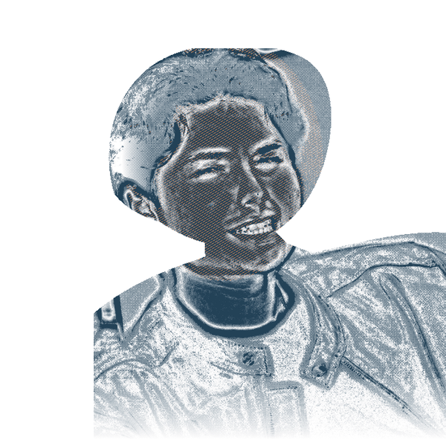
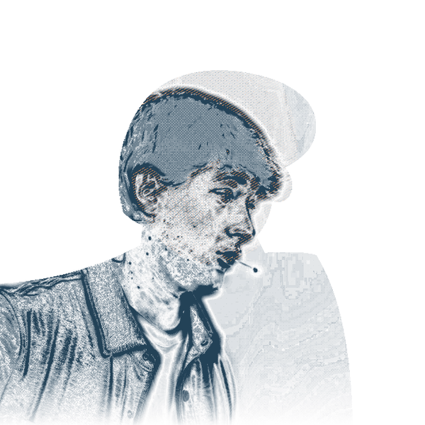
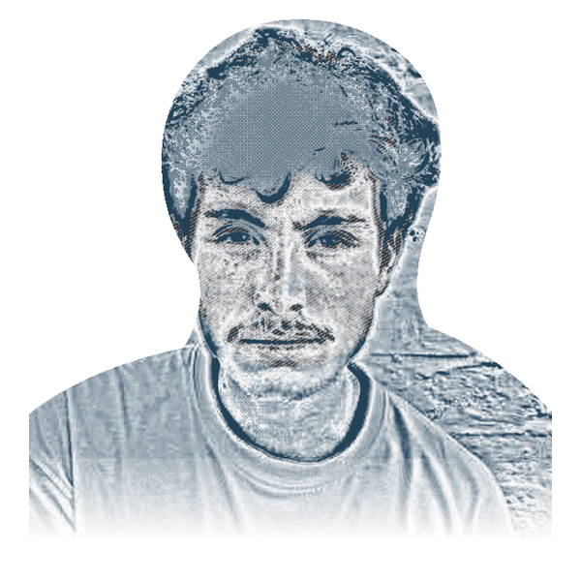
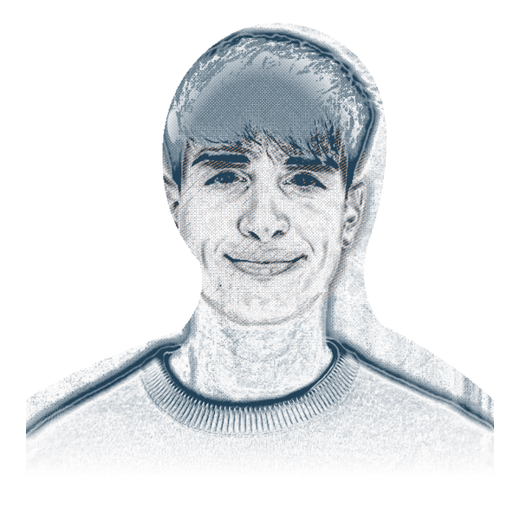
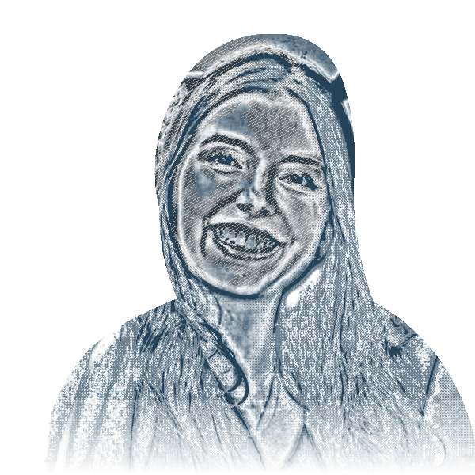
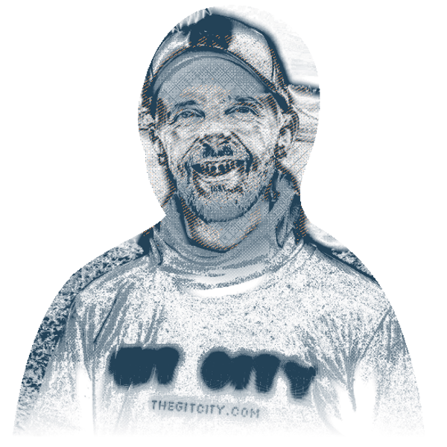
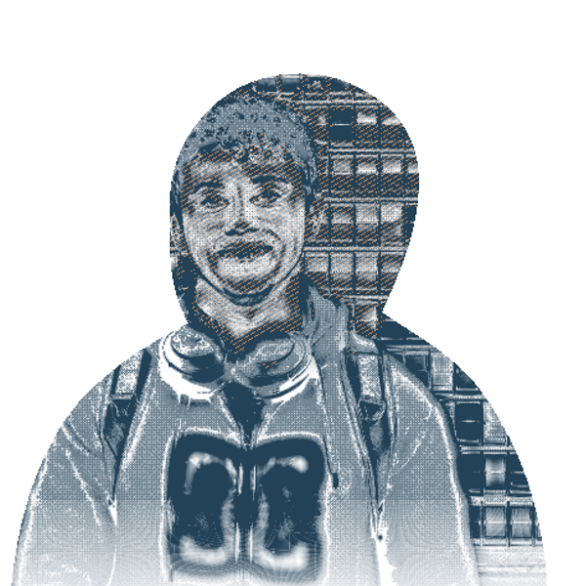
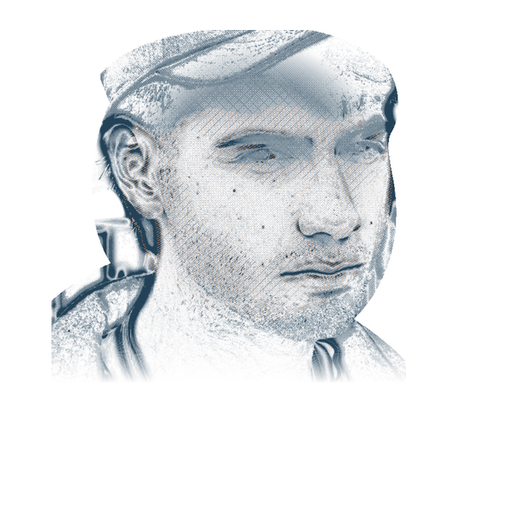
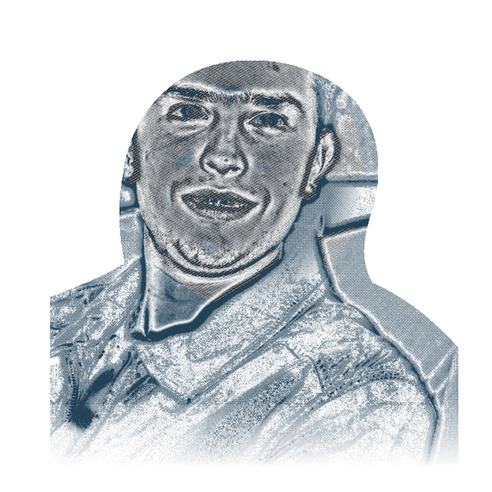














ANTIGRAVITY CAPITAL / ACCESS
✦
PUENTES
Puentes brings Latin America’s next wave of AI builders
into San Francisco’s strongest teams.
33 FELLOWS TODAY
/
150 FELLOWS BY 2028
OPPORTUNITY
We believe in fellows early and create opportunities that can change their lives.
Monto
Pablo
Tomás
Mateo
Andrés
EARLY TEAMS
VERCEL
REPLIT
COGNITION
KREA
CIRCLEBACK
We help our founders hire AI-fluent builders with unusual judgment and range.
ACCESS
We earn our place in the networks where new companies form.
Laís
Samuel
Ignacio
Germán
Agus
TEACHY
DELPHI
FLAI
TERAC
BEM
20
FELLOWS NOW LIVING IN SF
7
FELLOWS BUILDING OUR COMPANIES
3
FELLOWS FOUNDING COMPANIES
Bem, Flai, and Terac
GUESTS FROM
Notes:
Working Puentes slide. The ten portraits are representative members of the 33-person Puentes network. The 23 solid nodes complete today's network. The 150 fellows by 2028 figure is a future scale target, not a current result. The bottom strip names organizations represented by guests at Puentes; it does not imply that every organization employs a fellow or has a formal institutional partnership. Mateo's portrait remains provisional pending final asset confirmation.
Guest logo treatment follows the investment-strategy slide: https://deck.antigravity.capital/?slide=strategy . Official vector paths recolored navy at 84% opacity. Floodgate retains its banner with transparent lettering. Sources:
OpenAI: https://cdn.openai.com/business-guides-and-resources/identifying-and-scaling-ai-use-cases.pdf
Applied Intuition: https://www.appliedintuition.com/#inline-header-logo
Sentry: https://sentry.io/welcome/#inline-header-logo
Brex: https://www.brex.com/#inline-header-logo
HappyRobot: https://www.happyrobot.ai/#inline-header-logo
Bland: https://www.bland.ai/#inline-header-logo
Anthropic: https://www.anthropic.com/news#inline-header-logo
Applied Compute: https://www.appliedcompute.com/#inline-header-svg
Resend: https://resend.com/#inline-header-svg
General Catalyst: https://cdn.prod.website-files.com/69df4e62ff62d7b5568fc58b/69e8832670eb5345d6b87a6d_GC_Wordmark_Black_RGB.svg
Emergence: https://www.emcap.com/#inline-header-svg
Floodgate: https://cdn.prod.website-files.com/5fdf46ca7a44603e763a4c35/5fdf5a58546b45d5333b1e34_floodgate-nav-logo.svg
Base10: https://base10.vc/#inline-header-svg
Ribbit: https://www.ribbitcap.com/#inline-header-svg

