Slide 1
ANTIGRAVITY CAPITAL / FUND I
✦
Antigravity Fund I in numbers
18 months
21
$90M+
$2.1M Fund I
Since final close
Companies backed
Raised by eight portfolio companies
since our first investment
$XX
$XX
XX / XX
Capital invested
Capital left to deploy
TVPI / DPI
3 / 33
11
2
Puentes cohorts / fellows
20 fellows living in SF
Portfolio hires we helped make
New investments since our last letter
Place Labs and Intelligent Machines
Working figures as of September 11. Capital, TVPI and DPI remain to be finalized.
Notes:
## 1. Where Antigravity stands
**Main point:** We have spent the last 18 months building this portfolio and developing as investors. This is an opportunity to share where we are and what we have learned.
- Begin with why we are holding our own spotlight. The founder sessions have created a candid relationship with LPs; it feels right to give them the same access to our work. Kim suggested this months ago.
- Briefly place the firm in time: what Gadi and Daniel brought to the partnership, what the world looked like when we started, and what we are becoming better at through investing together. Keep the personal account short and specific.
- Fund I is almost fully deployed. Give LPs a clear view of invested capital, portfolio size, remaining investable capital, and realized and unrealized progress.
- Use Shopgenie to make realized proceeds tangible. Distinguish money distributed to LPs from proceeds retained or recycled, and both from paper value.
- Build the opening around the following “Antigravity Fund I in numbers” draft.
**Material:** One or two simple slides. Use selected SOI figures, with an as-of date. The detailed SOI stays available in the data room.
### Antigravity Fund I in numbers
- **18 months** since our **$2.1M Fund I's final close**
- **$XX capital invested**
- **$XX capital left to deploy**
- **21 companies backed**
- **$90M+ raised by eight portfolio companies** since we first invested
- **XX TVPI · XX DPI**
- **Three Puentes cohorts · 33 fellows · 20 living in SF**
- **11 portfolio hires** we helped make
- **Two new investments** since our last LP letter: **Place Labs and Intelligent Machines**
These are Gadi's selected opening figures. The capital and performance placeholders remain open until the SOI is reconciled. Keep the eight-company financing tally behind the $90M+ figure available in the supporting notes, and date the snapshot.
**Measurement note:** The 11 portfolio hires is the broader Antigravity hiring contribution. The previous Puentes slide counted seven fellows working at portfolio companies. These measure different things; keep their definitions separate.
**Transition:** What has changed in the world since we began, and what do the companies we own help us understand about it?
Source: Gadi’s working notes, September 11, 2026. Discussion with Daniel: https://notes.granola.ai/t/406bb135-9fa4-4d9f-8c10-b9e3194a8a4b-008umkv4

Slide 2
ANTIGRAVITY CAPITAL / INVESTMENT STRATEGY
✦
The opportunity, through our companies
The New Stack
The New Company
Tools that make AI reliable and useful
Businesses where software does more of the work
Halluminate
Pace
Strong delivery for Anthropic drives growth
$200m post-money Series A
Watching customer concentration
GED / Pearson and Miami-Dade adult education
Electrician training
Institutional distribution across distinct customers
Veria Labs
Flai
Deep hacking expertise, now commercial wins
PostHog and Ramp
Approximately $1.5m ARR
Software running more dealership operations
$6m ARR
$27m Series A at $150m post-money
Bem
Terac
More responsibility inside existing customers
Some contracts now $250k–$500k ACV
New-customer pipeline remains the challenge
Human expertise on demand
Helped hire ~80% of engineers, including first hires
That work earned the chance to invest more
Notes:
Source: Gadi's September 11, 2026 working updates and subsequent outline corrections in this Codex conversation. Supporting local sources: analysis/2026-09-11-fund-i-spotlight-working-outline.md; output/spotlight-daniel-2026-09-11/company-note-review.md; output/spotlight-daniel-2026-09-11/soi-reconciliation.md. Visual framework and design reference: output/access-daniel-handoff-2026-09-10/assets/deck-reference/strategy-slide.jpg. This slide is a discussion map with six independent company stories.
THE NEW STACK: tools and infrastructure for training, testing, monitoring and securing AI agents. THE NEW COMPANY: businesses built around AI doing more of the work, from customer request to finished result. Halluminate, Flai and Terac preserve their placement in the existing strategy slide. Veria and Bem are placed on the stack side and Pace on the company side in this working map.
HALLUMINATE: $30m Series A at $200m post-money, not $200m of capital raised. Strong delivery for Anthropic, the largest customer, has driven growth. Customer concentration and a volatile competitive market remain important. Antigravity organized an approximately $1m SPV with nearly ten LPs participating/interested; confirm its closing before calling it funded.
VERIA LABS: long-standing Capture the Flag team. We trusted the team's understanding of hacking and product judgment. Gadi reports competitive wins with PostHog and Ramp and approximately $1.5m ARR reached quickly since December. Date of ARR figure still needs a final refresh. Commercial wins are encouraging evidence, not proof of the ultimate investment outcome.
BEM: responsibility and contract value expanded within existing customers; some contracts reached $250k–$500k ACV. The constraint has been adding enough new customers to the pipeline. Gadi's prior update: approximately $1.3m–$1.4m ARR, $10m Series A at a $50m valuation, whose pre/post basis was unspecified. These figures are not on the slide.
PACE: the three customer contexts are GED/Pearson, Miami-Dade adult education and electrician training/IEC chapters. Approximately $2.1m reported revenue remains unclassified as to period and definition, so the slide omits that number. Daniel holds the current context and was due to speak with Victoria Tuesday.
FLAI: Gadi reports $6m ARR and a closed $27m Series A at $150m post-money. Discuss the work Flai takes over across dealership communications, scheduling and follow-up.
TERAC: human expertise on demand, including consumer research and AI training. At the last conversation with Zac, approximately $20m annualized revenue. Zac's stated intention to reach approximately $50m annual revenue before a Series A is a future threshold. Gadi's latest update says Antigravity helped hire approximately 80% of engineers, including the first hires, and helped shape engineering culture from day one. That contribution deepened the operating relationship and helped earn a chance to invest more. The follow-on structure, amount and terms remain in progress, so the slide does not describe a completed follow-on. This is the first teaser for Puentes and a natural transition into access. Revenue metrics and ACV have different definitions and should not be compared as equivalent.

Slide 3

ANTIGRAVITY CAPITAL / ACCESS
✦
Our strongest access begins before the round
and is earned through the work
Ari / HappyRobot / Flai
Applied Intuition
Origami / Bluejay
We helped Ari join HappyRobot as its second engineer.
When he started Flai, we helped with YC and the team.
We saw Pedro, Justin and Daniel operate at Applied for years. That informed our conviction in Place Labs and Intelligent Machines.
We introduced Intelligent Machines’ first customer.
We introduced Luke as Origami’s first hire. Luke introduced us to Faraz, Bluejay’s CTO.
The depth of our work with Finn made us seek a repeatable format.
Months later, the first Puentes cohort
Notes:
Sources: Gadi's latest September 11, 2026 outline corrections in this Codex conversation; output/access-daniel-handoff-2026-09-10/handoff.md and production-notes.md for exact historical contributions. Design and background: output/access-daniel-handoff-2026-09-10/final/access-slide.pptx and assets/access-empty-slide.png.
This simplified slide contains three stories in order. Keep Origami / Bluejay last and continue immediately into Puentes. There is no separate pricing defense or valuation comparison.
ARI / HAPPYROBOT / FLAI: We helped Ari join HappyRobot as its second engineer. When Ari and his brother started Flai we helped them get into YC. We invested in Flai's YC round, not its first check, and later helped build the team. The contribution began before the next company existed and continued as the founder's needs changed.
APPLIED NETWORK: Place Labs and Intelligent Machines were largely founder bets. We watched these founders operate at Applied over years and developed conviction in their seriousness, understanding of the current moment, execution and fit as partners. Gadi's latest recollection: Pedro led data infrastructure as Applied shifted toward transformer-based models and in-house training, requiring roughly 1,000 times the data scale. Justin was the first engineer on the defense team and built it to approximately 50 people before leaving. Pedro and Justin were best friends at Applied and we thought they would make excellent co-founders. These are Gadi's operating recollections and are not used as slide metrics.
Daniel in this story is Daniel Jabbour, not Daniel Ha. We knew Daniel for years and Yousef somewhat less. Daniel was an early Applied engineer, developed commercial responsibilities, served as Qasar's chief of staff and right hand, then led new markets as general manager and closed some of the company's largest contracts. We helped him expand Applied Intuition into Brazil. We wanted to invest in Intelligent Machines before its financing process, including encouraging Daniel to open the bank account and take early financing. The founders chose a single later process. We earned participation through introducing their first customer. Gadi considers Yousef's standards extraordinarily high and describes a very competitive round. Daniel Jabbour is also an Antigravity Fund I LP. Gadi says that status had little bearing on OUR decision to invest: our conviction came from years of seeing Daniel's work and judgment. Separately, introducing Intelligent Machines' first customer earned the founders' decision to include Antigravity in the round. Preserve both directions: knowing the team informed our investment decision, while our concrete contribution gave the team a reason to include us. If agreed with Daniel in advance, leave room for him to offer brief thoughts in the meeting. No invitation or speaking commitment has been made by this slide.
ORIGAMI / BLUEJAY / PUENTES: We introduced Luke to Origami CEO Finn as the company's first hire. Luke then directly introduced us to his close college friend Faraz, Bluejay's CTO. Finn is the founder, Luke is the first employee, and Luke made the Bluejay introduction. That first-hire experience helped Gadi see how consequential early employees are and how supporting this decision affords deep involvement with a founder and the company. It motivated Gadi to seek a repeatable format to do more of this work. Months later Antigravity held the first Puentes. This describes a contributing origin and the subsequent search, not an immediate or sole cause. Follow this story directly with why Puentes exists, how it serves fellows and Antigravity, and its results. Detailed Puentes stories are covered by the shared outline, not additional slides in this two-slide draft.

Slide 4
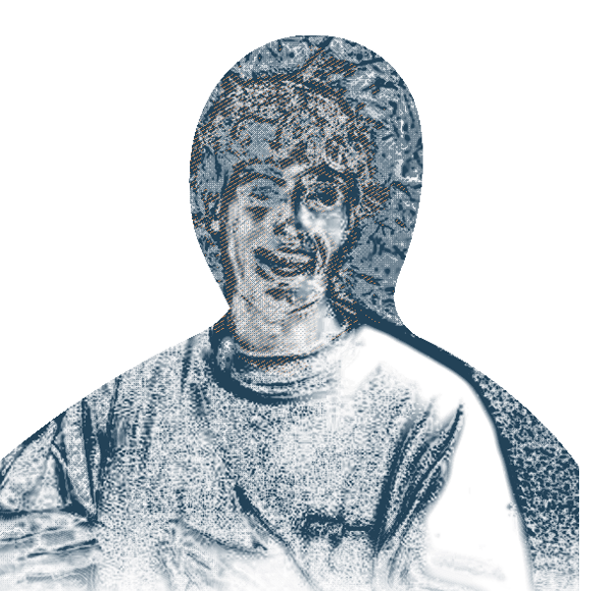
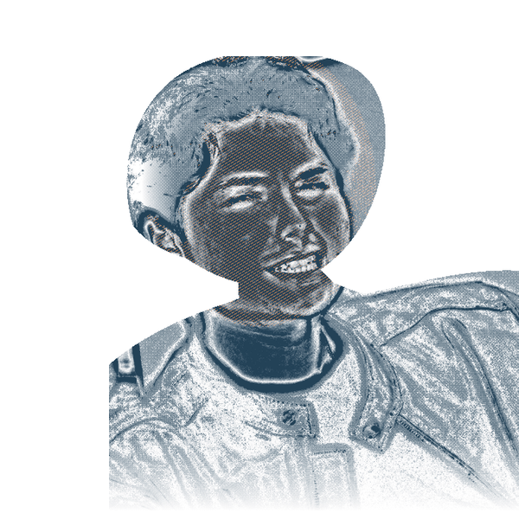
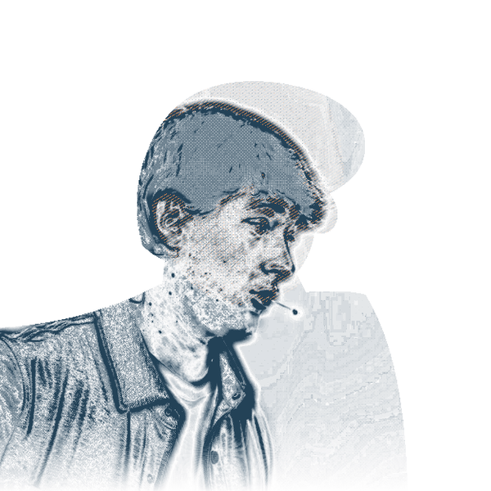
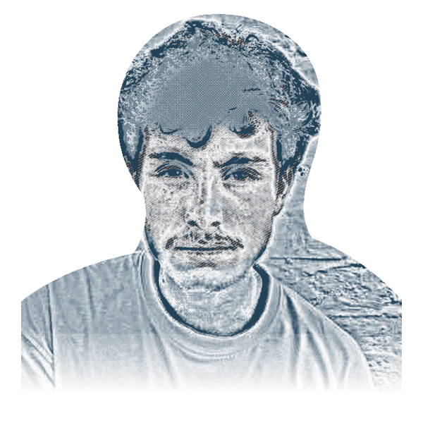
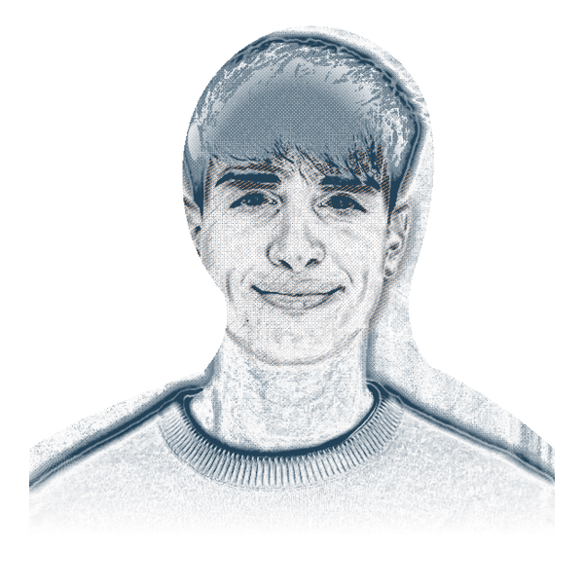
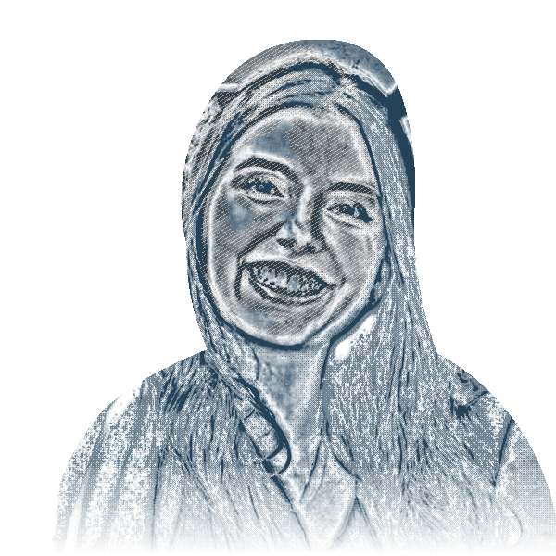
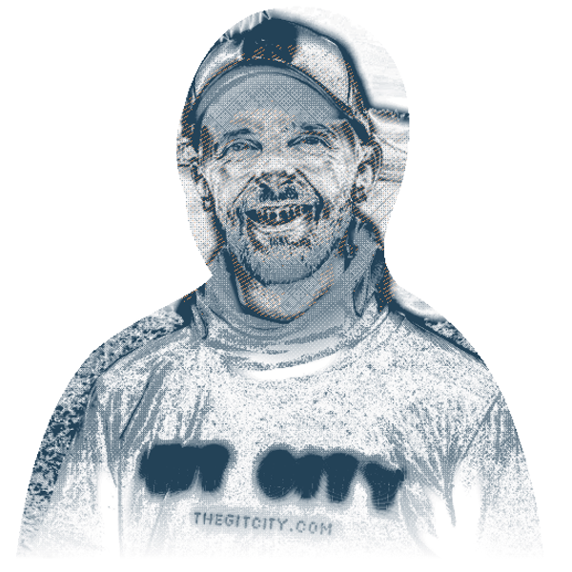
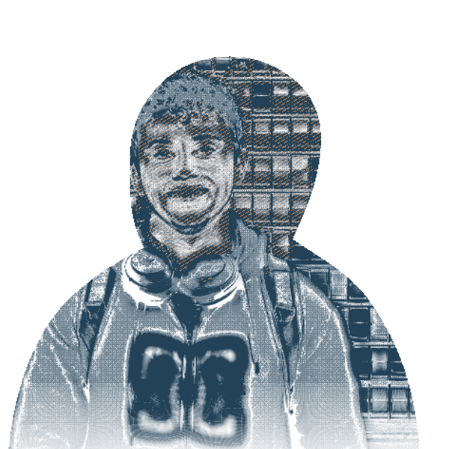
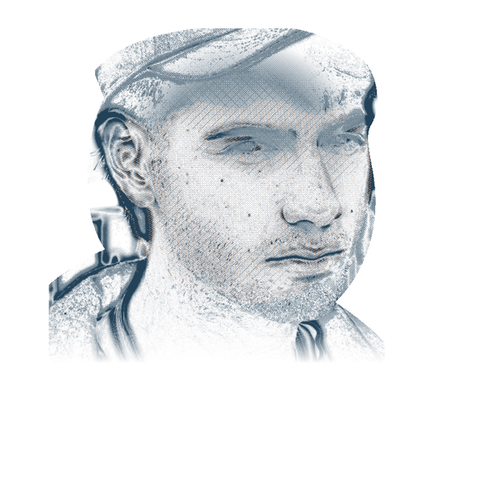
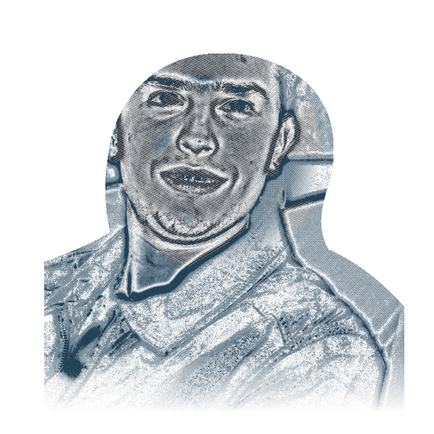














ANTIGRAVITY CAPITAL / ACCESS
✦
PUENTES
Puentes brings Latin America’s next wave of AI builders
into San Francisco’s strongest teams.
33 FELLOWS TODAY
/
150 FELLOWS BY 2028
OPPORTUNITY
We believe in fellows early and create opportunities that can change their lives.
Monto
Pablo
Tomás
Mateo
Andrés
EARLY TEAMS
VERCEL
REPLIT
COGNITION
KREA
CIRCLEBACK
We help our founders hire AI-fluent builders with unusual judgment and range.
ACCESS
We earn our place in the networks where new companies form.
Laís
Samuel
Ignacio
Germán
Agus
TEACHY
DELPHI
FLAI
TERAC
BEM
20
FELLOWS NOW LIVING IN SF
7
FELLOWS BUILDING OUR COMPANIES
3
FELLOWS FOUNDING COMPANIES
Bem, Flai, and Terac
GUESTS FROM
Notes:
Working Puentes slide. The ten portraits are representative members of the 33-person Puentes network. The 23 solid nodes complete today's network. The 150 fellows by 2028 figure is a future scale target, not a current result. The bottom strip names organizations represented by guests at Puentes; it does not imply that every organization employs a fellow or has a formal institutional partnership. Mateo's portrait remains provisional pending final asset confirmation.
Guest logo treatment follows the investment-strategy slide: https://deck.antigravity.capital/?slide=strategy . Official vector paths recolored navy at 84% opacity. Floodgate retains its banner with transparent lettering. Sources:
OpenAI: https://cdn.openai.com/business-guides-and-resources/identifying-and-scaling-ai-use-cases.pdf
Applied Intuition: https://www.appliedintuition.com/#inline-header-logo
Sentry: https://sentry.io/welcome/#inline-header-logo
Brex: https://www.brex.com/#inline-header-logo
HappyRobot: https://www.happyrobot.ai/#inline-header-logo
Bland: https://www.bland.ai/#inline-header-logo
Anthropic: https://www.anthropic.com/news#inline-header-logo
Applied Compute: https://www.appliedcompute.com/#inline-header-svg
Resend: https://resend.com/#inline-header-svg
General Catalyst: https://cdn.prod.website-files.com/69df4e62ff62d7b5568fc58b/69e8832670eb5345d6b87a6d_GC_Wordmark_Black_RGB.svg
Emergence: https://www.emcap.com/#inline-header-svg
Floodgate: https://cdn.prod.website-files.com/5fdf46ca7a44603e763a4c35/5fdf5a58546b45d5333b1e34_floodgate-nav-logo.svg
Base10: https://base10.vc/#inline-header-svg
Ribbit: https://www.ribbitcap.com/#inline-header-svg

Slide 5
ANTIGRAVITY CAPITAL / PUENTES
✦
Helping build Terac’s engineering team
~80%
of Terac’s engineering team hired with our help,
including the first employees
Engineering culture from day one
Close involvement with Zac and the team
That work helped earn the opportunity to invest more.
Germán Fernández / Terac
The additional investment’s structure and terms are still in progress.
Notes:
### Terac: immediate impact on a company we own
**What this story adds:** The effect of helping a founder build an engineering team and culture from the beginning.
- Build on the earlier Terac discussion. Puentes and our hiring work have been closely involved with the first employees and, according to Gadi's current estimate, approximately **80% of the engineering team**.
- That work brought us into an unusually close relationship with Zac and the development of the company's engineering culture.
- It helped earn the opportunity to improve our investment position. The additional check remains in progress; the contribution and relationship are already real.
- This is the most immediate connection between Puentes, helping our portfolio and developing a more meaningful role as an investor. Keep it brief enough to avoid replaying the earlier company and follow-on discussion.
Source: Gadi’s working notes, September 11, 2026. Discussion with Daniel: https://notes.granola.ai/t/406bb135-9fa4-4d9f-8c10-b9e3194a8a4b-008umkv4

Slide 6
ANTIGRAVITY CAPITAL / PUENTES
✦
Tomás Holtz at Cognition
One fellow joins a team.
The relationships extend.
Relationships across Cognition
New conversations across engineering and
business development.
A further connection through SV Angel
We are inviting an early Cognition employee
to the next Puentes cohort.
Tomás Holtz / Cognition
Notes:
### Tomás Holtz: relationships inside Cognition and beyond
**What this story adds:** One fellow joining a strong team can create relationships well beyond that individual.
- Tomás's role at Cognition has already helped activate a number of relationships there. Explain the specific introductions and conversations that followed.
- People and roles Gadi wants to cover: **Daniella, Jaime, an FDE in Chile, Bryan, head of BD**. The speaking notes should identify the actual connection to each and clarify the names/roles before turning this list into a diagram.
- There is a further connection through SV Angel: an early Cognition employee whom we are now inviting to the next Puentes cohort.
- Cognition's existing experience hiring fellows helps make that invitation credible. This is an invitation underway, not a confirmed participant.
- The story shows how helping a fellow join a team can give us more relationships with the people doing important work around them.
Source: Gadi’s working notes, September 11, 2026. Discussion with Daniel: https://notes.granola.ai/t/406bb135-9fa4-4d9f-8c10-b9e3194a8a4b-008umkv4

Slide 7
ANTIGRAVITY CAPITAL / PUENTES
✦
Samuel Rizzon
Moving to San Francisco with his wife,
with a son on the way.
They drove to our São Paulo event and
offered to cook for future cohorts.
Being first to believe can build a relationship
that capital alone cannot buy.
Samuel Rizzon / Delphi
Notes:
### Samuel Rizzon: the personal relationship that follows a life-changing opportunity
**What this story adds:** Being the first to believe in someone can create a lasting relationship that capital alone cannot buy.
- Tell Samuel's story through the change in his life: moving to San Francisco with his wife and preparing to have a son.
- They have said they want to cook for every future Puentes cohort.
- When Gadi held a Puentes event in São Paulo, they drove from a small city to be there.
- These are personal expressions of how much the relationship means to them. Their wish to contribute back makes the long-term significance of this work tangible.
- Gadi's point is that this kind of loyalty is earned through believing in people early and helping change what is possible for them. The relationship can last well beyond a cohort or an individual job.
**How to use the three stories:** Terac shows company impact and an opportunity for greater ownership; Tomás shows how relationships extend; Samuel shows personal impact and the desire to give back. Prepare all three and decide in rehearsal how much time each needs. The Terac callback can be short because the business and investment reasoning have already been introduced.
**Material:** The Puentes overview and supporting portraits/company references already exist. The spoken detail should explain what happened to the person and why it matters. A future-fellow target or an exhaustive guest-logo tour is optional supporting context.
**Transition:** The next cohort is an opportunity for LPs to see this work and meet the people themselves.
Source: Gadi’s working notes, September 11, 2026. Discussion with Daniel: https://notes.granola.ai/t/406bb135-9fa4-4d9f-8c10-b9e3194a8a4b-008umkv4

Slide 8
ANTIGRAVITY CAPITAL / WHAT COMES NEXT
✦
The work ahead
Finishing Fund I
Almost fully deployed. The potential Terac follow-on
would increase our exposure to a founder we know well.
Puentes / October 18–26
Applications have closed, with approximately 260 applicants.
We are planning an opportunity for LPs to meet the fellows in SF.
Continuing our conversations
Fund II conversations are already underway.
The data room is available to explore and share feedback.
Notes:
## 5. The work ahead
**Main point:** We are continuing the work LPs have just seen, and there are straightforward ways for them to stay involved.
- Briefly recap that Fund I is nearing the end of deployment. The reasoning behind the possible Terac investment has already been covered.
- The next Puentes cohort is **October 18–26**. Applications have closed; Gadi reported approximately **260 applicants** in the September 11 conversation. This is an application count, separate from the existing fellow counts.
- We are planning an opportunity for LPs to meet the fellows and see the week in person. Announce only the date and format actually settled by Wednesday.
- Acknowledge the Fund II conversations already underway and the support LPs have shown. Share the data-room link and invite people to explore the materials and offer feedback.
- Move into questions. Fund II's size, check size and ownership targets stay available for people who ask; they do not need a dedicated closing slide.
Source: Gadi’s working notes, September 11, 2026. Discussion with Daniel: https://notes.granola.ai/t/406bb135-9fa4-4d9f-8c10-b9e3194a8a4b-008umkv4

Slide 9
ANTIGRAVITY CAPITAL / DISCUSSION
✦
Where would you like to go deeper?
The portfolio and Fund I
Our investment decisions
Puentes and the work ahead
Notes:
## 6. Discussion and questions
Prepare a one- or two-sentence current view on every company, including small investments that have struggled. Both partners should be able to address the company status, the original reason for investing and what changed.
Keep supporting detail ready on fund performance, realized versus unrealized value, the remaining capital, company progress, pricing decisions, access, Puentes and Fund II. Daniel has the Tuesday conversation with Victoria to update Pace. Final speaking roles come after the sequence is settled.
The return simulator is removed from the spotlight. Its files remain internal preparation, and the earlier 5x exercise is not a forecast or a promised outcome.
Source: Gadi’s working notes, September 11, 2026. Discussion with Daniel: https://notes.granola.ai/t/406bb135-9fa4-4d9f-8c10-b9e3194a8a4b-008umkv4

