Slide 1
A Brief Introduction into ARCUS Cache Cluster: Installation, Basic Usage, Hello World!
NUSHABA GADIMLI

Slide 2
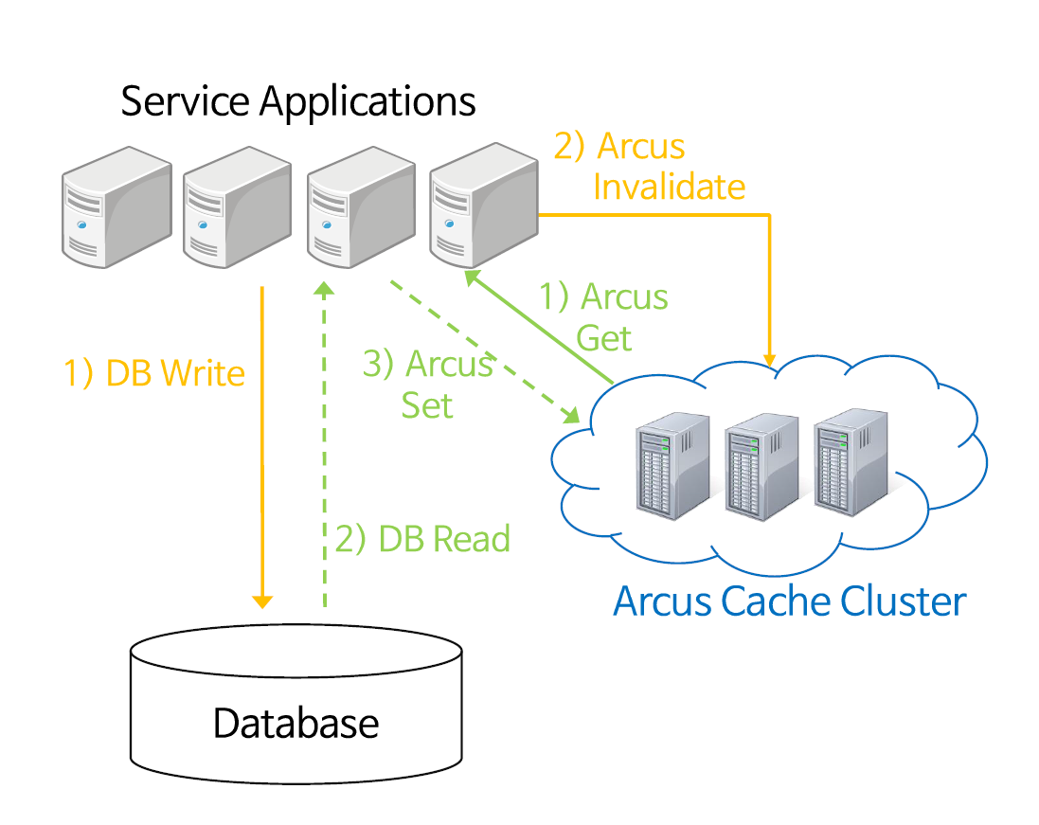

Slide 3
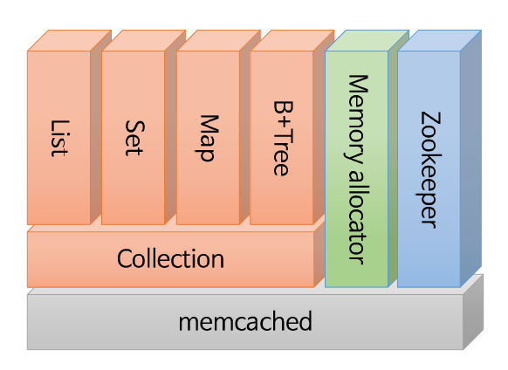

Slide 4
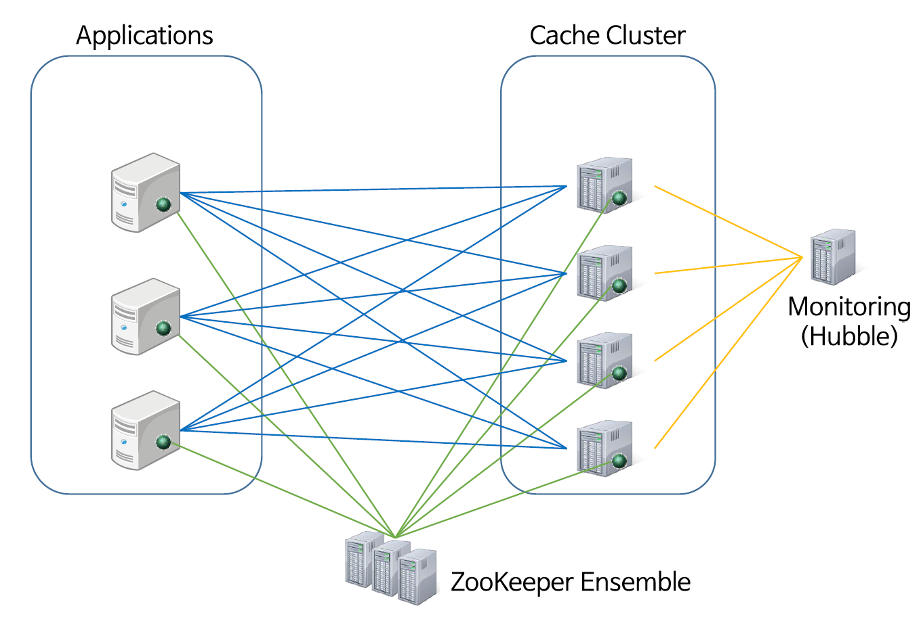
ARCUS Client
ARCUS Server

Slide 5


Applications
Cache Cluster
ARCUS Client
Client Library
* Lookup cache node list
* With change event notification, retrieve updated cache node list
Cache Node
* Start: register “ip:port” to ZK
* Stop: remove “ip:port” from ZK
ARCUS Server
IP1
IP2
IP3
IP4
*Manages [cluster name: cache node list]
e.g. “bookstore”:
ZooKeeper
Ensemble
“IP1:11211” “IP2:11211” “IP3:11211” “IP4:11211”

