Slide 1
TextCraft

Slide 2
Stages
Get Insights
Tailored insights on topic analysis and sentiment analysis for identifying word relationships and meaning over entire dataset and over each response group
03
Load Corpus
Scalable approach through web application programming interfaces(APIs) or structured csv files
TextCraft
01
02
Process Corpus
Top Word Counts, Top Word TF-IDF scores and word suggestions to remove, Customized Annotation and Topic analysis configuration

Slide 3
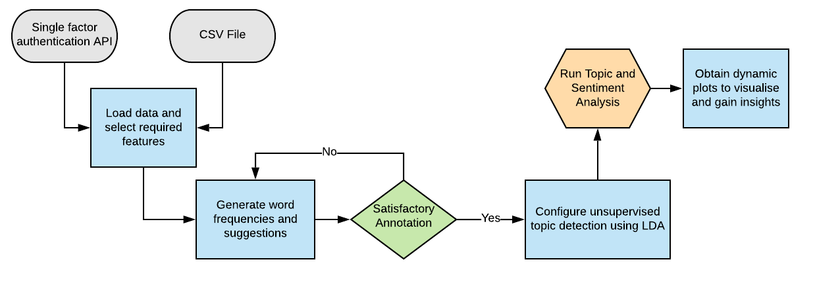
Workflow

