Slide 1
CHATBOT TESTING

Slide 2
INTRODUCTION:
Objective :
Validate chatbot testing capability
Emphasize accuracy, adaptability, and test case design
Prioritize test result accuracy and reliability
Status:
Key functions: design, execute tests, document results
Issues:
Define performance metrics and Understand project complexity
Ensure guideline access and Focus on testing process
Recommendation:
Collaborate with stakeholders and Gather insights from past projects
Ensure guideline access and Refine testing process

Slide 3
HIGH-LEVEL ARCHITECTURE:
Tested frontend :
Web interface /text interaction
Simple interface
HTML/CSS/JS
Test execution environment: secure for chatbot interaction
Frontend Tech
SECURE AREA FOR TESTERS
DEPENDS ON CLIENT
Reporting Database: test result storage
Execution Tech
POSTGRESQL,MYSQL,OR CLOUD
STORAGE OF RESULTS
Analysis &Report Tool: custom or existing BI
Database Tech
PYTHON/JAVASCRIPT/EXCEL
Analysis Tech

Slide 4
WORKFLOW
Main Process
Error Handling
Select Chatbot
Retest With Modified Input
Design Tests
Execute Tests
Error Analysis
Flag For Review
Report Generation
Client Feedback

Slide 5
MESSAGE SEQUENCE CHART(MSC):
USER
CHATBOT FRONTEND
CHATBOT BACKEND
NLU
USER INPUT
REQUEST PROCESSING
NLU PROCESSING
INTENT RECOGNITION
RESPONSE GENERATION
DISPLAY RESPONSE
USER
CHATBOT FRONTEND
CHATBOT BACKEND
NLU

Slide 6
UI WIREFRAMING
Test Case Creation Interface
Input/Output Space :
Chatbot Type Selection :
Types
Error Classification :
Errors

Slide 7
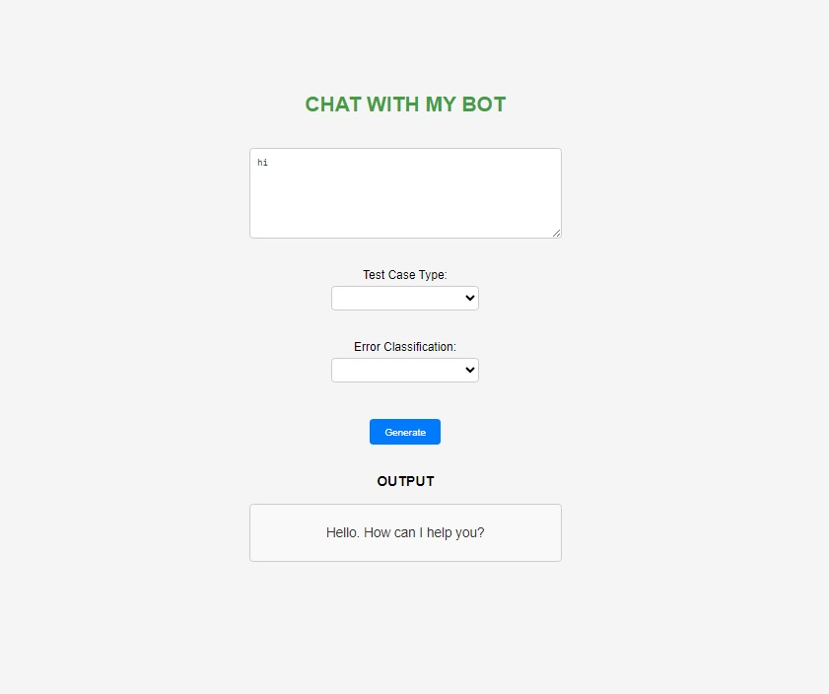
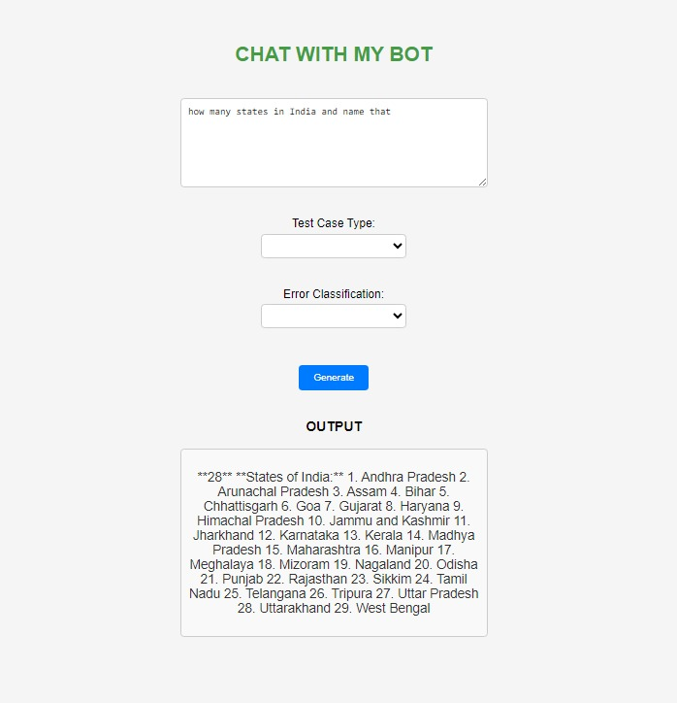

Slide 8
SUMMARY:
Objective :
Validate chatbot testing capability
Emphasize accuracy, adaptability, and test case design
Prioritize test result accuracy and reliability
Status:
Key functions: design, execute tests, document results
Issues:
Define performance metrics and Understand project complexity
Ensure guideline access and Focus on testing process
Recommendation:
Collaborate with stakeholders and Gather insights from past projects
Ensure guideline access and Refine testing process

