Slide 1

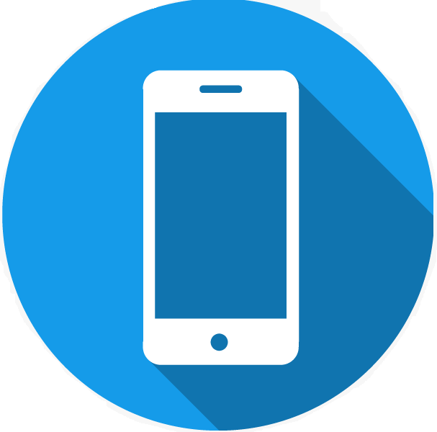


WE REPAIR
Phone
Laptop
Desktop
Tablet
1.1.7

Slide 2
WE REPAIR
Display
Battery
Back Panel
Camera
Power Button
Home Button
Volume Buttons
Speakers
Ear Speaker
Head Phone Jack
Phone
1.1.7

Slide 3
WE REPAIR
Display
Battery
Touch Pad
ABH Panel
Fan Replacement
Power Button
Keyboard
Hinges
Speakers
Hardware & Software's
Laptop
1.1.7

Slide 4
WE REPAIR
Graphics Card
HDD Replacement
RAM Replacement
SMPS
Fan Replacement
Power Button
Chip Level Issues
Hardware & Software's
Desktop
1.1.7

Slide 5
WE REPAIR
Display Glass and Combo
Password Unlocking
Speakers
Battery Replacement
Camera Not Working
Power Button and volume buttons
Head Phone jack
Charging Port
Hardware & Software's
Tablet
1.1.7

Slide 6
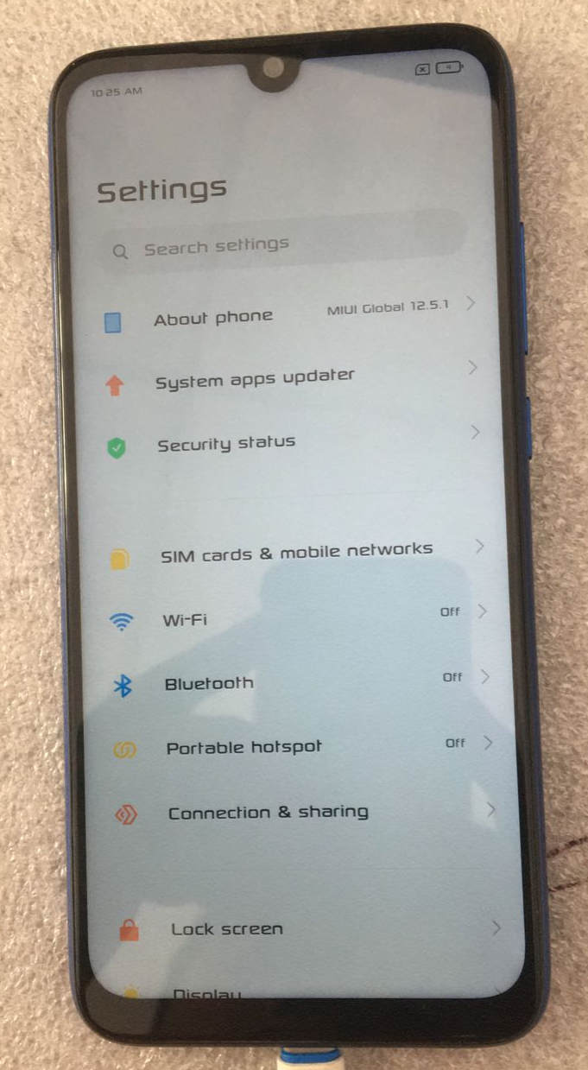
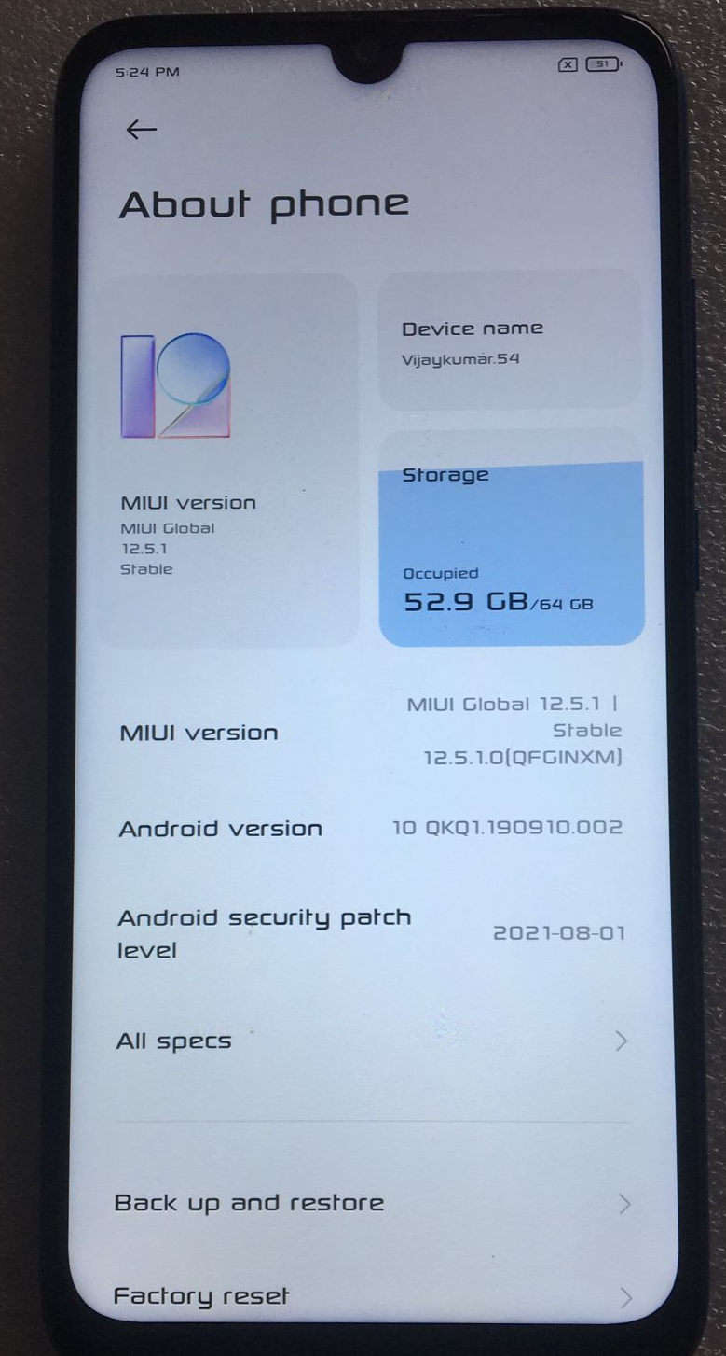
Redmi Note 7 – Charging port Replacement
Before
After
The device was given to us with no charging condition
We had Replaced the Charging port and tested it is charging or not
1.1.7
10-03-2021
2

Slide 7
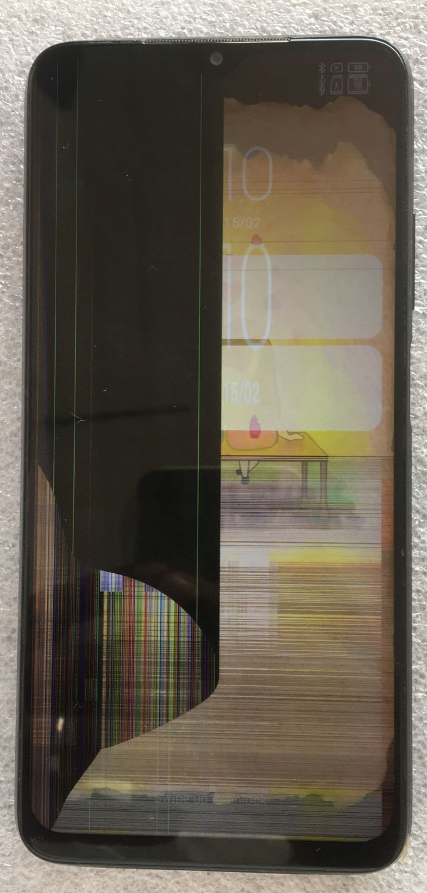
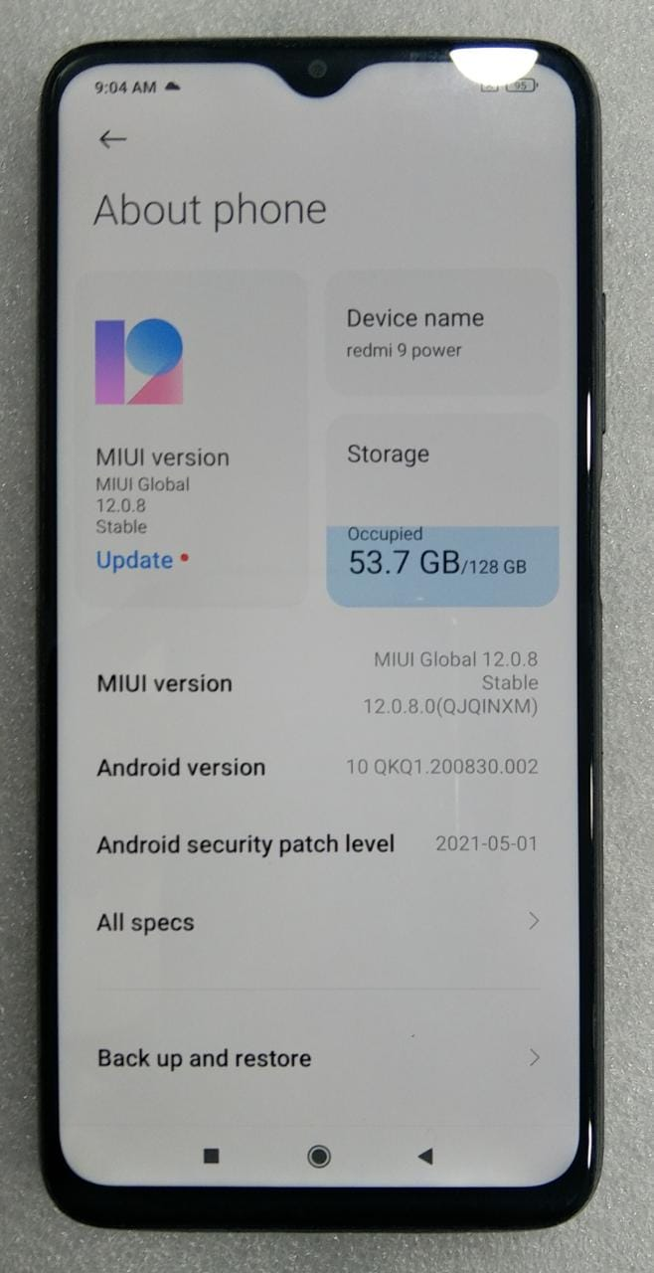
Realme 9 Power – Display Combo Replacement
Before
After
The device was given to us with broken display
We had Replaced the Display Combo and made it functioning
1.1.7
10-03-2021
2

Slide 8
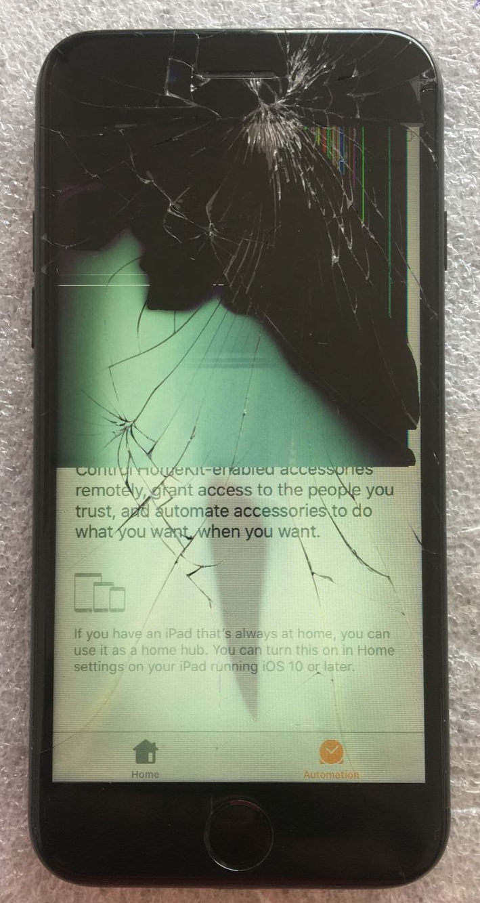
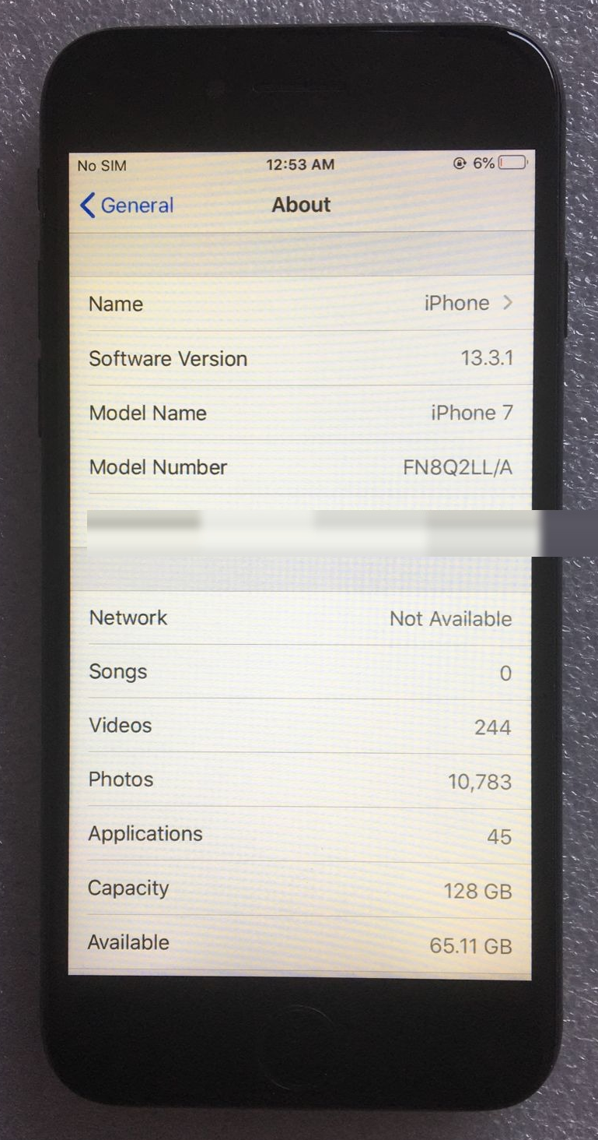
iPhone 7 – Display Combo Replacement
Before
After
The iPhone was given to us with the display combo damaged condition
We had Replaced the Display Combo and made it functioning
1.1.7
10-03-2021
2

Slide 9
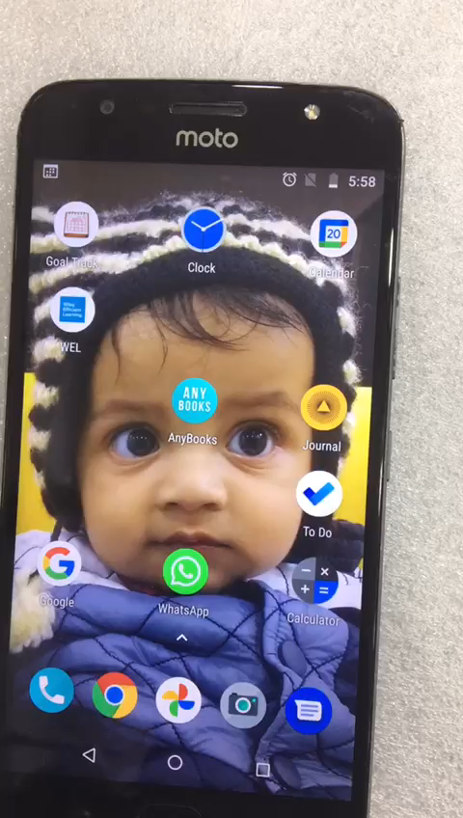
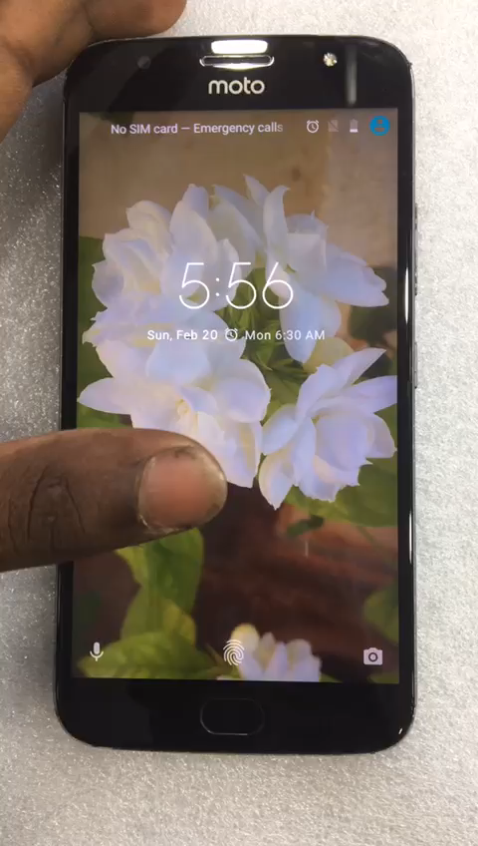
Moto G5s Plus – Touch Glass Replacement
Before
After
The phone was given to us with touch not working
We had Replaced the Touch Glass and got it working
1.1.7
10-03-2021
2

